Slide 1
Advanced Recommender Systems for E-commerce
A Comparative Study of Classical and Neural Approaches
Angsar Shaumen
Astana IT University
School of Artificial Intelligence and Data Science
February 2026

Slide 2
Problem & Motivation
Recommender systems are critical for e-commerce
Challenge: Learning from sparse implicit feedback
Question: Do neural models outperform classical approaches?
Research Goal: Compare classical (MF) vs neural (NCF) under realistic constraints

Slide 3
Research Questions
1
How do classical and neural recommenders compare on ranking metrics?
Does NCF consistently outperform Matrix Factorization? How do models behave under extreme sparsity?
What are the computational trade-offs?
2
3
4

Slide 4
Dataset: Amazon Headphones
Processing Steps:
Filter: Headphones subcategory
Implicit feedback (binary)
5-core filtering
Time-based split (70/15/15)
Metric | Value
Users | 368
Items | 282
Interactions | 2,695
Sparsity | 97.4%

Slide 5
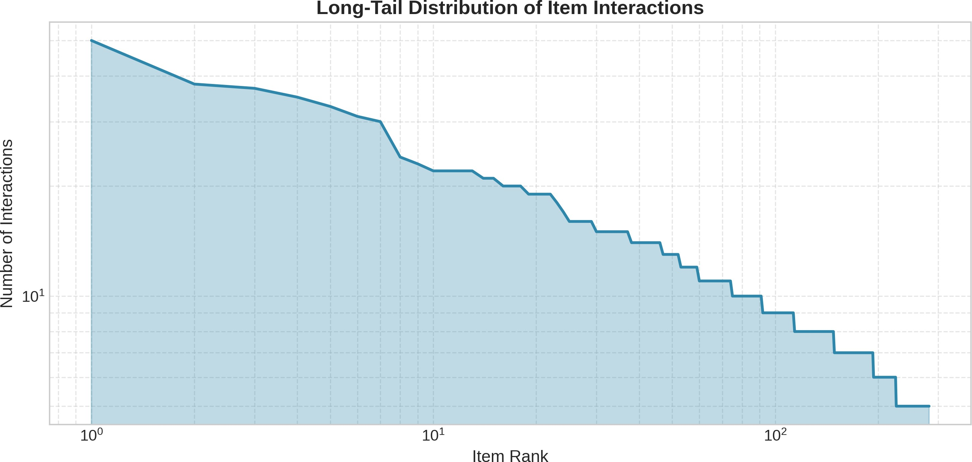
Data Distribution: Long-Tail Effect
Key Insight: Few items dominate interactions

Slide 6
Models Compared
Model
Type
Popularity
Item-KNN
Matrix Factorization NeuMF (NCF)
Baseline
Collaborative Filtering Classical (Latent Factors)
Neural Network
Evaluation: Precision@K, Recall@K, NDCG@K

Slide 7
Neural Collaborative Filtering (NCF)
User and Item embeddings (dim=32)
GMF path: Element-wise product
MLP path: Concatenation + hidden layers
Final: Sigmoid output for prediction
yˆ_{ui} = σ(h^{T} (ϕ_{GMF} ⊕ ϕ_{MLP} ))

Slide 8
Main Results
Model | P@10 | R@10 | NDCG@10
Popularity | 0.0023 | 0.0100 | 0.0050
Item-KNN | 0.0006 | 0.0057 | 0.0020
MF | 0.0017 | 0.0054 | 0.0021
NeuMF | 0.0023 | 0.0100 | 0.0059
Winner: NeuMF with NDCG@10 = 0.0059

Slide 9
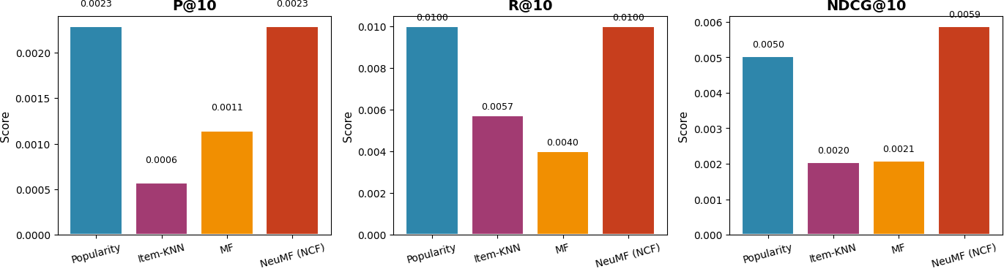
Model Comparison

Slide 10
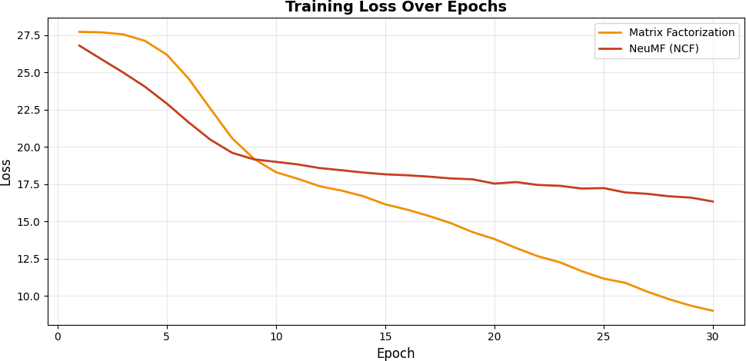
Training Dynamics
NCF converges slower but achieves better generalization

Slide 11
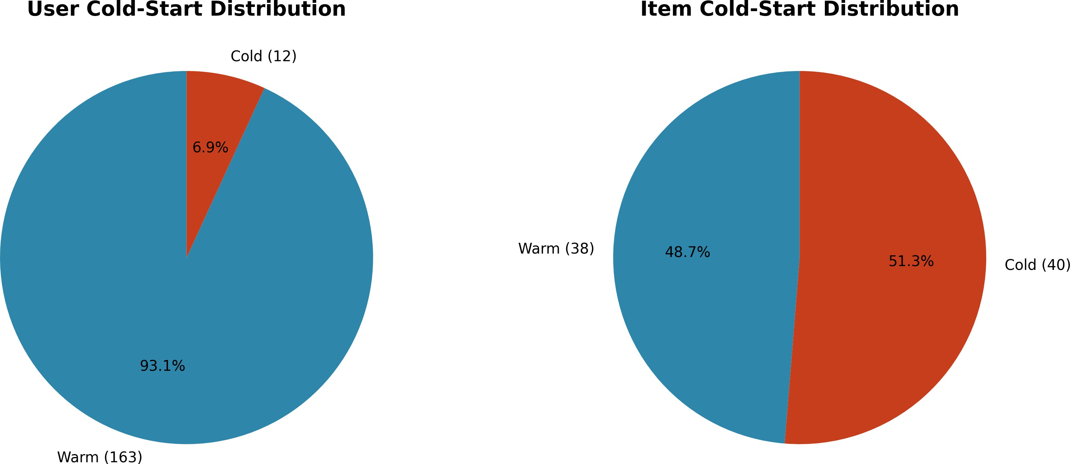
Cold-Start Analysis
48.6% cold users
51.3% cold items
Challenge for CF methods
Popularity as fallback

Slide 12
Key Findings
NCF wins with highest NDCG@10 (0.0059)
Sparsity hurts classical methods more than neural
Popularity is strong due to long-tail effect
Cold-start affects 50% of test entities
1
2
3
4

Slide 13
Limitations & Future Work
Limitations:
Small dataset after filtering (2,695 interactions)
No hybrid model due to limited metadata
Offline evaluation only
Future Work:
Incorporate item features (LightFM)
Sequential models (SASRec, BERT4Rec)
Online A/B testing

Slide 14
Conclusion
Summary
Neural Collaborative Filtering (NCF) outperforms classical Matrix Factorization in highly sparse e-commerce data, demonstrating the value of non-linear interaction modeling.
Code & Data: Available in the accompanying repository

Slide 15
References
He et al. (2017). Neural Collaborative Filtering. WWW.
Koren et al. (2009). Matrix Factorization Techniques. IEEE Computer. Rendle et al. (2009). BPR: Bayesian Personalized Ranking. UAI.
Hu et al. (2008). Collaborative Filtering for Implicit Feedback. ICDM. Sarwar et al. (2001). Item-based Collaborative Filtering. WWW.

Slide 16
Thank You!
Questions?

