Slide 1
GIS Exercise #4
AJ Brown
WR 514 Spring 2023

Slide 2
Exercise: Display heat map of US South homicide data using Python
Using geopandas and libpysal packages in Python
Upload data from libpysal package
Display county boundaries by state
Create heatmap from country data

Slide 3
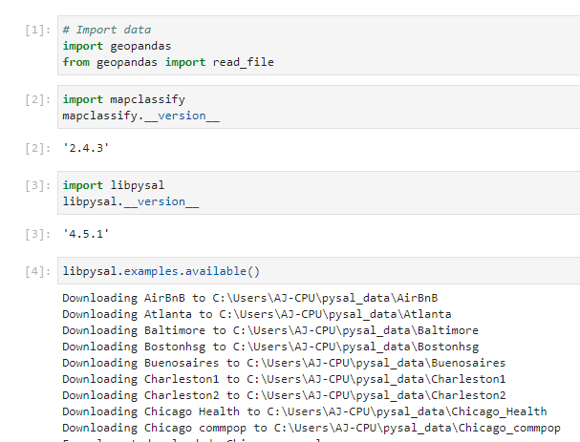
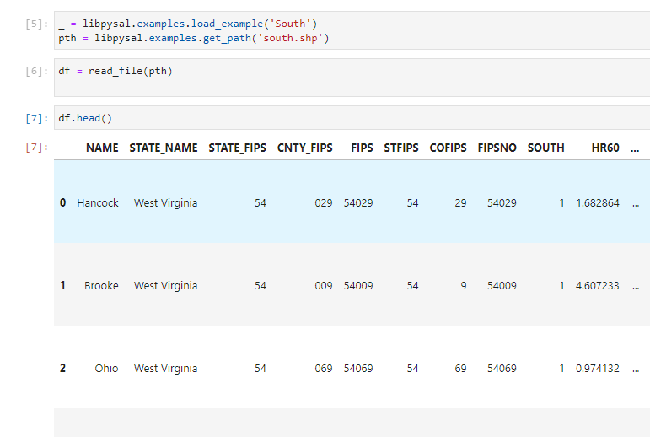
Step 1: Upload Data
Using libpysal, we upload the “South” dataset with county boundaries and homicide data

Slide 4
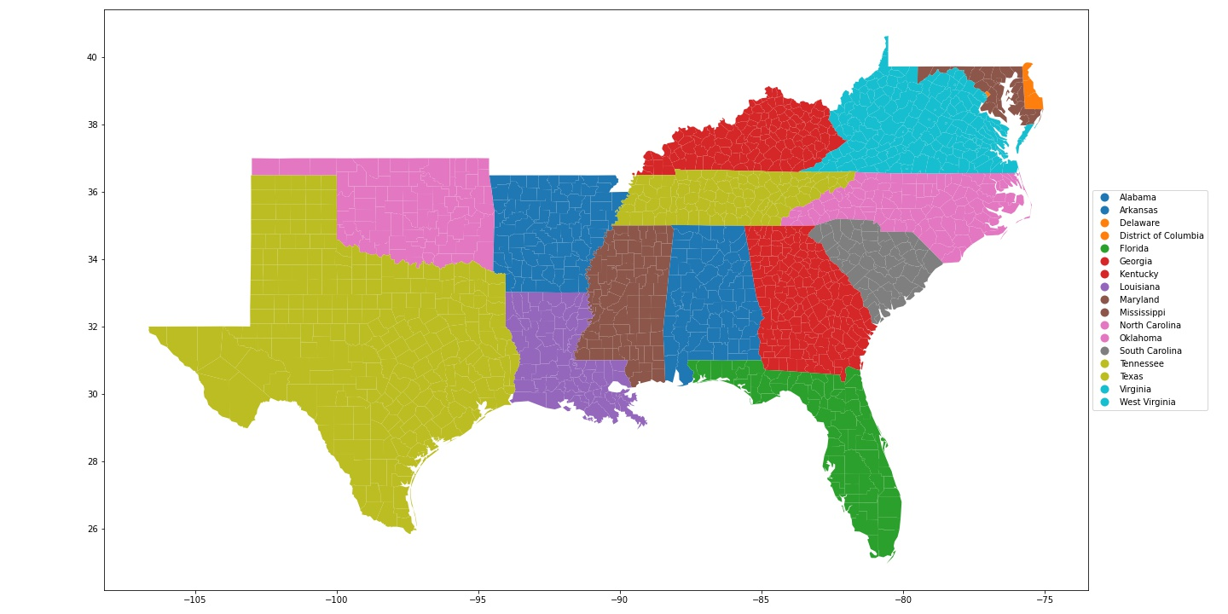
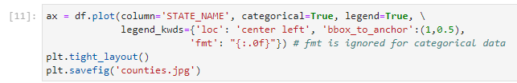
Step 2: Display county data
Geopandas makes it very easy to display data from the geopandas dataframe
First, let’s display all the counties, colored by State

Slide 5
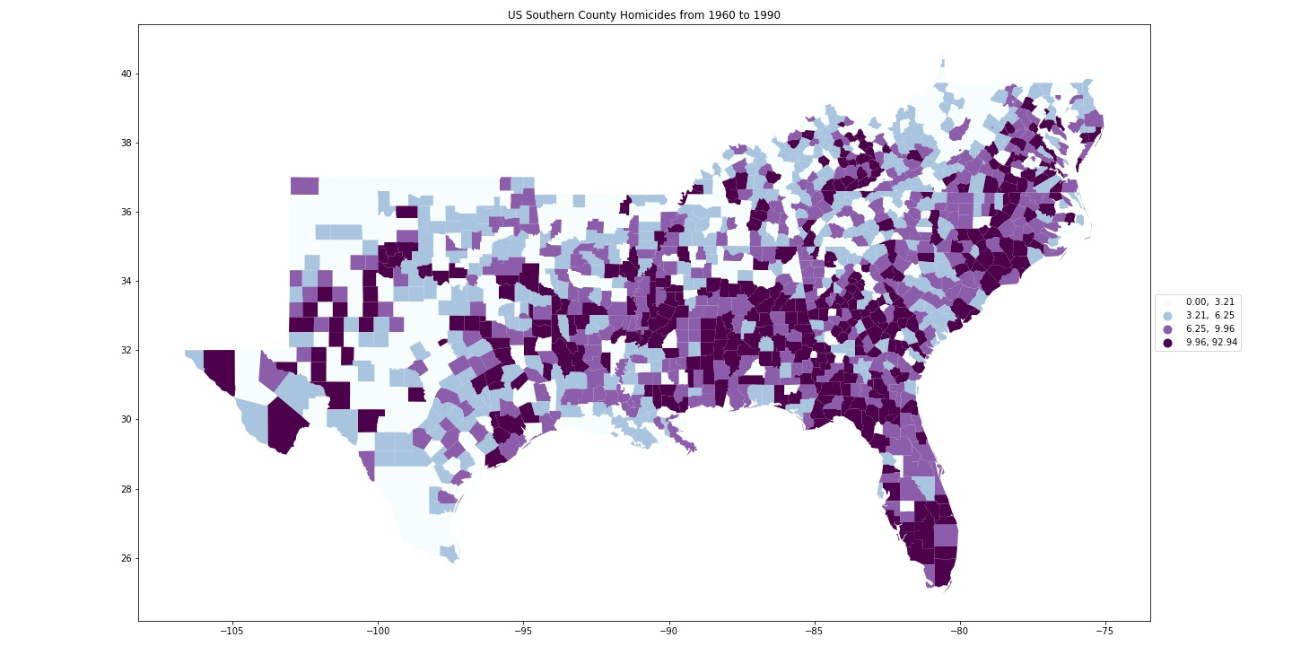
Step 4: Plot Homicide Heatmap
Done!
Note that we use equal quantiles to create colors
Next exercise will focus on reclassifying colors by different methods

Slide 6
Done! Thank You A.J. Brown

