Slide 1
GIS Exercise #5
AJ Brown
WR 514 Spring 2023

Slide 2
Exercise: Changing color classifications of a US Southern County Homicides in 1960-1990 Heatmap using Python
Using geopandas and libpysal packages in Python
Using heatmap generated in GIS Exercise #4
Plot original histogram for reference
Create multiple heatmaps by reclassifying data based on a few classification methods:
Quantiles (original)
Equal Intervals
Natural breaks

Slide 3
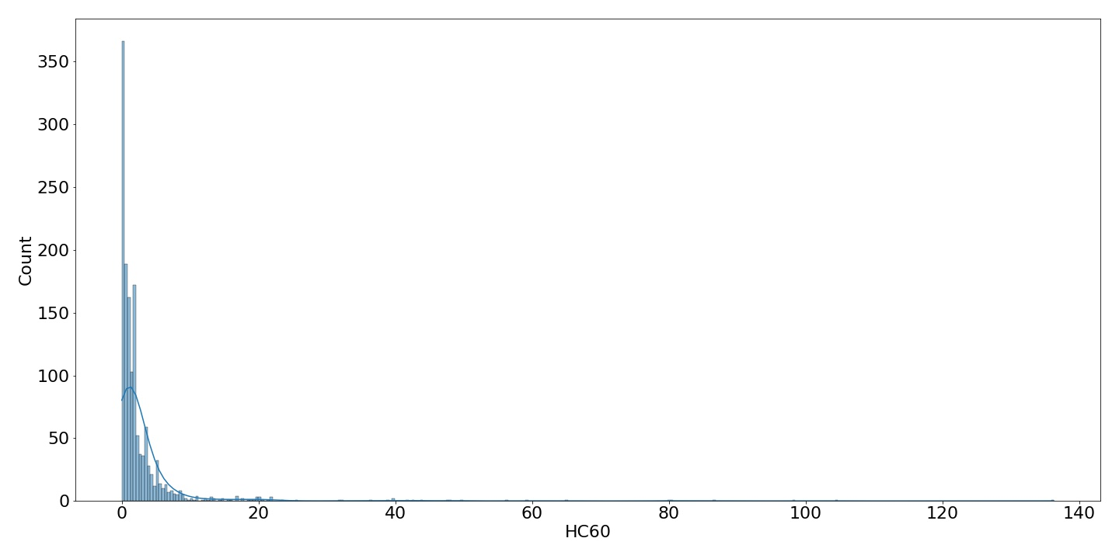
Original Histogram and Summary Stats for Reference
count 1412.000000
mean 3.024788
std 8.366587
min 0.000000
25% 0.333333
50% 1.000000
75% 2.666667
max 136.333333

Slide 4
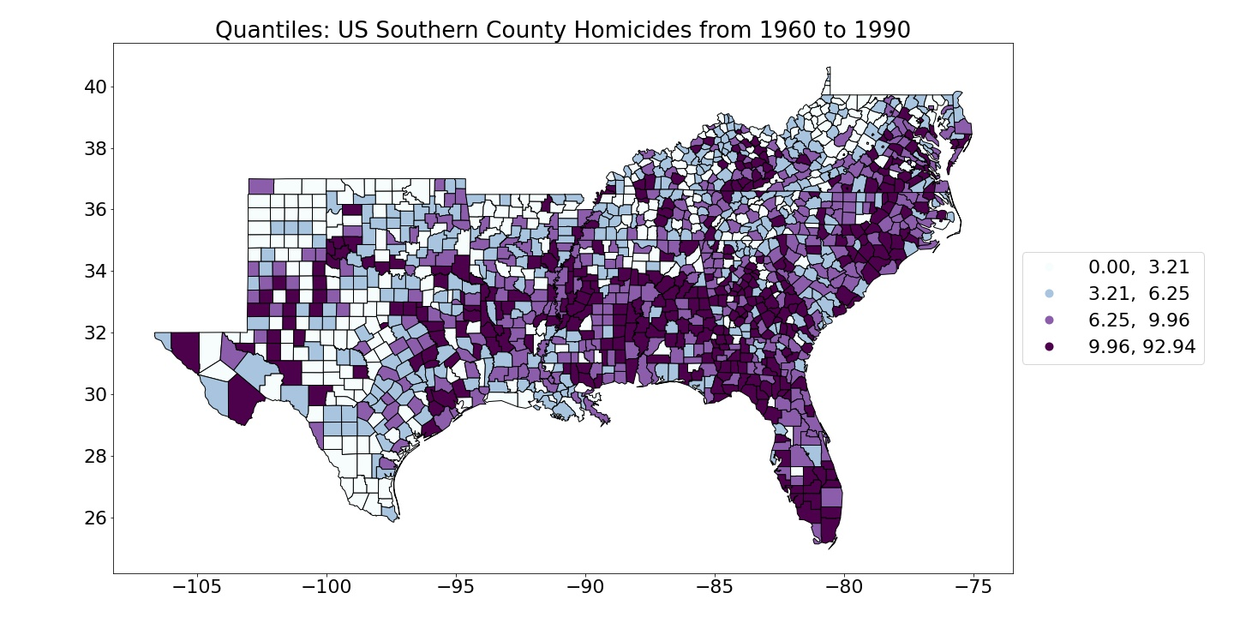
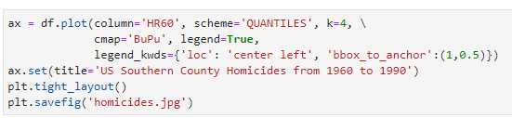
1: Quantiles (Original from Exercise #4)

Slide 5
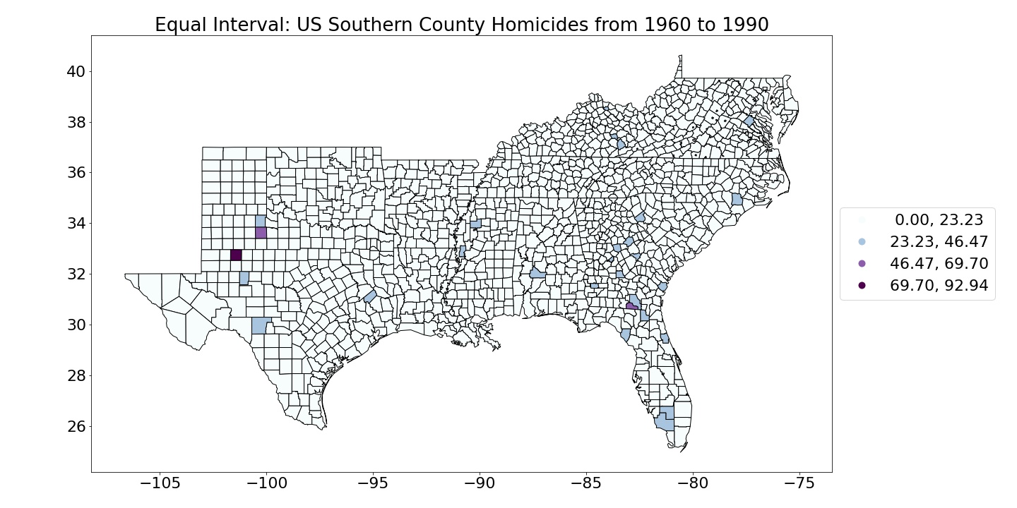
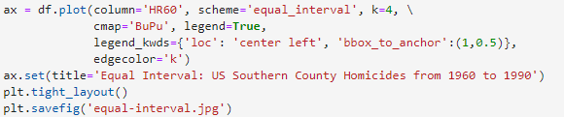
2: Equal Interval

Slide 6
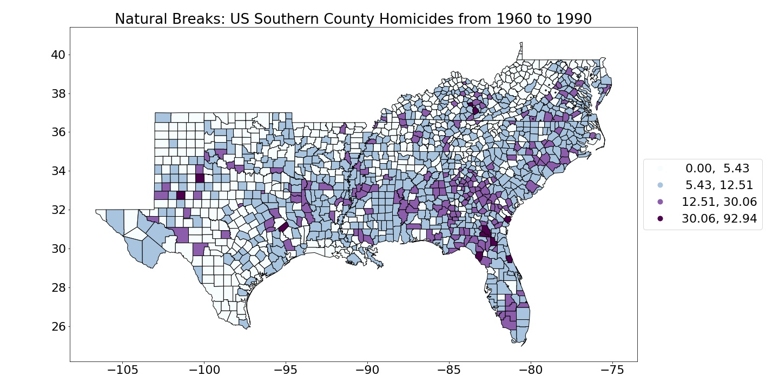
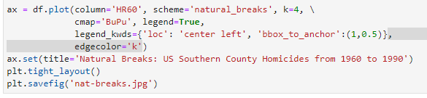
3: Natural Breaks

Slide 7
Done! Thank You A.J. Brown

