Slide 1
GIS Exercise #5
AJ Brown
WR 514 Spring 2023

Slide 2
Exercise: Clip Vector Data using Geopandas in Python
Using geopandas module in Python
Import world country boundaries
Create clip boundary
Clip boundary and illustrate

Slide 3
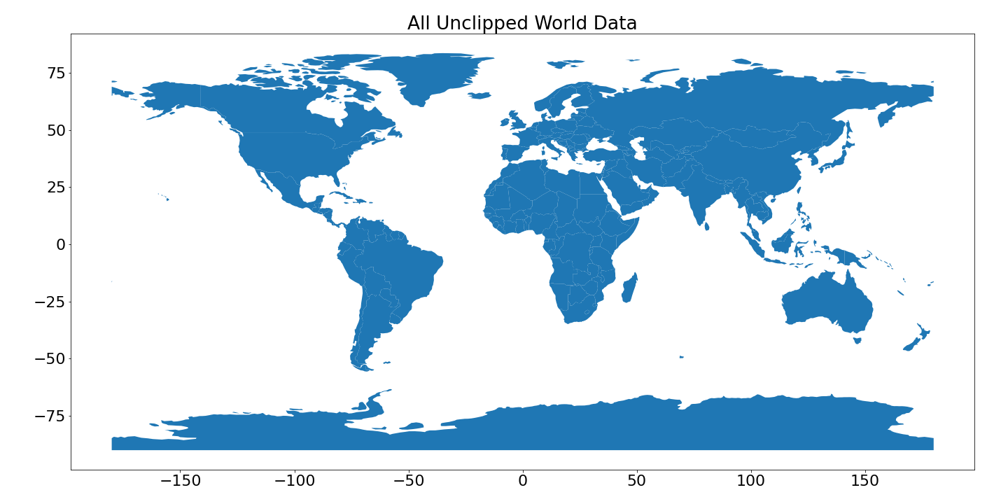
Step 1: Import world country boundaries

Slide 4
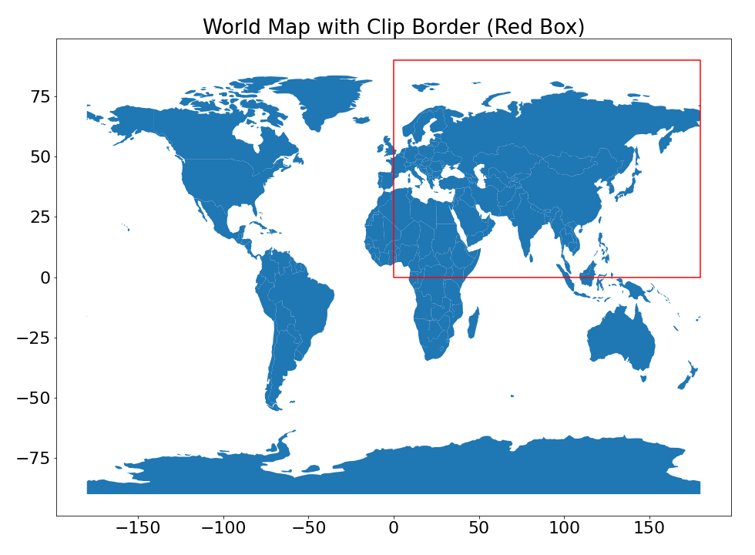
Step 2: Create Clip Boundary

Slide 5
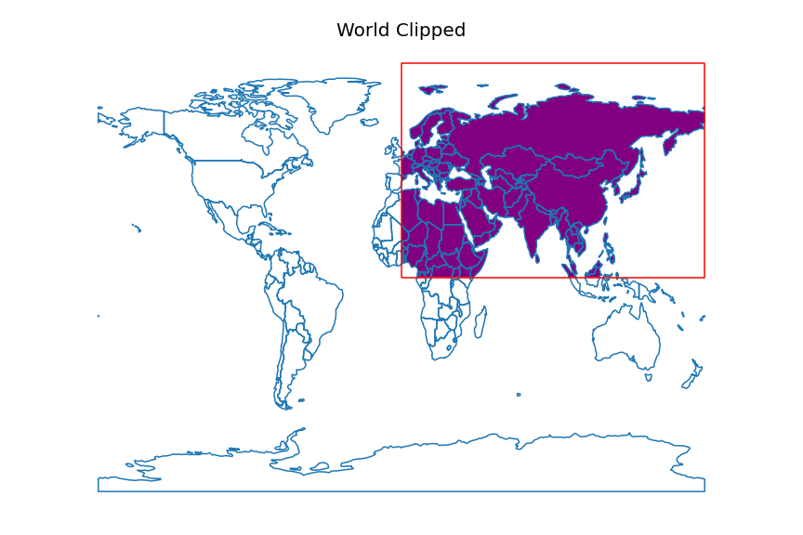
Step 3: Clip data and illustrate

Slide 6
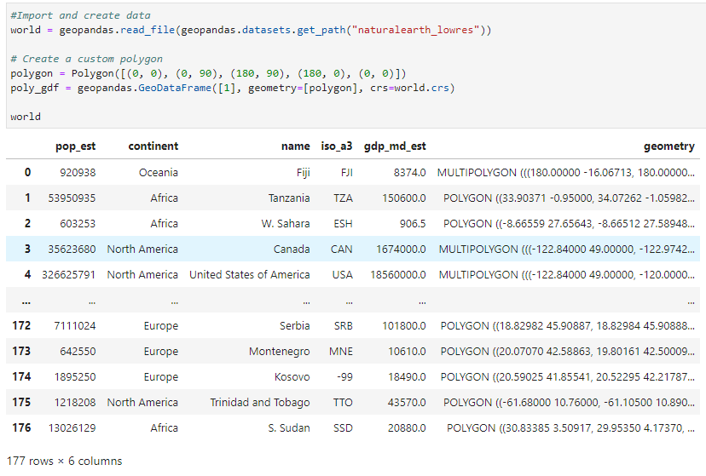
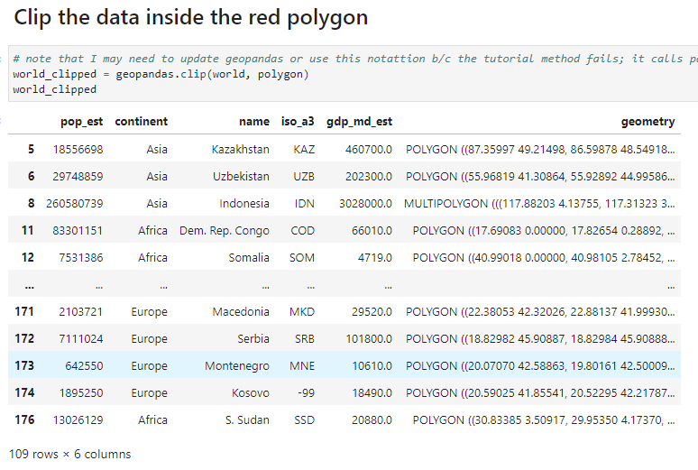
Dataframe comparison
Code available upon request

Slide 7
Done! Thank You A.J. Brown

