Slide 1
GIS Exercise #3
AJ Brown
WR 514 Spring 2023

Slide 2
Exercise: Aggregate country population in GeoPandas
Suppose we are interested in studying continent population, but we only have country-level data like the country dataset used in this exercise
We need to convert this to a continent-level dataset
This can be done using the dissolve() function in geopandas
This exercise will achieve this and display final results

Slide 3
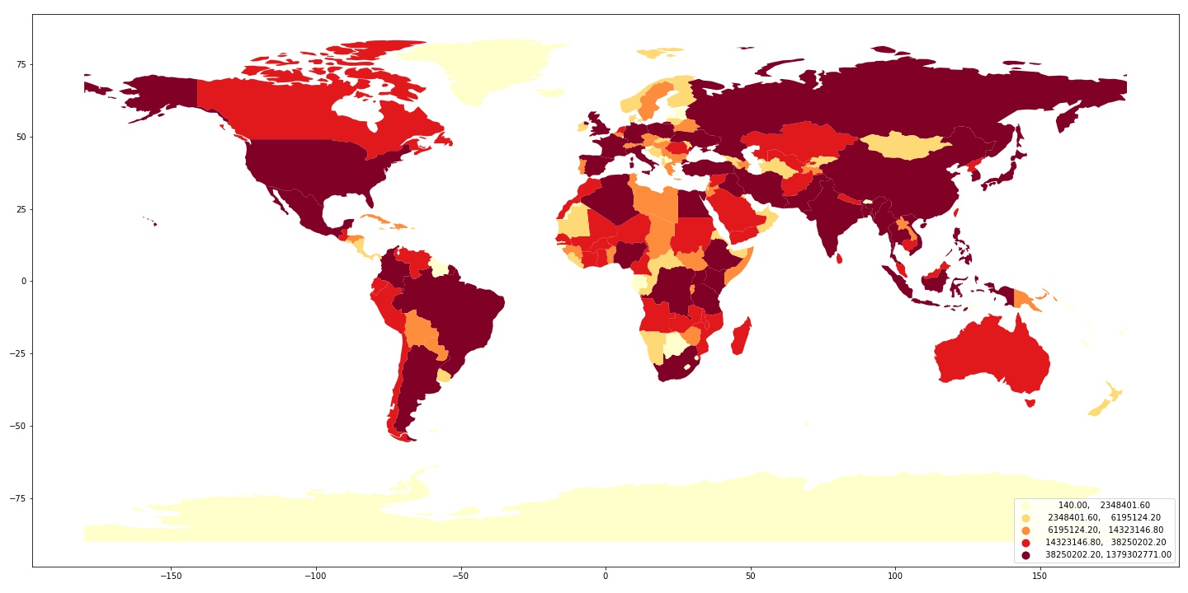
Step 1: Display country population data
Using geopandas, we upload the “naturalearth_lowres” dataset with country boundaries and population data
# import data
world = geopandas.read_file(geopandas.datasets.get_path('naturalearth_lowres'))
# sparse into population
world = world[['name','continent', 'geometry', 'pop_est']]

Slide 4
Step 2: Aggregate data
Geopandas makes it very easy to merge data by categorical variable, so long as we can tell it what do with the numerical data (e.g., sum, mean, median, etc.)
In this case, we want to sum the data to deliver a total population for each continent:
# Aggregate country data into continent data using dissolve()
continents = world.dissolve(by='continent', aggfunc='sum')
continents.head()

Slide 5
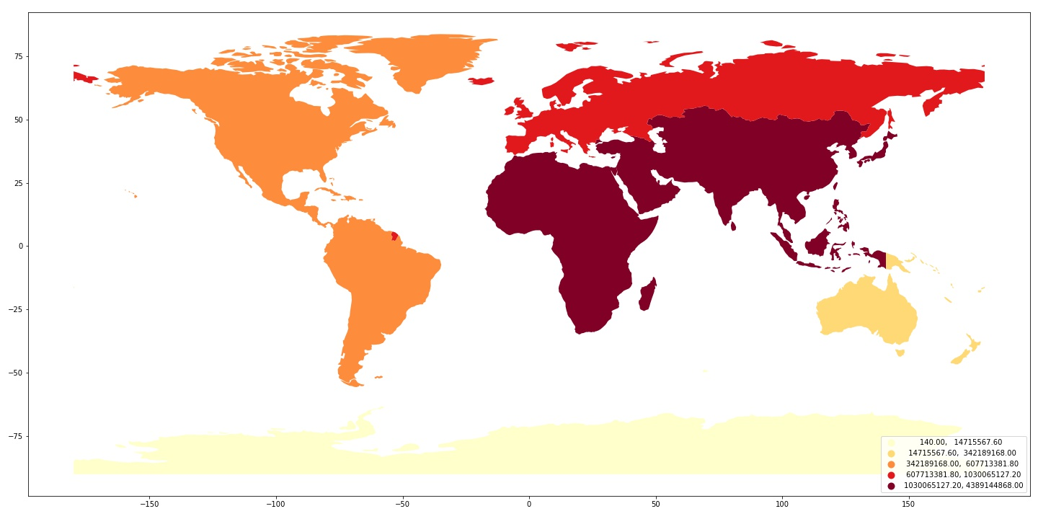
Step 3: Plot final continent Population data
# Plot newly aggregated data in map
continents.plot(column = 'pop_est', scheme='quantiles', cmap='YlOrRd', legend=True, legend_kwds={'loc': 'lower right'})

Slide 6
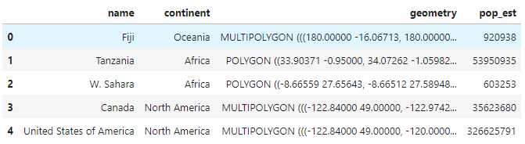
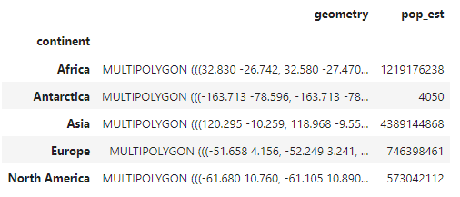
Compare dataframes
Country dataset
Continent dataset

Slide 7
Done! Thank You A.J. Brown

