Slide 1
GIS Exercise #1
AJ Brown
Spring 2023

Slide 2
Exercise: Display corn yield data
The purpose of this exercise is to display georeconciled combine data collected from an experimental site at the CSU Agricultural Research and Development Education Center (ARDEC) facility in 2022. These data will be further analyzed to understand potential differences between management treatments (not described in this exercise).
Plot points
Remove outliers
Colorize points by yield
Future directions

Slide 3
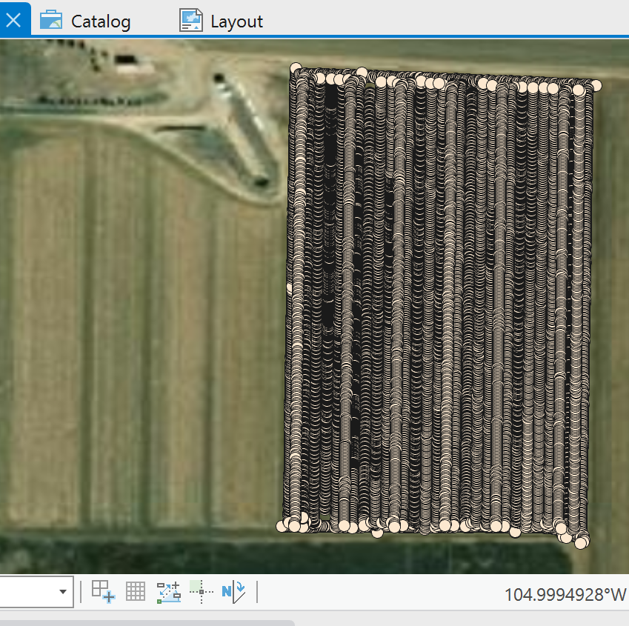
Plot Points
Using a WGS84 projection, gps points associated with corn yield were displayed in ArcPro over the study field (n=13,085)
However, this doesn’t tell us anything about yield distribution

Slide 4
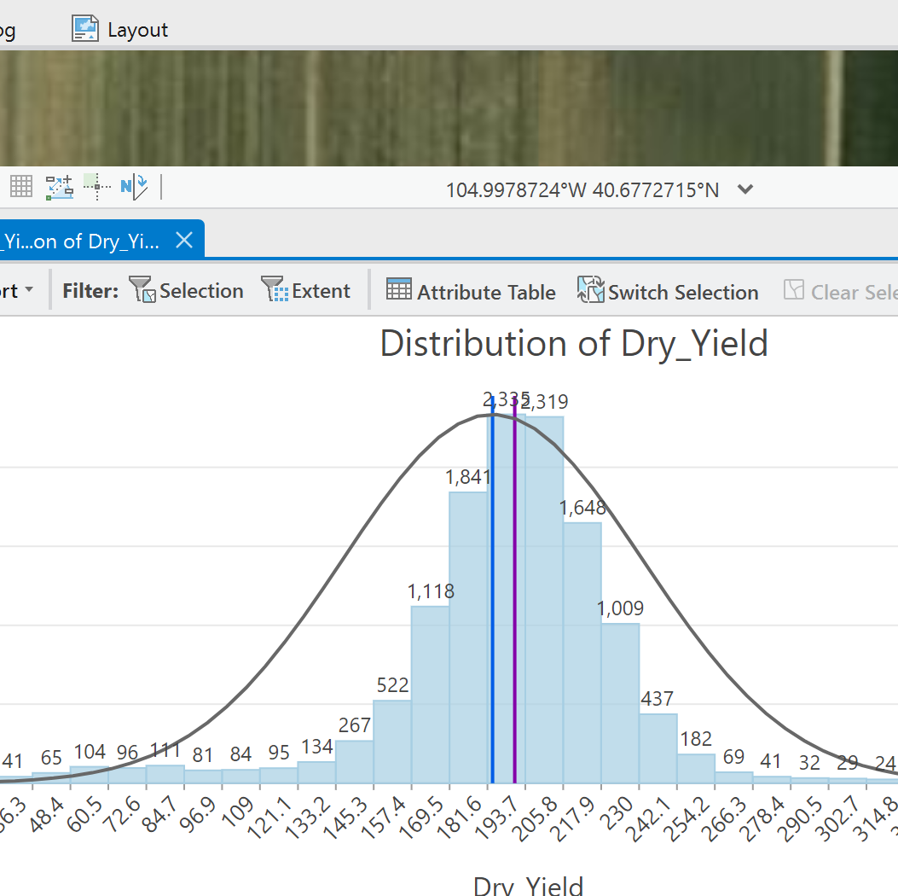
Remove outliers
Looking at the histogram of yields detected in the data, all yields above 400 bushels/acre were removed, as it was determined to be unreasonable for the corn field conditions
However, lower end outliers could not be eliminated, as it was quite possible to detect low yields near edges of the field or other areas

Slide 5
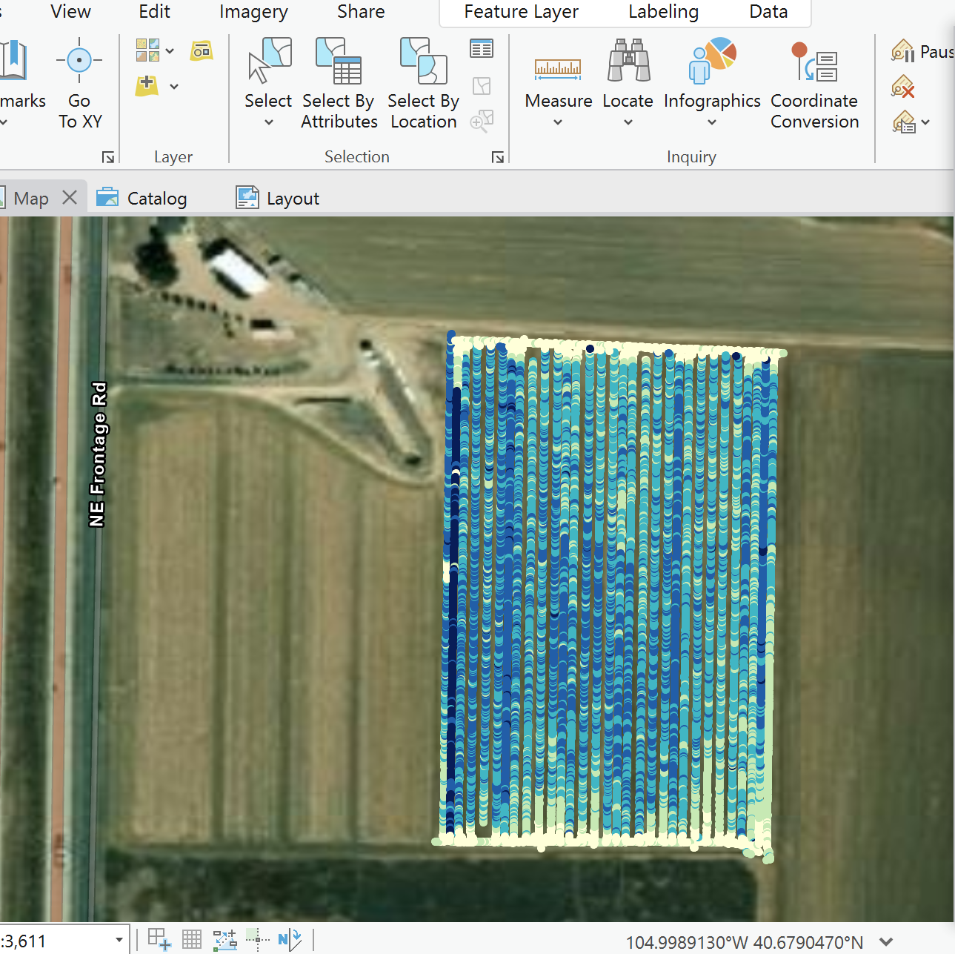
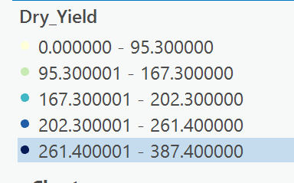
Colorize Points
Symbology was adjusted according to graduated values after outlier elimination (i.e., colored by given ranges in legend)
Here is the final point (for now)

Slide 6
Future Directions
In future exercises, we will create an interpolation of the presented yield points
Thank you
-AJ Brown

