Slide 1
GIS Exercise #10
AJ Brown
WR 514 Spring 2023

Slide 2
Exercise 10: Fill gaps in your data with areal interpolation
ESRI Geostatistical Exercise: https://learn.arcgis.com/en/projects/fill-gaps-in-your-data-with-areal-interpolation/
Data may not always be complete. Your data may have gaps due to inconsistent data collecting methods or technical problems with sensors. Typically, features with missing data are not shown on the final map or are represented with a gray color. But sometimes you may want to fill in these gaps, either to conduct further analysis or to improve your map's appearance.
In ArcGIS Pro, there are two common methods for filling gaps in spatial data. Neither can re-create the true values for your missing data, but they offer more reliable results than simple guesswork. The first method is the Fill Missing Values tool. It estimates values based on neighboring features, offering different methods for selecting and sampling from those neighbors.
In this tutorial, you'll use the second method—geostatistics—to map the spatial variation of data across the entire study area. Predicted values are then pulled from the resulting map to fill the gaps in your data. Geostatistics allows you to predict values in locations that have not been measured, using data from measurements elsewhere in your study area. Typically geostatistics uses point data, but it can also interpolate from data stored in polygons, as you'll use in this tutorial.

Slide 3
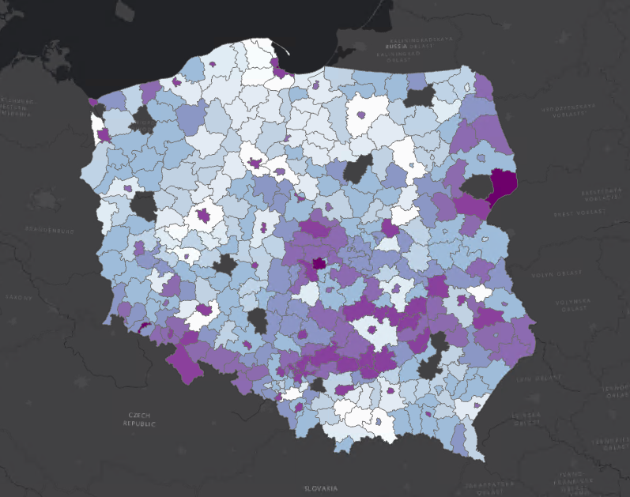
Step 1: Display map of Poland with missing senior population data
This map depicts powiaty, which are administrative units similar to counties, in Poland. The polygons are colored to represent the percentage of the population aged 65 years or older. Unfortunately, the data is incomplete. Ten powiaty contain no value for the percentage of seniors.
If you know the values for most of the features in your dataset, you can use them to predict continuous values across the entire area. We’ll do this to map the spatial distribution of seniors in Poland.
We will do this using the Aeral Interpolation tool in the geostatistical wizard using ArcGIS Pro

Slide 4
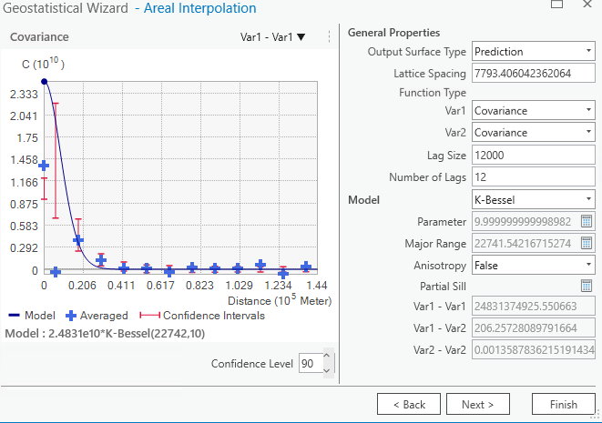
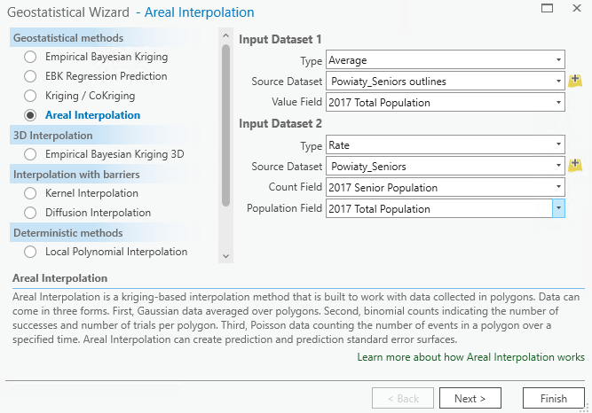
Step 2: Input data and fit covariance model
Select the appropriate dataset
Fit the population data covariance with the proper model

Slide 5
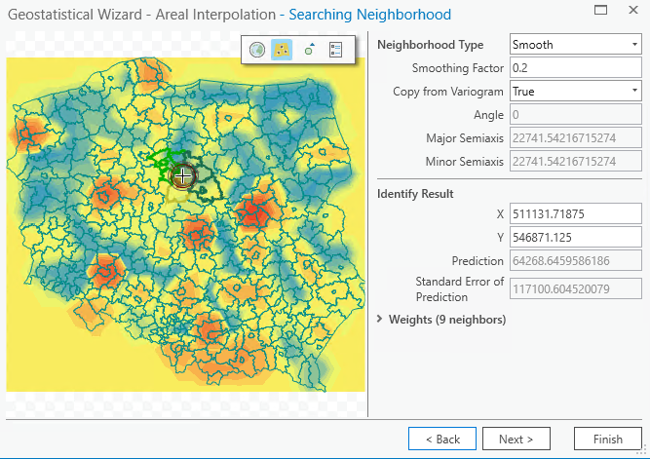
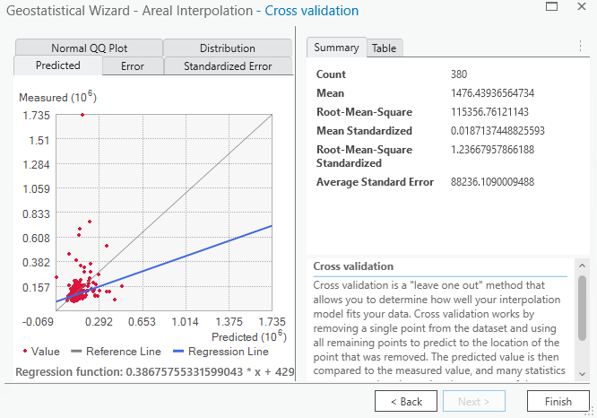
Step 3: Define search neighborhood and see goodness of fit
Not so good, we need to create interpolated polygons b/c our initial heatmap is inaccurate

Slide 6
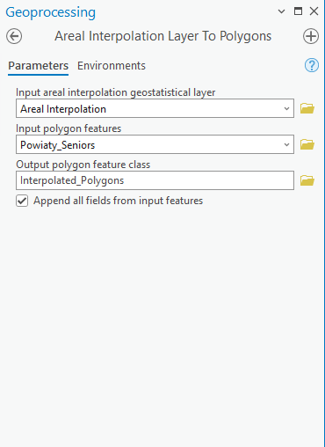
Step 4: Run Areal Interpolation Layer to Polygons tool

Slide 7
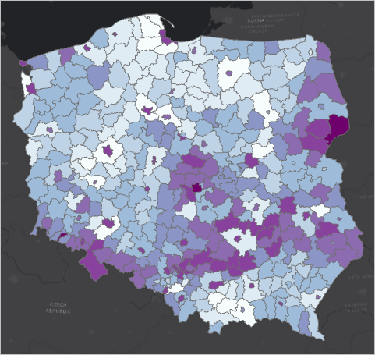
Step 5: Change Symbology to match original and display

Slide 8
Step 6: Compare pre/post maps
Left = Before
Right = After

Slide 9
Done! Thank You A.J. Brown

