Slide 1
GIS Exercise #2
AJ Brown
WR 514 Spring 2023

Slide 2
Exercise: Interpolate Corn Yield Data
The purpose of this exercise, following GIS Exercise #1, is to display interpolated, geo-reconciled combine data collected from an experimental site at the CSU Agricultural Research and Development Education Center (ARDEC) facility in 2022. These data will be further analyzed to understand potential differences between management treatments (not described in this exercise).
Used point data cleaned in exercise #1, in the geostatistical wizard
Select an interpolation method and select and optimize input parameters
Look at model calibration and cross validation goodness of fit results
Display final interpolation map

Slide 3
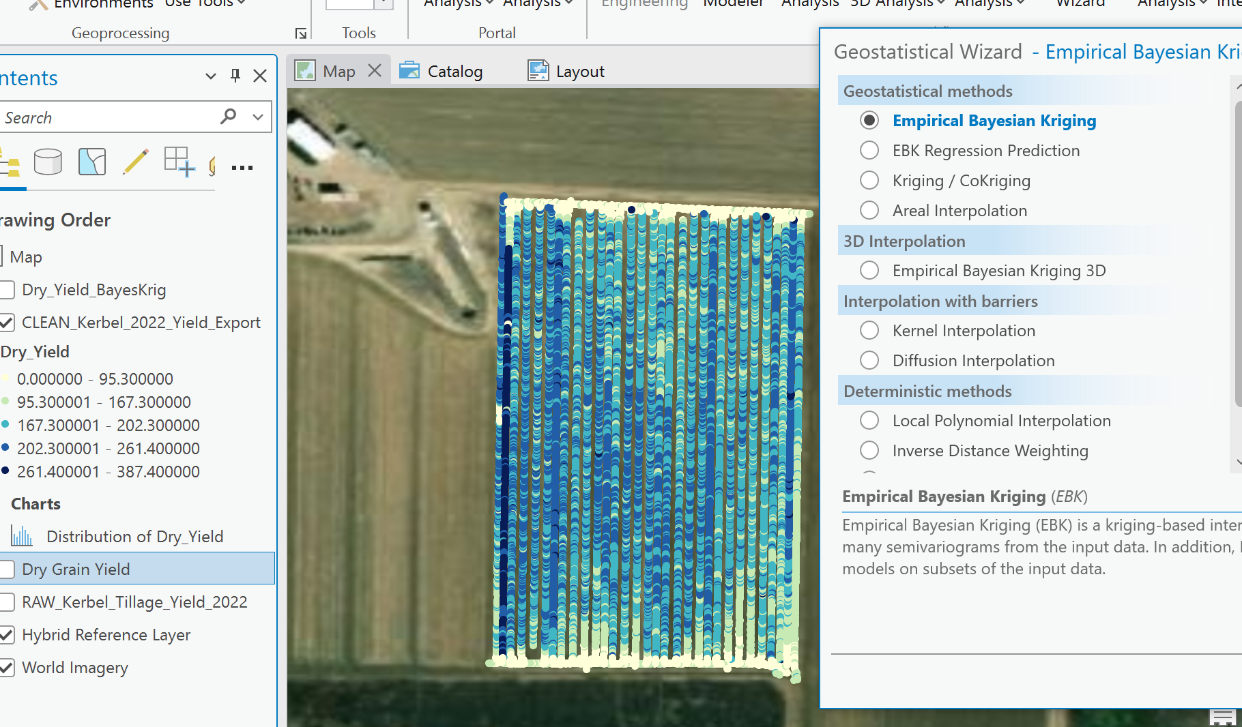
Step 1: Use geostatistical wizard
Open the geostatistical wizard tool in ArcPro and import the cleaned data points derived in GIS Exercise #1
Make sure to specify “Dry_Yield” as the desired display attribute

Slide 4
Step 2a: Select an interpolation method and select and optimize input parameters
In this case, Empirical Bayesian Kriging (EBK) interpolation is selected
EBK interpolation accounts for the error in estimating the underlying semivariogram through repeated simulations.
This makes it a more robust statistical method, while simultaneously reducing the number of known parameters needed to obtain a pragmatic result
It takes subsets of the data and derives a prior distribution from multiple model runs for making future predictions
Finally, one good thing about EBK methods is that it can handle relatively nonstationary data, which was not checked for in this exercise, so it lends itself to use here
The subset size (i.e., the number of points used in each subset simulation) was set to 200
The number of simulations was set to 100

Slide 5
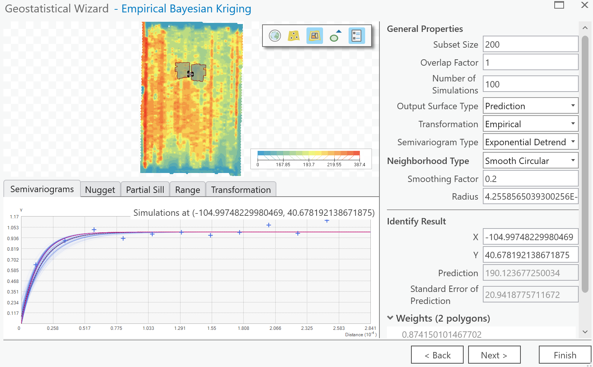
Step 2b: Select an interpolation method and select and optimize input parameters
The data required an Empirical transformation to best fit the majority of semivariograms observed in the dataset
The semivariogram of best fit for these data was the “Exponential Detrended” model
The neighborhood type was set to “smooth circular” for flexibility by the EDK algorithm
All other parameters were left as default

Slide 6
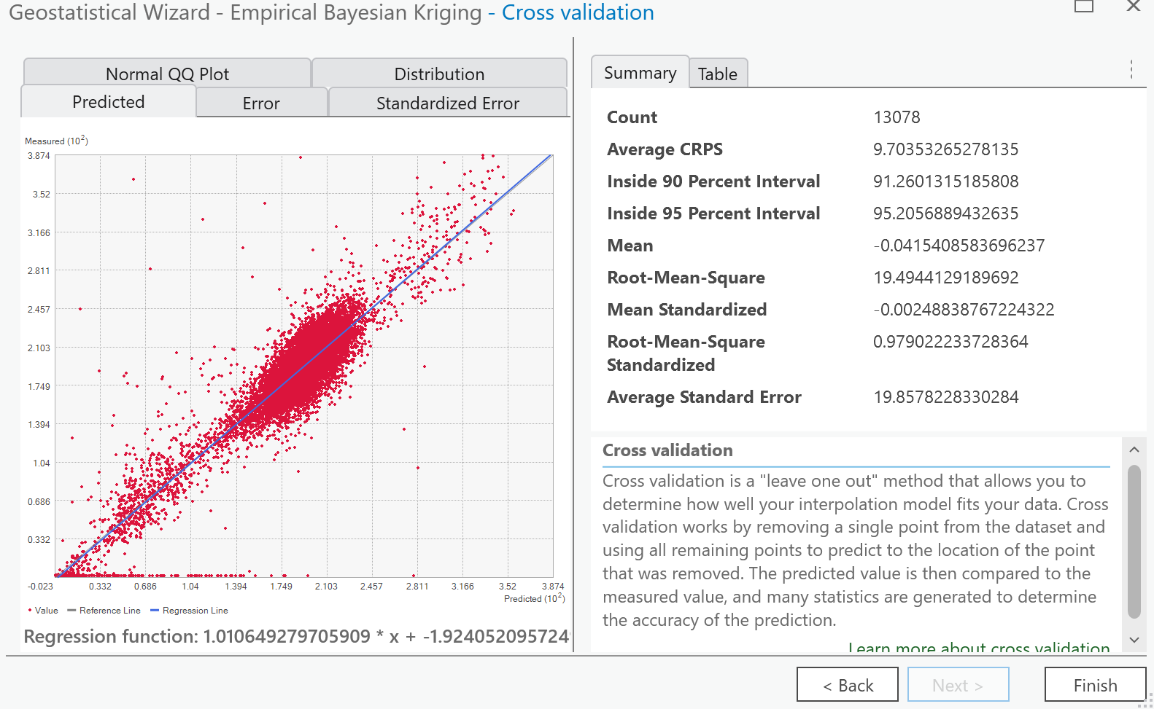
Step 3: Look at model calibration and cross validation goodness of fit (GOF) results
Model Calibration Results
Not reported in ArcPro (not ideal for stats nerds)
Cross Validation Results
“leave one out” method used
Not ideal for spatial datasets (RuB and Brenning, 2006), but default and unchangeable in ArcPro
Mean Error = -0.04
RMSE = 19.50 bushels/acre
Overall, the model performed okay
The data might need additional cleaning to eliminate some points that were clearly an issue for the EDK algorithm (e.g., There were clearly some 0’s measured in the middle of the field that the algorithm did not handle well)
Being accurate within +/- 19.5 bu./ac. Is not often accurate enough for agricultural research

Slide 7
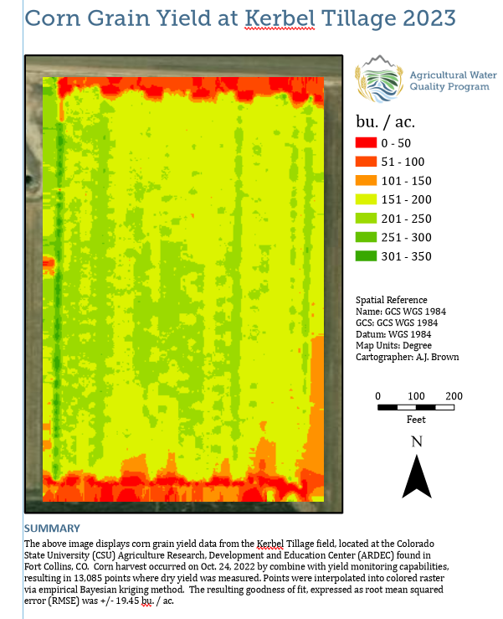
Step 4: Display final interpolation map
Assuming that the error found in the previous step is acceptable, here is a display of the final interpolation map
The data have been colored such that red = bad yield, and green = good yield.
Some insights from the map
Yield is poorest on the ends of the field (i.e., where surface irrigation enters/exits the field), which is common because of irrigation related issues
The combine picked up a single row on the West (Left) side, that is likely an error. (i.e., it’s unlikely a single pass of the combine gets unusually high yield like this)
Yield generically decreases from W to E
We suspect this is due to irrigation head issues on the concrete ditch that supplies siphon tube water.

Slide 8
Conclusions
Interpolation is an incredibly valuable tool in agricultural research
Unfortunately, it is also statistically heavy, requiring much data cleaning and assumption checking for accurate and useful results
These data could use additional cleaning to make the final result a better representation of yield in the field
E.g., abnormally high yield pass from combine
numerous (seemingly) random zeros in the dataset
However, we could still determine that yield decreased generally from W to E, which aligns with irrigation issues we observe in-situ. Therefore, this map has still proven to be quite useful
Thanks! -AJ

