Slide 1
GIS Exercise #7
AJ Brown
WR 514 Spring 2023

Slide 2
Exercise: Contiguity Weights in Python using GeoPandas and libpysal
Contiguity means that two spatial units share a common border of non-zero length. Operationally, we can further distinguish between a rook and a queen criterion of contiguity, in analogy to the moves allowed for the such-named pieces on a chess board.
The rook criterion defines neighbors by the existence of a common edge between two spatial units. The queen criterion is somewhat more encompassing and defines neighbors as spatial units sharing a common edge or a common vertex. Therefore, the number of neighbors according to the queen criterion will always be at least as large as for the rook criterion.
In practice, the construction of the spatial weights from the geometry of the data cannot be done by visual inspection or manual calculation, except in the most trivial of situations. To assess whether two polygons are contiguous requires the use of explicit spatial data structures to deal with the location and arrangement of the polygons.
It is important to keep in mind that the spatial weights are critically dependent on the quality of the spatial data source (GIS) from which they are constructed. Problems with the topology in the GIS (e.g., slivers) will result in inaccuracies for the neighbor relations included in the spatial weights. In practice, it is essential to check the characteristics of the weights for any evidence of problems. When problems are detected, the solution is to go back to the GIS and fix or clean the topology of the data set.
In this exercise, we derive contiguity weights and create rook and queen contiguity networks for display.

Slide 3
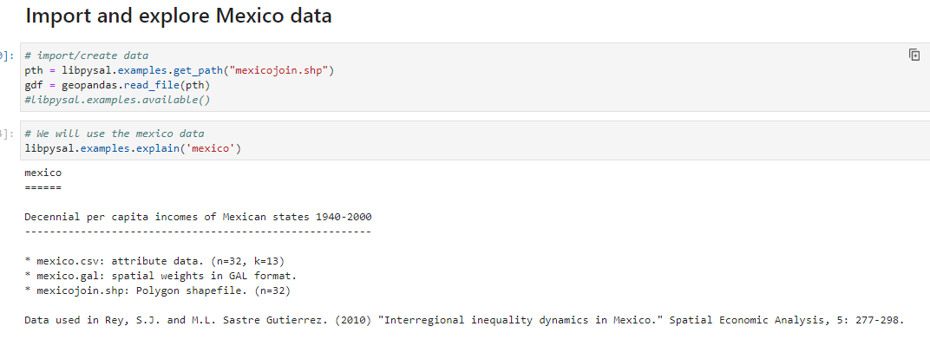
Step 1: Import Mexico State boundaries

Slide 4
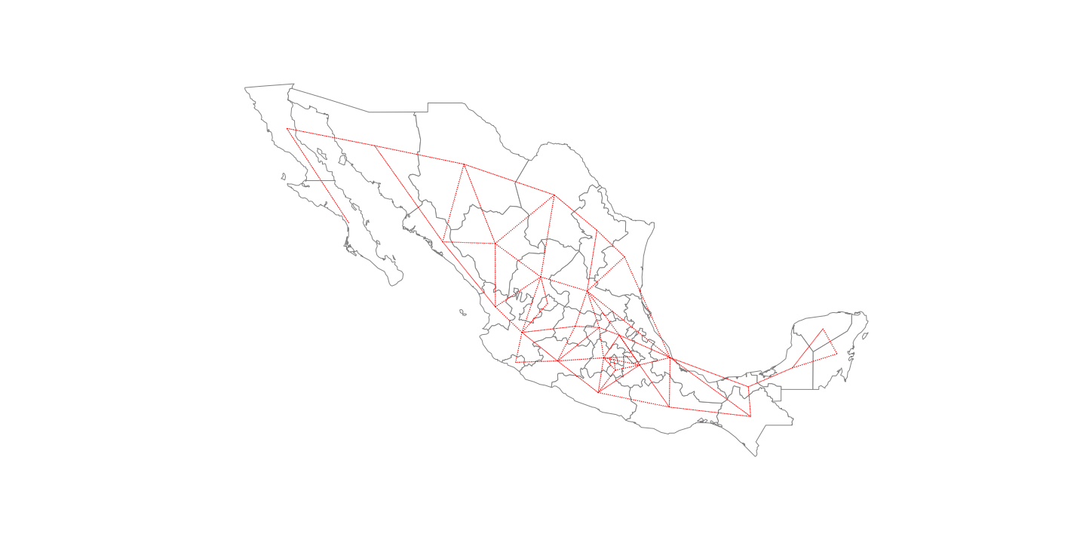
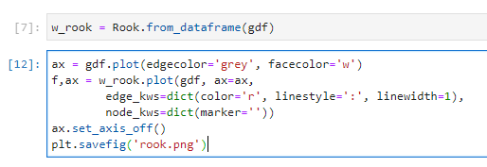
Step 2a: Create Rook Network Map

Slide 5
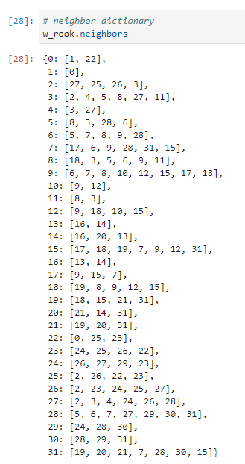
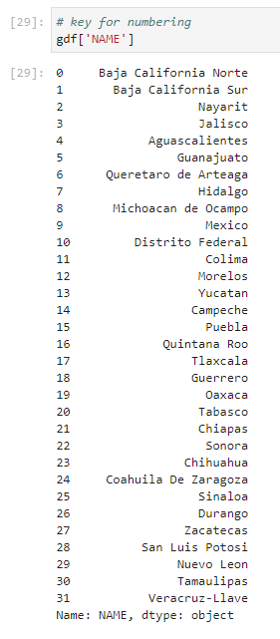
Step 2b: Display Rook Weights So, Baja California Norte (0) has 2 rook neighbors: Baja California Sur (1) and Sonora (22). Additionally, Jalisco (3), has 6 neighbors

Slide 6
Step 3a: Create Queen Network Map

Slide 7
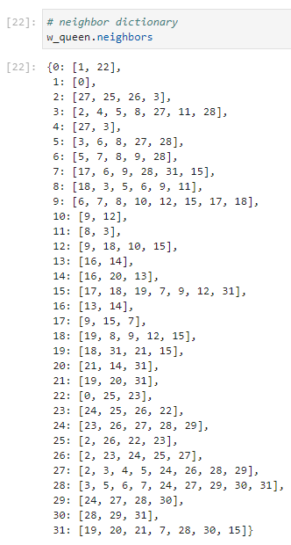
Step 3b: Display Queen Weights So, Baja California Norte (0) has 2 rook neighbors: Baja California Sur (1) and Sonora (22). This time, Jalisco (3), has 7 neighbors! There are other differences as well.

Slide 8
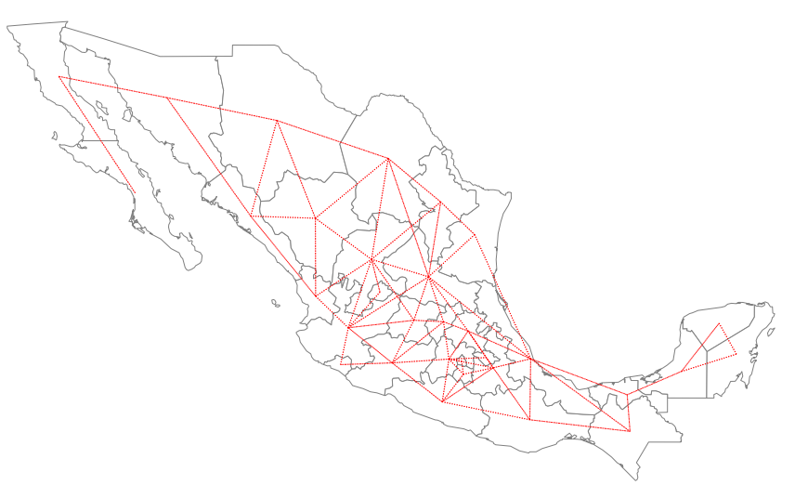
Final: Map Comparison
Rook
Queen

Slide 9
Done! Thank You A.J. Brown

