Slide 1
GIS Exercise #8
AJ Brown
WR 514 Spring 2023

Slide 2
Exercise 8: Plotting Locations of CoAgMet and Northern Water Weather Stations in CO using Python
COlorado AGricultural Meteorological nETwork — COAGMET and Northern Water operates a network of agricultural weather stations around the state of Colorado. The data from these stations lets users calculate Evapotranspiration (ET) values to model water use for various crops, and determine current weather conditions accurately.
This exercise will plot the location of each weather station in CO, colored by owner type

Slide 3
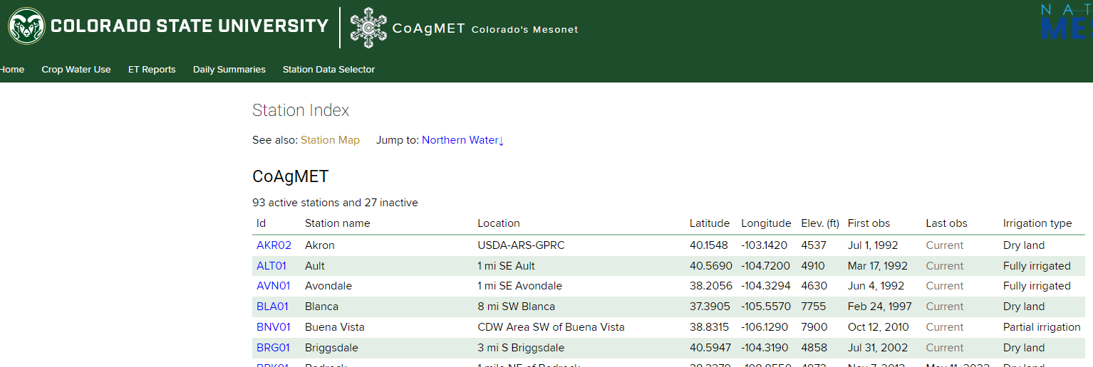
Step 1: Create CSV of data
https://coagmet.colostate.edu/station/index
Use these data to create a CSV containing weather station XY data

Slide 4
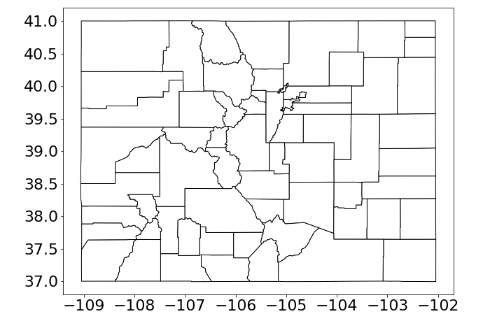
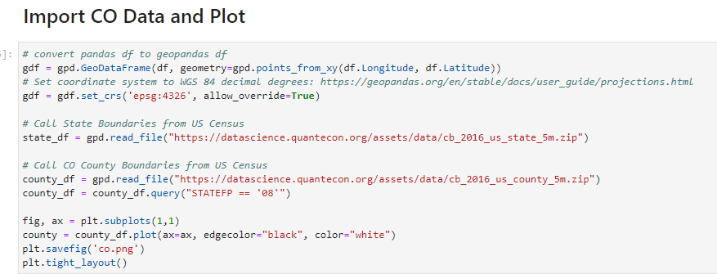
Step 2: Import Data CO Boundaries

Slide 5
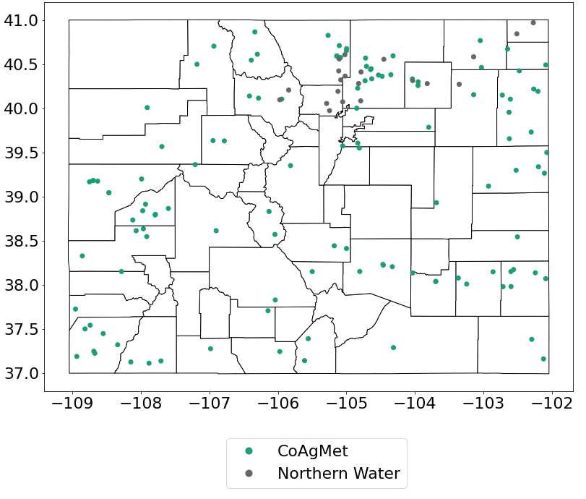
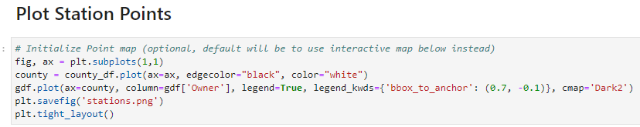
Step 3: Plot Station Locations

Slide 6
Done! Thank You A.J. Brown

