Slide 1
GIS Exercise #9
AJ Brown
WR 514 Spring 2023

Slide 2
Exercise 9: Create Voronoi map of Coagmet Weather Station Locations in CO
In the previous exercise we plotted the CoAgMet weather station locations in Colorado, but now we will create a Voronoi map from the station points.
Thiessen polygon maps, which are also called Voronoi diagrams, are used to define and to delineate proximal regions around individual data points by using polygonal boundaries. They are employed by many disciplines including weather forecasters, hydrologists and geographers, and by geologists.
Simply put, a Voronoi shape designates where the nearest given point is to something within the shape.
So, in this example, being in a certain Voronoi shape tells you where the nearest weather station is; a valuable statistic to have when selecting the most representative weather to your location.

Slide 3
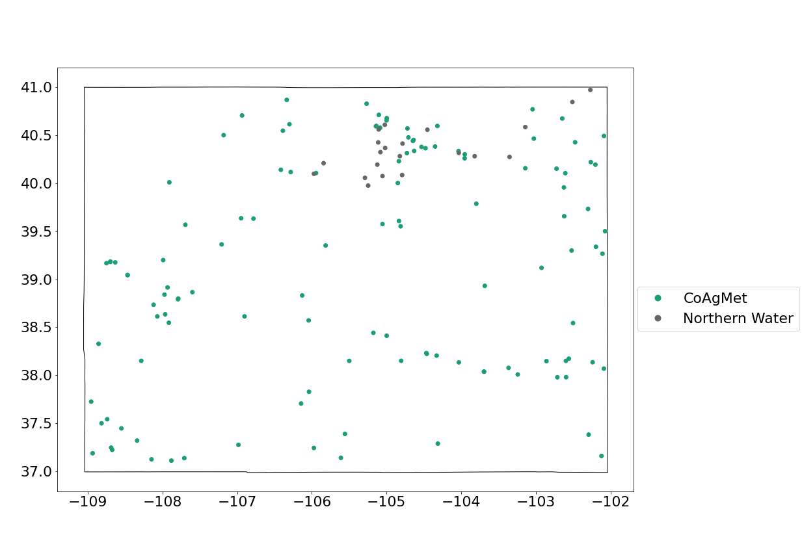
Step 1: Create CO Map w/o county boundaries w/ station points

Slide 4
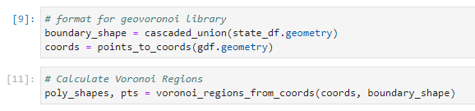
Step 2: Format data for Geovoronoi module
The Geopandas format need manipulation to work with an existing Geovoronoi module that will create Voronoi shapes for us

Slide 5
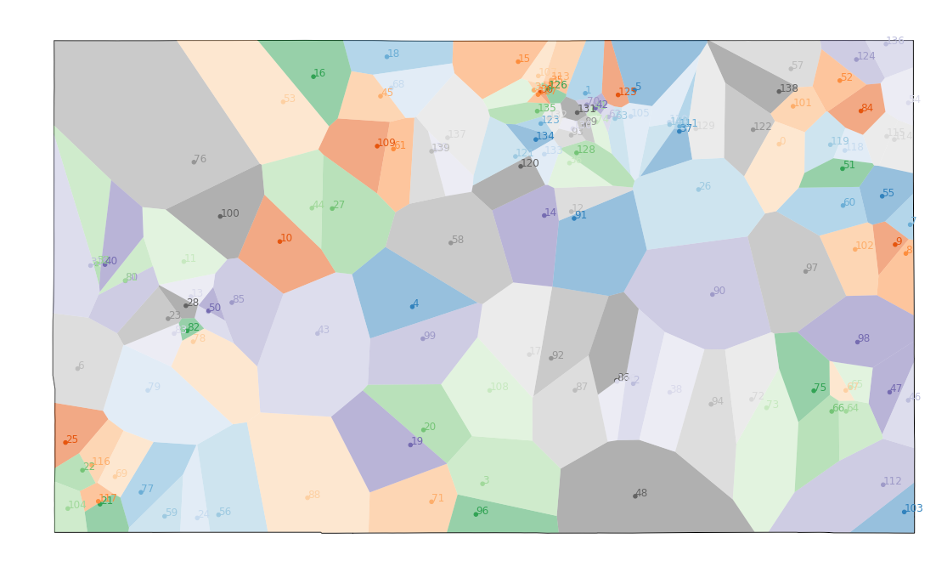
Step 3: Display Voronoi Map

Slide 6
Done! Thank You A.J. Brown

