Slide 1
Multivariate Analysis of Glycaemic Control Using demographic, lifestyle, and clinical predictors in Type 1 Diabetes
Author: Ans Riaz (23079633)
MSc Data Science with Advanced Research – University of Hertfordshire
GitHub: https://github.com/ansmalik67/multimodal-glucose-forecasting.git

Slide 2
Background & Motivation
Glycaemic instability is difficult to predict.
Multivariate factors influence glucose levels.
Machine learning helps uncover hidden patterns.

Slide 3
Research Question & Objectives
Can multivariate ML models predict glycaemic levels?
Does socioeconomic status influence diabetes control?
Objectives:
  Clean & transform dataset
  Perform EDA
  Train Ridge Regression, RF, GBM
  Evaluate with MAE, RMSE, R²

Slide 4
Dataset Overview
Records: ~647858 rows of patient time-series data
Features: 40+ columns including:
Biometrics: Glucose (GL), Time, Weight, Height
Clinical Data: Insulin dosage, Kidney Disease
Lifestyle: Alcohol, Exercise, Diet
Demographics: Age, Gender, Race
Temporal Feature: Timestamped every 5–15 minutes
Challenges: Extremely High Frequency data, Categorical Clinical Variables, missing values and many more.

Slide 5
Preprocessing & Feature Engineering
Datetime Processing
Lag Features
Encoding categorical columns
Scaling numerical features
Creating engineered predictors

Slide 6
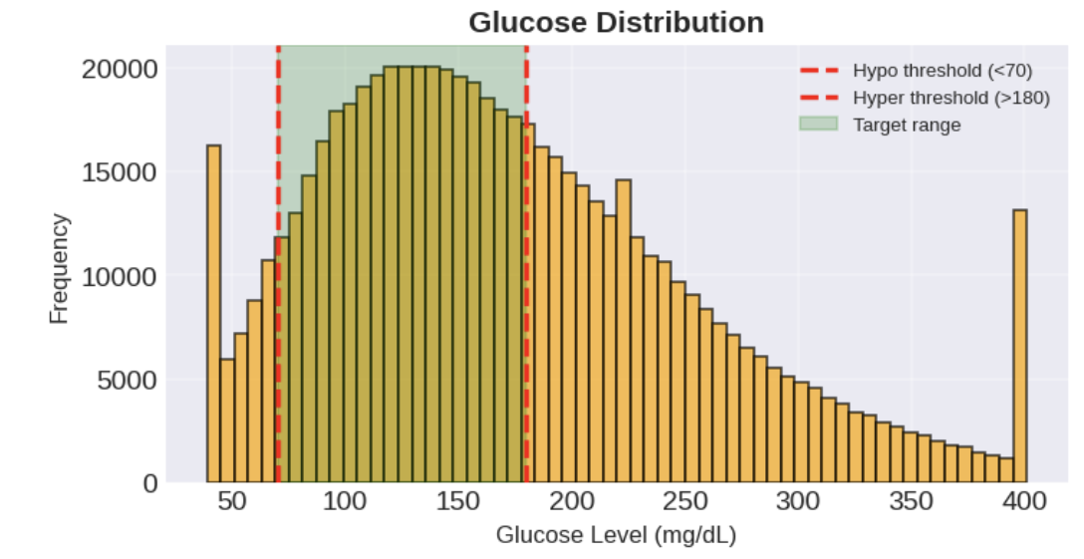
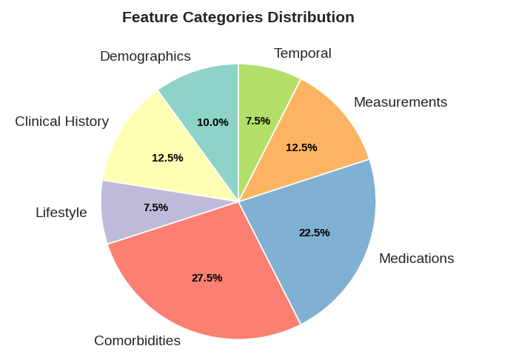
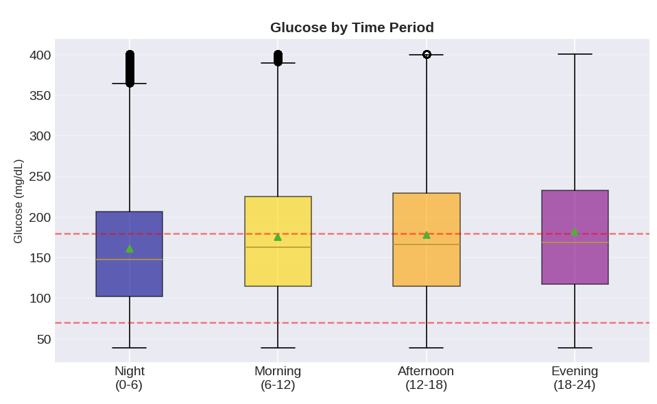
Exploratory Data Analysis
Distribution plots
Boxplots for lifestyle vs glucose
Correlation heatmap
Insights used to guide modelling

Slide 7
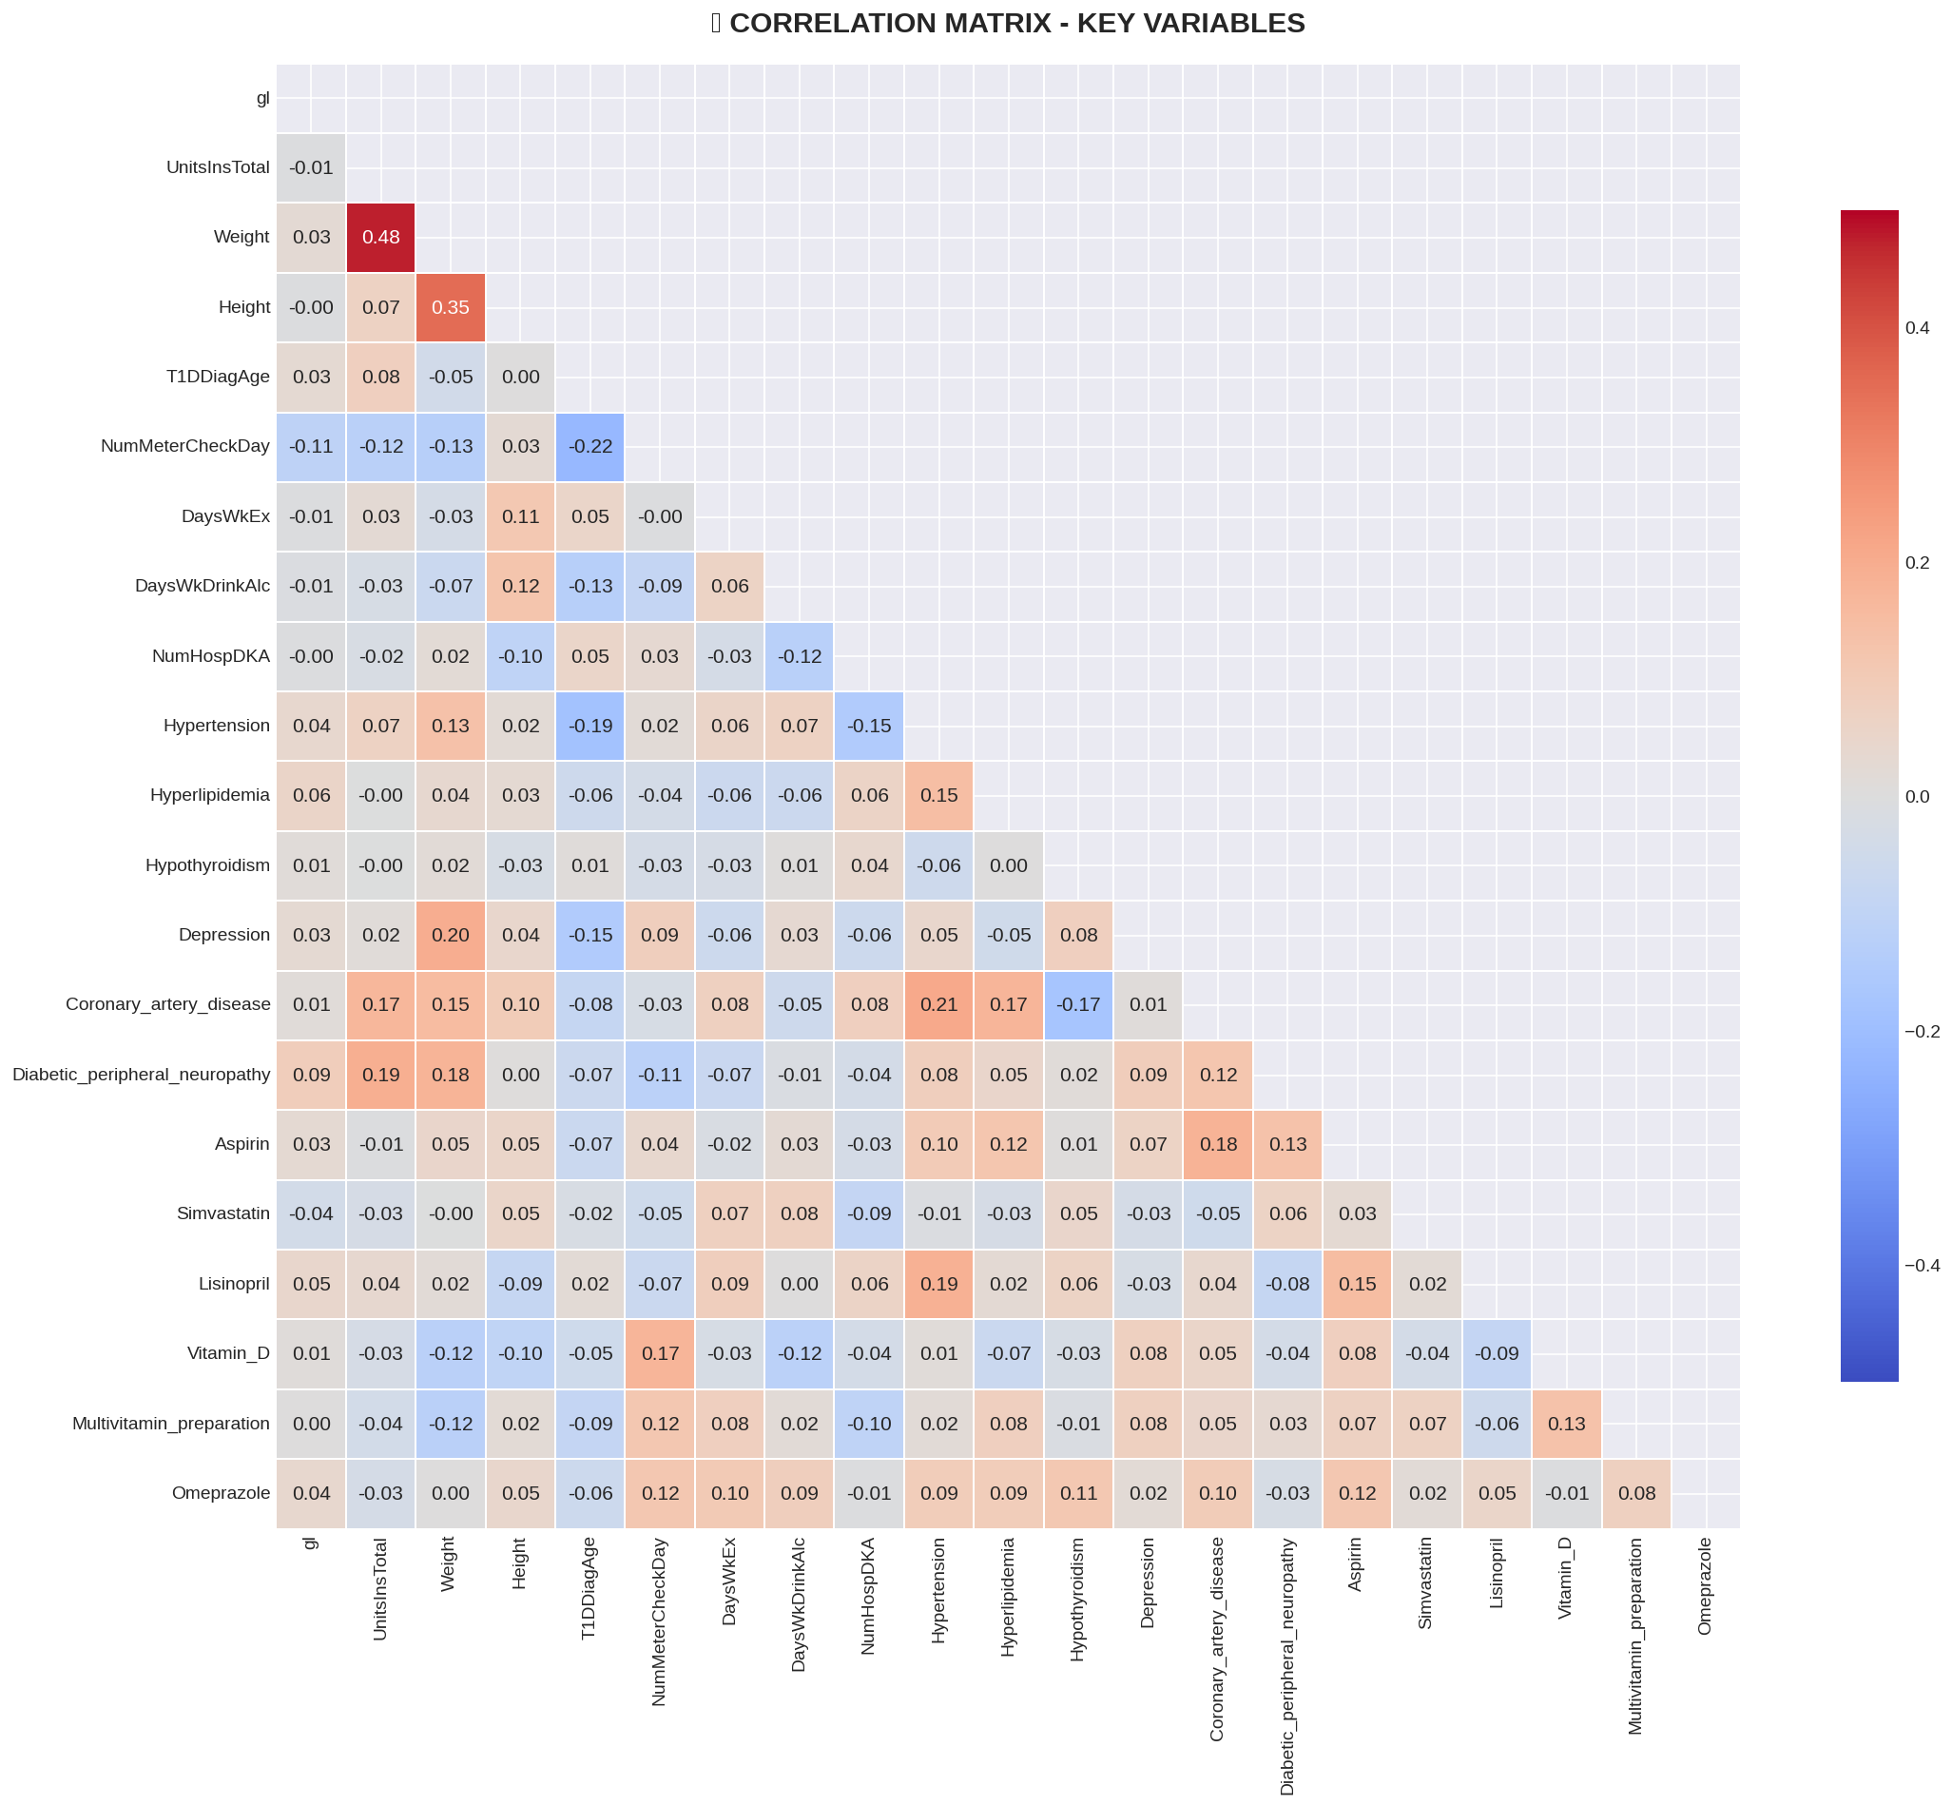

Slide 8
Models Used
Ridge Regression (baseline)
Random Forest Regressor
Gradient Boosting Regressor
Grid Search for optimisation

Slide 9
Model Optimisation
Tuned learning rate, depth, n_estimators
Selected best-performing GBM model

Slide 10
Evaluation Metrics
MAE – avg absolute error
RMSE – penalises large deviations
R² – overall model fit

Slide 11
Results Summary
Gradient Boosting best performer
Random Forest strong but lower accuracy
Ridge Regression weakest
Model | MAE | RMSE | R2
Gradient Boosting | 3.962 | 62.669 | 0.991
Random Forest | 3.992 | 63.350 | 0.991
Ridge Regression | 4.135 | 66.128 | 0.990

Slide 12
Critical Discussion
Limitations:
Missing data
No timestamped features
Strengths:
Strong predictive performance
Robust EDA & preprocessing

Slide 13
Implications
Helps understand risk factors
Supports clinical decision-making
Framework for future predictive systems

Slide 14
References
Prioleau, T., Lu, B. & Cui, Y. (2025) Glucose-ML: A collection of longitudinal diabetes datasets for development of robust AI solutions
Shashaj, B. et al. (2022). Machine learning for personalized insulin and glucose forecasting.
Li, K. et al. (2020). Time-series models for diabetes management.

Slide 15
Conclusion & Future Work
Conclusion:
GBM best model
Multivariate prediction successful
Future:
Add LSTM+GRU
More datasets
Interpretability via SHAP

Slide 16

Q&A
Thank you! Ready for questions.

