Slide 1


Tunisian Aeroday 2019
TIME AIRLINES
Notes:
1

Slide 2

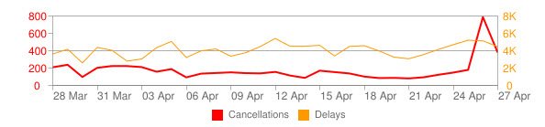
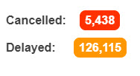
THE HURDLE
Last 30 days in Europe
Task 1
Source: flightstats.com
28/04/2019
2
Notes:
2

Slide 3




THE VISION
28/04/2019
3
Notes:
3

Slide 4
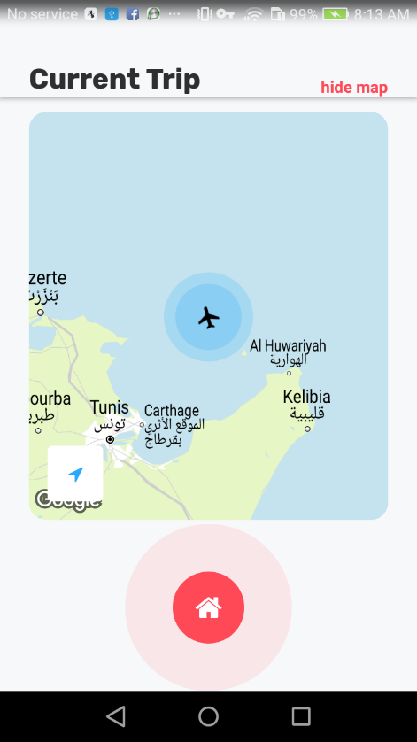



Chat Room
Each airport has a unique chat room
Send images or geographical positions
Stay anonymous
28/04/2019
4
Notes:
4

Slide 5
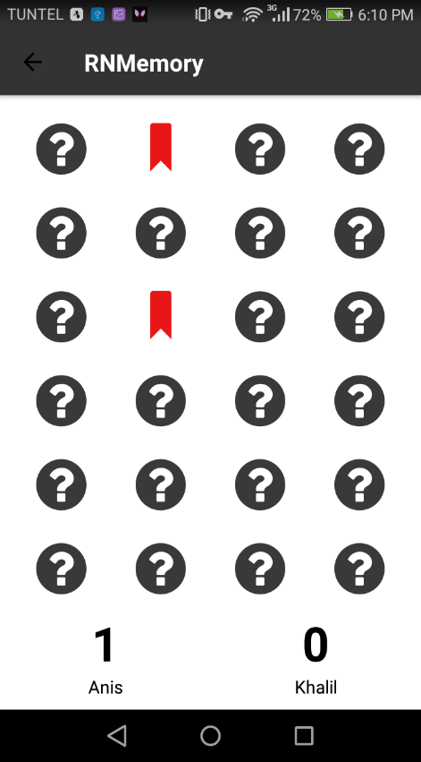

Multiplayer Games
Choose an opponent
Accept or refuse game invitations
28/04/2019
5
Notes:
5

Slide 6
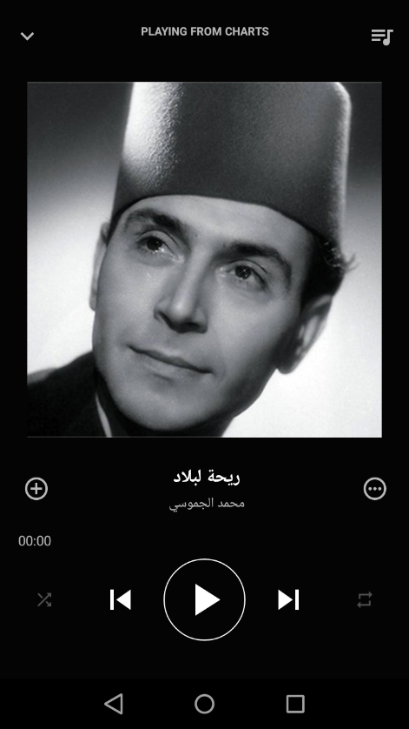

Discover Music
Playlists customized for each country
Folklore music
28/04/2019
6
Notes:
6

Slide 7

Track your Flight
Track your flight in real time
Visualize it on the map
Be ahead of delays
28/04/2019
7
Notes:
7

Slide 8


TECHNOLOGIES
28/04/2019
8
Notes:
8

Slide 9
LIVE DEMO
28/04/2019
9
Notes:
9

Slide 10
Thank you for your Attention
Notes:
10

