Slide 1
Simon Says App Screens
Generated slides for the demo presentation

Slide 2
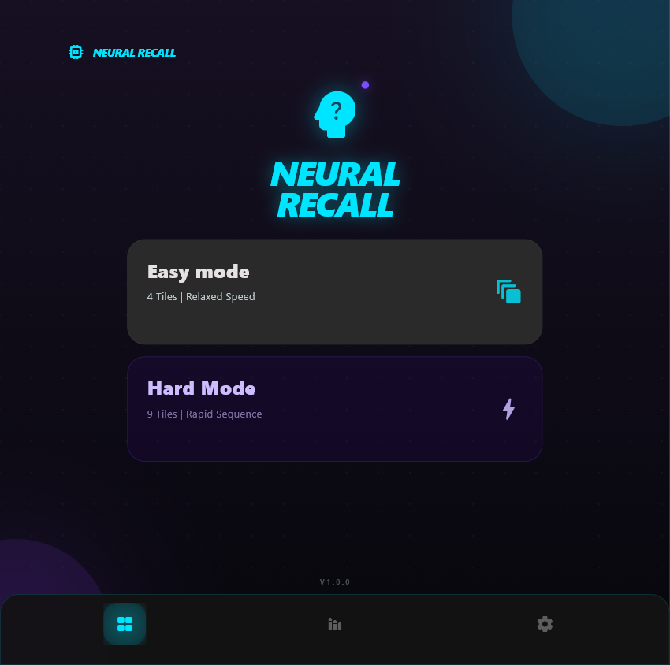
Main Menu

Slide 3
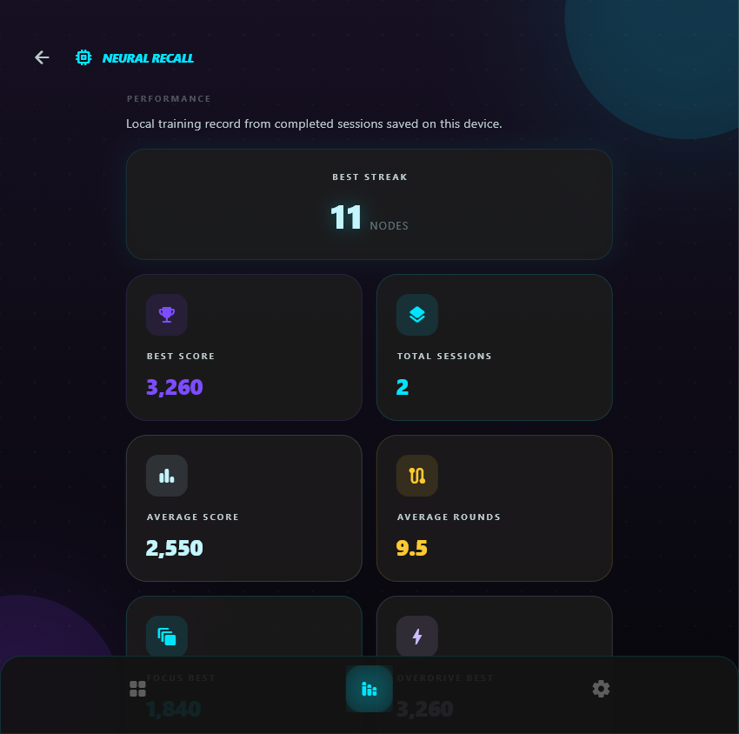
Stats Screen

Slide 4
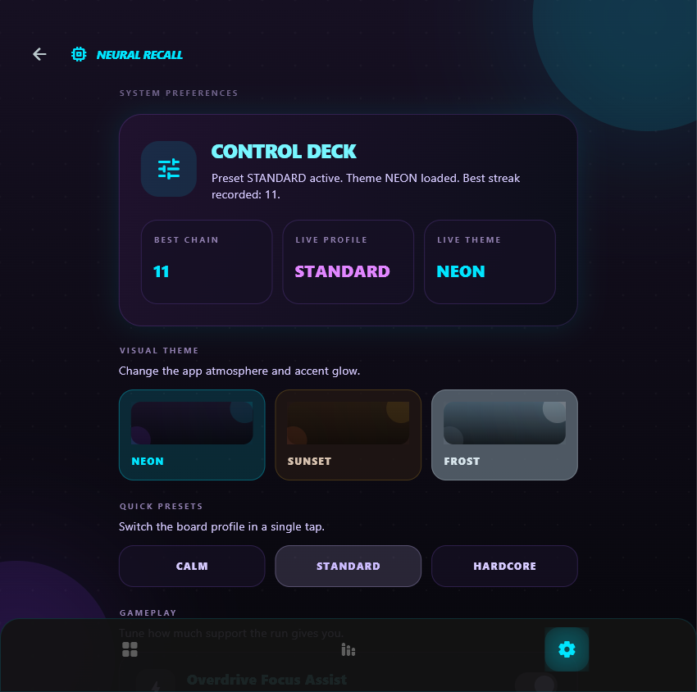
Settings Screen

Slide 5
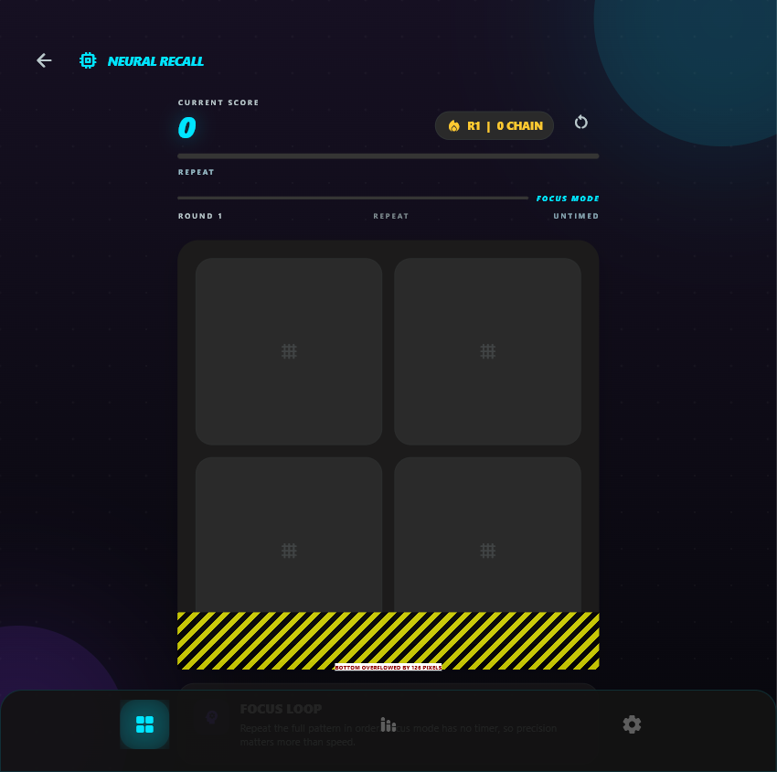
Focus Mode

Slide 6
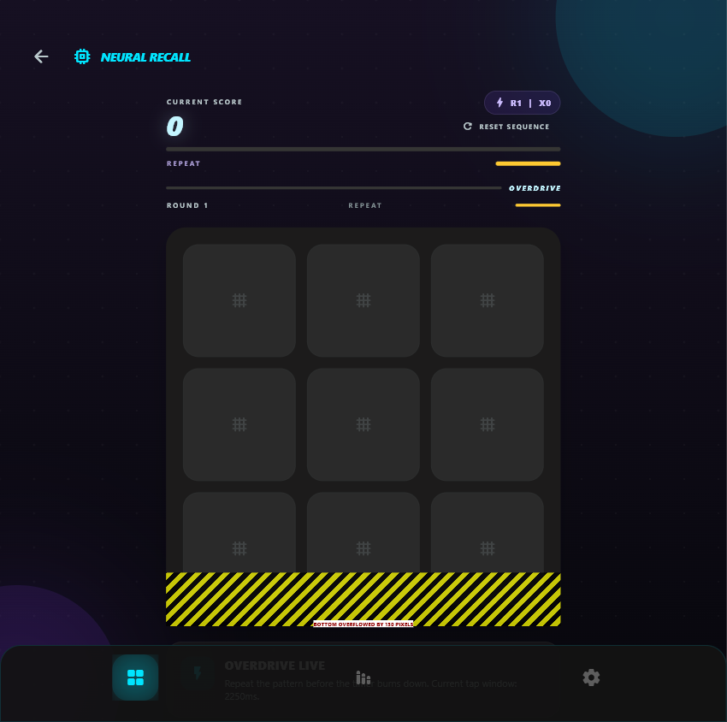
Overdrive Mode

