Slide 1



Pipeline for any Maven-based web-application
DevOps education program
Final project
Andrii Sokolov

Slide 2

COUPLE WORDS ABOUT ME

Slide 3
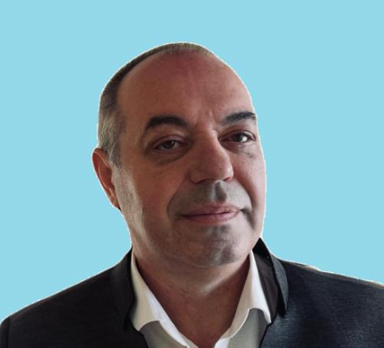
Self-introduce
I’ve being worked at IT from last century.
My IT way was began at the Alkar-Teleport. The name of company was changed some times but my chair wasn’t changed. I’d worked at the Alkar-Optima-Vega Telecom about 11 years.
Next 11 years I’ve worked at the PrivatBank. PrivatLinux was one of my successful projects at the Bank.
I’ve occupied a different positions but love to black screen with green letters I carry out through all my life.

Slide 4
INIITIALIZE ENVIRONMENT

Slide 5
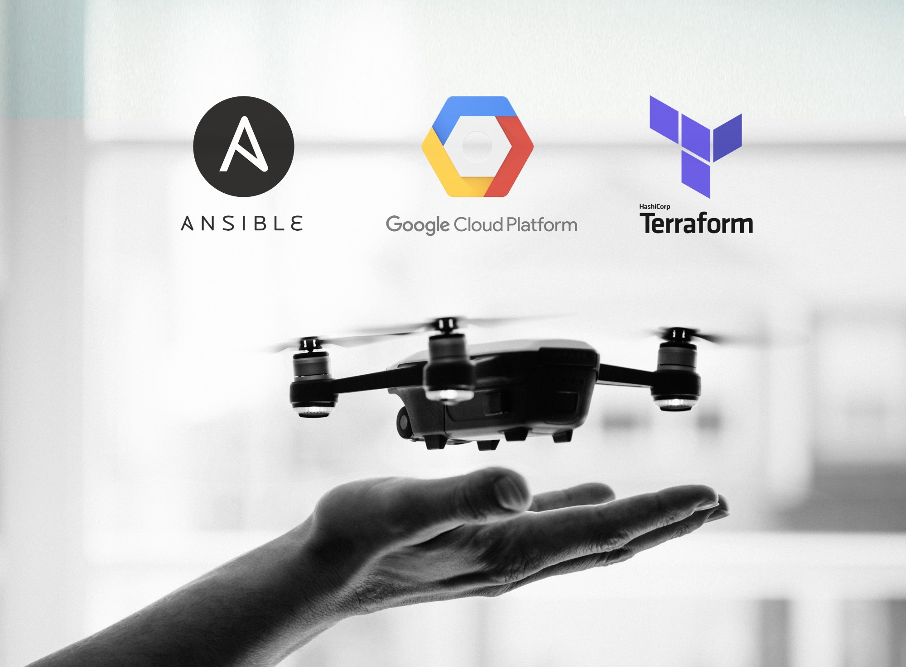
What we are using:

Slide 6




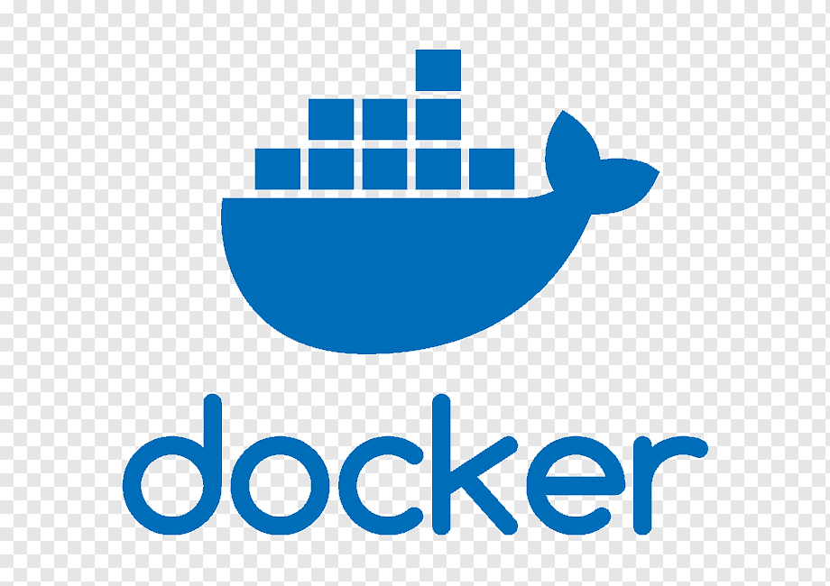
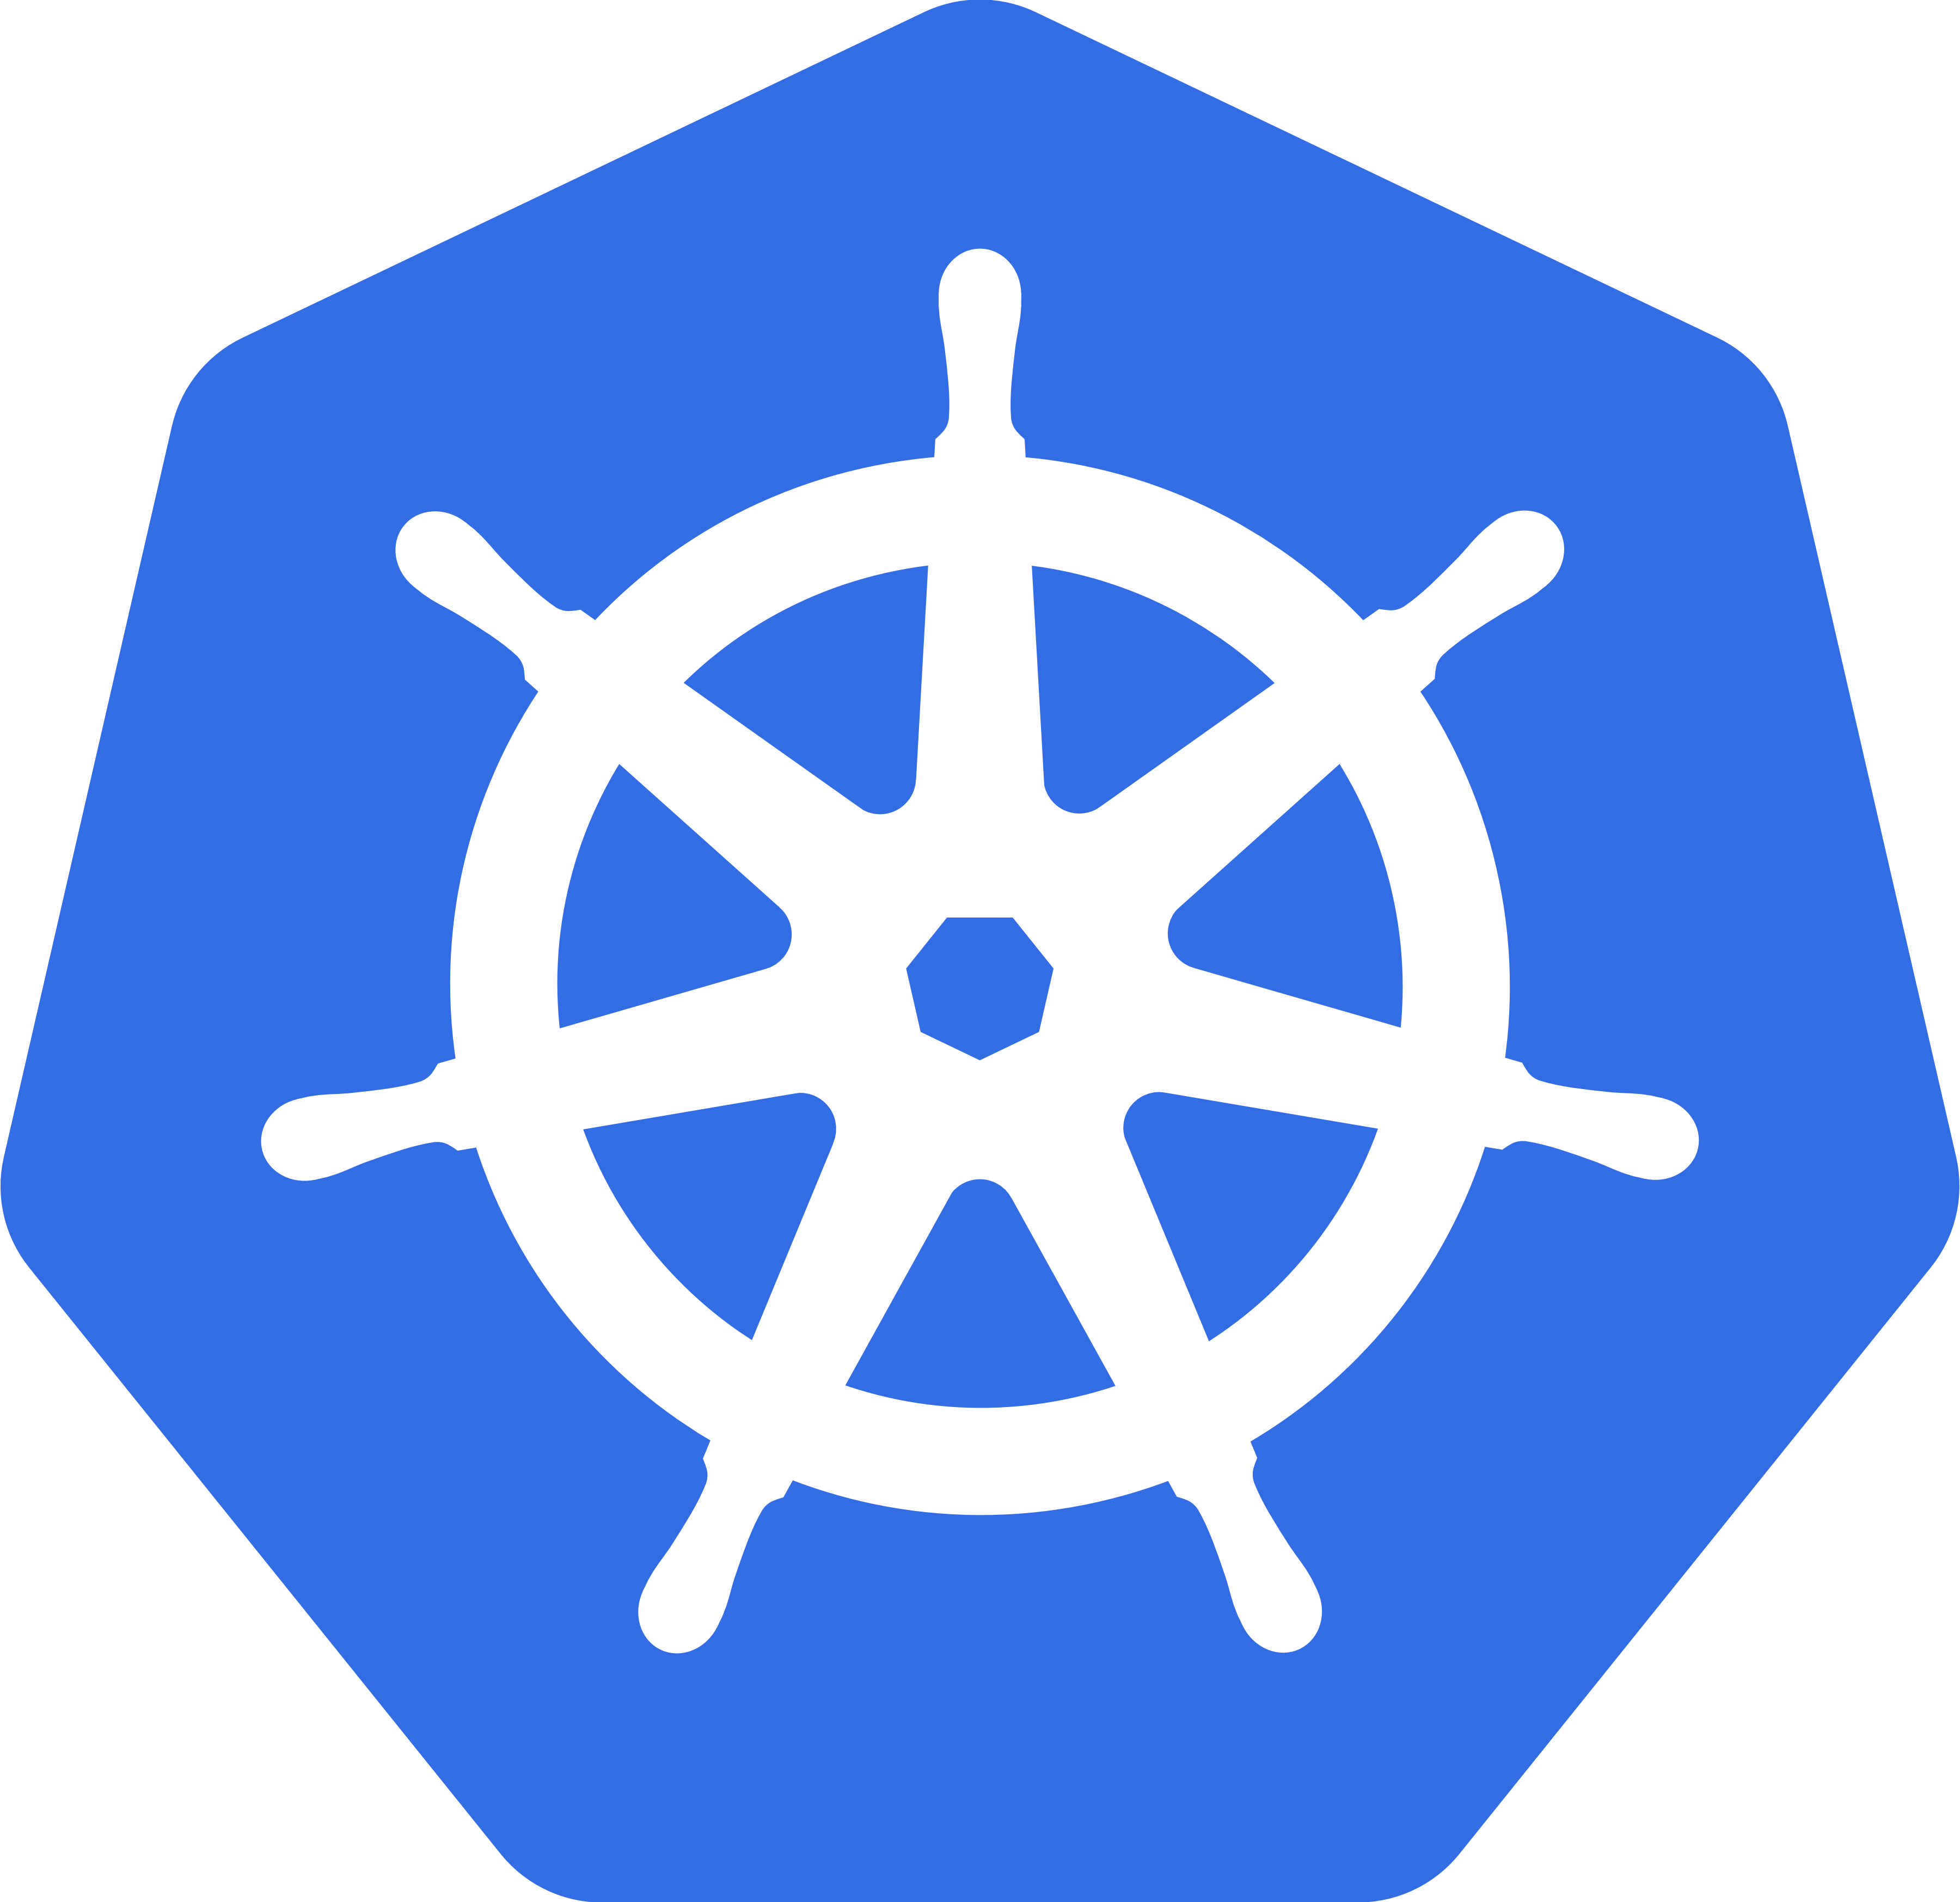




Scheme of environment
Master
Kuber
dev

Slide 7

Terraform’s objectives
Generate a key’s pair
Expand three servers
Put public and private key in certain proper place
Install ansible
Configure ansible
Clone repo from git with playbook
Run playbook
https://github.com/ansokoloff/infrastructure/blob/main/main.tf

Slide 8

Ansible objectives
Install docker
Install common software
Create users for Jenkins nodes
Put public key for Jenkins users
Install k8s
Install kubectl
Install helm
https://github.com/ansokoloff/infrastructure/blob/main/global.yaml

Slide 9

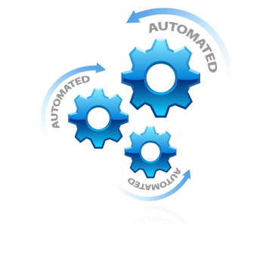
Conclusion

Slide 10
APPLICATION

Slide 11
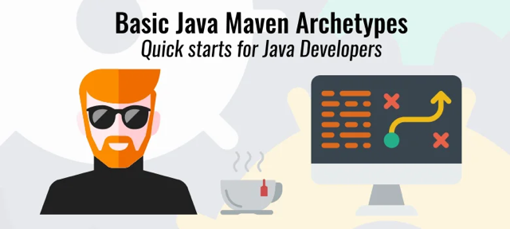
Maven-based web-application

Slide 12
PIPELINE

Slide 13
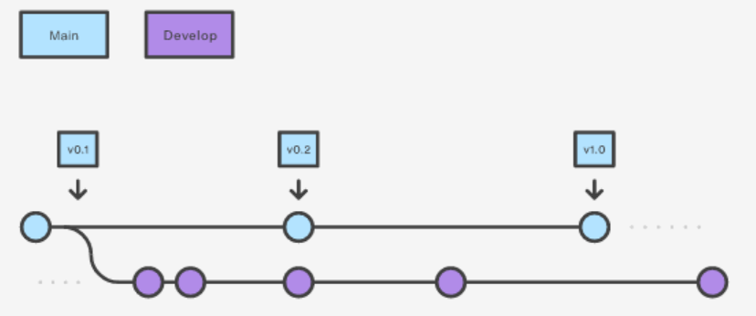
Git branches

Slide 14
Pipeline
STAGE | TOOL | Branch
Clone repo from Github | Git | Develop
Build app | Docker | Develop
Create artifact | Docker | Develop
Test artifact | Docker, bash | Develop
Publish artifact | Docker, docker hub | Develop
Create new revision | Bash, git | Main
Deploy to prod | Helm, K8s | Main

Slide 15
Q & A

Slide 16

Thank you!

