Slide 1



Pipeline for any Maven-based web-application
DevOps education program
Final project
Andrii Sokolov

Slide 2

INIITIALIZE ENVIRONMENT

Slide 3
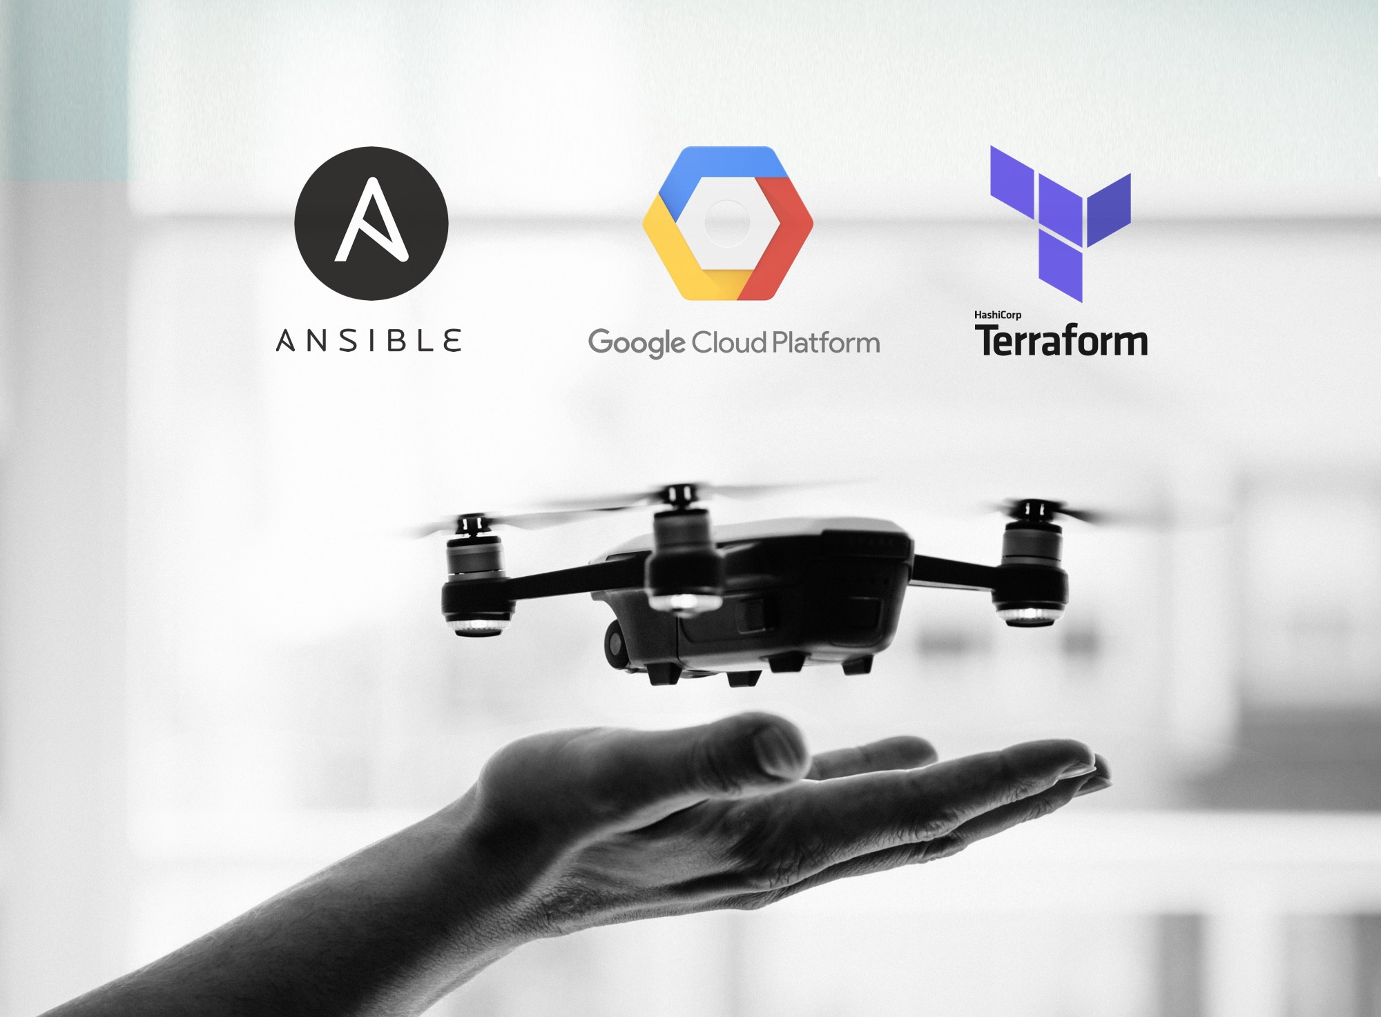
What we are using:

Slide 4
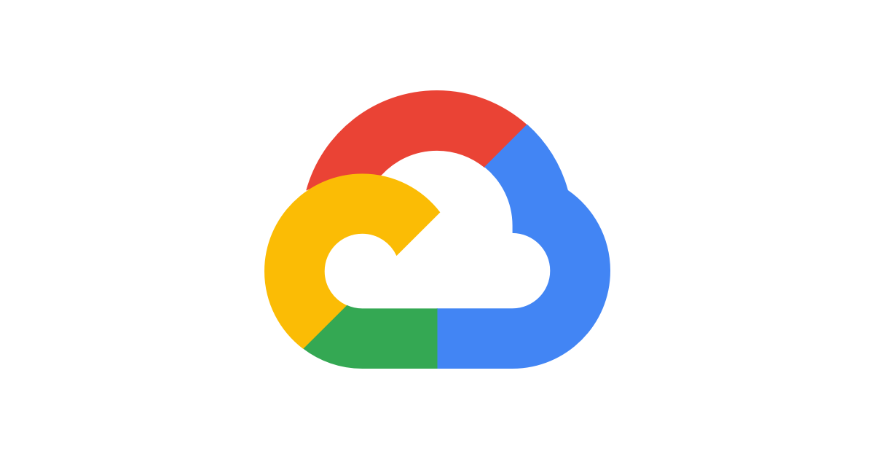
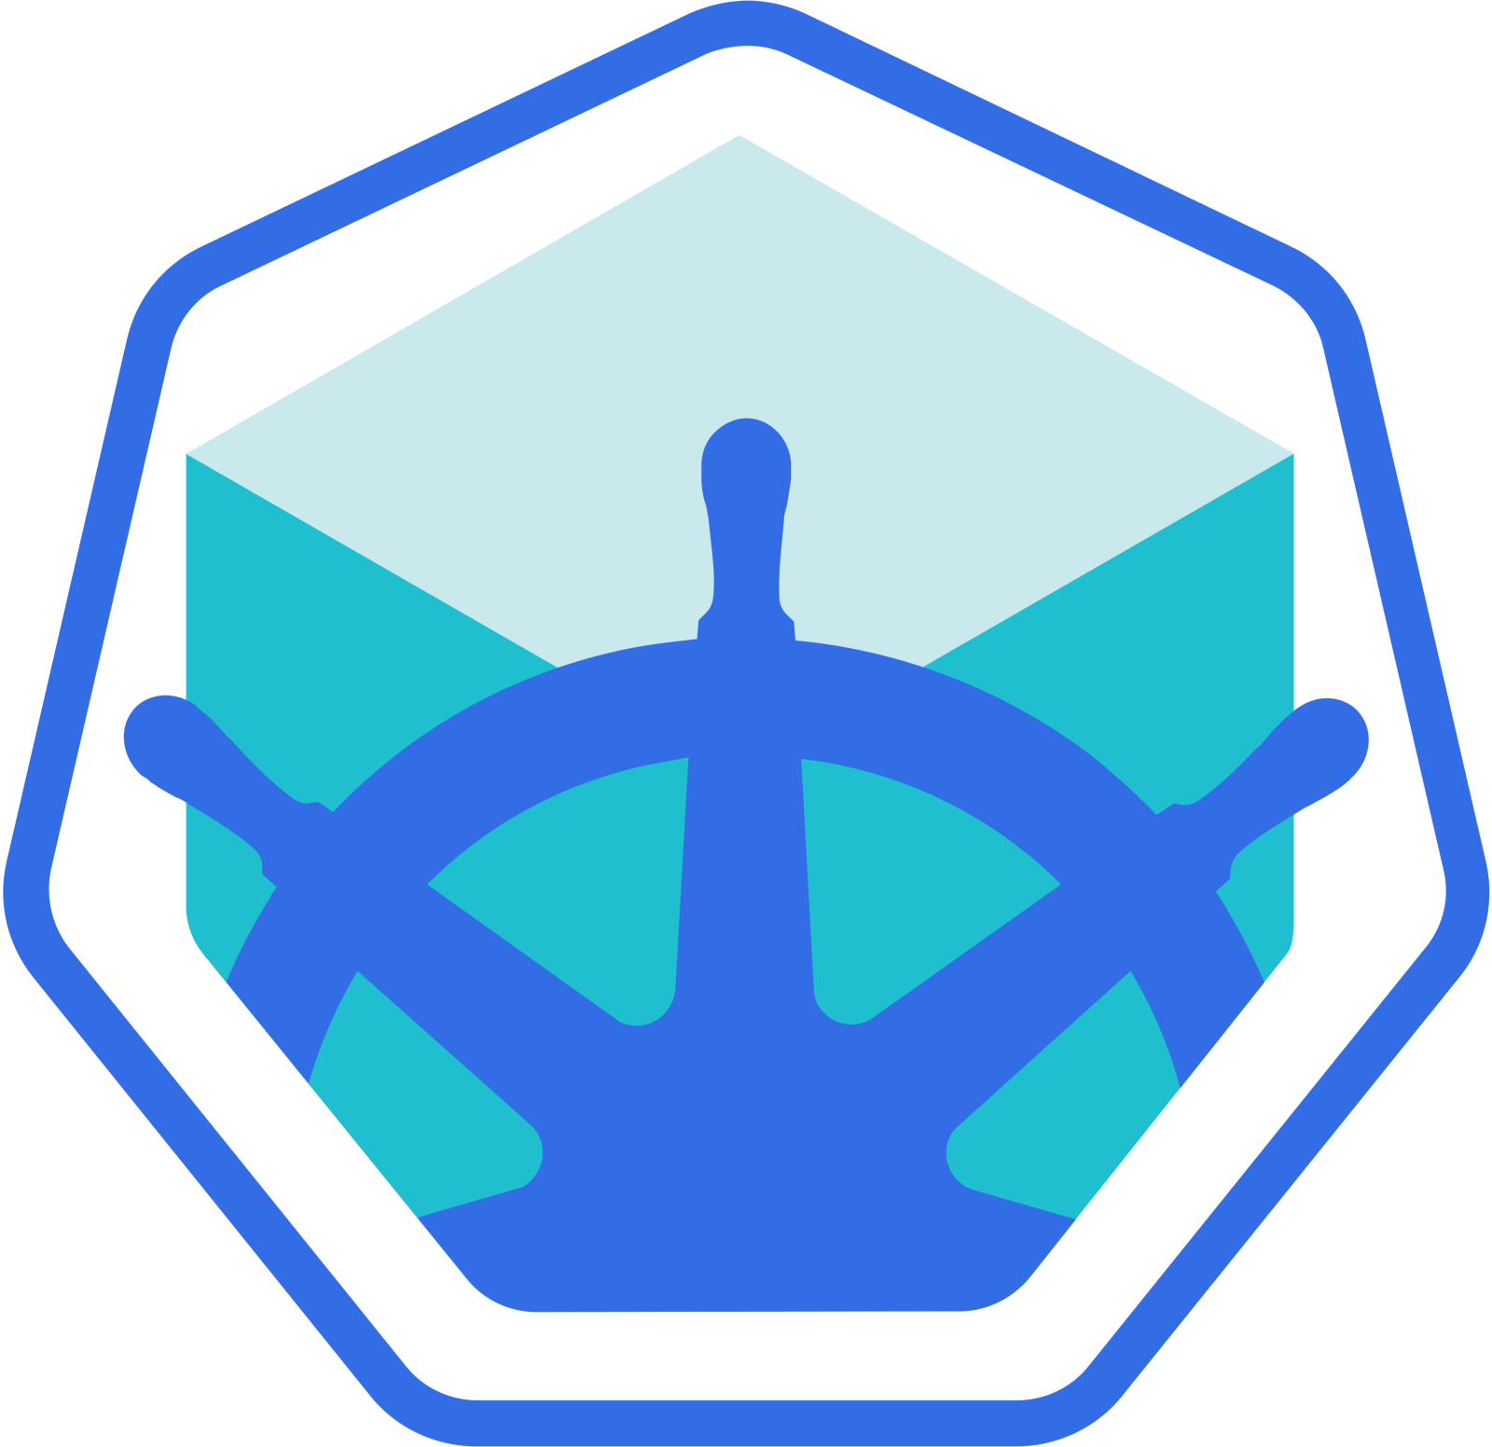

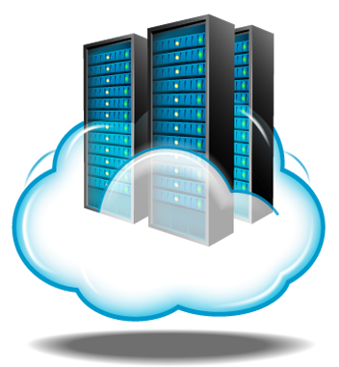
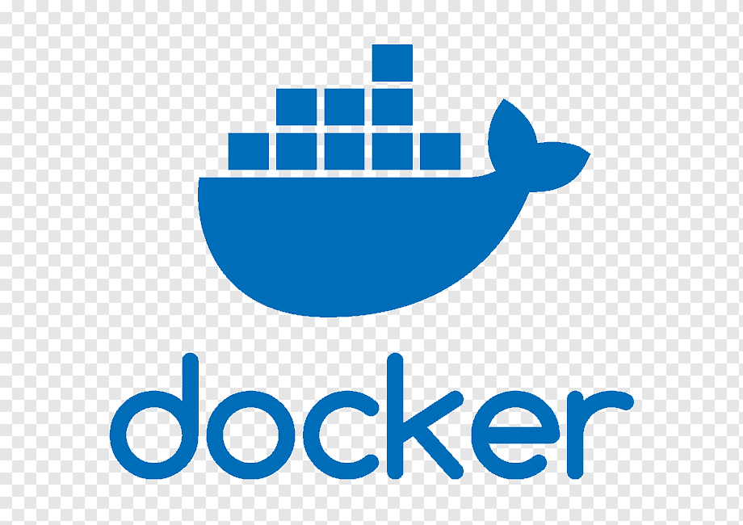
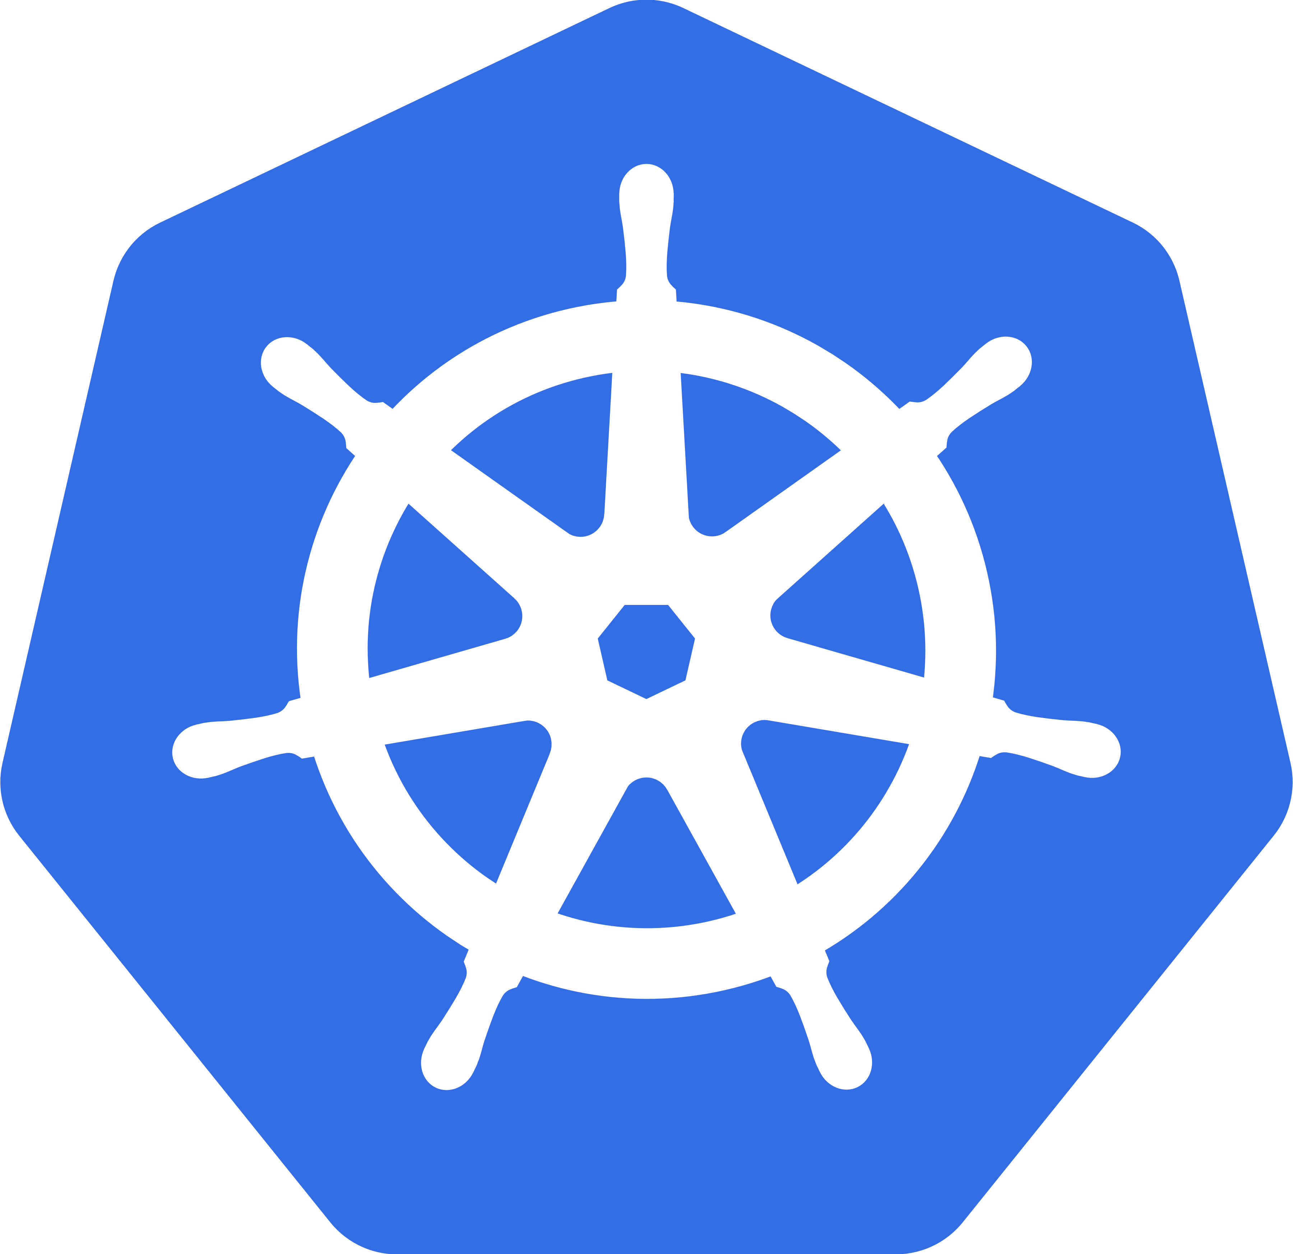




Scheme of environment
Master
Kuber
dev

Slide 5

Terraform’s objectives
Generate a key’s pair
Expand three servers
Put public and private key in certain proper place
Install ansible
Configure ansible
Clone repo from git with playbook
Run playbook
https://github.com/ansokoloff/infrastructure/blob/main/main.tf

Slide 6
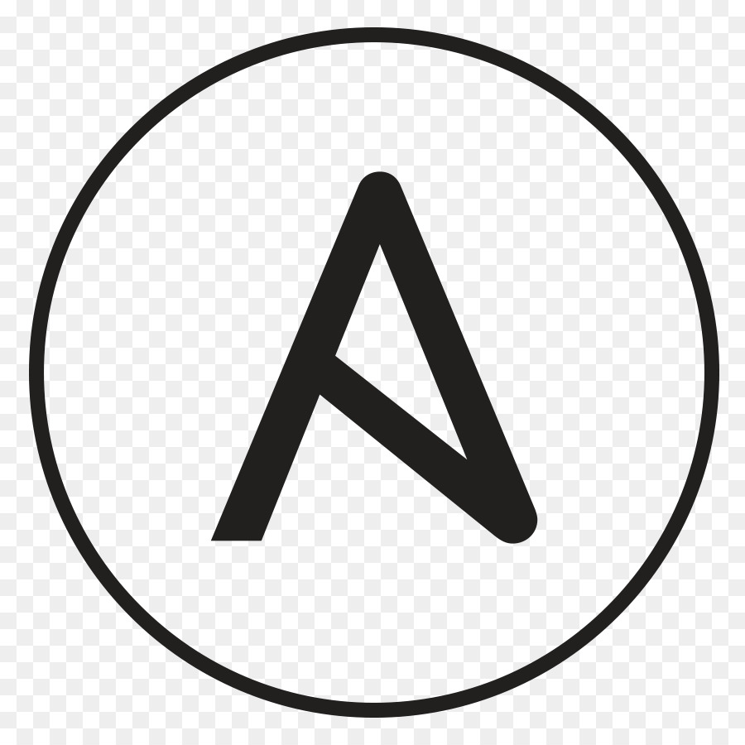
Ansible objectives
Install docker
Install common software
Create users for Jenkins nodes
Put public key for Jenkins users
Install k8s
Install kubectl
Install helm
https://github.com/ansokoloff/infrastructure/blob/main/global.yaml

Slide 7

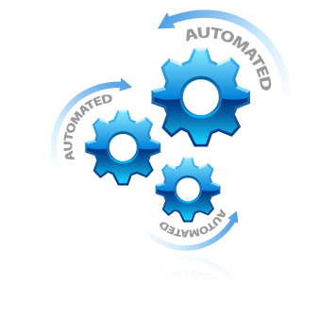
Conclusion

Slide 8
APPLICATION

Slide 9
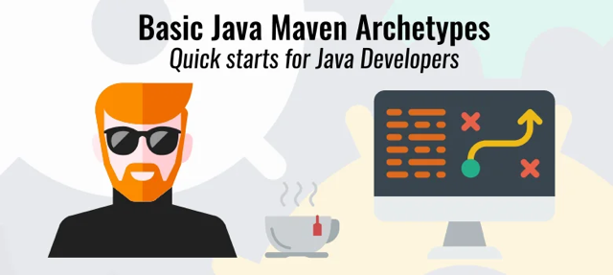
Maven-based web-application

Slide 10
PIPELINE

Slide 11
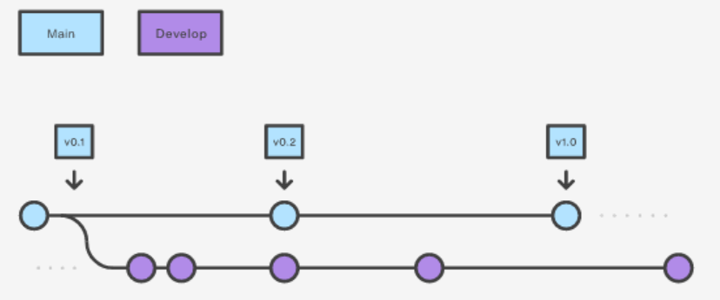
Git branches

Slide 12
Pipeline
STAGE | TOOL | Branch
Clone repo from Github | Git | Develop
Build app | Docker | Develop
Create artifact | Docker | Develop
Test artifact | Docker, bash | Develop
Publish artifact | Docker, docker hub | Develop
Create new revision | Bash, git | Main
Deploy to prod | Helm, K8s | Main

Slide 13
Q & A

Slide 14

Thank you!

