Slide 1
Hadoop Cluster Implementation with High Availability in Local and Cloud
Authors: Tsz-Yeung Lau
Student ID: 11327605
Email: tylau70242@gmail.com
Affiliation: Dept. of Computer Science & Information Engineering, Chaoyang University of Technology
Date: 07 January 2025

Slide 2
Outline
Overview
Installation (Hadoop, Zookeeper, Hbase)
Configuration (Hadoop, Zookeeper, Hbase)
Testing (Hadoop, Zookeeper, Hbase)
Map-Reduce
Extension
Conclusion

Slide 3
Overview
To set up Hadoop with High Availability (HA), it is essential to use both Hadoop and Zookeeper. Zookeeper plays a crucial role in ensuring seamless failover by automatically switching to the secondary NameNode if the primary NameNode becomes unavailable.
We will deploy the Hadoop cluster across both local infrastructure and the cloud, utilizing Google Cloud Platform (GCP) as the cloud environment. The initial cluster setup will consist of 2 NameNodes and 3 DataNodes. Upon completing the initial configuration, we will expand the cluster by adding an additional DataNode and explore integrating GPU capabilities to enable AI computing within the cluster.

Slide 4
Installation
To set up a cluster with 3 NameNodes and 2 DataNodes, a total of 5 Virtual Machines (VMs) will be required. For local deployment, virtualization tools like VirtualBox or VMware can be used to create the necessary VMs. On Google Cloud Platform (GCP), the Compute Engine service will be utilized to provision 5 virtual machines for the cluster.
Additionally, we need to configure the network mode to bridge. This ensures that each VM is assigned its own internal IP address, enabling seamless communication between the nodes in the cluster.
Hardware resources:
1 vCore/pCore
2GB vMemory
20GB vStorage
vNetwork Interface Cards (vNICs)
OS: Ubuntu 22.04 LTS Server

Slide 5
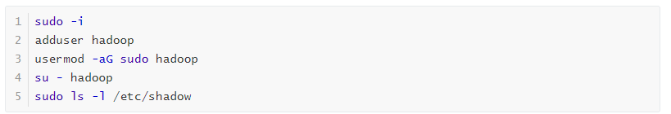
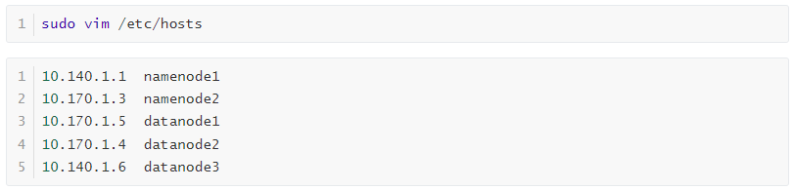
Installation
Create Hadoop User (All node (Optional)):
Edit /etc/hosts (All node):

Slide 6
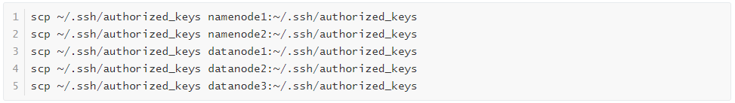
Installation
Generate ssh-key (All Namenode, Datanode1):
Copy the key to all other nodes including Namenode and Datanode:

Slide 7

Installation
If you encounter the error "Permission denied (publickey)" on GCP, you can resolve it by appending your public key to the ~/.ssh/authorized_keys file on the VM. This can be done using the following command:
Install JDK1.8 on all nodes:

Slide 8

Installation
Download and unzip Hadoop on Primary Namenode:

Slide 9
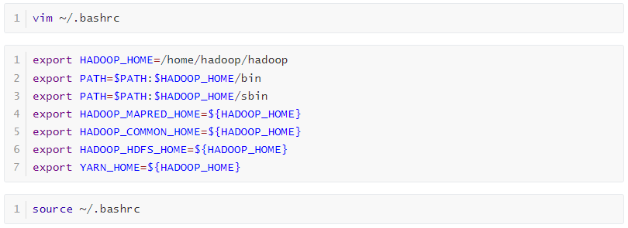
Configuration
Set the environment variables(All Namenode):

Slide 10
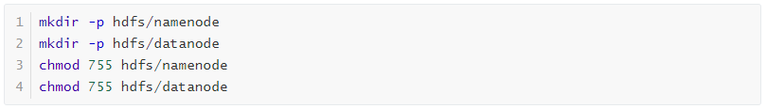
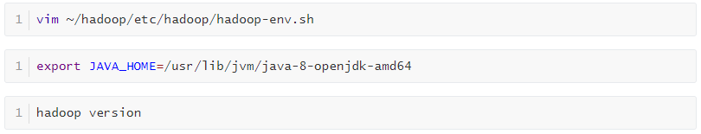
Configuration
Create Hadoop Folder (All Node):
Set Java Home(Primary Namenode)

Slide 11
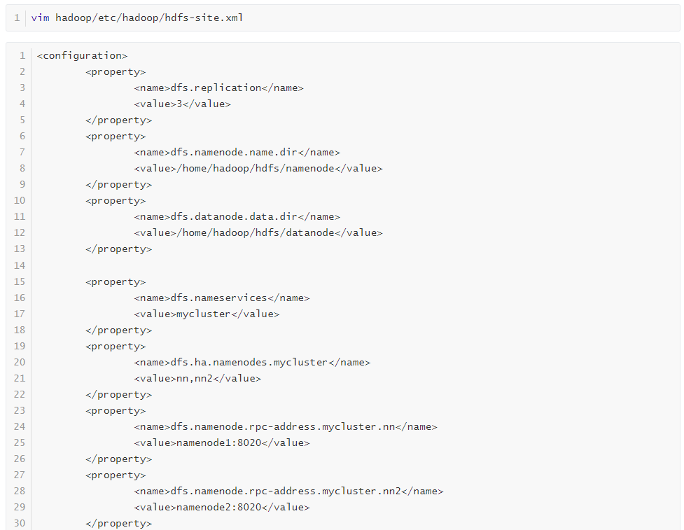
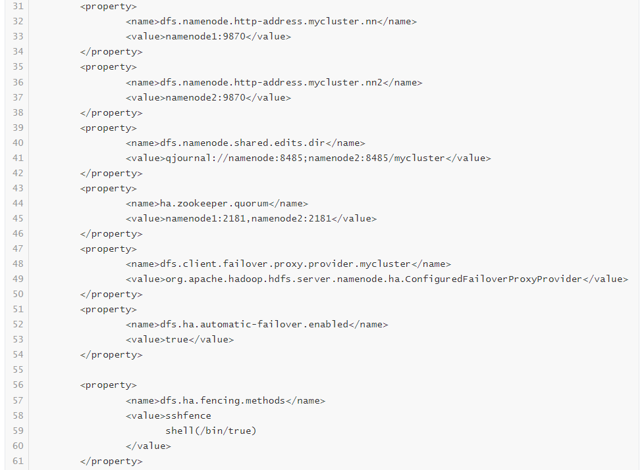
Configuration
Configure hdfs-site.xml(Primary Namenode):

Slide 12
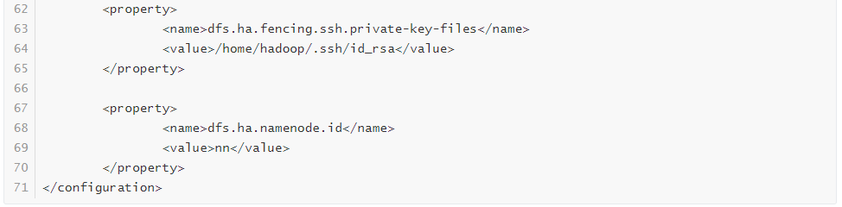
Configuration
Configure hdfs-site.xml (Primary Namenode):

Slide 13
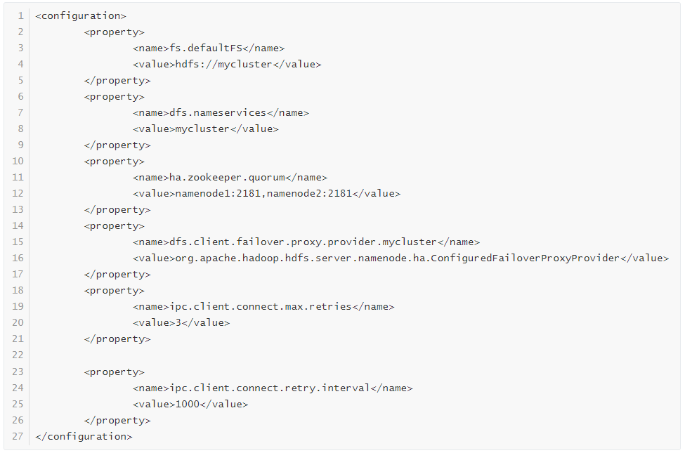
Configuration
Configure core-site.xml (Primary Namenode):

Slide 14
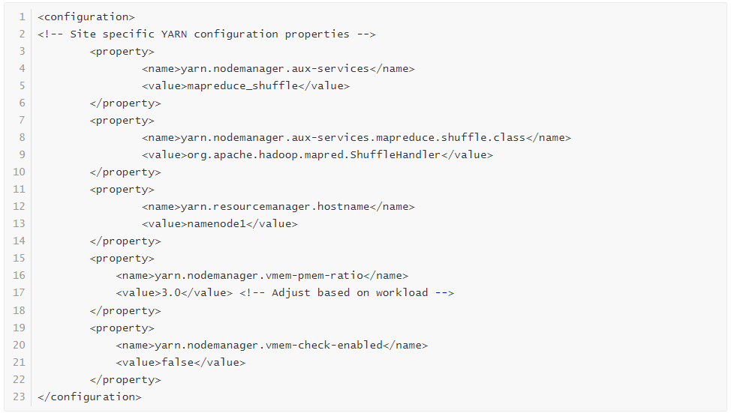
Configuration
Configure yarn-site.xml (Primary Namenode):

Slide 15
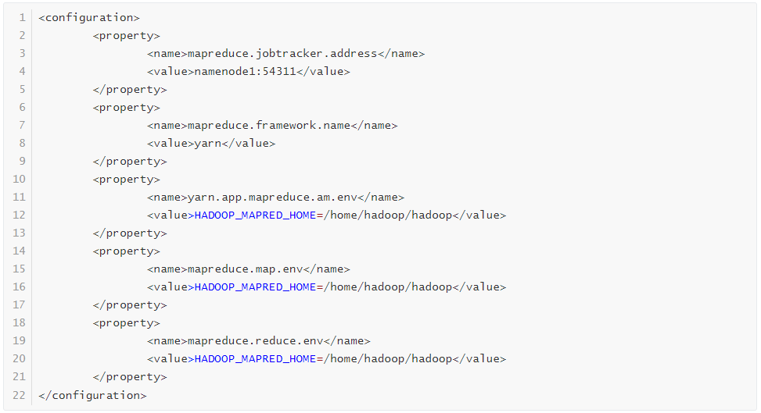
Configuration
Configure mapred-site.xml (Primary Namenode):

Slide 16
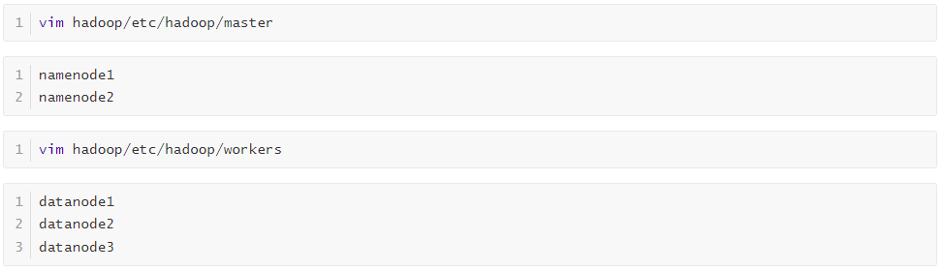
Configuration
Configure Master and workers (Primary Namenode):

Slide 17
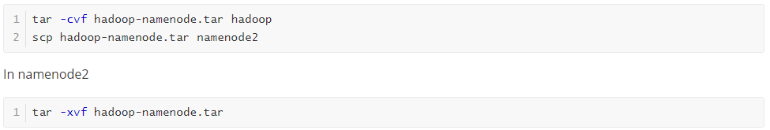
Configuration
Copy Hadoop to Namenode2:

Slide 18
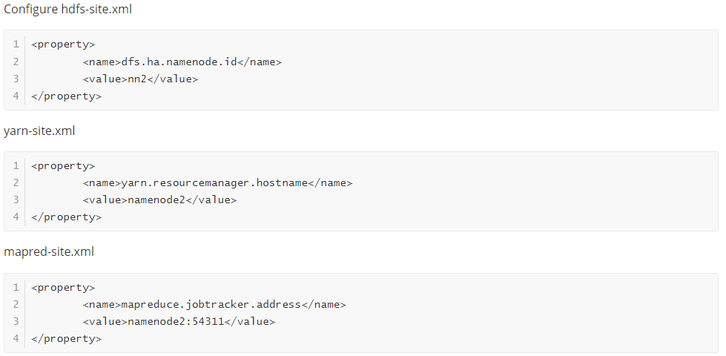
Configuration
Edit the following xml value in Namenode2:

Slide 19
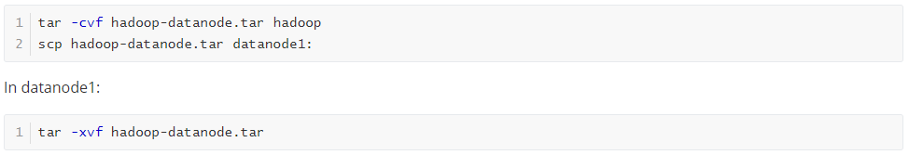
Configuration
Copy Hadoop to Datanode1:

Slide 20
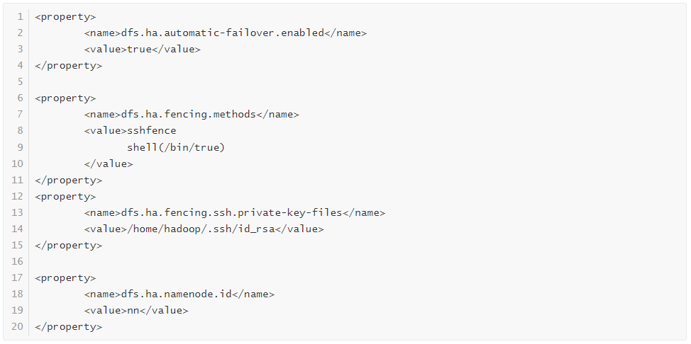
Configuration
Remove the following in Datanode1-hdfs-site.xml:

Slide 21
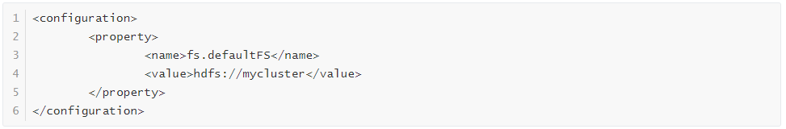
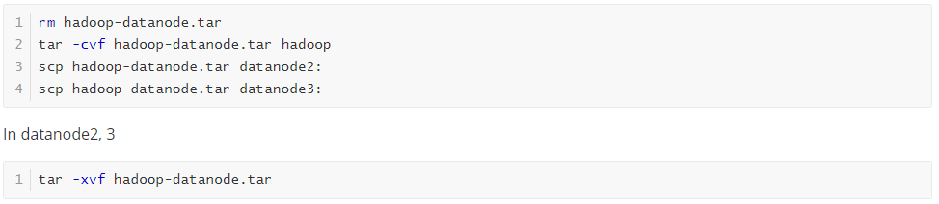
Configuration
Keep only the following in Datanode1-core-site.xml:
Copy Hadoop to all Datanode(generate a ssh-key pair like step 1 if can't connect):

Slide 22
Zookeeper for High Availability
n a Hadoop cluster with High Availability (HA) enabled, ZooKeeper facilitates the active-standby coordination of NameNodes. Each NameNode sends periodic heartbeats to ZooKeeper, and the ActiveStandbyElector mechanism ensures that only one NameNode is active.
The active NameNode holds a znode in ZooKeeper, while the standby monitors ZooKeeper for state changes. If the active NameNode fails, ZooKeeper, together with the Failover Controller, triggers a failover, promoting the standby to active.
Heartbeats file:
Image: fsimage_000000000000000XXXX
Logs: edits_000000000000000XXXX-000000000000000XXXX
Path: In hdfs-site.xml: {dfs.namenode.name.dir}/current/

Slide 23
Zookeeper Installation
Download Zookeeper for HA (Primary Namenode):

Slide 24
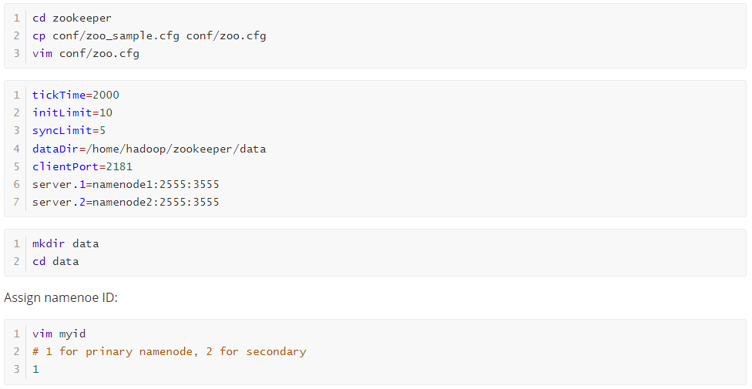
Zookeeper Configuration
Configure Zookeeper for HA (Primary Namenode):

Slide 25
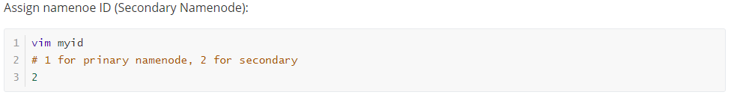
Zookeeper Configuration
Copy Zookeeper to Secondary Namenode:

Slide 26
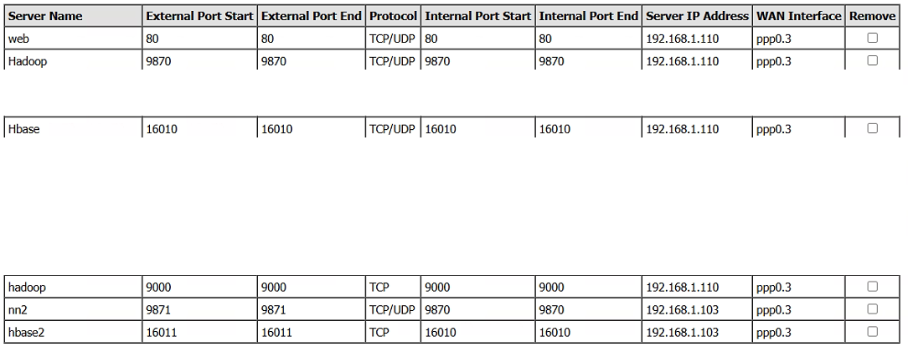
Port forwarding in your Local Router

Slide 27
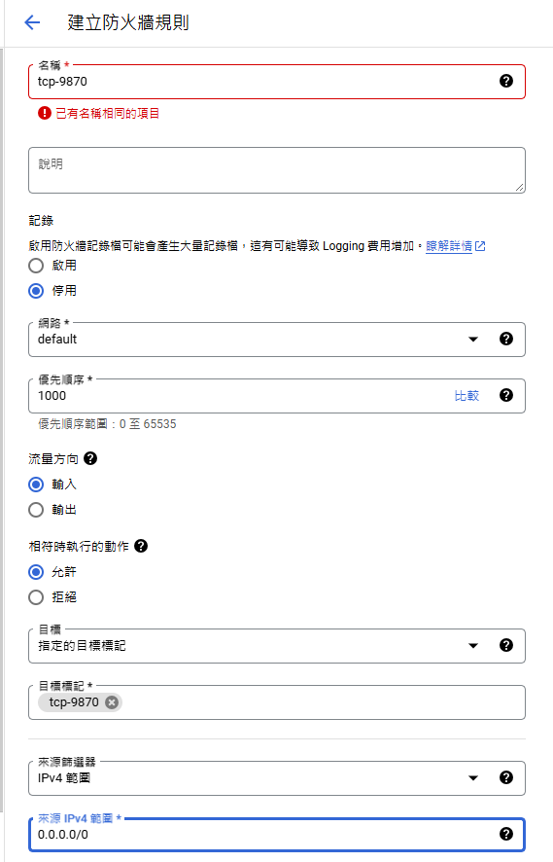
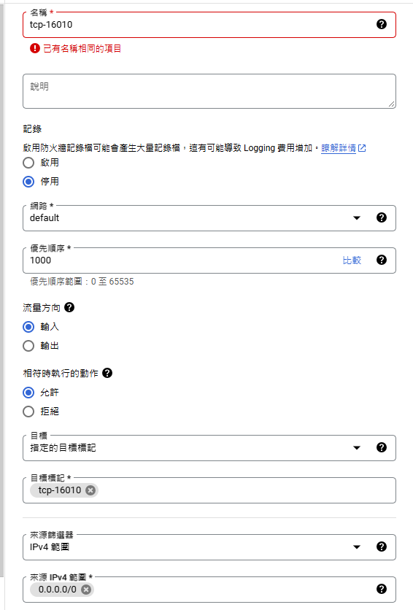
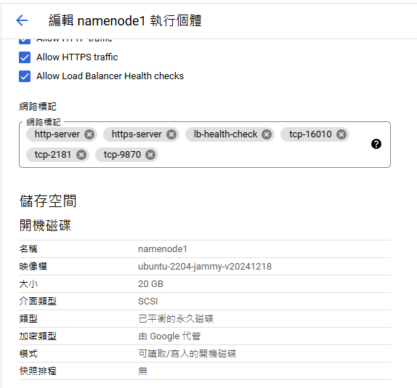
Open port in GCP (Create and Assign tag)

Slide 28
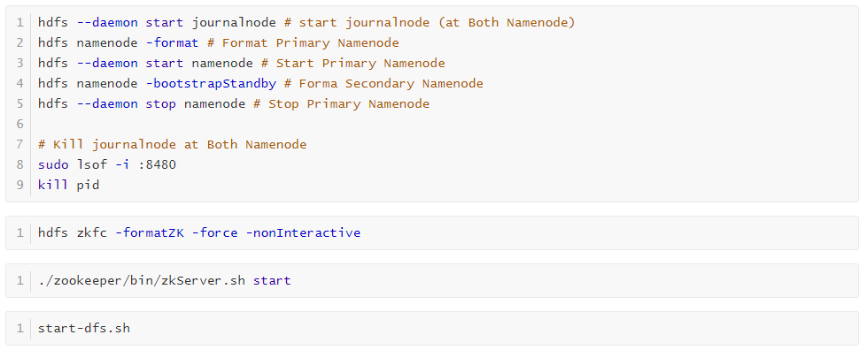
Format and Start HDFS

Slide 29
Hbase Installation
Download and Unzip Hbase:

Slide 30
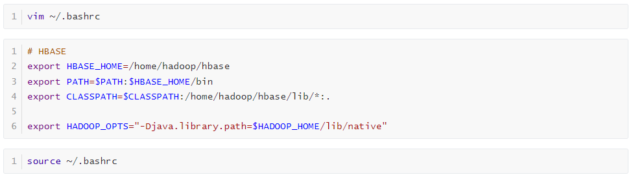
Hbase Configuration
Set the environment variables(All Node):

Slide 31
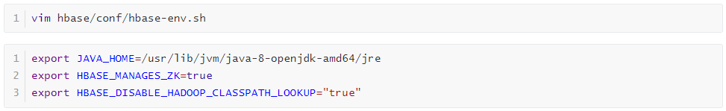
Hbase Configuration
Configure hbase-env.sh, add Java Home (Primary Namenode):

Slide 32
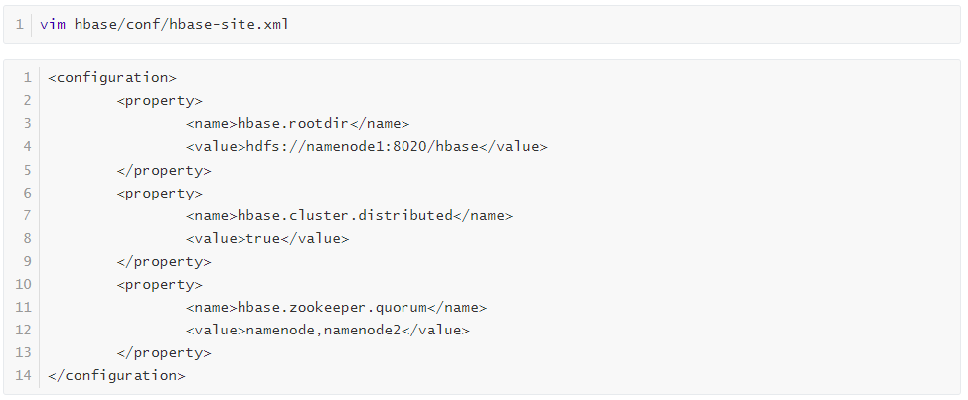
Hbase Configuration
Configure hbase-site.xml (Primary Namenode):

Slide 33
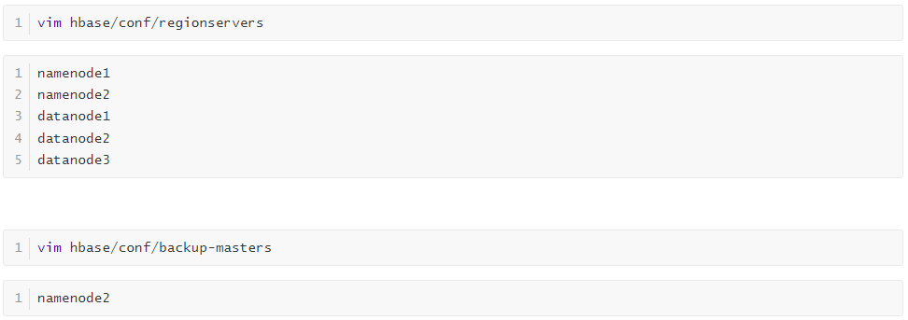
Hbase Configuration
Set regionservers and backup-masters (Primary Namenode):

Slide 34
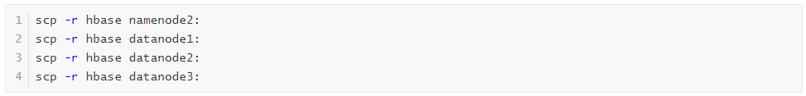
Hbase Configuration
Copy Hbase to All node:
Start Hbase:

Slide 35
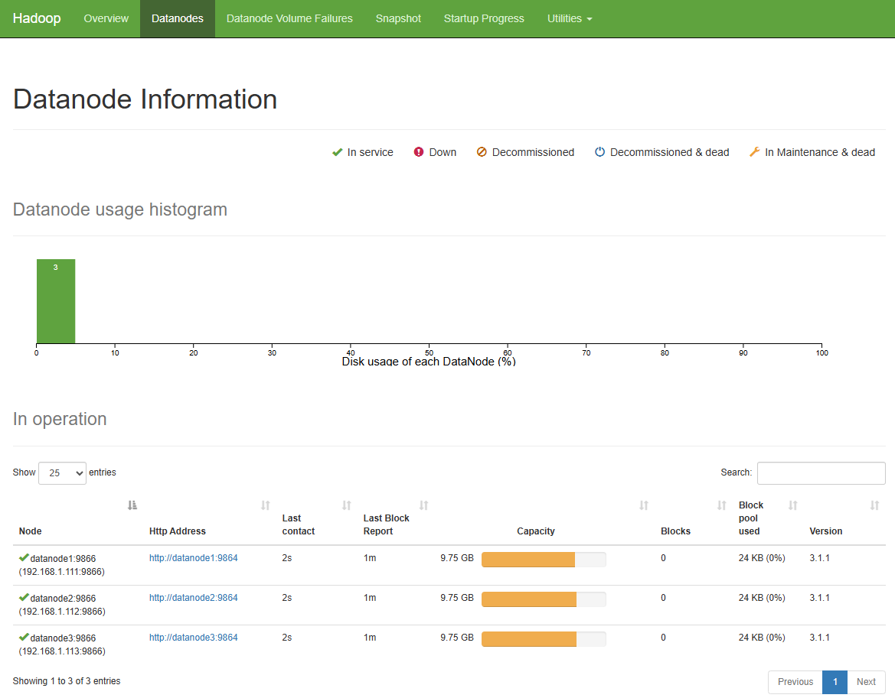
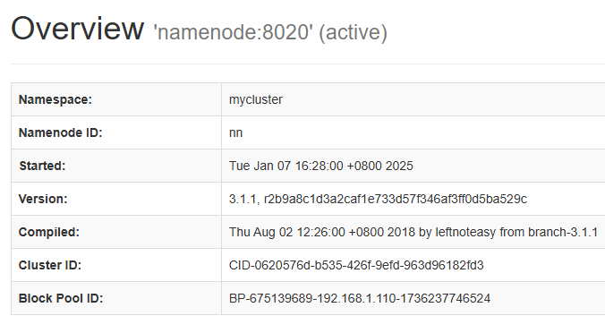
Testing Hadoop
Access http://namenode1:9870/ in browser

Slide 36

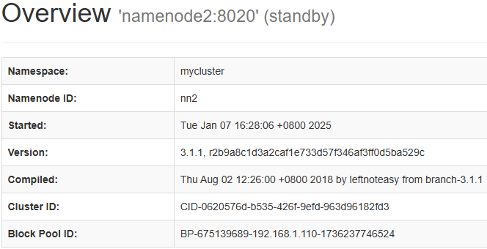
Testing Hadoop
Access http://namenode2:16010/ in browser

Slide 37
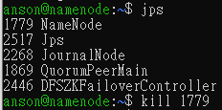
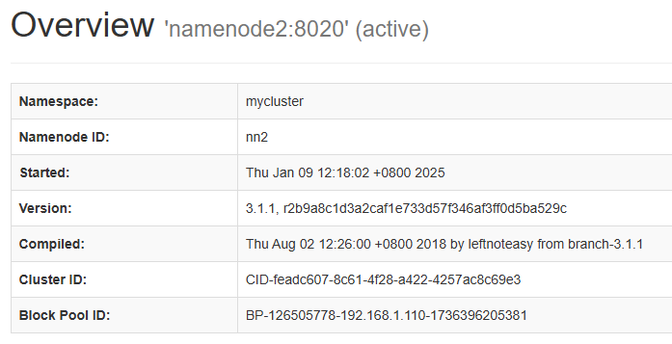

Testing Hadoop (Kill Primary)
When the Primary NameNode is terminated, the Secondary NameNode will automatically become active.

Slide 38
Testing Hadoop (Kill Primary)
Zookeeper log:

Slide 39
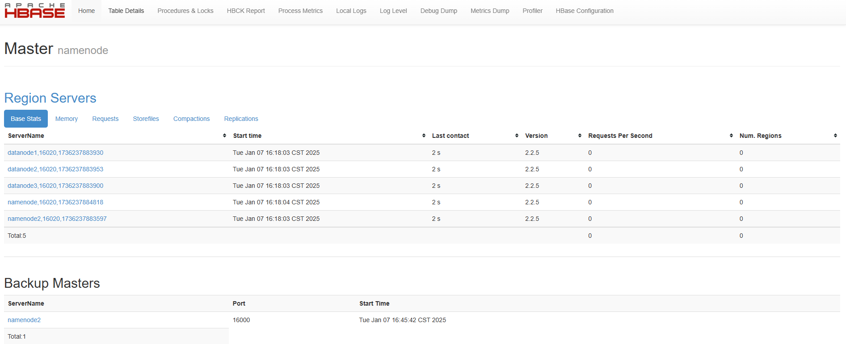
Testing Hbase
Access http://namenode1:16010/ in browser

Slide 40
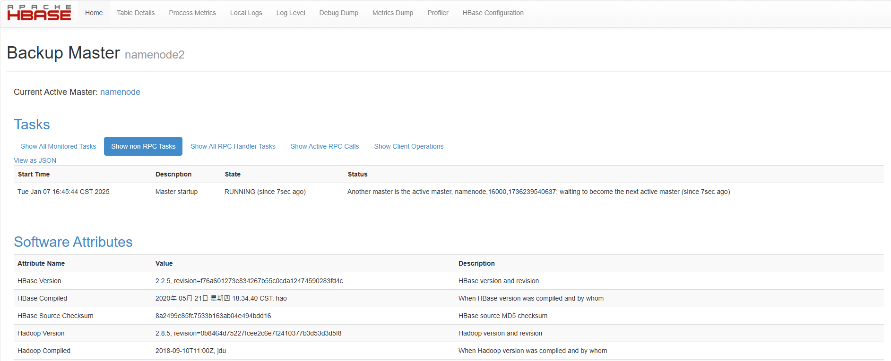
Testing Hbase
Access http://namenode2:16010/ in browser

Slide 41
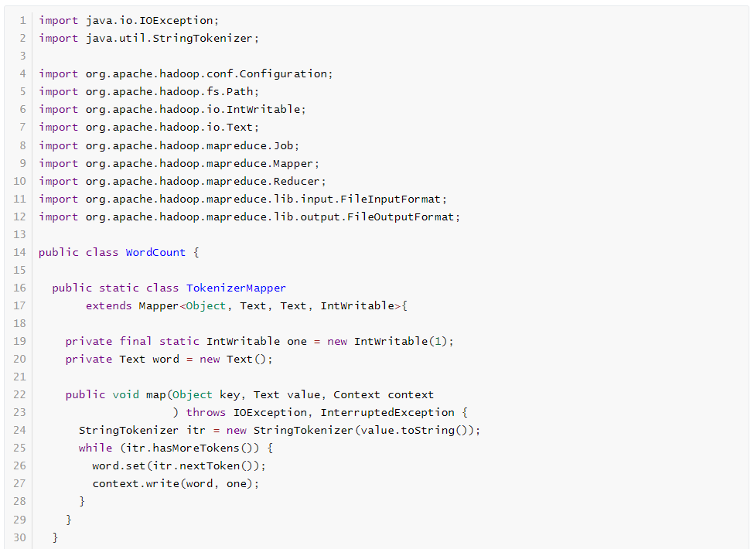
Map-Reduce
Mapper Code:

Slide 42
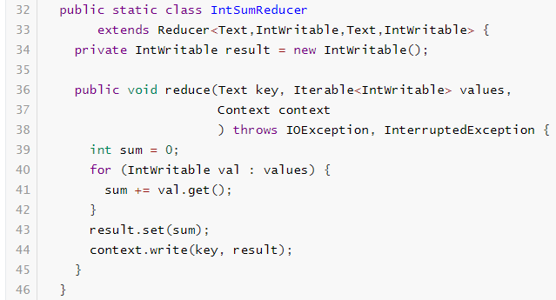
Map-Reduce
Reducer Code:

Slide 43
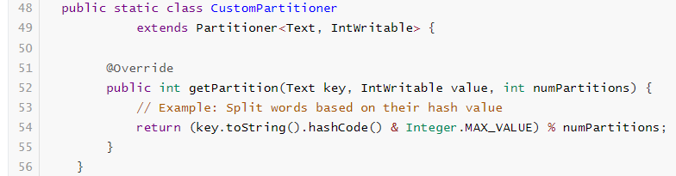
Map-Reduce
Partitioner Code:

Slide 44
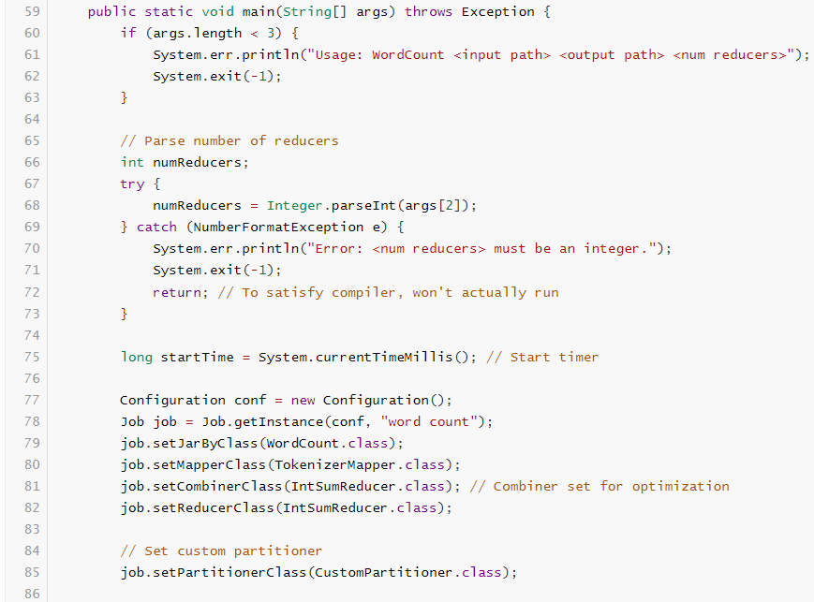
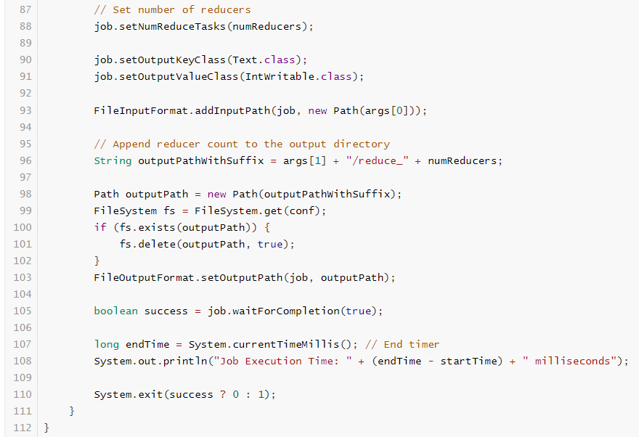
Map-Reduce
Main Function:

Slide 45
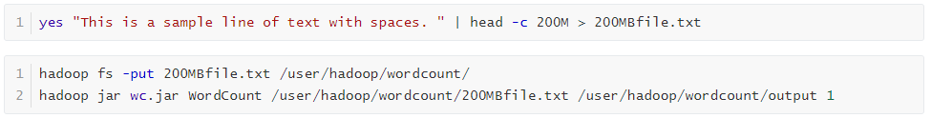
Map-Reduce
Create JAR:
Create a 200MB txt file and execute the jar:

Slide 46
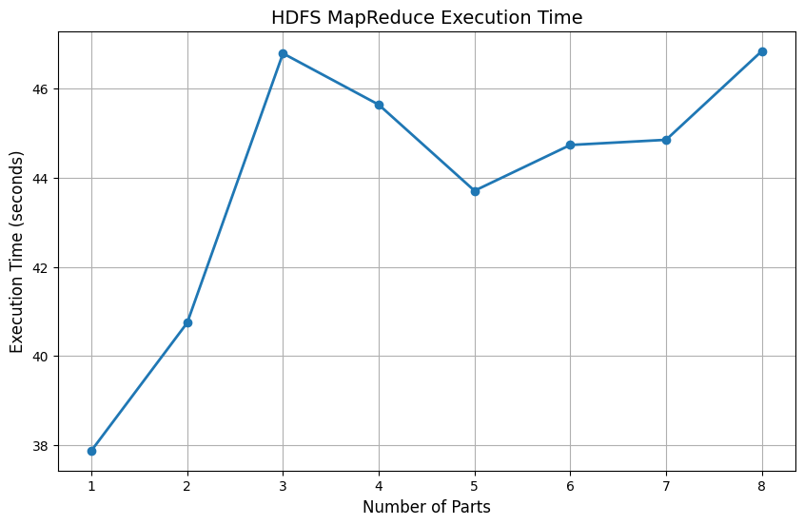
Map-Reduce Partition Result
I consulted ChatGPT to recommend the appropriate number of reducers for processing a 200 MB repetitive file. It suggested using 4–8 reducers. To test this, I conducted an experiment. The results indicate that 5 reducers performed the best. Below is the plot of the results:

Slide 47
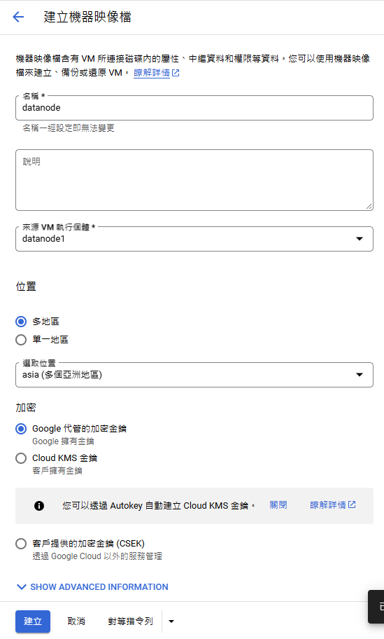
Adding Datanode
Create a Datanode :
Create an image of datanode1
Add ssh public key to DataNodes
Copy Hadoop and hbase to datanode(from DN1)
Install JDK1.8
Edit Namenodes /etc/hosts (add new DN IP)
Restart HDFS

Slide 48
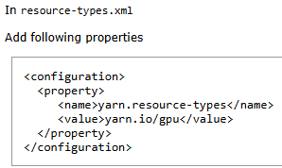
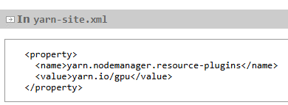
Use GPU with Map-Reduce
https://hadoop.apache.org/docs/r3.1.1/hadoop-yarn/hadoop-yarn-site/UsingGpus.html

Slide 49
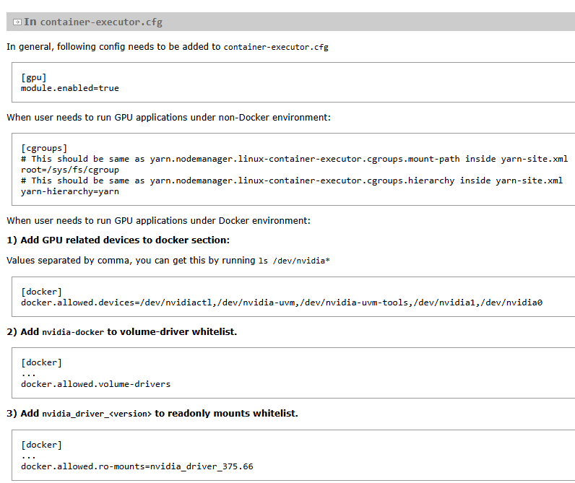
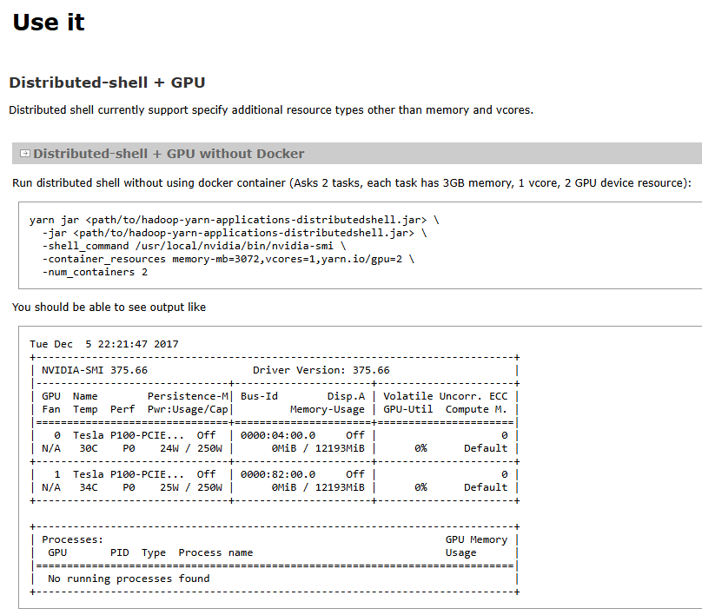
Use GPU with Map-Reduce
https://hadoop.apache.org/docs/r3.1.1/hadoop-yarn/hadoop-yarn-site/UsingGpus.html

Slide 50
Use GPU with Map-Reduce
Here are some open-based Machine Learning Model code with Python and Map-Reduce:
mapreduce-based-machine-learning/LogisticRegMapReduce.py at main · prithviraj-maurya/mapreduce-based-machine-learning

Slide 51
References
Apache Hadoop 3.4.1 – Hadoop Cluster Setup. (2024). Apache.org. https://hadoop.apache.org/docs/r3.4.1/hadoop-project-dist/hadoop-common/ClusterSetup.html
Apache ZooKeeper. (2010). Apache.org. https://zookeeper.apache.org/
‌Apache Hadoop 3.1.1 – Using GPU On YARN. (2018). Apache.org. https://hadoop.apache.org/docs/r3.1.1/hadoop-yarn/hadoop-yarn-site/UsingGpus.html
‌Prabha. (2018, December 8). Apache Hadoop Installation on Ubuntu (multi-node cluster). Spark by {Examples}. https://sparkbyexamples.com/hadoop/apache-hadoop-installation/
‌[GCP教學-Python] #4 建立防火牆規則. (2020, March 31). 1010Code. https://andy6804tw.github.io/2020/03/31/gcp-python-ep4/

