Slide 1
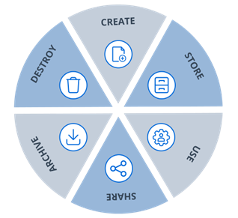
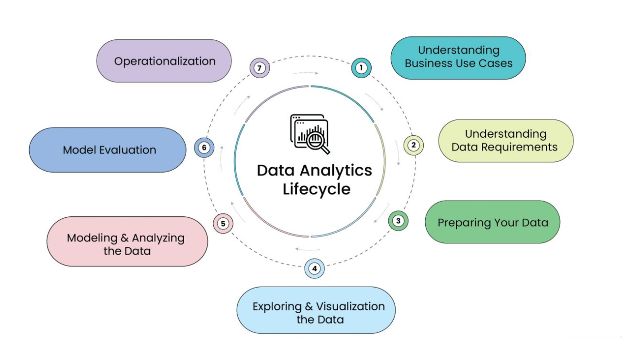

Data Analysis Lifecycle

Slide 2
Requirements
Requirements were not 100% clear
Specific questions Oliver had about user activity
Structure and relationships among the CSV files (posts, comments, users)
Data sanitization or masking procedures
Questions for Oliver
What specific insights or patterns are you looking to glean from the user activity data?
Are there particular timeframes or periods of interest for this analysis?
Do you have preferences regarding how the data should be presented (E.g., Graphs, tables)?
Analyse the requirements
Understand the context and objective of the task
Identified the primary components of the task (ERD, SQLite database, Load Data, Queries, Record)
Create an ERD, set up the SQLite database, and load data
Craft SQL queries base on the ‘Requirements spreadsheet’ document
Ensure all queries are recorded in the queries table
Create a presentation to cover relevant topics and questions

Slide 3
Tools
Tools used that are appropriate for the job
SQLite is recommended by ChatData for ad-hoc data analytics tasks
SQLite bundled with Python offers a lightweight and efficient solution
Jupyter Notebook allows for an interactive and documented approach to data analysis
Reasons to use SQLite instead of PostgreSQL for this project
Avoid direct access to the production PostgreSQL database due to security and privacy concerns
SQLite allows analysts to work on local copies of the data
SQLite is lightweight and is suitable for ad-hoc analytics tasks
Benefits of adopting relational database technologies
Structured Data Storage
Data Integrity
Flexibility in Querying
Scalability
Security
Data Consistency- ACID
Normalization
Concurrent Access

Slide 4
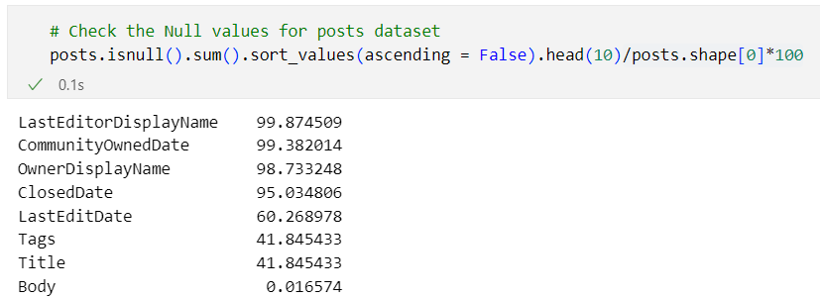
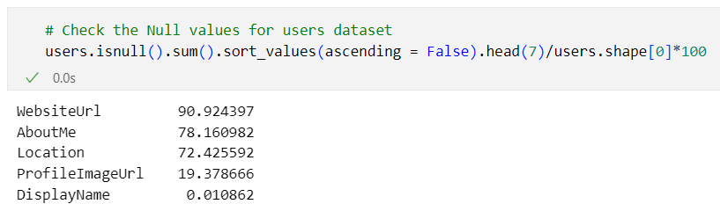
Quality
Source data and natural mapping to the database
Data CSV file appeared to be well-organized with clear column headers representing attributes
Natural mapping from the CSV columns to SQLite table columns
Data consistency? Data issues?
Data types for each column
X Missing values for some column

Slide 5
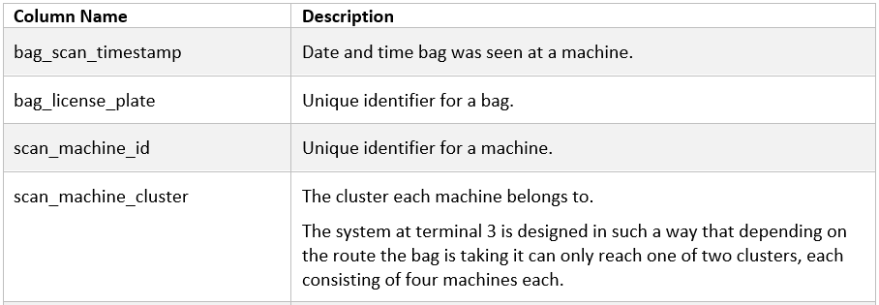
Quality
Definitions of the data
Data dictionary or more detailed descriptions would be beneficial
Actions taken to ensure the data quality
Data Profiling
Data Validation
Data Cleansing
Feedback & Collaboration
Documentation
Seek Clarifications

Slide 6
Security, Ethics and Legislation
Was the personal data sufficiently masked?
Columns in the user dataset like DisplayName, WebsiteUrl, Location, AboutMe, and ProfileImageUrl may hold personal details or identifiers
Possible techniques to unmask the participants in the data
Data Linking (DisplayName and Location)
Text, Image, and Location Analysis (DisplayName, AboutMe, ProfileImageUrl, and Location)
Ethical considerations
Privacy Concerns
Informed Consent
Transparency
Data Legislation
GDPR (General Data Protection Regulation)

