Slide 1
Wildlife Conservation Society Data Visualization Platform
By Table 37

Slide 2
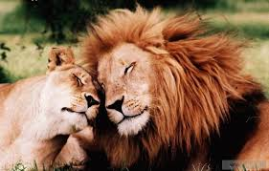

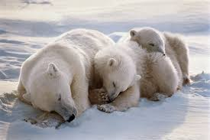
Our Story
We love animals
People are killing animals
We need to stop the people from killing animals
We need to get people to stop the people from killing animals

Slide 3
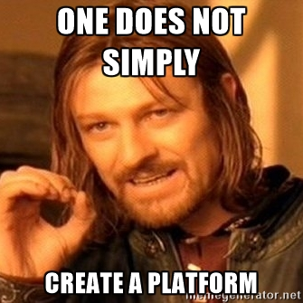
A Platform… Really?
Should we build a platform for a non-profit?
Ability to support is a major concern
Keep it very dry and simple -
Lambda
S3
AWS Elasticsearch Service + Kibana
OpenVPN for security
Keep it cheap!

Slide 4
Data Import
The SMART API needs to be protected so we wrote an ingestion module
CloudWatch Timed Event triggers a Lambda function
Lambda Function queries the SMART API for new data
Data gets written to an Intake S3 Bucket

Slide 5
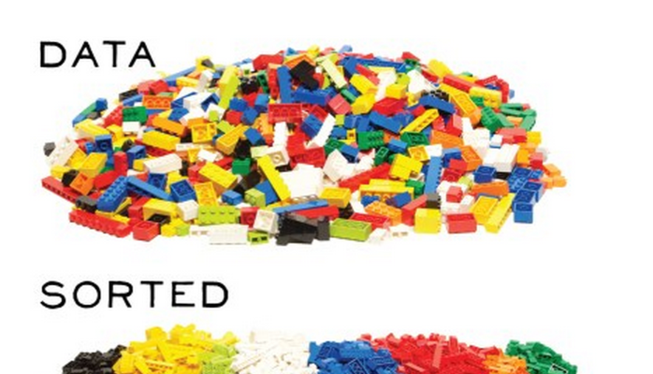
Data Normalization
Data from humans is ugly☹
Simple Lambda Function to Normalize
S3 Trigger on Bucket calls Lambda
Lambda tranforms CSV data to JSON

Slide 6
Data Distribution
Phase 1
Visualize the Data
Identify Data Model Gaps
Phase 2
Take Advantage of Predictive Analytics
Work with our trusted 3rd Parties to gain further insights into the data
Injection of Machine Learning insights and 3rd Party insights into existing pipeline

Slide 7
Phase 1 - Data Usage
More Effective Ranger Manager
Data is secured via a VPN
Ranger uses Dashboards to gain insights
Ranger Manager informs Ranger to keep him safe and increase effectiveness

Slide 8
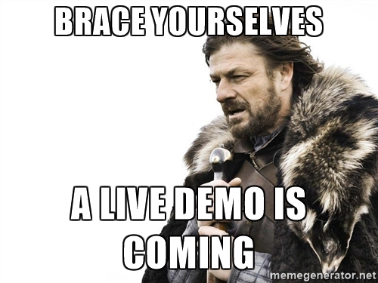
Demo

Slide 9
Deployment View
Environment per Data Silo
Protect the data
Buckets are unique to tenant
Kibana instance per tenant

