Slide 1

Project Stand Up 1
Group 6
Interactive Visual Analytics for
Australian Hospitalised Road Traffic Injury Trends
2026
Tan Jean Shern
Darren Ling Jun Hang
Foo Jin Xuan

Slide 2
Background & Dataset Overview
Data Source
Target Audience
BITRE Hospitalized Injury Data (2011 – 2021).
Road safety policy researchers, transport authorities,
general public.
Governance/Privacy
Open-access aggregated public health data ( no personal Identifiable info)

Slide 3

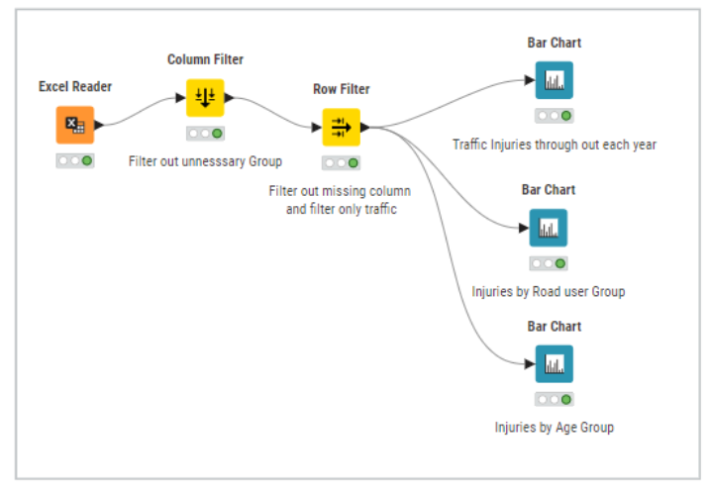
Work Completed

Slide 4
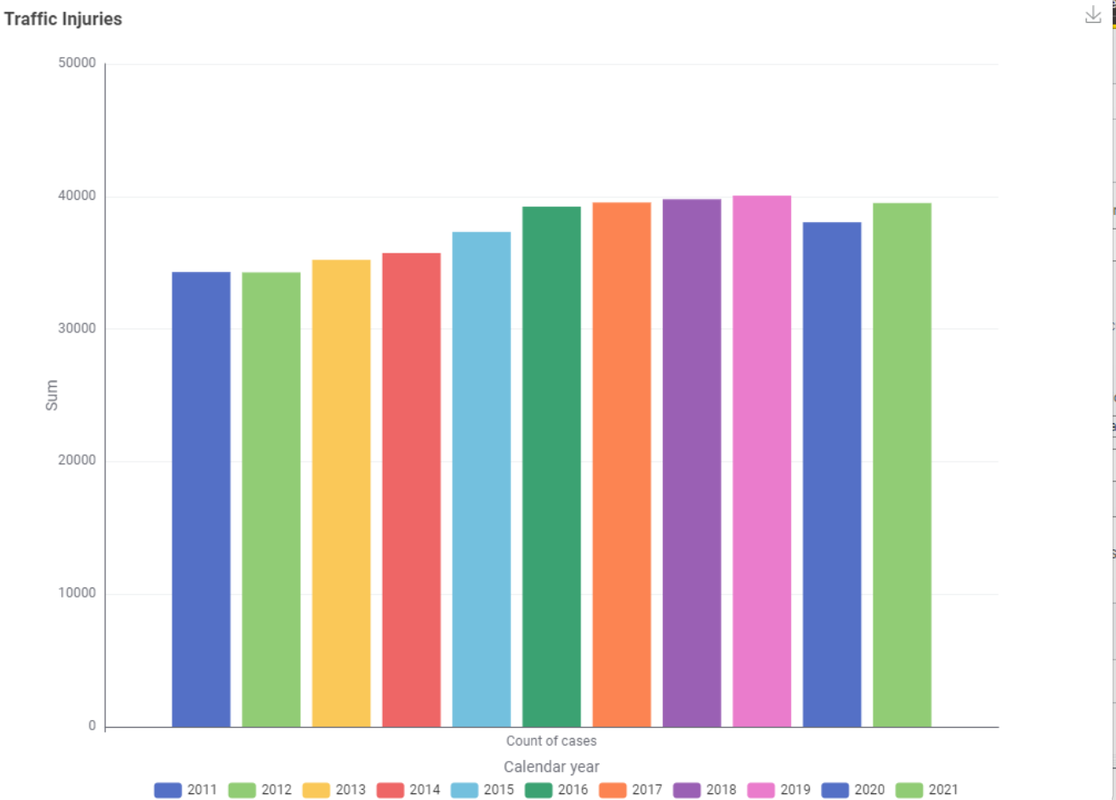
Total Injuires (Years)
Count of cases
2011 – 34294
2012 – 34270
2013 – 35217
2014 – 35729
2015 – 37325
2016 – 39231
2017 – 39541
2018 – 39787
2019 – 40060
2020 – 38054
2021 – 39505

Slide 5
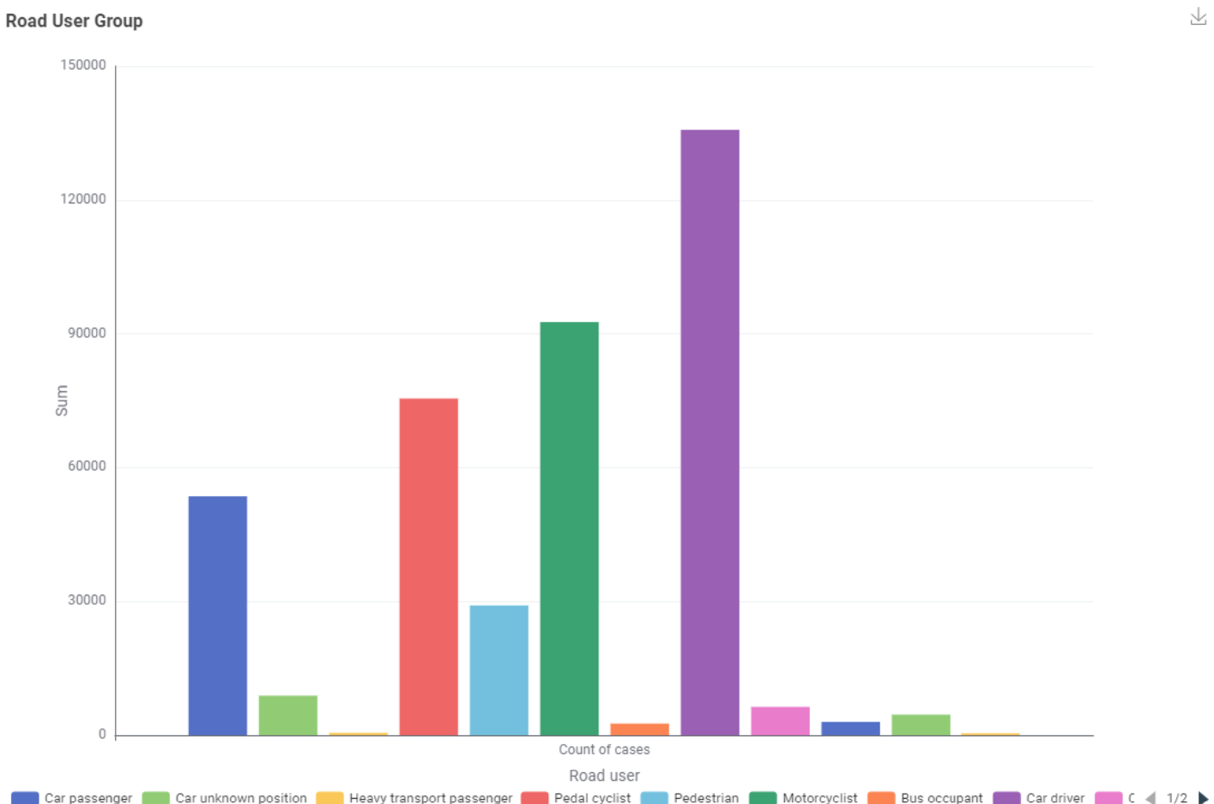
Total Injuires (By User group)
Road User Group
Car passenger – 53577
Car unknown position – 8880
Heavy transport Passenger – 554
Pedal Cyclist – 75486
Pedestrians – 29093
Motorcyclist – 92642
Bus occupant – 2602
Car Driver – 135733
Others – 6367
Pick-up truck – 3002
Heavy Transport Driver – 4630

Slide 6
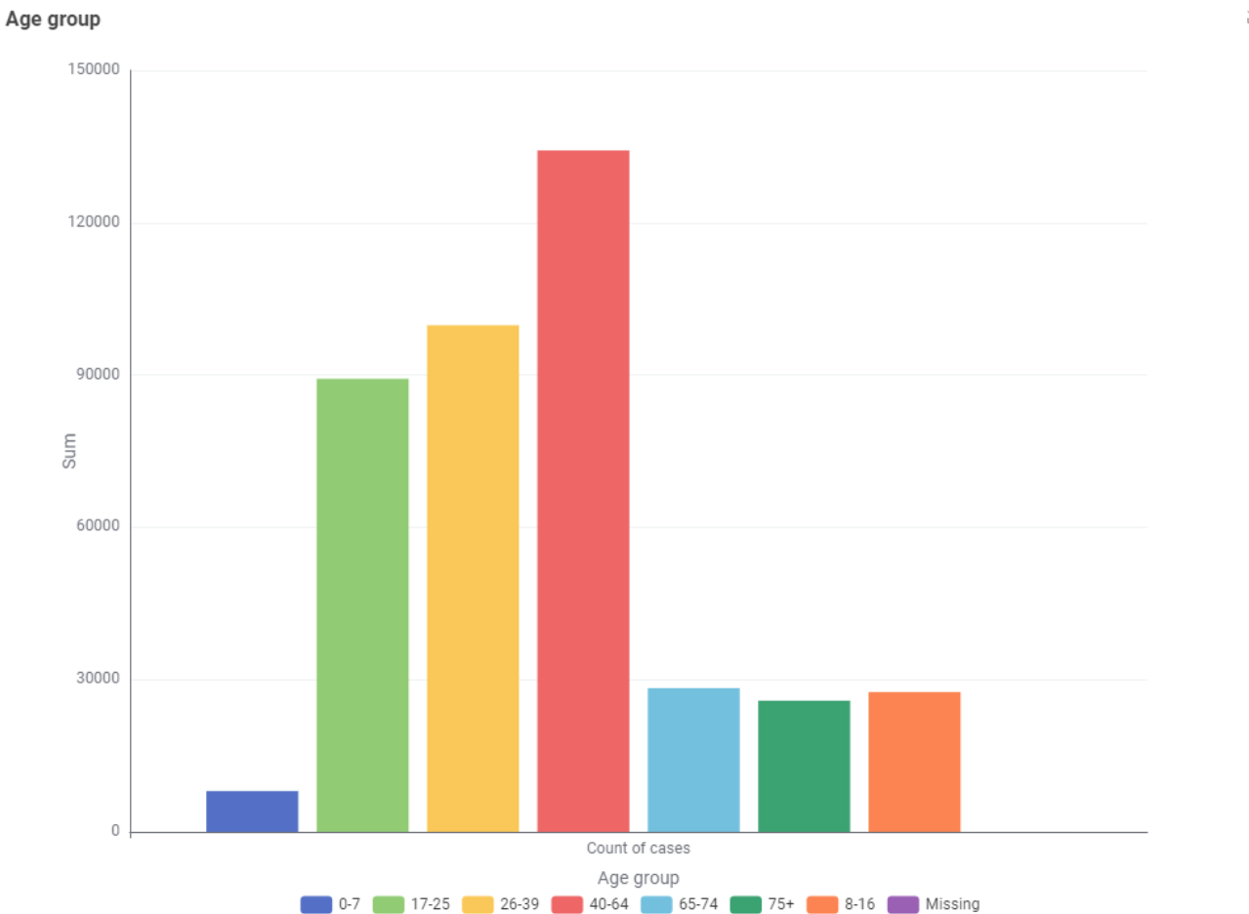
Total Injuires (By Age Group)
Road User Age Group
0-7 – 8051
8-16 - 27528
17-25 – 89259
26-39 – 99795
40-64 – 134246
65-74 - 28305
75+ - 25828

Slide 7
THANK YOU

