Slide 1
TRANSPLANT
EQUITY IN
THE U.S.
Disparities in access to heart, kidney, and lung transplants
Capstone presentation built from the waitlist, candidate waiting-time, CDC mortality, and Census datasets.
Heart • Kidney • Lung
RICHARD ANSON NASHVILLE SOFTWARE SCHOOL COHORT DA16

Slide 2
RESEARCH QUESTIONS AND SCOPE
Primary question
Are there measurable disparities in access to heart, kidney, and lung transplants in the United States based on demographic, socioeconomic, and geographic factors?
Do transplant access patterns differ by race, ethnicity, sex, or age?
Are long waits uneven across demographic or geographic groups?
How do insurance status or region relate to the likelihood of reaching transplant?
Are outcome-related measures distributed unevenly across groups?
Supporting question

Slide 3
KEY DEFINITION
Registration — A listing on a transplant waitlist; a single patient may hold multiple listings across centers or organs.
Candidate — A unique patient counted once, regardless of how many listings they have.
Waitlist burden — The intensity of the waitlist in a state or region relative to its population.
Waitlist per 100k — A population-normalized waitlist measure.
Long‑wait share (≥1 year) — The proportion of candidates or registrations waiting at least one year.
Wait‑time buckets — Grouped waiting‑time categories (e.g., <30 days, 1–<2 years, 2+ years) showing distribution across short vs. long waits.
Crude mortality rate = overall deaths per population (unadjusted); used here as regional context, not waitlist-specific mortality
UNOS – United Network for Organ Sharing

Slide 4
WHY I CHOSE THIS PROJECT
This subject is very personal to me. My son received a heart transplant, which provided me with direct experience of the urgency, complexity, and emotional challenges involved in obtaining life-saving transplant care. Throughout the process, it became evident that factors beyond medical necessity, such as geographic location, available resources, and systemic obstacles within healthcare, can greatly affect access and outcomes. This experience deepened my dedication to employing data analytics to explore disparities in heart transplant access and to provide evidence that promotes more equitable and inclusive healthcare decisions.

Slide 5
DATA INPUTS AND ANALYTIC WORKFLOW
1. Source files
2. Standardize
unos_waitlist.csv
Cand+reg_Organ_by_Waiting._Time.csv
uno_transplant.csv
CDC_MORTALITY_cleaned_joined_long.csv
census_cleaned.csv
Clean and standardize numeric fields (counts, rates, percents).
Align geography (state names/abbreviations + consistent region labels).
Forward-fill organ labels in grouped tables.
Reshape wait-time buckets (wide → long) and compute % waiting ≥ 1 year for apples-to-apples comparisons.
Main analysis units: states, regions, and candidate waiting-time subgroups.
The strongest disparity measure in these files is long-wait share rather than mean wait days, because several wait-time summary fields are constant within organ.
CDC mortality is used here only as a population context, not as waitlist mortality.

Slide 6
TOTAL TRANSPLANTS OVER TIME (US) — ALL RECIPIENT AGES
This line chart tracks the total number of U.S. transplants each year (all organs combined), using the “All Recipient Ages” total.
There’s a steady long-term increase from the late 1980s through the 2000s. There’s a flattening/slow growth period around the late 2000s to early 2010s. Growth accelerates strongly after 2015, reaching the highest levels around 2023–2025.
Why does the line drop sharply at the end? That big drop at the last point is almost always a data reporting issue, not a real collapse, most likely: the last year is incomplete/partial-year, the newest year hasn’t finished being updated in the dataset. One slide-ready takeaway: “Total transplants have increased substantially over time, with especially rapid growth in the last decade; the final-year drop likely reflects partial-year reporting rather than a true decline.”

Slide 7
ALL ORGAN TRANPLANT PER 100K (SEX)
The male bar is noticeably higher than the female bar. Interpreting the bar heights: males have a higher transplant rate per 100k than females in 2025 (roughly 30k vs 19k on this chart’s scale).
Males received transplants at a higher per-capita rate than females in 2025.
The gap is about 6.4 more transplants per 100k for males.
In relative terms, the male rate is roughly 1.6× (about 60%) higher than the female rate.

Slide 8
ALL ORGAN TRANPLANT (RACE/ETHNICITY)
This bar chart shows the share of all U.S. transplants in 2025 (all organs combined) by race/ethnicity. The y-axis is a proportion (0 to 1), so each bar represents what percent of total transplants went to that group.
This shows the distribution of transplants
Transplants in 2025 were concentrated among White recipients (49%), with Black (22%) and Hispanic/Latino (19%) recipients comprising substantial but smaller shares.

Slide 9
HEART: STATES WITH HIGHEST WAITLIST PER 100K
It ranks the top 12 states (and DC) with the highest heart waitlist burden, measured as Heart waitlist per 100,000 residents.
District of Columbia is a clear outlier with the highest waitlist per 100k by a wide margin. After DC, states like Ohio, Nebraska, Utah, Massachusetts, Minnesota, New York, Illinois, Tennessee, Georgia, South Carolina, and Virginia follow with smaller differences among them. This suggests geographic variation in heart transplant demand and/or access patterns (referrals, listing practices, center availability), even before patient-level data.

Slide 10
KIDNEY: STATES WITH HIGHEST WAITLIST PER 100K
It ranks the top 12 states (and DC) with the highest heart waitlist burden, measured as Heart waitlist per 100,000 residents.
A higher value means more pressure/need relative to the population. This can reflect a mix of higher kidney disease burden, more referrals/listings, transplant center concentration, cross-state listing patterns, and differences in access to evaluation/listing.

Slide 11
LUNG: STATES WITH HIGHEST WAITLIST PER 100K
Lung waitlist rates are much lower overall than kidney (the scale is under 1 per 100k in the chart). The top states include Pennsylvania (highest), Michigan, Washington, Ohio, Minnesota, New York, Missouri, Massachusetts, Oklahoma, Maryland, Illinois, and Wisconsin.
Because lung transplants are less common, small numeric differences can still be meaningful. Higher per-capita waitlist rates may reflect where specialized lung transplant centers are located, regional referral patterns, local prevalence of severe lung disease, and listing practices.

Slide 12
LONG WAITS ARE ALSO UNEVEN ACROSS REGIONS
Biggest pattern
Kidney has the highest share of candidates waiting at least one year in every region. Heart is intermediate. The lung is the lowest.
Northeast stands out for kidney with the highest long-wait share (around the high-60% range).
The Midwest has the highest lung long-wait share (around the high-teens), compared with other regions. Heart varies less by region (only a few percentage points difference), suggesting a more consistent long-wait burden across the country.

Slide 13
CANDIDATE WAIT-TIME BUCKETS SUGGEST DEMOGRAPHIC DISPARITIES
Kidney again tends to sit highest, but group ordering still shifts within each organ.
The bucket file mixes “All Races” with race-specific groups and sometimes appends “Non-Hispanic.” Labels were normalized for comparison.

Slide 14
REGIONAL ACCESS BURDEN
Heart
Kidney
Lung

Slide 15
REGIONAL CONTEXT POINTS TO STRUCTURAL DIFFERENCES AROUND ACCESS
Uninsured share
Median income
Population mortality crude rate

Slide 16
HOTSPOTS SHOW WHERE BURDEN CONCENTRATES
Rank
Heart
Kidney
Lung
1
District of Columbia (7.4)
District of Columbia (159.2)
Pennsylvania (0.9)
2
Ohio (2.5)
Massachusetts (49.1)
Michigan (0.7)
3
Nebraska (2.1)
California (45.3)
Washington (0.7)
4
Utah (2.1)
South Dakota (42.3)
Ohio (0.6)
5
Massachusetts (1.9)
Pennsylvania (38.2)
Minnesota (0.5)

Slide 17
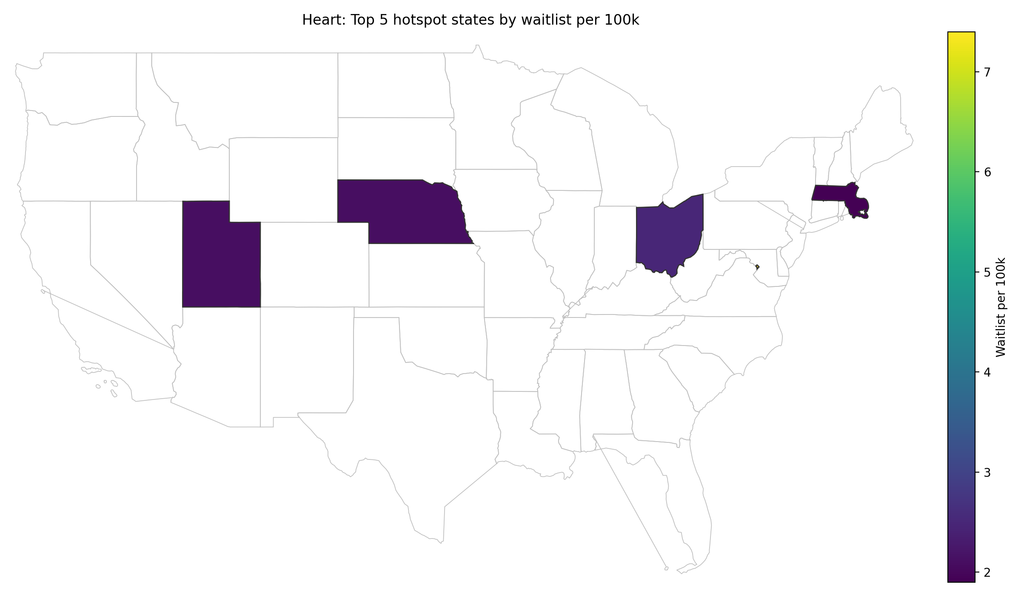
DEMOGRAPHIC HOTSPOTS SHOW WHERE BURDEN CONCENTRATES

Slide 18
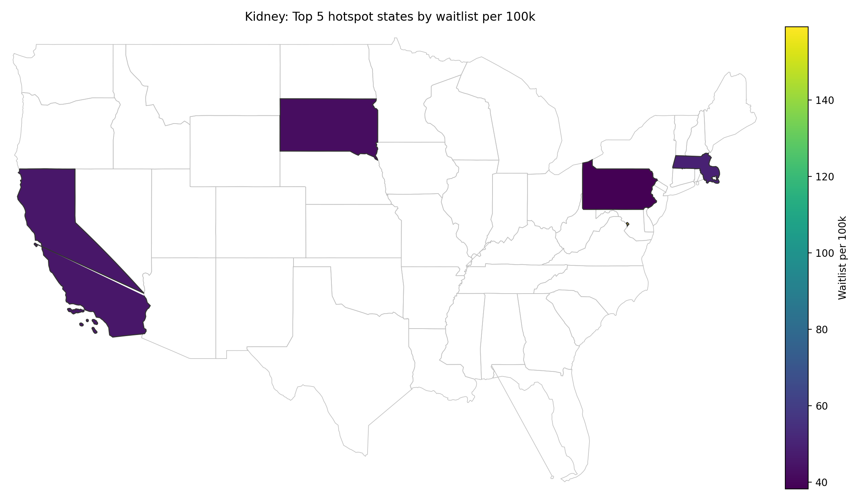
DEMOGRAPHIC HOTSPOTS SHOW WHERE BURDEN CONCENTRATES

Slide 19
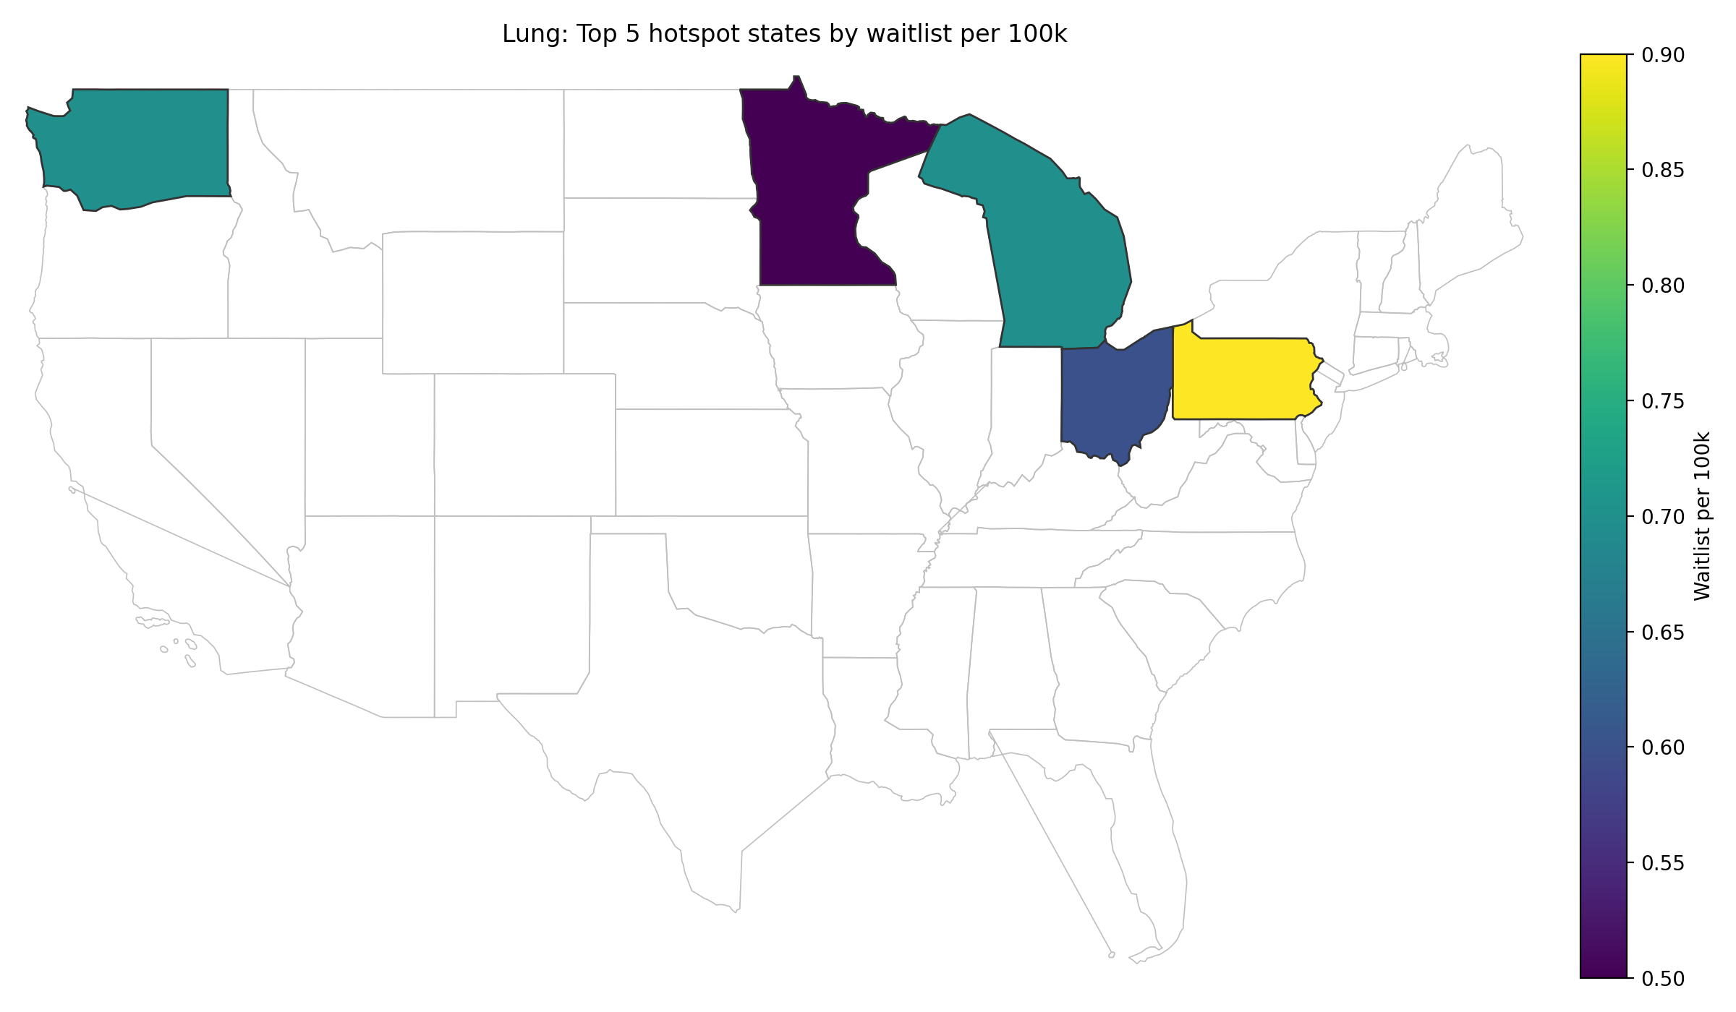
DEMOGRAPHIC HOTSPOTS SHOW WHERE BURDEN CONCENTRATES

Slide 20
KEY FINDINGS
Access burden is not evenly distributed
Kidney shows the highest waitlist burden per 100k across regions/states
It also has the highest long-wait share (≥1 year) compared with heart and lung
Region matters
The South tends to be higher on heart waitlist burden and related social risk context
Long-wait shares vary across the four U.S. regions (Northeast, Midwest, South, West)
Demographic differences are visible
Race/ethnicity groups show different exposure to waits ≥1 year
Patterns differ by organ, indicating uneven long-wait burden across groups
Geography is concentrated
A small set of states accounts for the highest per-capita waitlist burden
Concentration is especially strong for the kidney waitlist burden

Slide 21
Conclusion
The data support the conclusion that transplant access is unevenly distributed across geography, organ type, and candidate subgroups — but the strongest evidence here is about disparity patterns, not causal drivers.

