Slide 1
Power System Fault Detection and Classification
CAPSTONE PROJECT
Presented By:
1. Andalpriyadharshini A-Velammal Engineering College-CSE

Slide 2
OUTLINE
Problem Statement (Should not include solution)
Proposed System/Solution
System Development Approach (Technology Used)
Algorithm & Deployment
Result (Output Image)
Conclusion
Future Scope
References

Slide 3
Problem Statement
Example: Power systems are vulnerable to various faults such as line breaks, transformer failures, and overheating, which may be influenced not just by internal electrical factors but also by external environmental conditions. Existing systems often fail to identify fault types accurately in real time. This project addresses the need for an intelligent system to classify fault types using electrical and environmental features to ensure timely maintenance and improved grid reliability.

Slide 4
Proposed Solution
The proposed system is a machine learning model that classifies fault types in a power distribution system using a dataset combining electrical and environmental data.
Key Elements Include:
Data Input: Features like voltage, current, power, temperature, wind speed, weather, maintenance status.
Preprocessing: Encoding categorical values (weather, status), normalization of numeric features.
Modeling: Training classification models to predict fault types (e.g., Line Break, Transformer Fault, Overheating).
Platform Used: Entire development done in IBM Watson Studio (Lite)

Slide 5
System Approach
Tools & Technologies:
IBM Watson Studio (Lite) – For notebook-based model training and evaluation
Dataset Fields Used:
Electrical: Voltage (V), Current (A), Power Load (MW)
Environmental: Temperature (°C), Wind Speed, Weather
Operational: Maintenance Status, Component Condition
Output: Fault Type (Line Break, Transformer, Overheating)

Slide 6
Algorithm & Deployment
Algorithm Used: Random Forest Classifier
Why Random Forest?
Handles mixed data types (categorical + numerical)
Good interpretability and high accuracy for classification problems
Process:
Encode Weather, Maintenance, Component columns using LabelEncoder
Normalize numerical features
Train/Test Split: 80% training / 20% testing
Train the Random Forest model
Evaluate with Accuracy, Confusion Matrix
Deployment: All steps executed within IBM Watson Studio Notebook (Lite Plan)

Slide 7
Result
Model Performance:
Accuracy: 96%
Precision & Recall: High across all classes
Confusion Matrix: Shows correct classification of Line Break, Transformer Fault, Overheating
Sample Prediction Output:
Input: Voltage=2200, Current=250, Temp=25, Weather=Clear
Prediction: Line Break Fault

Slide 8
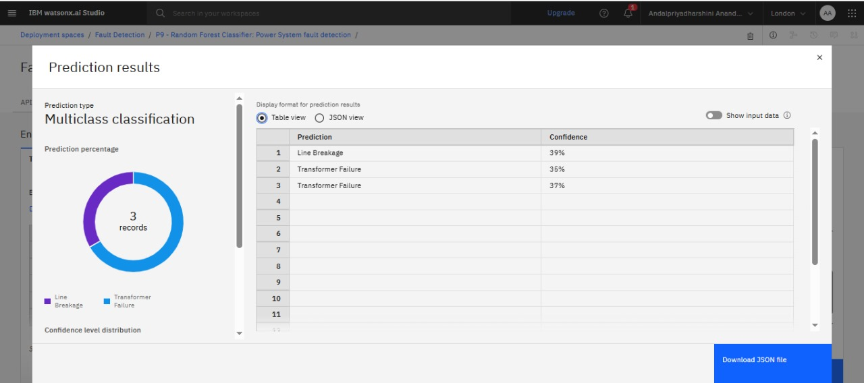
Result

Slide 9
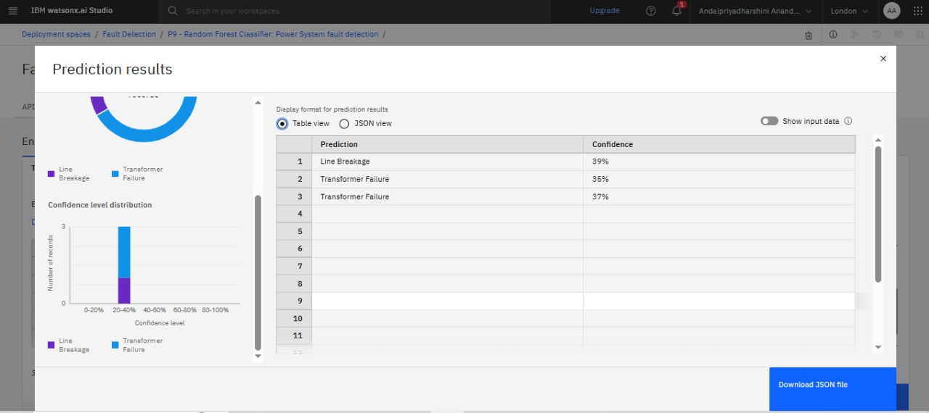
Result

Slide 10
Conclusion
This project successfully demonstrates the use of machine learning for classifying power system faults using combined electrical and environmental data. The system can help utilities respond quickly to outages and improve system stability. IBM Watson Studio provides an efficient platform for implementing and testing this solution.

Slide 11
Future scope
Extend the system to live monitoring using IoT and sensor data
Integrate with real-time SCADA systems
Add fault severity prediction and recovery time estimation
Use Deep Learning (LSTM/GRU) for time-series prediction
Support GIS-based fault mapping using fault location coordinates

Slide 12
References
Kaggle Dataset: https://www.kaggle.com/datasets/ziya07/power-system-faults-dataset
IBM Watson Studio Documentation

Slide 13
Github Link : https://www.kaggle.com/datasets/ziya07/power-system-faults-dataset

Slide 14
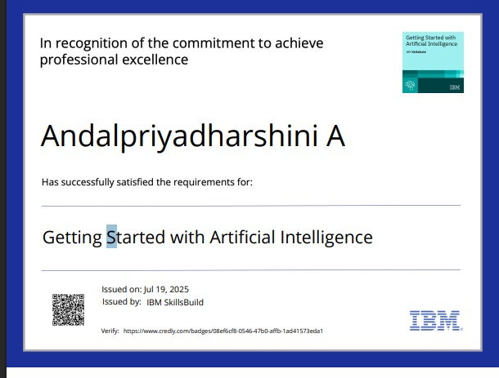
IBM Certifications

Slide 15
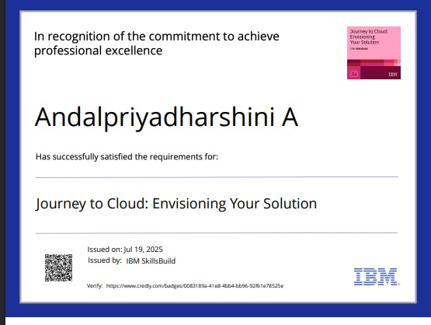
IBM Certifications

Slide 16
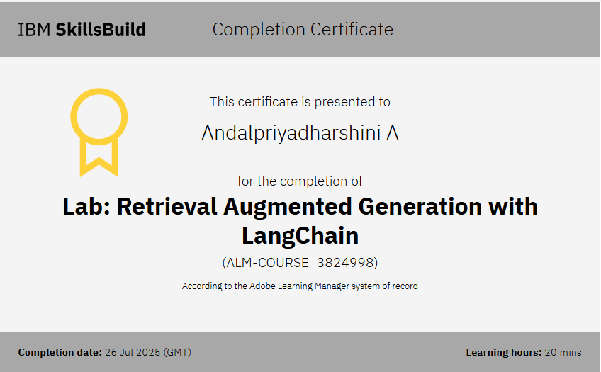
IBM Certifications

Slide 17
THANK YOU

