Slide 1





ADJECTIVE ?
ADVERB ?

Slide 2
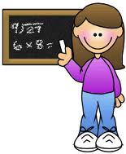
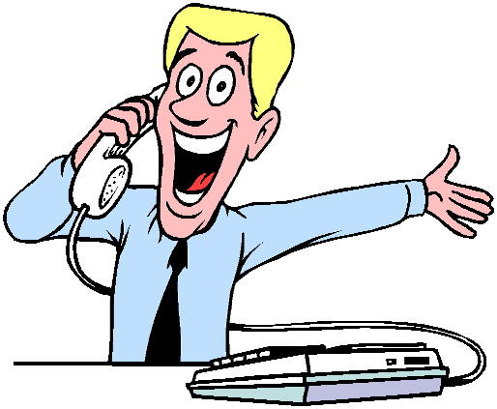
An adjective tells us more about a noun
Example: A young girl
An adverb tells us more about a verb.
Example: He speaks happily

Slide 3
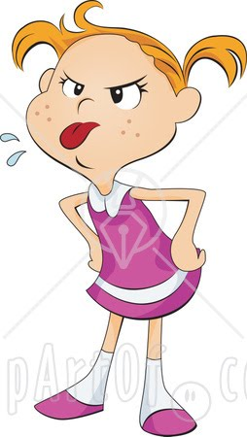
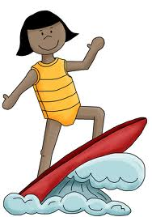
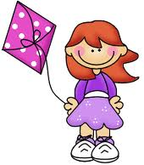
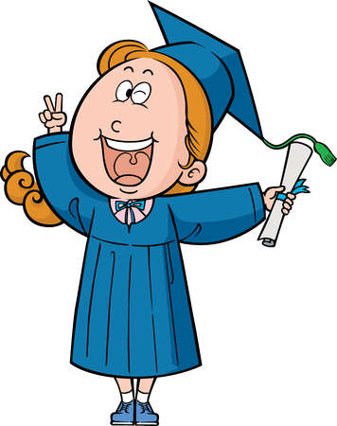
FORMATION OF ADVERBS
sad + -ly = sadly
nervous + -ly = nervously
quiet + -ly = quietly
terrible + -ly = terribly
happy + -ly = happily
angry + -ly = angrily
IRREGULAR FORMS
good - well fast – fast hard - hard
low - low

Slide 4
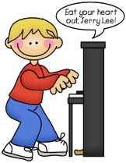



The boy played the piano ………
good
well

Slide 5
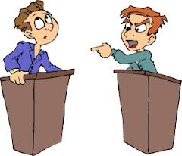
He speaks …….
ANGRY
angrily

Slide 6
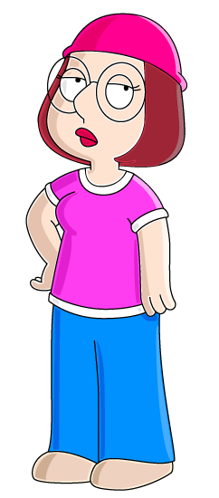

The girl is wearing some ...... blue trousers
nicely
NICE

Slide 7
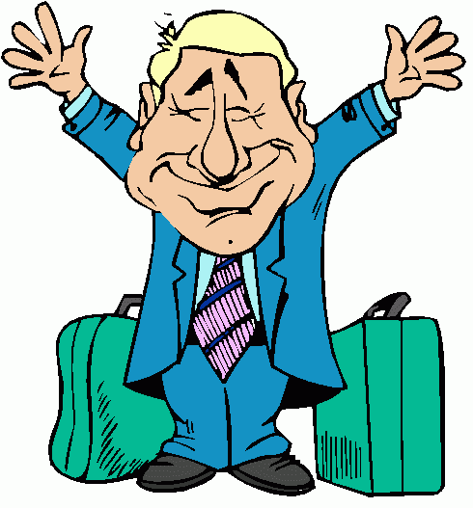
Uncle Paul arrived ………
late
LATELY

Slide 8
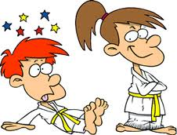
She beat him ………
EASY
EASILY

Slide 9
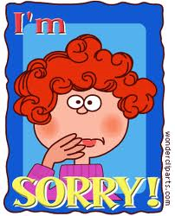
My best friend was …….. sorry
TERRIBLE
TERRIBLY

Slide 10
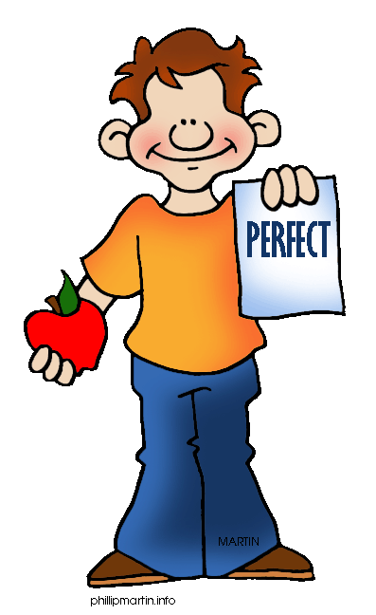
REMEMBER
There are adjectives ending in ly
Friendly
Lively
Lovely
Daily
Early
Silly
Weekly

