Slide 1


Adverbs
of
GAME
Choose the right option.

Slide 2
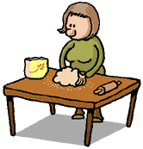

Mrs. White is nervous. She cooks...
GREAT
nervosly
nervously
nervouslly

Slide 3
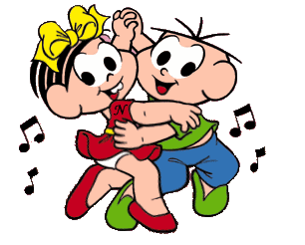

They are good dancers. They dance ...
GREAT
well
goodly
good

Slide 4
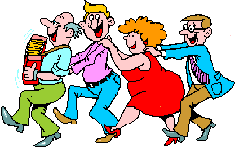

They are happy. They live ...
GREAT
happyly
happilly
happily

Slide 5


Susan’s voice is beautiful. She sings...
GREAT
beautifuly
beautifully
beautiful

Slide 6
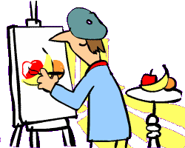

He is a bad painter. He paints ...
GREAT
bad
badlly
badly

Slide 7
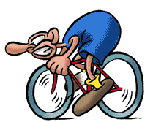
He is a fast cyclist. He cycles…
GREAT
fast
fastly
fastlly

Slide 8

He is a successful businessman. He ... concluded the deal.
GREAT
successfuly
successfully
sucessfully

Slide 9

The children are noisy. They play…
GREAT
noisyly
noisilly
noisily

Slide 10
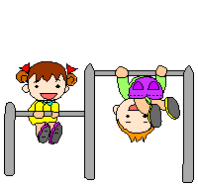
These children are quiet. Theyplay...
GREAT
quietlly
quietly
quitely

Slide 11

Mr. Brown is very calm. He walks…
GREAT
calmlly
calmily
calmly

Slide 12

Snails are slow. They move...
GREAT
slowlly
slowly
slow

Slide 13

It is easy to climb the rock.He climbs it …
GREAT
easilly
easyly
easily

Slide 14
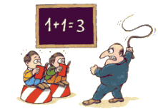
The teacher is angry.He ... punhishes the students.
GREAT
angrily
angrilly
angryly

Slide 15
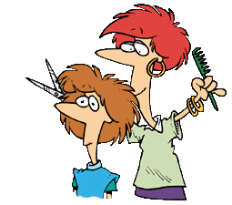
Susan is very careful. She cuts the hair...
GREAT
carefuly
carefully
carfully

Slide 16
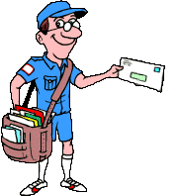
The postman is very punctual. He … delivers the mail.
GREAT
panctually
punctualy
punctually

