Slide 1




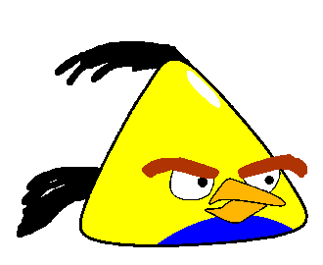
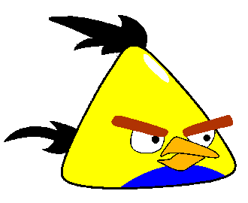







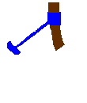





3
Piglette hit
2
1
3
Sorry!
CLOSE
2
Pig oink3
DIAMOND
Pig oink2
NEXT
Pig oink
HEART
2
OVAL
cbo
crh
cpd
3
Notes:
Bring to front in this order. Foreground slingshot, grass
1 = bomb, Blue OVAL4 2, triangle bird Red Heart6 3, red bird purple diamond8

Slide 2
3
Piglette hit
2
1
3
Sorry!
CLOSE
2
Pig oink3
CIRCLE
Pig oink2
NEXT
Pig oink
TRIANGLE
2
SQUARE
cbo
crh
cpd
3
Notes:
Bring to front in this order. Foreground slingshot, grass
1 = bomb, Blue OVAL4 2, triangle bird Red Heart6 3, red bird purple diamond8

Slide 3
3
Piglette hit
2
1
3
Sorry!
CLOSE
2
Pig oink3
CRESCENT
Pig oink2
NEXT
Pig oink
RECTANGLE
2
STAR
cbo
crh
cpd
3
Notes:
Bring to front in this order. Foreground slingshot, grass
1 = bomb, Blue OVAL4 2, triangle bird Red Heart6 3, red bird purple diamond8

Slide 4
3
Piglette hit
2
1
3
Sorry!
CLOSE
2
Pig oink3
DIAMOND
Pig oink2
YOU
WON!
Pig oink
HEART
2
CYLINDRICAL
cbo
crh
cpd
3
Notes:
Bring to front in this order. Foreground slingshot, grass
1 = bomb, Blue OVAL4 2, triangle bird Red Heart6 3, red bird purple diamond8

