Slide 1

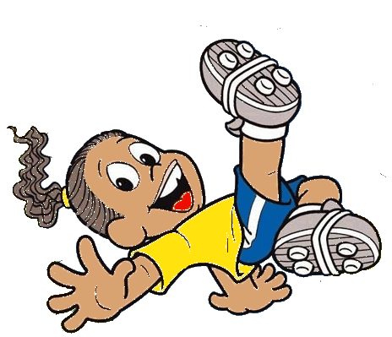

Slide 2
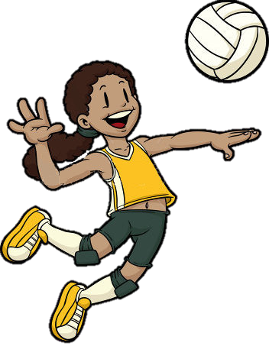



What sport is this?
She plays
volleyball
play
go
do

Slide 3
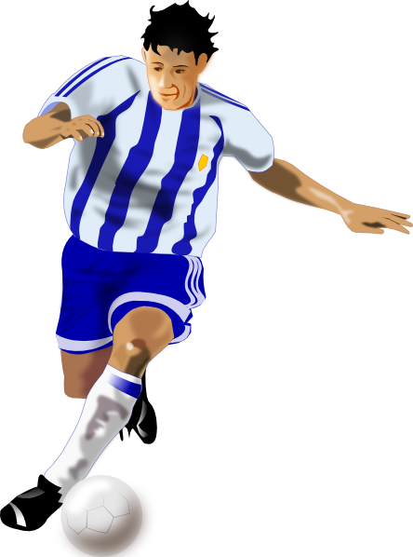
What sport is this?
He plays
football
play
go
do

Slide 4
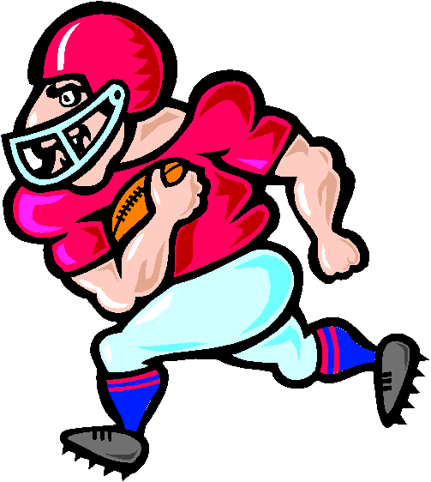
What sport is this?
He plays
American football
play
go
do

Slide 5
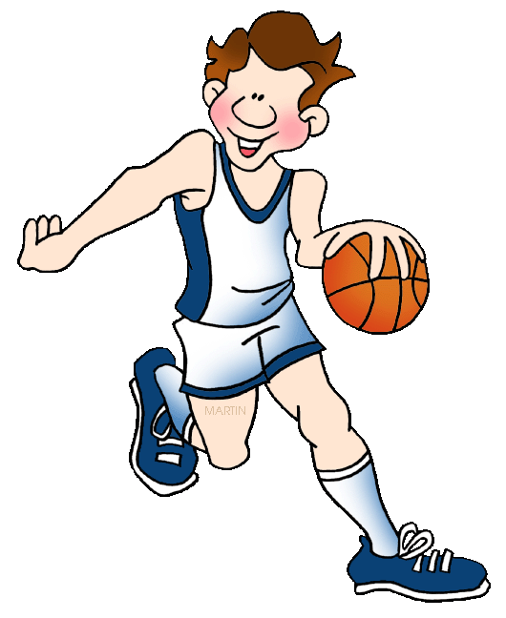
What sport is this?
He plays
basketball
play
go
do

Slide 6
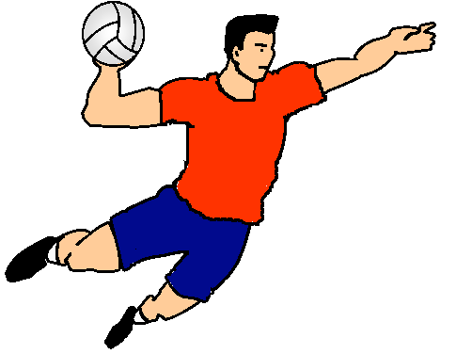
What sport is this?
He plays
handball
play
go
do

Slide 7
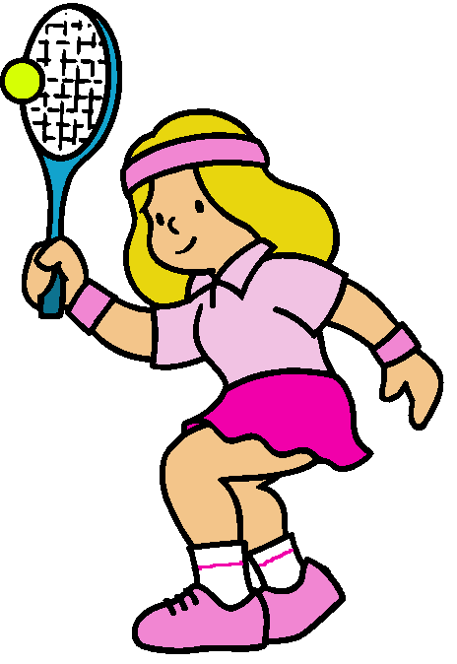
What sport is this?
She plays
tennis
play
go
do

Slide 8
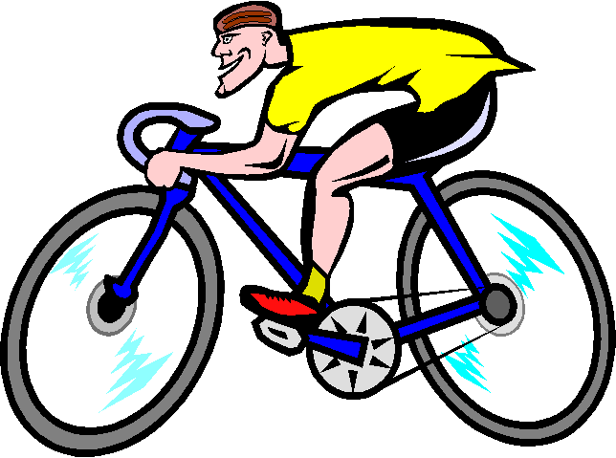
What sport is this?
He goes
cycling
play
go
do

Slide 9
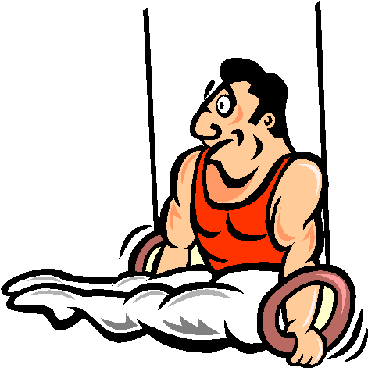
What sport is this?
He does
gymnastics
play
go
do

Slide 10
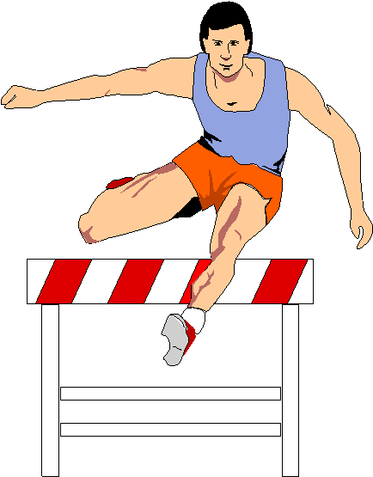
What sport is this?
He does
athletics
play
go
do

Slide 11
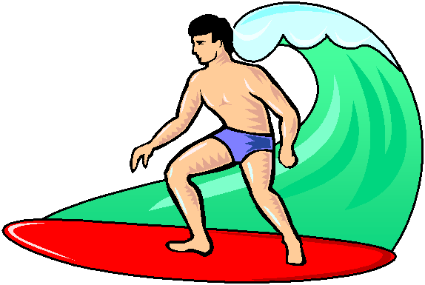
What sport is this?
He goes
surfing
play
go
do

Slide 12
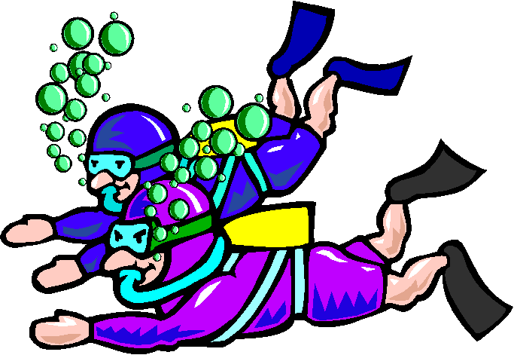
What sport is this?
They go
diving
play
go
do

Slide 13
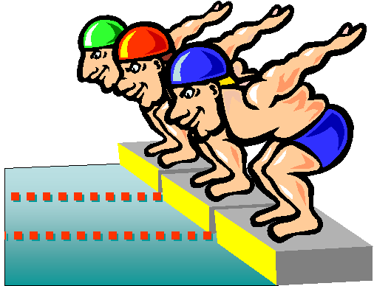
What sport is this?
They go
swimming
play
go
do

Slide 14
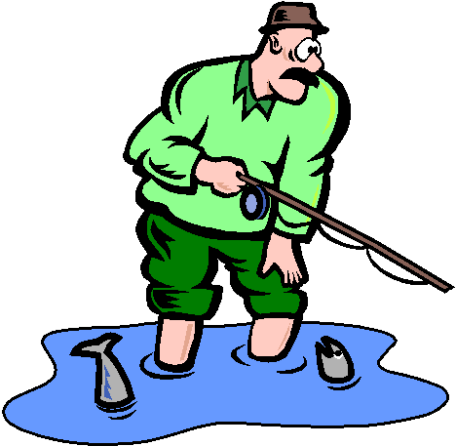
What sport is this?
He goes
fishing
play
go
do

Slide 15
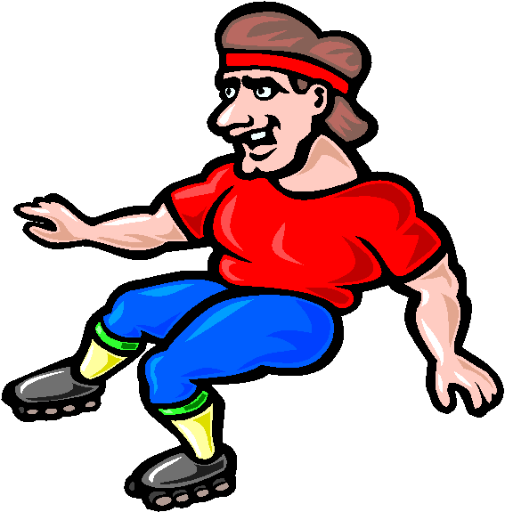
What sport is this?
He goes
skating
play
go
do

Slide 16
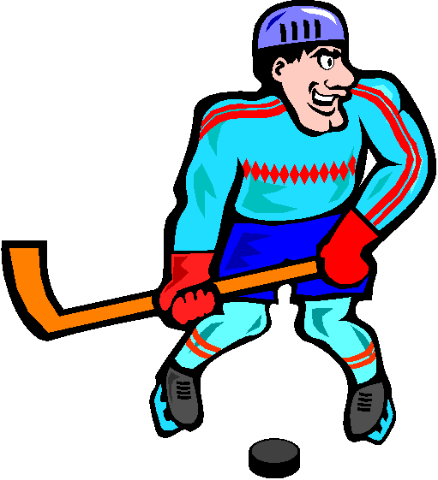
What sport is this?
He plays
ice hockey
play
go
do

Slide 17
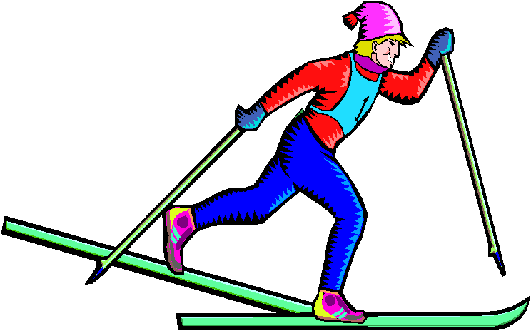
What sport is this?
He goes
skiing
play
go
do

Slide 18
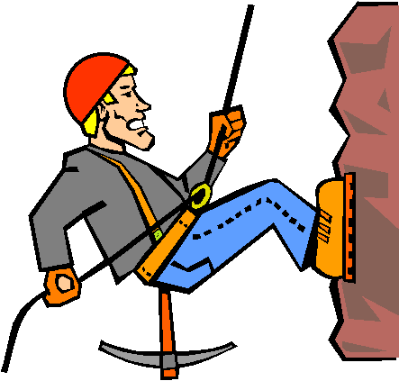
What sport is this?
He goes
climbing
play
go
do

Slide 19
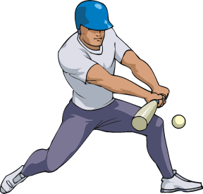
What sport is this?
He plays
baseball
play
go
do

Slide 20
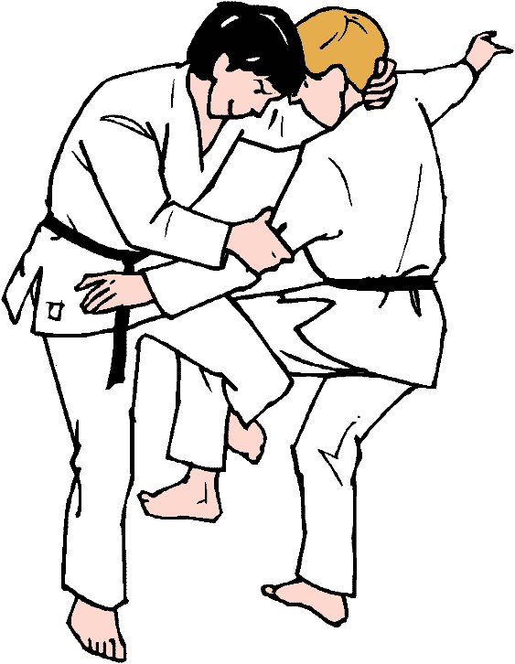
What sport is this?
They do
judo
play
go
do

Slide 21
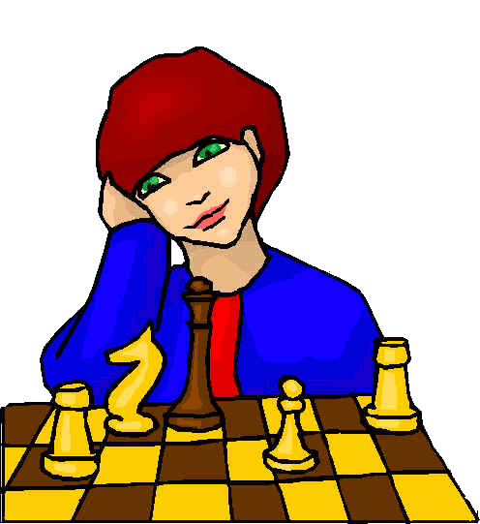
What sport is this?
She plays
chess
play
go
do

