Slide 1
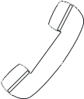

50:50
15
$1 Million
14
$500,000
Welcome to
Who Wants to be a Millionaire
13
$250,000
12
$125,000
11
$64,000
10
$32,000
9
$16,000
8
$8,000
7
$4,000
6
$2,000
5
$1,000
4
$500
3
$300
2
$200
1
$100

Slide 2

15
$1 Million
14
$500,000
13
$250,000
12
$125,000
11
$64,000
10
$32,000
9
$16,000
8
$8,000
7
$4,000
6
$2,000
5
$1,000
4
$500
3
$300
2
$200
1
$100

Slide 3
15
$1 Million
14
$500,000
Which of the following is a martial art?
13
$250,000
12
$125,000
11
$64,000
10
$32,000
9
$16,000
8
$8,000
7
$4,000
A
6
$2,000
5
$1,000
4
$500
3
$300
2
$200
50:50
1
$100
A: aikido
B: squash
C: polo
D: rugby

Slide 4
15
$1 Million
14
$500,000
13
$250,000
12
$125,000
11
$64,000
10
$32,000
9
$16,000
8
$8,000
7
$4,000
6
$2,000
5
$1,000
4
$500
3
$300
2
$200
1
$100

Slide 5
15
$1 Million
14
$500,000
Which of the following do you need for tennis?
13
$250,000
12
$125,000
11
$64,000
10
$32,000
9
$16,000
8
$8,000
7
$4,000
B
6
$2,000
5
$1,000
4
$500
3
$300
2
$200
50:50
1
$100
A: helmet
B: racket
C: rocket
D: flippers

Slide 6
15
$1 Million
14
$500,000
13
$250,000
12
$125,000
11
$64,000
10
$32,000
9
$16,000
8
$8,000
7
$4,000
6
$2,000
5
$1,000
4
$500
3
$300
2
$200
1
$100

Slide 7
15
$1 Million
14
$500,000
What do you call a person who watches a sport event?
13
$250,000
12
$125,000
11
$64,000
10
$32,000
9
$16,000
8
$8,000
7
$4,000
B
6
$2,000
5
$1,000
4
$500
3
$300
2
$200
50:50
1
$100
A: opponent
B: spectator
C: competitor
D: rival

Slide 8
15
$1 Million
14
$500,000
13
$250,000
12
$125,000
11
$64,000
10
$32,000
9
$16,000
8
$8,000
7
$4,000
6
$2,000
5
$1,000
4
$500
3
$300
2
$200
1
$100

Slide 9
15
$1 Million
14
$500,000
13
$250,000
12
$125,000
Where do you play badminton?
11
$64,000
10
$32,000
9
$16,000
8
$8,000
7
$4,000
D
6
$2,000
5
$1,000
4
$500
3
$300
2
$200
50:50
1
$100
A: on a pitch
B: on a course
C: on a field
D: on a court

Slide 10
15
$1 Million
14
$500,000
13
$250,000
12
$125,000
11
$64,000
10
$32,000
9
$16,000
8
$8,000
7
$4,000
6
$2,000
5
$1,000
4
$500
3
$300
2
$200
1
$100

Slide 11
15
$1 Million
14
$500,000
13
$250,000
12
$125,000
What do you use to hit a ball in golf?
11
$64,000
10
$32,000
9
$16,000
8
$8,000
7
$4,000
B
6
$2,000
5
$1,000
4
$500
3
$300
2
$200
50:50
1
$100
A: a racket
B: a club
C: a stick
D: a bat

Slide 12
Congratulations!
Congratulations!
Congratulations!
You’ve Reached
the $1,000
Milestone!

Slide 13
15
$1 Million
14
$500,000
13
$250,000
12
$125,000
11
$64,000
10
$32,000
9
$16,000
8
$8,000
7
$4,000
6
$2,000
5
$1,000
4
$500
3
$300
2
$200
1
$100

Slide 14
15
$1 Million
14
$500,000
How many squeres are there in a chess board?
13
$250,000
12
$125,000
11
$64,000
10
$32,000
9
$16,000
8
$8,000
7
$4,000
D
6
$2,000
5
$1,000
4
$500
3
$300
2
$200
50:50
1
$100
A: 36
B: 48
C: 72
D: 64

Slide 15
15
$1 Million
14
$500,000
13
$250,000
12
$125,000
11
$64,000
10
$32,000
9
$16,000
8
$8,000
7
$4,000
6
$2,000
5
$1,000
4
$500
3
$300
2
$200
1
$100

Slide 16
15
$1 Million
14
$500,000
What is a person who comes after the winner called?
13
$250,000
12
$125,000
11
$64,000
10
$32,000
9
$16,000
8
$8,000
7
$4,000
A
6
$2,000
5
$1,000
4
$500
3
$300
2
$200
50:50
1
$100
A: runner-up
B: semi-winner
C: silverist
D: seconder

Slide 17
15
$1 Million
14
$500,000
13
$250,000
12
$125,000
11
$64,000
10
$32,000
9
$16,000
8
$8,000
7
$4,000
6
$2,000
5
$1,000
4
$500
3
$300
2
$200
1
$100

Slide 18
15
$1 Million
14
$500,000
What was the first sport to be played on the moon?
13
$250,000
12
$125,000
11
$64,000
10
$32,000
9
$16,000
8
$8,000
7
$4,000
D
6
$2,000
5
$1,000
4
$500
3
$300
2
$200
50:50
1
$100
A: football
B: basketball
C: rugby
D: golf

Slide 19
15
$1 Million
14
$500,000
13
$250,000
12
$125,000
11
$64,000
10
$32,000
9
$16,000
8
$8,000
7
$4,000
6
$2,000
5
$1,000
4
$500
3
$300
2
$200
1
$100

Slide 20
15
$1 Million
14
$500,000
Where was Muhammad Ali born ?
13
$250,000
12
$125,000
11
$64,000
10
$32,000
9
$16,000
8
$8,000
7
$4,000
A
6
$2,000
5
$1,000
4
$500
3
$300
2
$200
50:50
1
$100
B: in the United Arab Emirates
A: in the USA
C: in Turkey
D: in Egypt

Slide 21
15
$1 Million
14
$500,000
13
$250,000
12
$125,000
11
$64,000
10
$32,000
9
$16,000
8
$8,000
7
$4,000
6
$2,000
5
$1,000
4
$500
3
$300
2
$200
1
$100

Slide 22
15
$1 Million
14
$500,000
13
$250,000
12
$125,000
Where will the 2016 Olympics be held ?
11
$64,000
10
$32,000
9
$16,000
8
$8,000
7
$4,000
B
6
$2,000
5
$1,000
4
$500
3
$300
2
$200
50:50
1
$100
A: London
B: Rio De Janeiro
C: Sydney
D: Berlin

Slide 23
Congratulations!
Congratulations!
Congratulations!
You’ve Reached
the $32,000
Milestone!

Slide 24
15
$1 Million
14
$500,000
13
$250,000
12
$125,000
11
$64,000
10
$32,000
9
$16,000
8
$8,000
7
$4,000
6
$2,000
5
$1,000
4
$500
3
$300
2
$200
1
$100

Slide 25
15
$1 Million
14
$500,000
When was the first NBA basketball game ?
13
$250,000
12
$125,000
11
$64,000
10
$32,000
9
$16,000
8
$8,000
7
$4,000
A
6
$2,000
5
$1,000
4
$500
3
$300
2
$200
50:50
1
$100
A: 1946
B: 1889
C: 1964
D: 1898

Slide 26
15
$1 Million
14
$500,000
13
$250,000
12
$125,000
11
$64,000
10
$32,000
9
$16,000
8
$8,000
7
$4,000
6
$2,000
5
$1,000
4
$500
3
$300
2
$200
1
$100

Slide 27
15
$1 Million
14
$500,000
We have a referee in football. Who do we have in tennis ?
13
$250,000
12
$125,000
11
$64,000
10
$32,000
9
$16,000
8
$8,000
7
$4,000
C
6
$2,000
5
$1,000
4
$500
3
$300
2
$200
50:50
1
$100
A: judge
B: bestman
C: umpire
D: referee

Slide 28
15
$1 Million
14
$500,000
13
$250,000
12
$125,000
11
$64,000
10
$32,000
9
$16,000
8
$8,000
7
$4,000
6
$2,000
5
$1,000
4
$500
3
$300
2
$200
1
$100

Slide 29
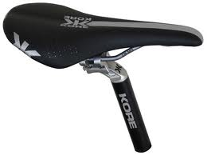
15
$1 Million
14
$500,000
13
$250,000
12
$125,000
What is it called ?
11
$64,000
10
$32,000
9
$16,000
8
$8,000
7
$4,000
C
6
$2,000
5
$1,000
4
$500
3
$300
2
$200
50:50
1
$100
A: seat
B: sit
C: saddle
D: chair

Slide 30
15
$1 Million
14
$500,000
13
$250,000
12
$125,000
11
$64,000
10
$32,000
9
$16,000
8
$8,000
7
$4,000
6
$2,000
5
$1,000
4
$500
3
$300
2
$200
1
$100

Slide 31
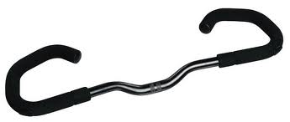
15
$1 Million
14
$500,000
This is a part of your bike. What is it called ?
13
$250,000
12
$125,000
11
$64,000
10
$32,000
9
$16,000
8
$8,000
7
$4,000
A
6
$2,000
5
$1,000
4
$500
3
$300
2
$200
50:50
1
$100
A: handlebar
B: handy
C: framework
D: graber

Slide 32
15
$1 Million
14
$500,000
13
$250,000
12
$125,000
11
$64,000
10
$32,000
9
$16,000
8
$8,000
7
$4,000
6
$2,000
5
$1,000
4
$500
3
$300
2
$200
1
$100

Slide 33
15
$1 Million
14
$500,000
What does your English teacher practise regularly ?
13
$250,000
12
$125,000
11
$64,000
10
$32,000
9
$16,000
8
$8,000
7
$4,000
C
6
$2,000
5
$1,000
4
$500
3
$300
2
$200
50:50
1
$100
A: yoga
B: jogging
C: swimming
D: nothing

Slide 34
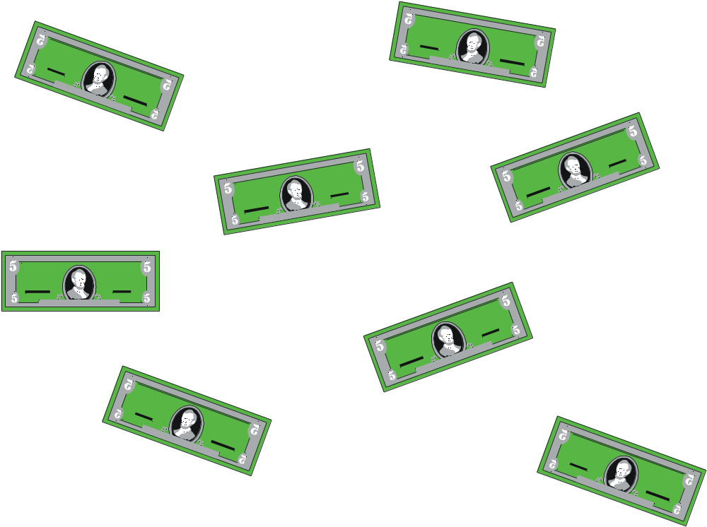
YOU WIN $1 MILLION DOLLARS!

