Slide 1
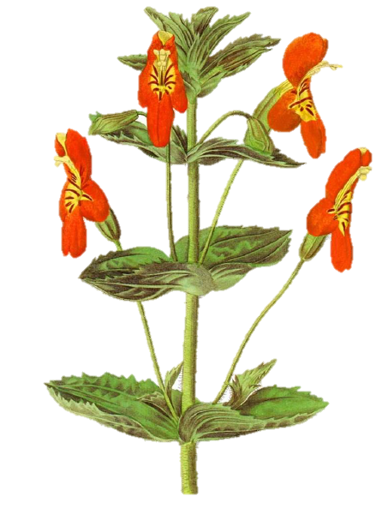
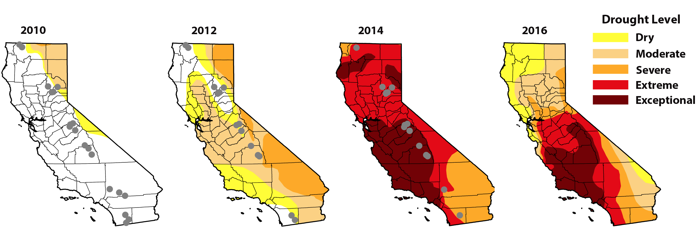
Drought Level
Dry
Moderate
Severe
Extreme
Exceptional
2010
2012
2014
2016
Figure 1. Baseline (2010) and time series (-2016) population samples of Erythranthe cardinalis across a period of exceptional drought and warming resembling projections for climate change. Black dots depict sampling locations in each year (odd years sampled but not shown).

Slide 2
2010
2012
2014
2016
Drought Level
Figure 1. Baseline (2010) and time series (-2016) population samples of M. cardinalis across a period of exceptional drought and warming. Black dots are sampling locations in each year (odd years sampled but not shown).
Dry
Moderate
Severe
Extreme
Exceptional

Slide 3
2010
2012
2014
2016
Drought Level
Figure 1. Baseline (2010) and time series (-2016) population samples of M. cardinalis across a period of exceptional drought and warming. Black dots are sampling locations per year (odd years not shown).
Dry
Moderate
Severe
Extreme
Exceptional

Slide 4
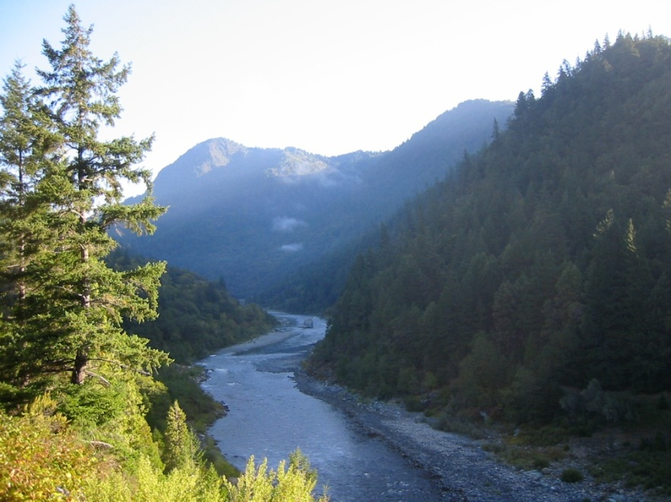
2010
2012
2014
2016
Drought Level
Dry
Moderate
Severe
Extreme
Exceptional
Figure 1. Baseline (2010) and time series (-2016) population samples of Mimulus cardinalis across a period of exceptional drought and warming resembling projections for climate change. Black dots are sampling locations in each year (odd years sampled but not shown). Inset pictures show plant and riparian habitat corridor.

