Slide 1
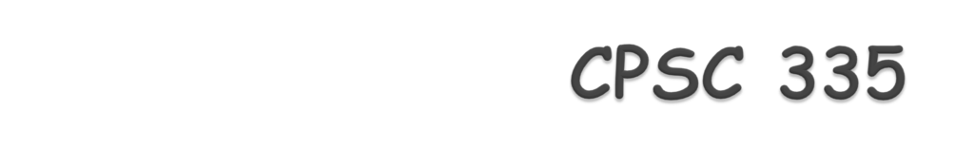
Search Strategies
Dr. Marina Gavrilova
Computer Science
University of Calgary
Canada

Slide 2

Tries – for word searchers, spell checking, spelling corrections
Digital Search Trees – for searching for frequent keys (in text, databases, applications)
Min-max search – for optimal move search in games
Alpha-beta pruning – improvement of min-max search
Branch-and-bound – algorithmic technique to limit the search

Slide 3
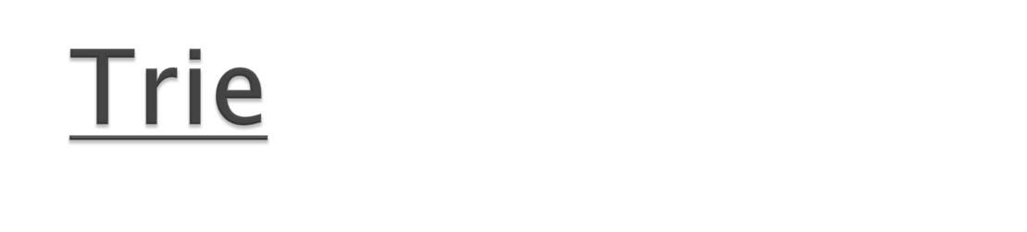
A Trie, or prefix tree, is an ordered tree data structure that is used to store an associative array where the keys are usually strings.
The term trie comes from "retrieval." Due to this etymology it is pronounced [tri] ("tree"), although some encourage the use of [traɪ] ("try") in order to distinguish it from the more general tree.

Slide 4
Unlike a binary search tree, no node in the tree stores the key associated with that node; instead, its position in the tree shows what key it is associated with.
All the descendants of any one node have a common prefix of the string associated with that node, and the root is associated with the empty string.
Values are normally not associated with every node, only with leaves and some inner nodes that happen to correspond to keys of interest.
Tries can be implemented using B-trees (as shown in class), arrays (see handout) or Binary Trees (see next slide).

Slide 5
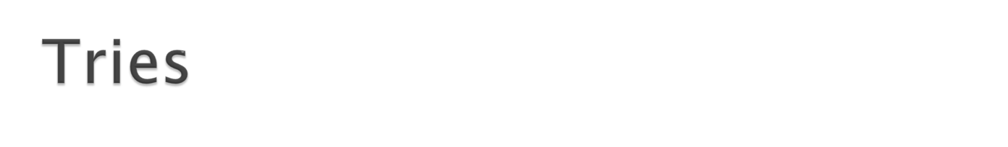
Most General Form Trie - General Tree
b
s
e
u
u
a
i
n
r
d
l
d
$
l
$
$
k
a
$
y
$
$
Set of strings: {bear, bid, bulk, bull, sun, sunday}
AALG, lecture 4, © Simonas Šaltenis, 2004

Slide 6
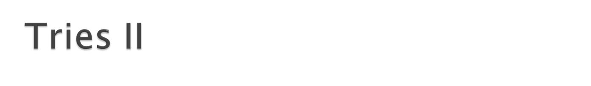
Properties of a trie:
  A multi-way tree.
  Each node has between 1 and k descendants.
  Each link of the tree has matching character.
  Each leaf node corresponds to the final word (string), which can be collected on a path from the root to this node.

Slide 7

The search algorithm follows the path from the root towards leaf, and can result in word being found or not found. Complexity –tree depth.
New string insertion checks if current character is at the current level of the tree, starting from the root, if yes – proceeds down that branch labeled with the character, if not – inserts a new branch at that level.

Slide 8
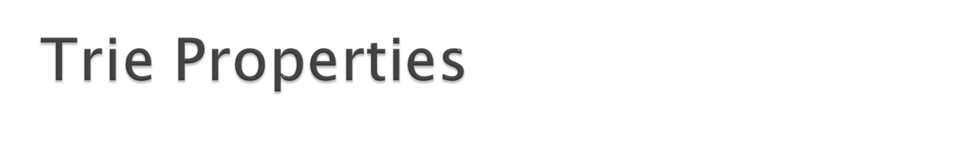
Trie can be implemented
    A 2d array (sequential trie)
    A linked list
    A binary search tree

Slide 9
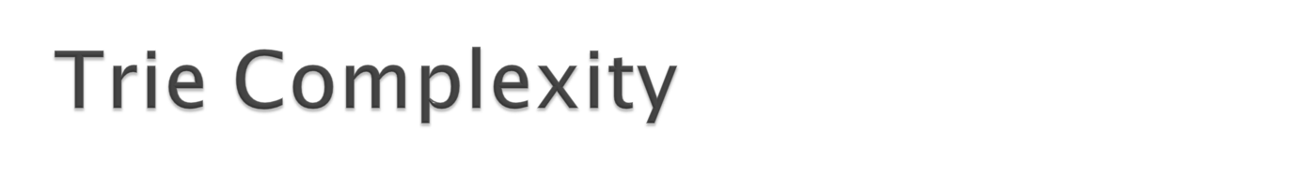
Size:
  O(N) in the worst-case
Search, insertion, and deletion (string of length p):
  O(kp) in general case

Slide 10
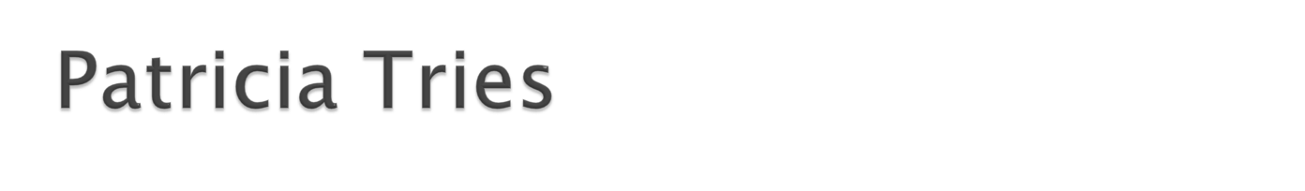
  Similar to prefix B tee
  Substitute a chain of one-child nodes with an edge labeled with a unique string
  Each non-leaf node (except root) has at least two children
b
s
b
sun
e
u
u
a
i
n
ear$
id$
ul
$
day$
r
d
l
d
$
l
$
l$
$
k
a
k$
$
y
$
$
AALG, lecture 4, © Simonas Šaltenis, 2004

Slide 11
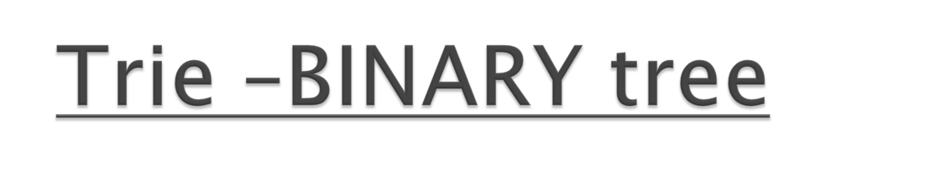
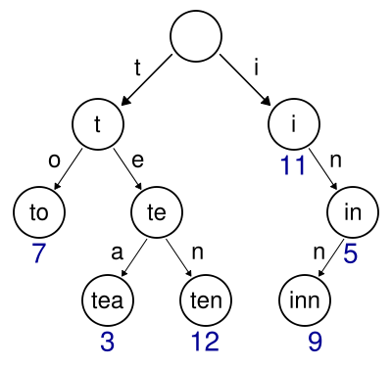
In the example shown, keys are listed in the nodes and values below them as a Binary Tree. Each complete English word has an integer value associated with it.
It is not necessary for keys to be explicitly stored in nodes. (In the figure, words are shown only to illustrate how the trie works.)
A trie for keys "to", "tea", "ten", "i", "in", and "inn“ (Wikepedia).

Slide 12
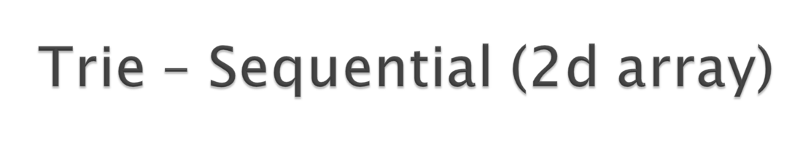
End of word (nil) and 26 characters – rows, number of columns grows as more strings get inserted, each column ONLY contains strings starting with the same character (i.e. c), more than one column can correspond to the same starting letter (i.e. cow and colt cannot be differentiated in column 2 as both start with co).
VERY INEFFICIENT IN TERMS OF SPACE.
#
a ant | cat
b
c 2
d dog
e
f
g gnu
…
o | cow
…

Slide 13
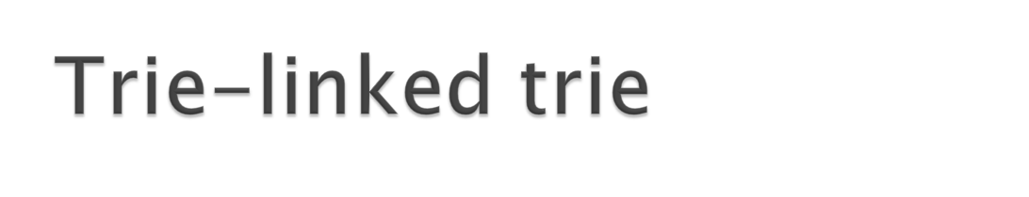
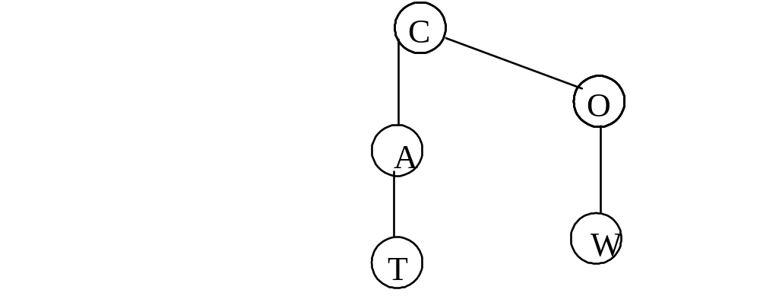
Vertical links correspond to next letter in a string, horizontal correspond to next letter in a string if there is more than one alternative (cat, cow). Each alphabet character has its own corresponding trie.

Slide 14
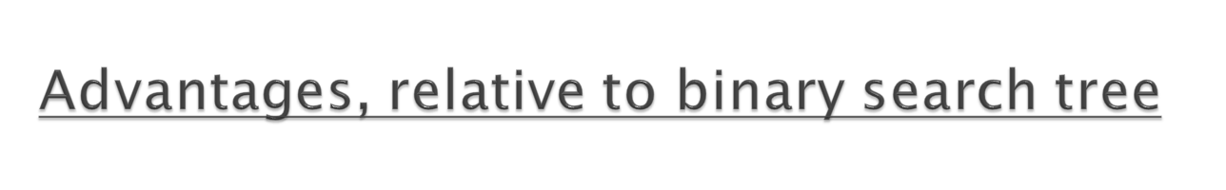
Looking up keys is faster. Looking up a key of length m takes worst case O(m) time. A BST takes O(log n) time, where n is the number of elements in the tree, because lookups depend on the depth of the tree, which is logarithmic in the number of keys. Also, the simple operations tries use during lookup, such as array indexing using a character, are fast on real machines.
Tries can require less space when they contain a large number of short strings, because the keys are not stored explicitly and nodes are shared between keys with common initial subsequences.
Tries help with longest-prefix matching, where we wish to find the key sharing the longest possible prefix of characters all unique.

Slide 15
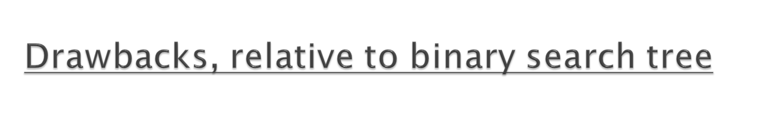
Tries can be slower in some cases than hash tables for looking up data, especially if the data is directly accessed on a hard disk drive or some other secondary storage device where the random access time is high compared to main memory.
It is not easy to represent all keys as strings, such as floating point numbers, which can have multiple string representations for the same floating point number, e.g. 1, 1.0, 1.00, +1.0, etc.
Tries are frequently less space-efficient than hash tables.
Unlike hash tables, tries are generally not already available in programming language toolkits.

Slide 16
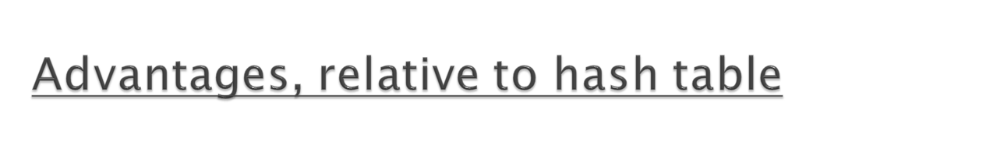
Looking up data in a trie is faster in the worst case, O(m) time, compared to an imperfect hash table. An imperfect hash table can have key collisions. A key collision is the hash function mapping of different keys to the same position in a hash table. The worst-case lookup speed in an imperfect hash table is O(N) time, but far more typically is O(1), with O(m) time spent evaluating the hash.
There are no collisions of different keys in a trie.
Buckets in a trie which are analogous to hash table buckets that store key collisions are only necessary if a single key is associated with more than one value.
There is no need to provide a hash function or to change hash functions as more keys are added to a trie. A trie can provide an alphabetical ordering of the entries by key.

Slide 17
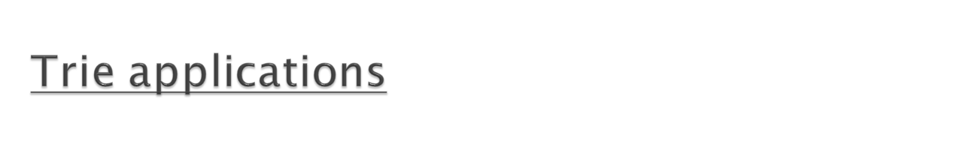
Dictionary representation
A common application of a trie is storing a dictionary, such as one found on a mobile telephone. Such applications take advantage of a trie's ability to quickly search for, insert, and delete entries; however, if storing dictionary words is all that is required (i.e. storage of information auxiliary to each word is not required), a minimal acyclic deterministic finite automaton would use less space than a trie.
Tries are also well suited for implementing approximate matching algorithms, including those used in spell checking software.
Full text search
A special kind of trie, called a suffix tree, can be used to index all suffixes in a text in order to carry out fast full text searches.
Sorting
Lexicographic sorting of a set of keys can be accomplished with a simple trie-based algorithm

Slide 18

A tree which stores the strings in internal nodes, so there is no need for extra leaf nodes to store the strings.
Searching is based on the binary representation of the search key.
If keys are uniformly distributed, the average time per operation is O(log N).
Worst case is O(b), where b is the number of bits in the search key.
Some other way is needed to handle duplicates.

Slide 19
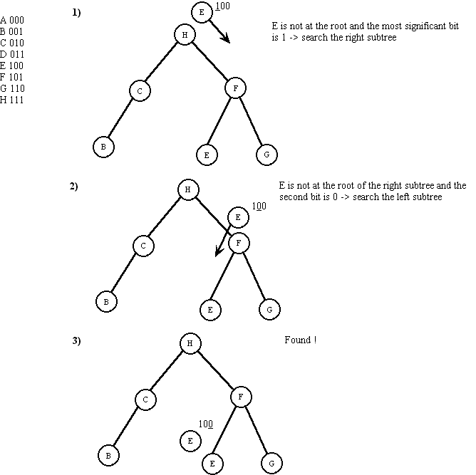
Example: searching the letter E from a digital search tree

Slide 20
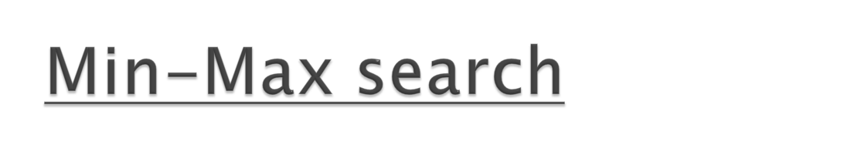
In chess, both players know where the pieces are, they alternate moves, and they are free to make any legal move. The object of the game is to checkmate the other player, to avoid being checkmated, or to achieve a draw if that's the best thing given the circumstances.
A chess program selects moves via use of a search function. A search function is a function that is passed information about the game, and tries to find the best move for side that the program is playing.

Slide 21
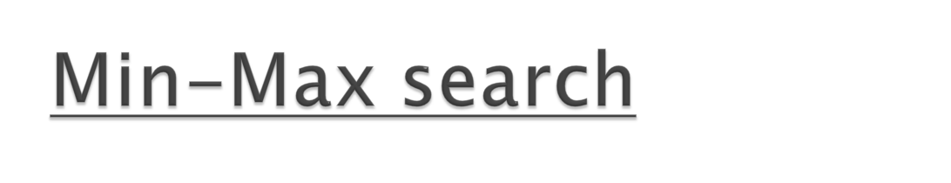
Min-max search is used on a B-tree like structure representing the space of all possible moves. Initial state of every game is a large B-tree, then a tree-search finds the move that would be selected if both sides were to play the best possible moves.

Slide 22
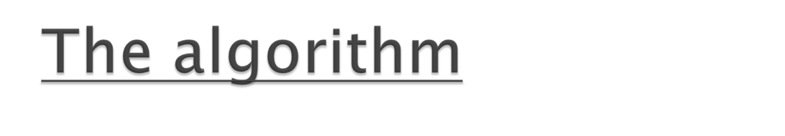
Let's say that at the root position (the position on the board now), it's White's turn to move. The Max function is called, and all of White's legal moves are generated. In each resulting position, the "Min" function is called. The "Min" function scores the position and returns a value. Since it is White to move, and White wants a more positive score if possible, the move with the largest score is selected as best, and the value of this move is returned.
The "Min" function works in reverse. The "Min" function is called when it's Black's turn to move, and black wants a more negative score, so the move with the most negative score is selected.
These functions are dual recursive, meaning that they call each other until the desired search depth is reached. When the functions "bottom out", they return the result of the "Evaluate" function.

Slide 23
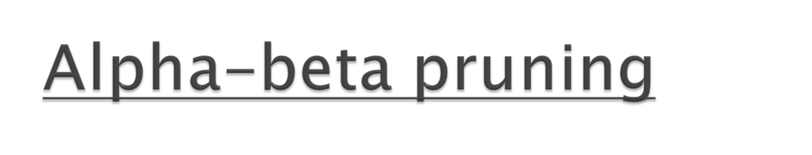
Alpha - Beta Pruning
  a technique that improves upon the minimax algorithm by ignoring branches on the game tree that do not contribute further to the outcome.

Slide 24

  During the process of searching for the next move, not every move (i.e. every node in the search tree) needs to considered in order to reach a correct decision.
  In other words, if the move being considered results in a worse outcome than our current best possible choice, then the first move that the opposition could make which is less then our best move will be the last move that we need to look at.

Slide 25

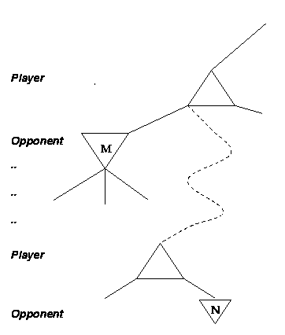
The idea is that if a path is worse than the current best path, time is not wasted trying to find out how bad it is.

Slide 26
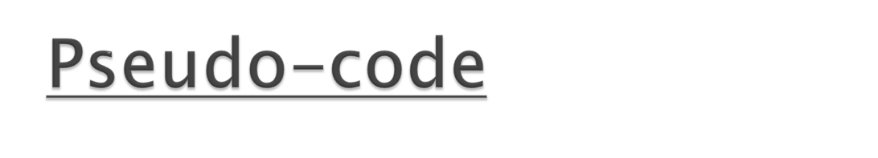
function Max-Value(state, game, œ, ß) returns the mimimax value of state
inputs:
state, current state in the game
game, game description
œ, the best score for MAX along the path to state
ß, the best score for MIN along the path to state
if CUTOFF-TEST(state) then return EVAL(state)
for each s in SUCCESSORS(state) do
œ <-- MAX(œ,MIN-VALUE(s,game,œ,ß)) if œ >= ß then return ß
end
return œ
function Min-Value(state, game, œ, ß) returns the mimimax value of state
if CUTOFF-TEST(state) then return EVAL(state)
for each s in SUCCESSORS(state) do
ß <-- MIN(ß,MAX-VALUE(s,game,œ,ß)) if ß <= œ then return œ
end
return ß

Slide 27
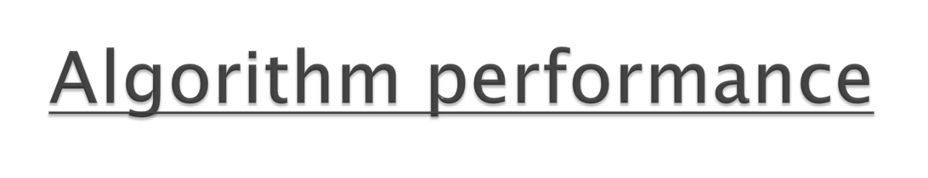
With Alpha-Beta Pruning the number of nodes on average that need to be examined is O(bd/2) as opposed to the Min-max algorithm which must examine 0(bd) nodes to find the best move. In the worst case Alpha-Beta will have to examine all nodes just as the original Minimax algorithm does. But assuming a best case result this means that the effective branching factor is b(1/2) instead of b.
For a chess game, which normally has a branching factor of 35, the branching factor will be reduced to 6! It means that a chess program running Alpha - Beta could look ahead twice as far in the same amount of time, improving the skill level of our chess program from a novice to an expert level player.

Slide 28

Definition: An algorithmic technique to find the optimal solution by keeping the best solution found so far. If a partial solution cannot improve on the best, it is abandoned.

Slide 29

For instance, suppose we want to find the shortest route from Zarahemla to Manti, and at some time the shortest route found until that time is 387 kilometers. Suppose we are to next consider routes through Cumeni. If the shortest distance from Zarahemla to Cumeni is 350 km and Cumeni is 46 km from Manti in a straight line, there is no reason to explore possible roads from Cumeni: they will be at least 396 km (350 + 46), which is worse than the shortest known route. So we need not explore paths from Cumeni.

Slide 30
The method can be implemented as a backtracking algorithm, which is a modified depth-first search, or using a priority queue ordering partial solutions by lower bounds.

Slide 31

Chess
Checkers
Tic-tac-toe
Other games

Slide 32
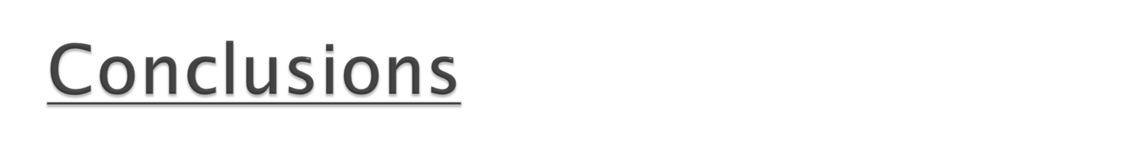

More techniques are being developed every day based both on advanced data structures, algorithms and AI methods to emulate cognitive process on computer.

