Slide 1
Chapter 4
The Divide-and-Conquer Strategy
4 -<number>

Slide 2
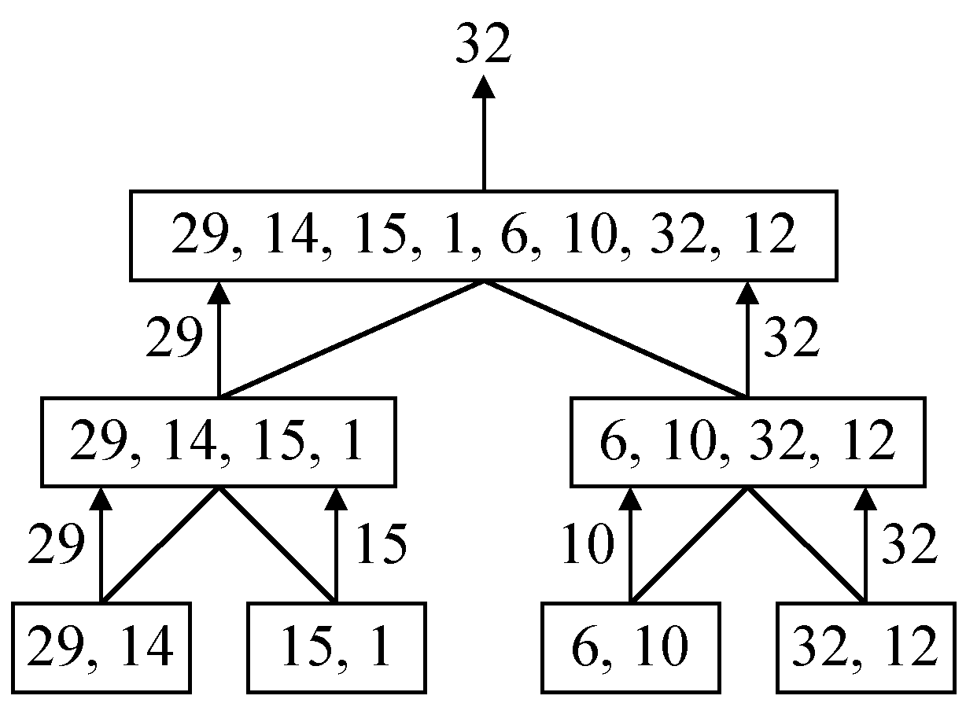
A simple example
finding the maximum of a set S of n numbers
4 -<number>

Slide 3

Time complexity
Time complexity:
T(n): # of comparisons
Calculation of T(n):
Assume n = 2^{k},
T(n) = 2T(n/2)+1
= 2(2T(n/4)+1)+1
= 4T(n/4)+2+1
:
=2^{k-1}T(2)+2^{k-2}+…+4+2+1
=2^{k-1}+2^{k-2}+…+4+2+1
=2^{k}-1 = n-1
4 -<number>

Slide 4
A general divide-and-conquer algorithm
Step 1: If the problem size is small, solve this problem directly; otherwise, split the original problem into 2 sub-problems with equal sizes.
Step 2: Recursively solve these 2 sub-problems by applying this algorithm.
Step 3: Merge the solutions of the 2 sub- problems into a solution of the original problem.
4 -<number>

Slide 5
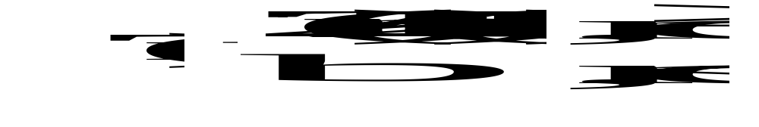
Time complexity of the general algorithm
Time complexity:
where S(n) : time for splitting
M(n) : time for merging
b : a constant
c : a constant
4 -<number>

Slide 6
Binary search
e.g. 2 4 5 6 7 8 9
↑
↑
↑
search 7: needs 3 comparisons
time: O(log n)
The binary search can be used only if the elements are sorted and stored in an array.
4 -<number>

Slide 7
Algorithm binary-search
Input: A sorted sequence of n elements stored in an array.
Output: The position of x (to be searched).
Step 1: If only one element remains in the array, solve it directly.
Step 2: Compare x with the middle element of the array.
Step 2.1: If x = middle element, then output it and stop.
Step 2.2: If x < middle element, then recursively solve the problem with x and the left half array.
Step 2.3: If x > middle element, then recursively solve the problem with x and the right half array.
4 -<number>

Slide 8
Algorithm BinSearch(a, low, high, x)
// a[]: sorted sequence in nondecreasing order
// low, high: the bounds for searching in a []
// x: the element to be searched
// If x = a[j], for some j, then return j else return –1
if (low > high) then return –1 // invalid range
if (low = high) then // if small P
if (x == a[i]) then return i
else return -1
else // divide P into two smaller subproblems
mid = (low + high) / 2
if (x == a[mid]) then return mid
else if (x < a[mid]) then
return BinSearch(a, low, mid-1, x)
else return BinSearch(a, mid+1, high, x)
4 -<number>

Slide 9
Quicksort
Sort into nondecreasing order
[26 5 37 1 61 11 59 15 48 19]
[26 5 19 1 61 11 59 15 48 37]
[26 5 19 1 15 11 59 61 48 37]
[11 5 19 1 15] 26 [59 61 48 37]
[11 5 1 19 15] 26 [59 61 48 37]
[ 1 5] 11 [19 15] 26 [59 61 48 37]
1 5 11 15 19 26 [59 61 48 37]
1 5 11 15 19 26 [59 37 48 61]
1 5 11 15 19 26 [48 37] 59 [61]
1 5 11 15 19 26 37 48 59 61
4 -<number>

Slide 10
Algorithm Quicksort
Input: A set S of n elements.
Output: The sorted sequence of the inputs in nondecreasing order.
Step 1: If |S|≤2, solve it directly.
Step 2: (Partition step) Use a pivot to scan all elements in S. Put the smaller elements in S₁, and the larger elements in S₂.
Step 3: Recursively solve S₁ and S₂.
4 -<number>

Slide 11
Time complexity of Quicksort
time in the worst case:
(n-1)+(n-2)+...+1 = n(n-1)/2= O(n²)
time in the best case:
In each partition, the problem is always divided into two subproblems with almost equal size.
n
n
×2 = n
2
log₂n
n
×4 = n
4
...
...
...
4 -<number>

Slide 12
Time complexity of the best case
T(n): time required for sorting n elements
T(n)≦ cn+2T(n/2), for some constant c.
≦ cn+2(c．n/2 + 2T(n/4))
≦ 2cn + 4T(n/4)
…
≦ cnlog₂n + nT(1) = O(nlogn)
4 -<number>

Slide 13
Two-way merge
Merge two sorted sequences into a single one.
time complexity: O(m+n),
m and n: lengths of the two sorted lists
[25 37 48 57][12 33 86 92]
[12 25 33 37 48 57 86 92]
merge
4 -<number>

Slide 14
Merge sort
Sort into nondecreasing order
log₂n passes are required.
time complexity: O(nlogn)
[25][57][48][37][12][92][86][33]
pass 1
[25 57][37 48][12 92][33 86]
pass 2
[25 37 48 57][12 33 86 92]
pass 3
[12 25 33 37 48 57 86 92]
4 -<number>

Slide 15
Algorithm Merge-Sort
Input: A set S of n elements.
Output: The sorted sequence of the inputs in nondecreasing order.
Step 1: If |S|≤2, solve it directly.
Step 2: Recursively apply this algorithm to solve the left half part and right half part of S, and the results are stored in S₁ and S₂, respectively.
Step 3: Perform the two-way merge scheme on S₁ and S₂.
4 -<number>

Slide 16
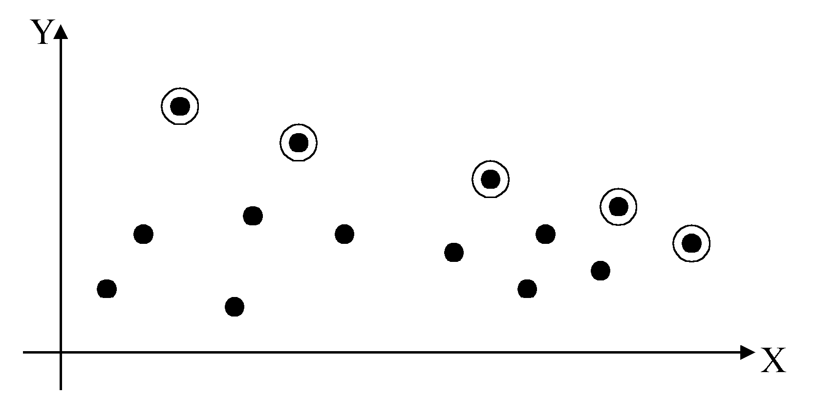
2-D maxima finding problem
Def : A point (x₁, y₁) dominates (x₂, y₂) if x₁ > x₂ and y₁ > y₂. A point is called a maximum if no other point dominates it
Straightforward method : Compare every pair of points.
Time complexity:
C(n,2)=O(n²)
4 -<number>

Slide 17
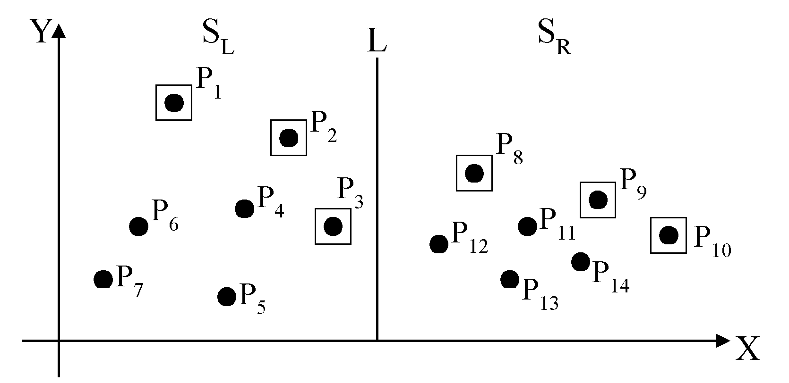
Divide-and-conquer for maxima finding
The maximal points of S_{L} and S_{R}
4 -<number>

Slide 18
The algorithm:
Input: A set S of n planar points.
Output: The maximal points of S.
Step 1: If S contains only one point, return it as the maximum. Otherwise, find a line L perpendicular to the X-axis which separates S into S_{L}and S_{R}, with equal sizes.
Step 2: Recursively find the maximal points of S_{L} and S_{R} .
Step 3: Find the largest y-value of S_{R}, denoted as y_{R}. Discard each of the maximal points of S_{L} if its y-value is less than y_{R}.
4 -<number>

Slide 19
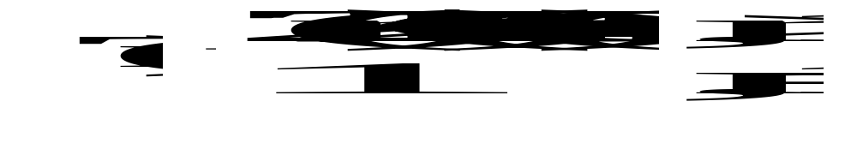
Time complexity: T(n)
Step 1: O(n)
Step 2: 2T(n/2)
Step 3: O(n)
Assume n = 2^{k}
T(n) = O(n log n)
4 -<number>

Slide 20
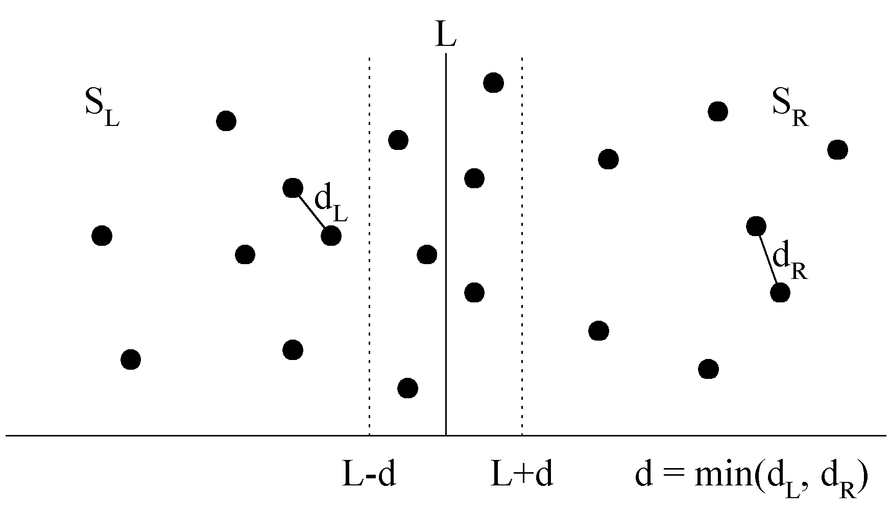
The closest pair problem
Given a set S of n points, find a pair of points which are closest together.
1-D version :
Solved by sorting
Time complexity :
O(n log n)
 2-D version
4 -<number>

Slide 21
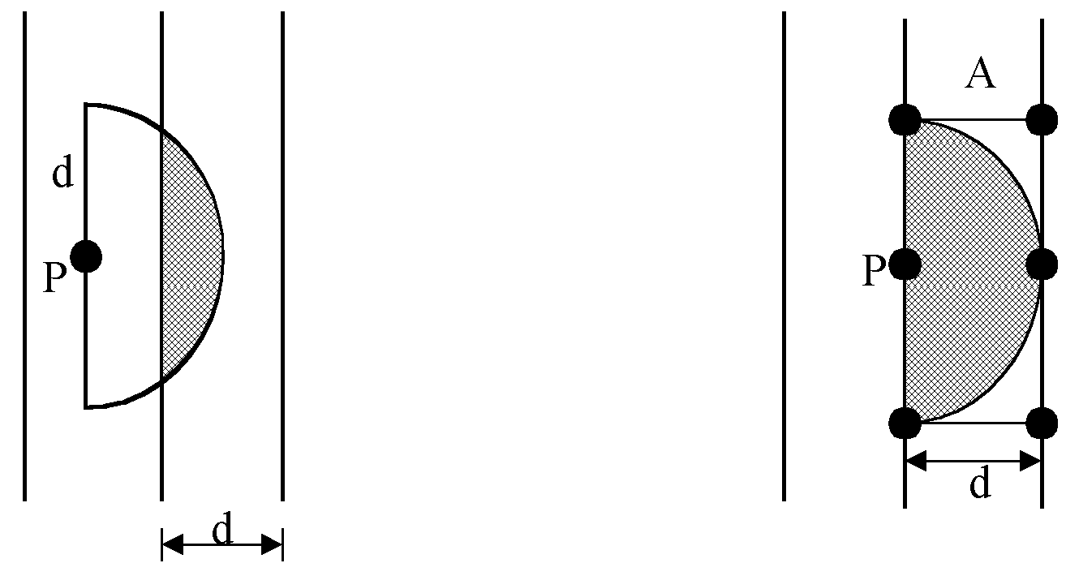
at most 6 points in area A:
4 -<number>

Slide 22
The algorithm:
Input: A set S of n planar points.
Output: The distance between two closest points.
Step 1: Sort points in S according to their y-values.
Step 2: If S contains only one point, return infinity as its distance.
Step 3: Find a median line L perpendicular to the X-axis to divide S into S_{L} and S_{R}, with equal sizes.
Step 4: Recursively apply Steps 2 and 3 to solve the closest pair problems of S_{L} and S_{R}. Let d_{L}(d_{R}) denote the distance between the closest pair in S_{L} (S_{R}). Let d = min(d_{L}, d_{R}).
4 -<number>

Slide 23
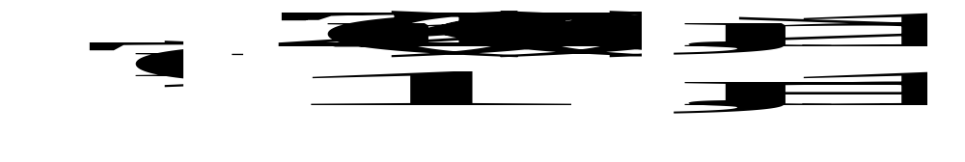
Step 5: For a point P in the half-slab bounded by L-d and L, let its y-value be denoted as y_{P} . For each such P, find all points in the half-slab bounded by L and L+d whose y-value fall within y_{P}+d and y_{P}-d. If the distance d′ between P and a point in the other half-slab is less than d, let d=d′. The final value of d is the answer.
Time complexity: O(n log n)
Step 1: O(n log n)
Steps 2~5:
⇒T(n) = O(n log n)
4 -<number>

Slide 24
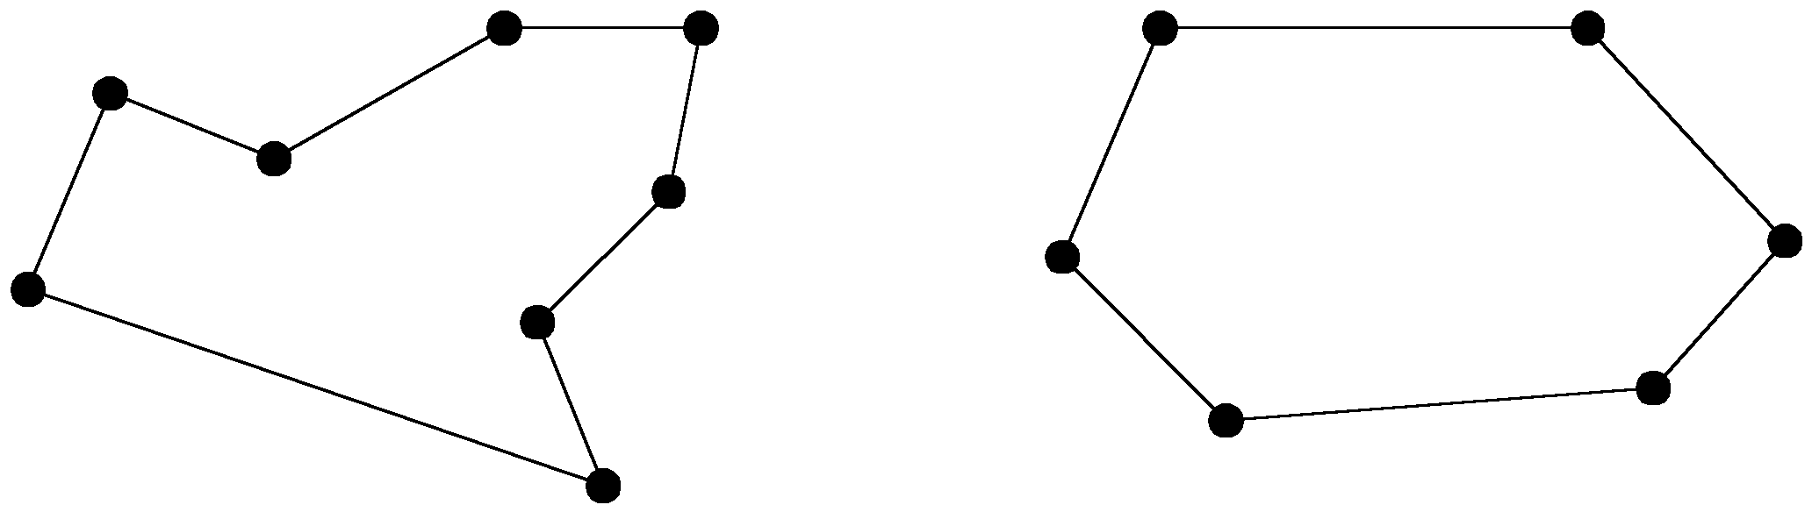
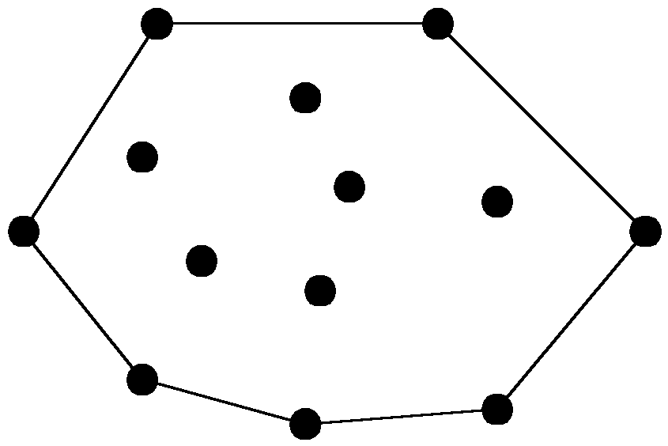
The convex hull problem
concave polygon:
convex polygon:
The convex hull of a set of planar points is the smallest convex polygon containing all of the points.
4 -<number>

Slide 25
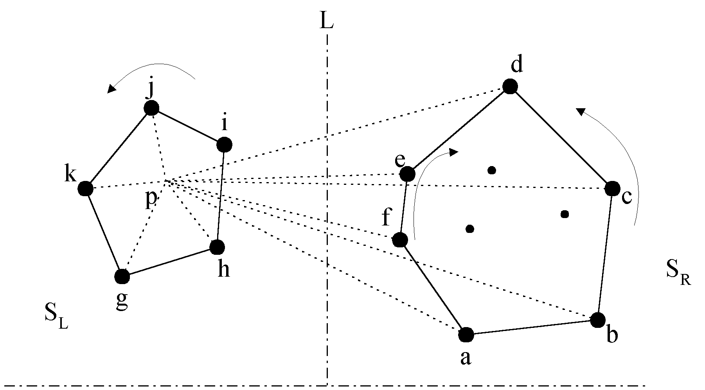
The divide-and-conquer strategy to solve the problem:
4 -<number>

Slide 26
The merging procedure:
Select an interior point p.
There are 3 sequences of points which have increasing polar angles with respect to p.
(1) g, h, i, j, k
(2) a, b, c, d
(3) f, e
Merge these 3 sequences into 1 sequence:
g, h, a, b, f, c, e, d, i, j, k.
Apply Graham scan to examine the points one by one and eliminate the points which cause reflexive angles.
(See the example on the next page.)
4 -<number>

Slide 27
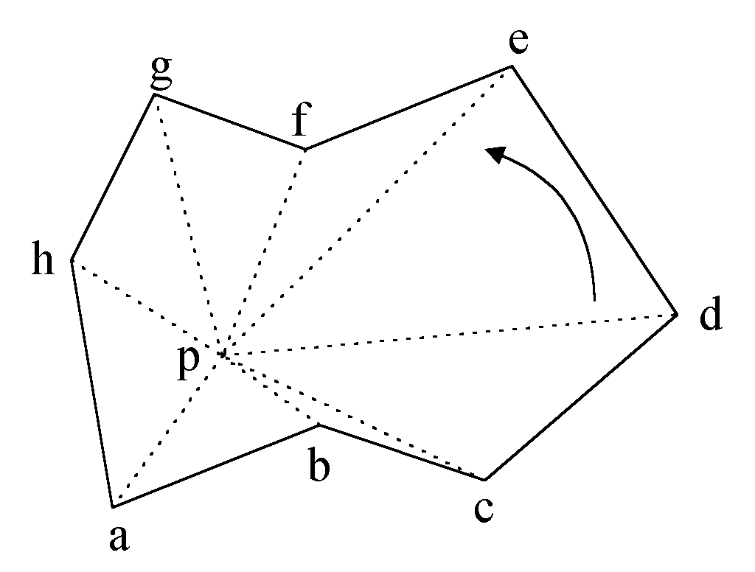
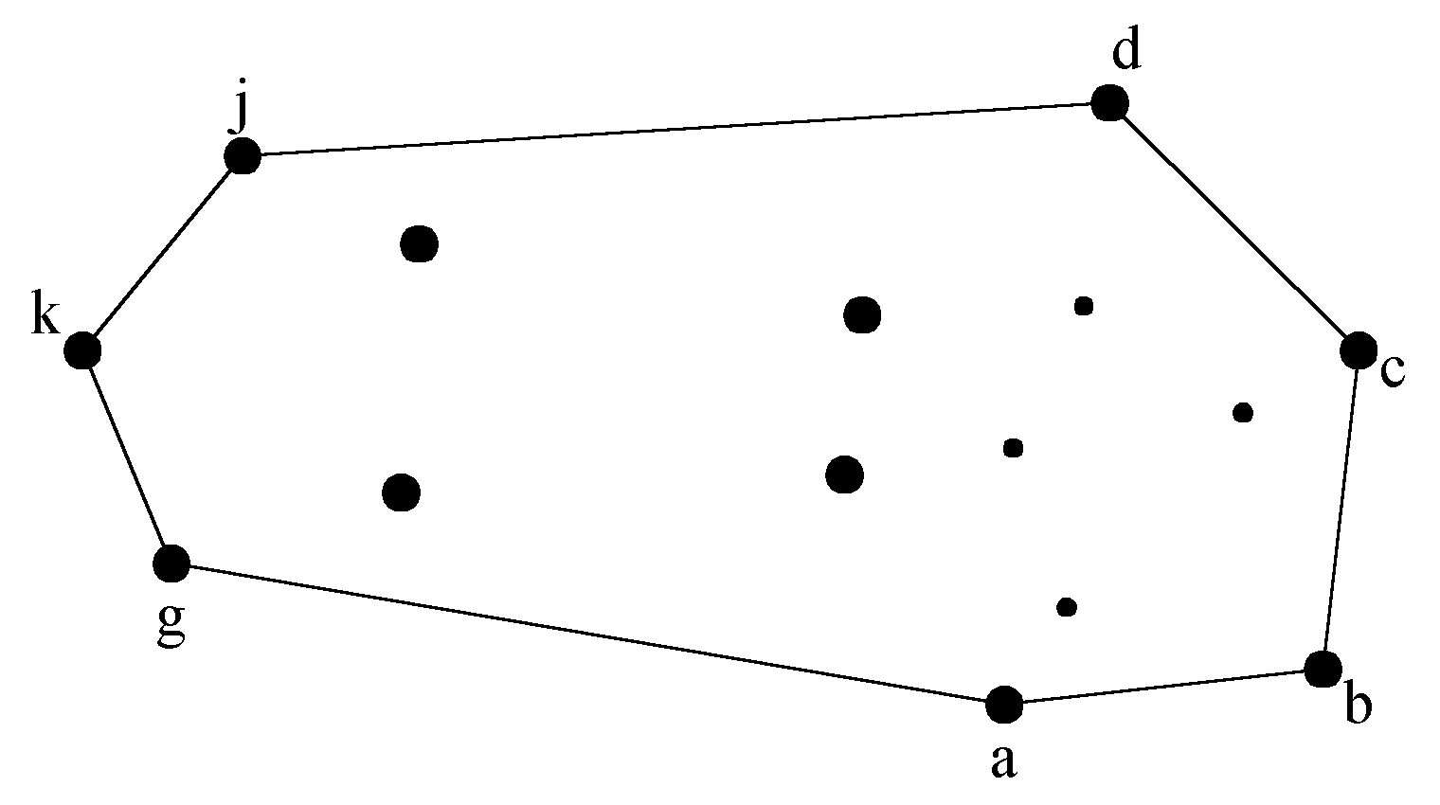
e.g. points b and f need to be deleted.
Final result:
4 -<number>

Slide 28
Divide-and-conquer for convex hull
Input : A set S of planar points
Output : A convex hull for S
Step 1: If S contains no more than five points, use exhaustive searching to find the convex hull and return.
Step 2: Find a median line perpendicular to the X-axis which divides S into S_{L} and S_{R}, with equal sizes.
Step 3: Recursively construct convex hulls for S_{L} and S_{R}, denoted as Hull(S_{L}) and Hull(S_{R}), respectively.
4 -<number>

Slide 29
Step 4: Apply the merging procedure to merge Hull(S_{L}) and Hull(S_{R}) together to form a convex hull.
Time complexity:
T(n) = 2T(n/2) + O(n)
= O(n log n)
4 -<number>

Slide 30
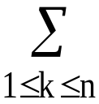
Matrix multiplication
Let A, B and C be n × n matrices
C = AB
C(i, j) = A(i, k)B(k, j)
The straightforward method to perform a matrix multiplication requires O(n³) time.
4 -<number>

Slide 31


Divide-and-conquer approach
C = AB
C₁₁ = A₁₁ B₁₁ + A₁₂ B₂₁
C₁₂ = A₁₁B₁₂ + A₁₂ B₂₂
C₂₁ = A₂₁ B₁₁ + A₂₂ B₂₁
C₂₂ = A₂₁ B₁₂ + A₂₂ B₂₂
Time complexity:
(# of additions : n²)
  We get T(n) = O(n³)
4 -<number>

Slide 32
Strassen’s matrix multiplicaiton
P = (A₁₁ + A₂₂)(B₁₁ + B₂₂)
Q = (A₂₁ + A₂₂)B₁₁
R = A₁₁(B₁₂ - B₂₂)
S = A₂₂(B₂₁ - B₁₁)
T = (A₁₁ + A₁₂)B₂₂
U = (A₂₁ - A₁₁)(B₁₁ + B₁₂)
V = (A₁₂ - A₂₂)(B₂₁ + B₂₂).
C₁₁ = P + S - T + V
C₁₂ = R + T
C₂₁ = Q + S
C₂₂ = P + R - Q + U
C₁₁ = A₁₁ B₁₁ + A₁₂ B₂₁
C₁₂ = A₁₁B₁₂ + A₁₂ B₂₂
C₂₁ = A₂₁ B₁₁ + A₂₂ B₂₁
C₂₂ = A₂₁ B₁₂ + A₂₂ B₂₂
4 -<number>

Slide 33

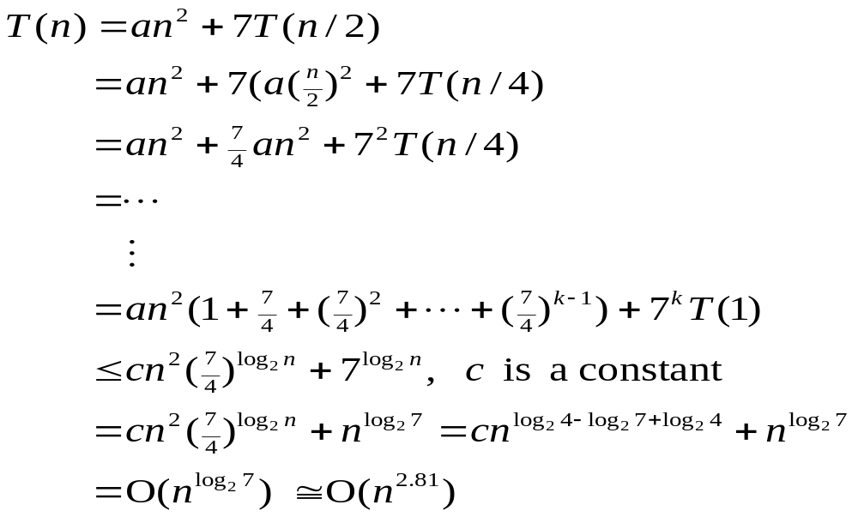
Time complexity
7 multiplications and 18 additions or subtractions
Time complexity:
4 -<number>

Slide 34
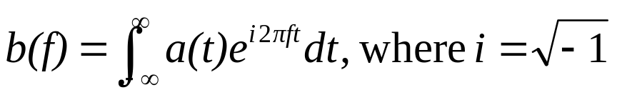
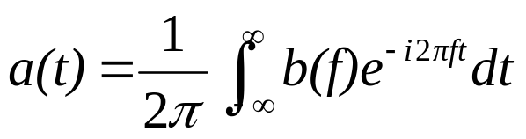
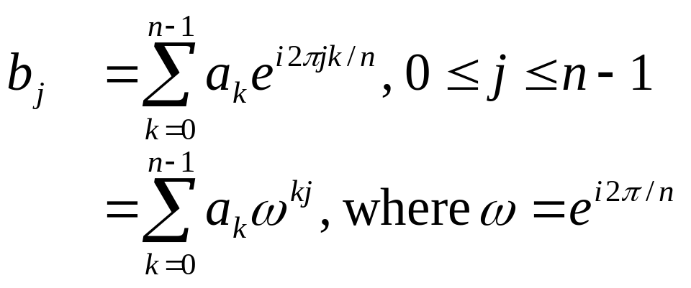
Fast Fourier transform (FFT)
Fourier transform
Inverse Fourier transform
Discrete Fourier transform(DFT)
Given a₀, a₁, …, a_{n-1} , compute
4 -<number>

Slide 35
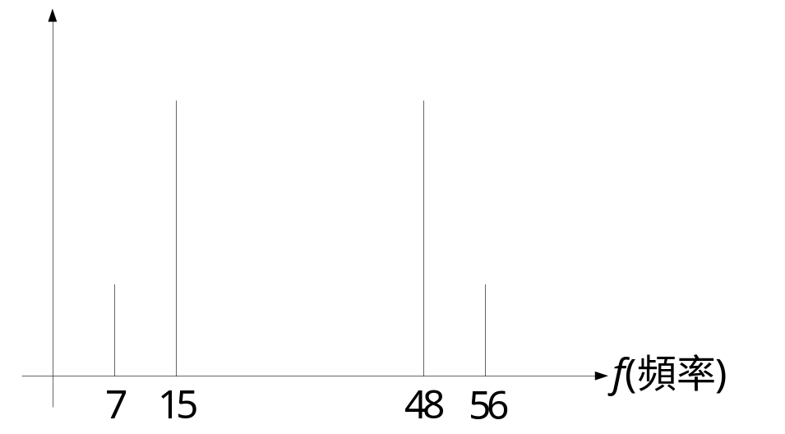
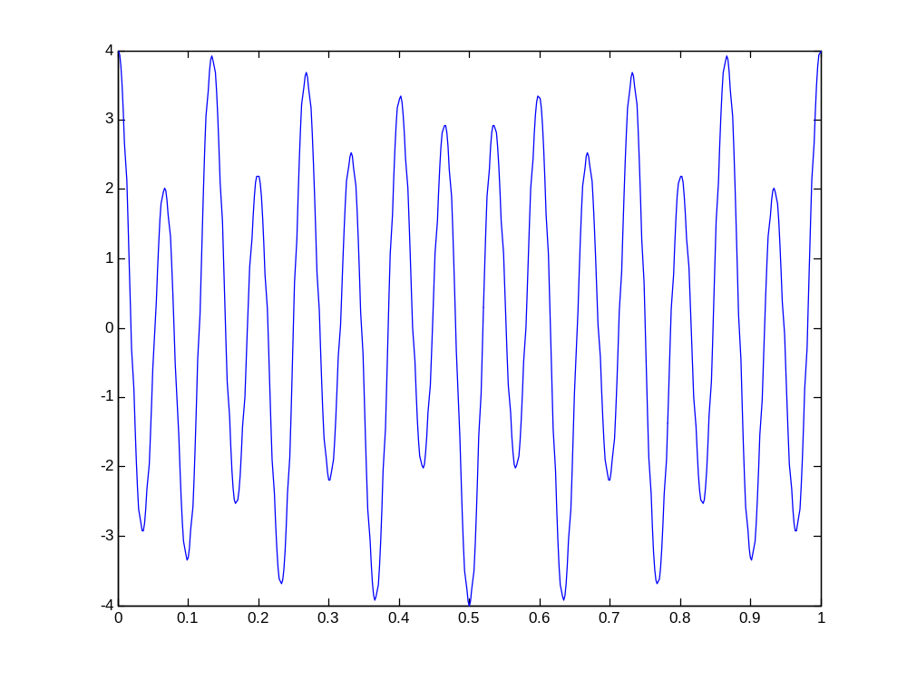
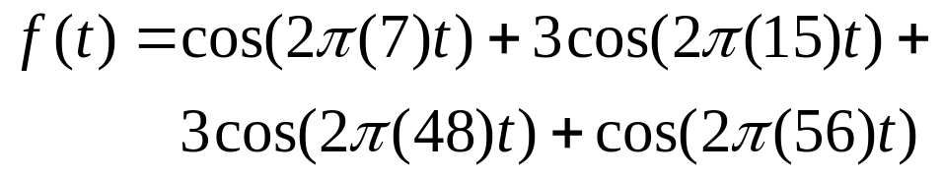
DFT and waveform(1)
Any periodic waveform can be decomposed into the linear sum of sinusoid functions (sine or cosine).
4 -<number>

Slide 36
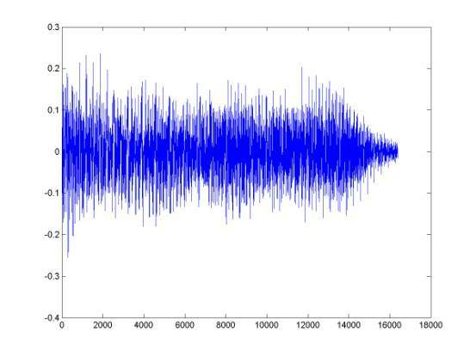
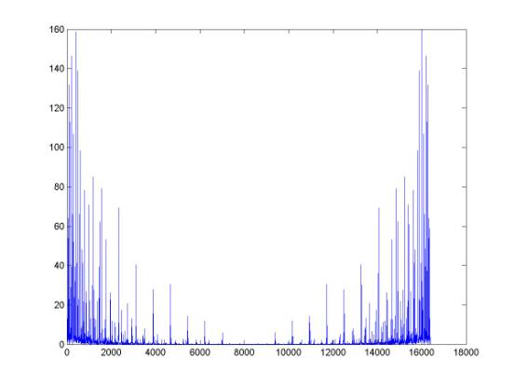
DFT and waveform (2)
The waveform of a music signal of 1 second
The frequency spectrum of the music signal with DFT
4 -<number>

Slide 37
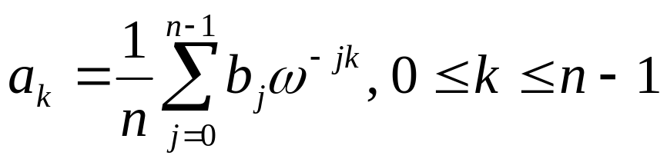
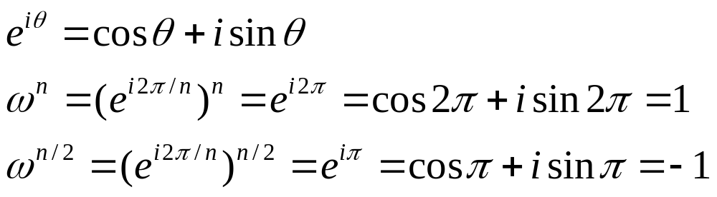
FFT algorithm
Inverse DFT:
DFT can be computed in O(n²) time by a straightforward method.
DFT can be solved by the divide-and-conquer strategy (FFT) in O(nlogn) time.
4 -<number>

Slide 38
FFT algorithm when n=4
n=4, w=e^{i2π/4} , w⁴=1, w²=-1
  b₀=a₀+a₁+a₂+a₃
  b₁=a₀+a₁w+a₂w²+a₃w³
  b₂=a₀+a₁w²+a₂w⁴+a₃w⁶
  b₃=a₀+a₁w³+a₂w⁶+a₃w⁹
another form:
  b₀ =(a₀+a₂)+(a₁+a₃)
  b₂ =(a₀+a₂w⁴)+(a₁w²+a₃w⁶) =(a₀+a₂)-(a₁+a₃)
When we calculate b₀, we shall calculate (a₀+a₂) and (a₁+a₃). Later, b₂ van be easily calculated.
Similarly,
  b₁ =(a₀+ a₂w²)+(a₁w+a₃w³) =(a₀-a₂)+w(a₁-a₃)
  b₃ =(a₀+a₂w⁶)+(a₁w³+a₃w⁹) =(a₀-a₂)-w(a₁-a₃).
4 -<number>

Slide 39
FFT algorithm when n=8
n=8, w=e^{i2π/8}, w⁸=1, w⁴=-1
b₀=a₀+a₁+a₂+a₃+a₄+a₅+a₆+a₇
b₁=a₀+a₁w+a₂w²+a₃w³+a₄w⁴+a₅w⁵+a₆w⁶+a₇w⁷
b₂=a₀+a₁w²+a₂w⁴+a₃w⁶+a₄w⁸+a₅w¹⁰+a₆w¹²+a₇w¹⁴
b₃=a₀+a₁w³+a₂w⁶+a₃w⁹+a₄w¹²+a₅w¹⁵+a₆w¹⁸+a₇w²¹
b₄=a₀+a₁w⁴+a₂w⁸+a₃w¹²+a₄w¹⁶+a₅w²⁰+a₆w²⁴+a₇w²⁸
b₅=a₀+a₁w⁵+a₂w¹⁰+a₃w¹⁵+a₄w²⁰+a₅w²⁵+a₆w³⁰+a₇w³⁵
b₆=a₀+a₁w⁶+a₂w¹²+a₃w¹⁸+a₄w²⁴+a₅w³⁰+a₆w³⁶+a₇w⁴²
b₇=a₀+a₁w⁷+a₂w¹⁴+a₃w²¹+a₄w²⁸+a₅w³⁵+a₆w⁴²+a₇w⁴⁹
4 -<number>

Slide 40
After reordering, we have
b₀=(a₀+a₂+a₄+a₆)+(a₁+a₃+a₅+a₇)
b₁=(a₀+a₂w²+a₄w⁴+a₆w⁶)+ w(a₁+a₃w²+a₅w⁴+a₇w⁶)
b₂=(a₀+a₂w⁴+a₄w⁸+a₆w¹²)+ w²(a₁+a₃w⁴+a₅w⁸+a₇w¹²)
b₃=(a₀+a₂w⁶+a₄w¹²+a₆w¹⁸)+ w³(a₁+a₃w⁶+a₅w¹²+a₇w¹⁸)
b₄=(a₀+a₂+a₄+a₆)-(a₁+a₃+a₅+a₇)
b₅=(a₀+a₂w²+a₄w⁴+a₆w⁶)-w(a₁+a₃w²+a₅w⁴+a₇w⁶)
b₆=(a₀+a₂w⁴+a₄w⁸+a₆w¹²)-w²(a₁+a₃w⁴+a₅w⁸+a₇w¹²)
b₇=(a₀+a₂w⁶+a₄w¹²+a₆w¹⁸)-w³(a₁+a₃w⁶+a₅w¹²+a₇w¹⁸)
Rewrite as
b₀=c₀+d₀ b₄=c₀-d₀=c₀+w⁴d₀
b₁=c₁+wd₁ b₅=c₁-wd₁=c₁+w⁵d₁
b₂=c₂+w²d₂ b₆=c₂-w²d₂=c₂+w⁶d₂
b₃=c₃+w³d₃ b₇=c₃-w³d₃=c₃+w⁷d₃
4 -<number>

Slide 41
c₀=a₀+a₂+a₄+a₆
c₁=a₀+a₂w²+a₄w⁴+a₆w⁶
c₂=a₀+a₂w⁴+a₄w⁸+a₆w¹²
c₃=a₀+a₂w⁶+a₄w¹²+a₆w¹⁸
Let x=w²=e^{i2π/4}
c₀=a₀+a₂+a₄+a₆
c₁=a₀+a₂x+a₄x²+a₆x³
c₂=a₀+a₂x²+a₄x⁴+a₆x⁶
c₃=a₀+a₂x³+a₄x⁶+a₆x⁹
Thus, {c₀,c₁,c₂,c₃} is FFT of {a₀,a₂,a₄,a₆}.
Similarly, {d₀,d₁,d₂,d₃} is FFT of {a₁,a₃,a₅,a₇}.
4 -<number>

Slide 42
General FFT
In general, let w=e^{i2π/n} (assume n is even.)
w^{n}=1, w^{n/2}=-1
  b_{j} =a₀+a₁w^{j}+a₂w^{2j}+…+a_{n-1}w^{(n-1)j},
  ={a₀+a₂w^{2j}+a₄w^{4j}+…+a_{n-2}w^{(n-2)j}}+
  w^{j}{a₁+a₃w^{2j}+a₅w^{4j}+…+a_{n-1}w^{(n-2)j}}
  =c_{j}+w^{j}d_{j}
  b_{j+n/2}=a₀+a₁w^{j+n/2}+a₂w^{2j+n}+a₃w^{3j+3n/2}+…
  +a_{n-1}w^{(n-1)j+n(n-1)/2}
  =a₀-a₁w^{j}+a₂w^{2j}-a₃w^{3j}+…+a_{n-2}w^{(n-2)j}-a_{n-1}w^{(n-1)j}
  =c_{j}-w^{j}d_{j}
  =c_{j}+w^{j+n/2}d_{j}
4 -<number>

Slide 43
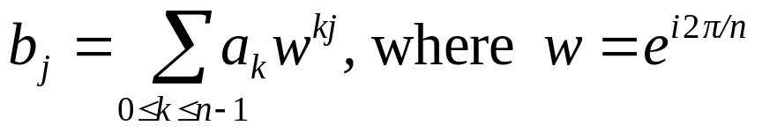
Divide-and-conquer (FFT)
Input: a₀, a₁, …, a_{n-1}, n = 2^{k}
Output: b_{j}, j=0, 1, 2, …, n-1
where
Step 1: If n=2, compute
b₀ = a₀ + a₁,
b₁ = a₀ - a₁, and return.
Step 2: Recursively find the Fourier transform of {a₀, a₂, a₄,…, a_{n-2}} and {a₁, a₃, a₅,…,a_{n-1}}, whose results are denoted as {c₀, c₁, c₂,…, c_{n/2-1}} and {d₀, d₁, d₂,…, d_{n/2-1}}.
4 -<number>

Slide 44
Step 3: Compute b_{j}:
b_{j} = c_{j} + w^{j}d_{j} for 0 ≤ j ≤ n/2 - 1
b_{j+n/2} = c_{j} - w^{j}d_{j} for 0 ≤ j ≤ n/2 - 1.
Time complexity:
T(n) = 2T(n/2) + O(n)
= O(n log n)
4 -<number>

