Slide 1

Working with Angular
Deep Dive

Slide 2
Components

Slide 3
Building Reusable Component
Product
Accept input (info)
Fire event (remove)
<app-product [info]="" (remove)="onProductRemoved()"></app-product>

Slide 4
Property & Event Binding
HTML Elements
Directives
Components
Native Properties & Events
Custom Properties & Events
Custom Properties & Events
<p [innerHTML]>
<button (click)>
<p [ngClass]>
<div [ngStyle]>
<some-element (addItem)>

Slide 5
Component Interaction
Add
Products
Output
(Custom event)
Input
(Custom property)
Product Add
Product
Info

Slide 6
Custom Property Binding
@Component({
selector: 'app-product-info',
template: `<h4>{{title}}</h4>`
})
export class ProductInfoComponent {
@Input() title = 'None';
}
Alias
@Input('t') title = 'None';
<app-product-info [title]="p.title">
</app-product-info>
<app-product-info [t]="p.title">
</app-product-info>

Slide 7
Custom Event Binding (EventEmitter)
@Component({
selector: 'app-product-add',
template: `<div>
Title: <input type='text' [(ngModel)]='title'><br>
Price: <input type='text' [(ngModel)]='price'><br>
In Stock: <input type='checkbox' [(ngModel)]='stock'><br>
<button (click)='onAddSubmit()'>Add</button></div>`
})
@Output() productAdded:EventEmitter<any> = new EventEmitter<any>();
onAddSubmit(){
this.productAdded.emit({title:this.title,
price:this.price,stock:this.stock});
}

Slide 8
Custom Event Binding (EventListener)
@Component({
selector: 'app-products',
template: `<app-product-add (productAdded)='onProductAdded($event)'>
</app-product-add>
<ul><li *ngFor="let p of products">
<app-product-info [t]="p.title"
[p]="p.price" [s]="p.stock"></app-product-info></li></ul>`
})
export class ProductsComponent {
products = [];
onProductAdded(data:any){
this.products.push(data);
}
}

Slide 9
Using Local References in Template
Local reference is the reference to DOM node.
Template
<input type="text" #titleInput>
<button (click)="onAddItem(titleInput)">Add</button>
onAddItem(titleInput:HTMLInputElement) {
this.itemAdded.emit({type:this.value, title:titleInput.value});
}

Slide 10
@ViewChild
Property decorator that configures a view query.
Template
<select #selectTypeElem>
@ViewChild('selectTypeElem') typeInput:ElementRef;
console.log(this.typeInput.nativeElement.value);

Slide 11
Content Projection
Content Projection is to project content from the parent Component to child Component

Slide 12
ng-content
If we add the tag <ng-content></ng-content> anywhere in our template HTML for our component. The inner content of the tags that define our component are then projected into this space.
app.component.html
page-comp.component.html
<page-comp>
<h1>Main Title</h1>
<h2>Sub Title</h2>
</page-comp>
<div>
<div>
<ng-content select="h1"></ng-content>
</div>
<div>
<ng-content select="h2"></ng-content>
</div>
</div>

Slide 13
@ContentChild
To access content which is stored in another component and passed via ng-content, ContentChild can be used to get the reference to the element.
app.component.html
<other-comp>
<p #paragraphContent>Some Content</p>
</other-comp>
other-comp.component.ts
@ContentChild(‘paragraphContent') paragraph:ElementRef;
this.paragraph.nativeElement.innerHTML

Slide 14
Change Detection
Each Angular Component has an associated change detector, which is created at application startup time.
By default, Angular Change Detection works by checking if the value of template expressions have changed. This is done for all components.
By default, Angular does not do deep object comparison to detect changes, it only takes into account properties used by the template
https://blog.angular-university.io/how-does-angular-2-change-detection-really-work/

Slide 15
Lifecycle Hooks
constructor
On creating component or directive instance with new
ngAfterContentInit
Called after content (ng-content) has been projected into View
ngOnChanges
Called after a bound input property changes
ngAfterContentChecked
Called everytime the projected content has been checked
ngOnInit
Called only once the component is initialized
ngAfterViewInit
Invoked when component’s view (and child views) has been fully initialized
ngDoCheck
Called during every change detection run
ngAfterViewChecked
Called after the component’s view (and child views) has been checked
ngOnDestroy
Invoked before angular destroys comp/direc

Slide 16
View Encapsulation

Slide 17
Style Scope
The styles specified in @Component metadata apply only within the template of that component.
Styles are not inherited by any components nested within the template nor by any content projected into the component.

Slide 18
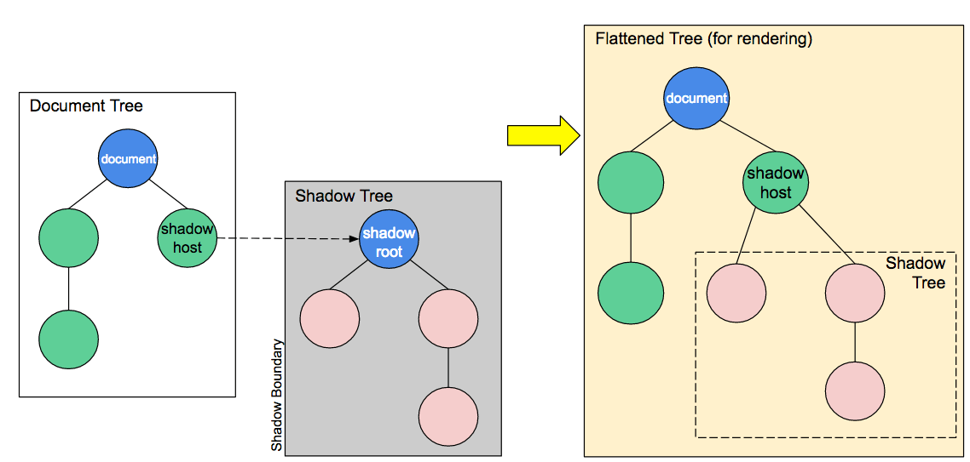
Shadow DOM
An important aspect of web components is encapsulation — being able to keep the markup structure, style, and behavior hidden and separate from other code on the page so that different parts do not clash, and the code can be kept nice and clean.
https://developer.mozilla.org/en-US/docs/Web/Web_Components/Using_shadow_DOM

Slide 19
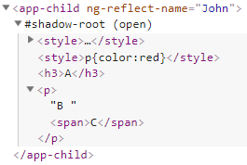

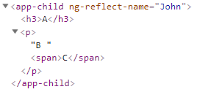
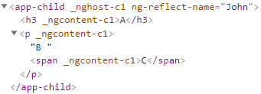
Modes
Native
@Component({
selector: 'app-child',
template: `<h3>A</h3>
<p>B <span>C</span></p>`,
styles: [`p{color:red}`],
encapsulation: ViewEncapsulation.None
})
None
Emulated (default)

Slide 20
Flow
styles.css
(M)
Emulated
(default)
Native
None
parent.component.css
(P)
M->P & P
P
P & P->M
M->C
child.component.css
(C)
M->C & C
C
C & C->M
M->P

Slide 21
Custom Directives

Slide 22
Creating Attribute Directives

Slide 23
Creating Attribute Directive
@Directive({
selector: '[appBasicHighLight]'
})
export class BasicHighLightDirective implements OnInit {
constructor(private elementRef : ElementRef) { }
ngOnInit() {
this.elementRef.nativeElement.style.backgroundColor = 'green';
}
}
<p appBasicHighLight>Style from basic highlight directive</p>

Slide 24
Renderer2
The Renderer2 class is an abstraction provided by Angular in the form of a service that allows to manipulate elements of your app without having to touch the DOM directly.
This is the recommended in environments that don’t have DOM access, like on the server, in a web worker or on native mobile.
https://alligator.io/angular/using-renderer2/

Slide 25
Using Renderer2
platform independent way of setting properties on our elements
@Directive({
selector: '[appBetterHighLight]'
})
export class BetterHighLightDirective implements OnInit {
constructor(private elemRef:ElementRef,private renderer:Renderer2
) { }
ngOnInit() {
this.renderer.setStyle(this.elemRef.nativeElement, ‘background-color’, ‘blue’);
}
}
<p appBetterHighLight>Style from better highlight directive</p>
Notes:
Angular has been built from the ground up to work in a number of different environments,
including server side via node and on a native mobile device. So the Angular team has provided a
platform independent way of setting properties on our elements via something called a Renderer

Slide 26
@HostListener
HostListener is the decorator to listen to events triggered on elements the directive is attached on.
@HostListener('mouseenter') mouseover(eventData: Event) {
}

Slide 27
@HostBinding
HostBinding is the decorator to bind to host element property.
@HostBinding('style.backgroundColor') backgroundColor:string;
@HostListener('mouseenter') mouseover(eventData: Event) {
this.backgroundColor = 'blue';
}
@HostListener('mouseleave') mouseleave(eventData: Event) {
this.backgroundColor = 'transparent';
}

Slide 28
Custom Property Binding in Directives
@Input() defaultColor:string = 'transparent';
@Input() highlightColor:string = 'blue';
<p appBetterHighlight [defaultColor]="'yellow'" [highlightColor]="'green'">Style from better highlight directive</p>

Slide 29
Creating Structural Directives

Slide 30
Views & ViewContainers
View is the smallest grouping of display elements that can be created and destroyed together
A view that belongs to a component is called a host view, represented by ViewRef
Comp.
Comp.
View Container
View
View
The root view is a component's host view. A host view can be the root of a tree of embedded views, collected in a view container (ViewContainerRef) attached to an anchor element in the hosting component. The view hierarchy is a key part of Angular change detection
DOM

Slide 31
View Types
View Container
Embedded View
(linked to template)
Host View
(linked to component)

Slide 32
Understand Structural Directive
<ul>
<li *ngFor="let i of arr">
<div *ngIf="i%2===1">
<p>This is Odd</p>
</div>
<ng-template [ngIf]="i%2===0">
<div>
<p>This is Even</p>
</div>
</ng-template>
</li>
</ul>

Slide 33
Creating Structural Directive
@Directive({
selector: '[appUnless]'
})
export class UnlessDirective {
@Input() set appUnless(condition:boolean){
if(!condition) {
this.vcRef.createEmbeddedView(this.templateRef);
} else {
this.vcRef.clear();
}
}
constructor(private templateRef:TemplateRef<any>, private vcRef: ViewContainerRef) { }
}

Slide 34
Using ngSwitch
value = 120;
<div [ngSwitch]="value">
<p *ngSwitchCase="5">Five</p>
<p *ngSwitchCase="10">Ten</p>
<p *ngSwitchCase="100">Hundred</p>
<p *ngSwitchDefault>Default</p>
</div>

