Slide 1

Working with Angular
modules

Slide 2
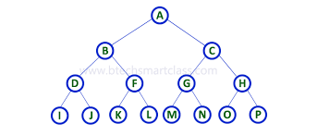
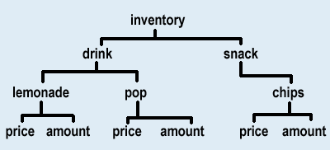
Landscape

Slide 3
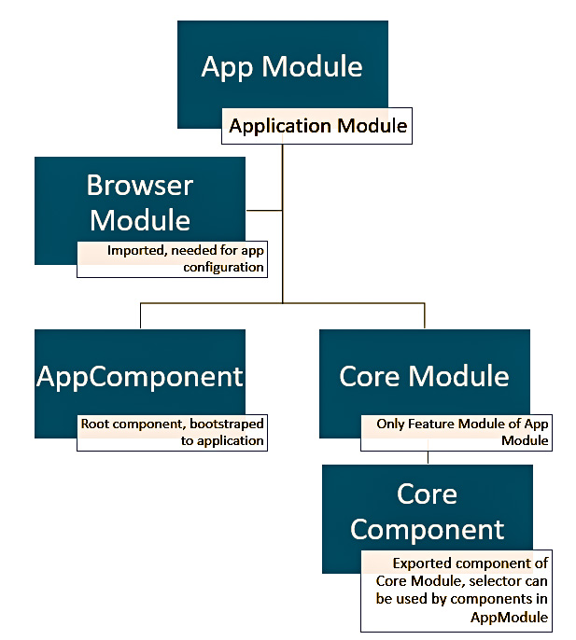
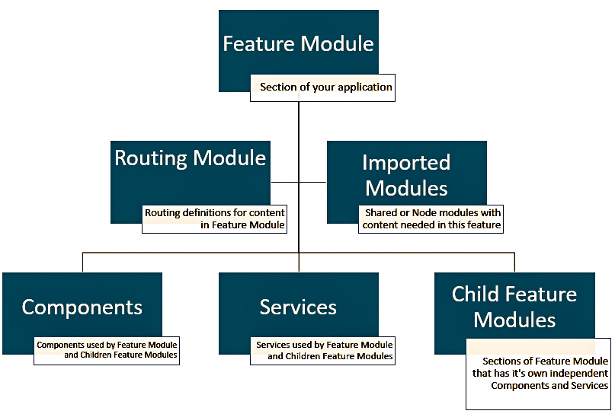
Module Design
Shared Module

Slide 4
AppModule
AppRoutingModule
@NgModule({
declarations: [
AppComponent,
HomeComponent,
NotFoundComponent,
UsersComponent,
EditUserComponent,
UserComponent,
ProductsComponent,
EditProductComponent,
ProductComponent
],
imports: [
BrowserModule,
FormsModule,
HttpModule,
AppRoutingModule
],
providers: [UsersService, ProductsService, AuthGaurdService, AuthService],
bootstrap: [AppComponent]
})
@NgModule({
imports: [
RouterModule.forRoot(appRoutes)
],
exports: [RouterModule]
})

Slide 5
Lazy Loading
@NgModule({
declarations: [
..
],
imports: [
ProductsModule
],
providers: [],
bootstrap: [AppComponent]
})
1. Remove the module (ProductsModule) from imports
2. Create separate routing module for products and routes inside
@NgModule({
imports: [ RouterModule.forChild(productsRoutes)
],
exports: [RouterModule]
})
3. Use loadChildren property with path to dynamically load module
{ path: ‘products', loadChildren: './products/products.module#ProductsModule'}

Slide 6
References
https://www.intertech.com/Blog/angular-module-tutorial-application-structure-using-modules/

