Slide 1
An introduction to
Deep Learning
More at neuralnetworksanddeeplearning.com
Winter School on Quantitative Biology
Learning and Artificial Intelligence
ICTP – November 2018

Slide 2
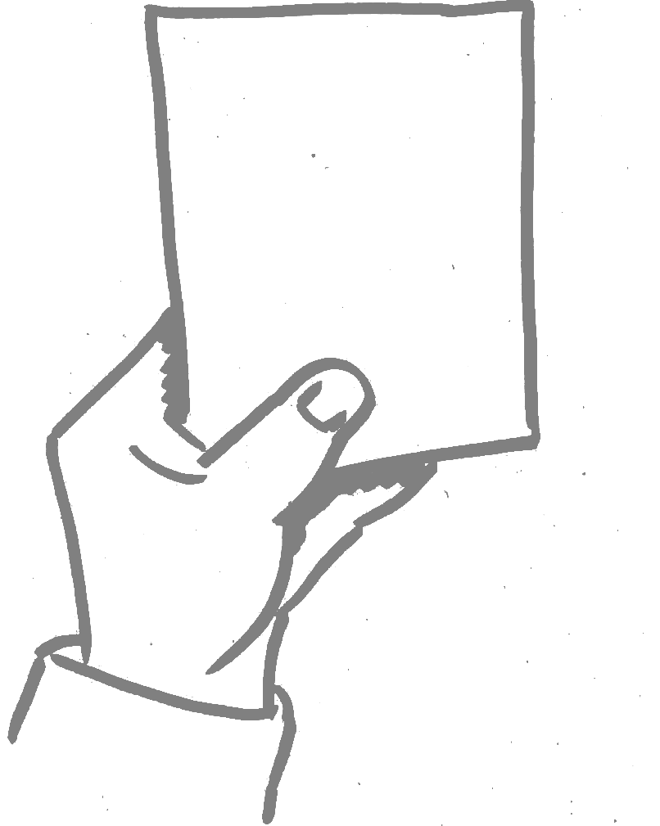
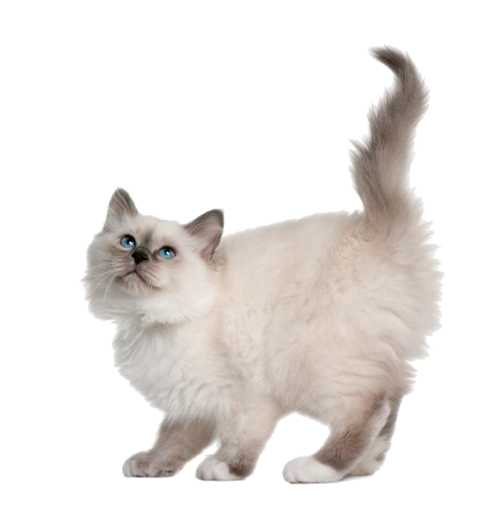
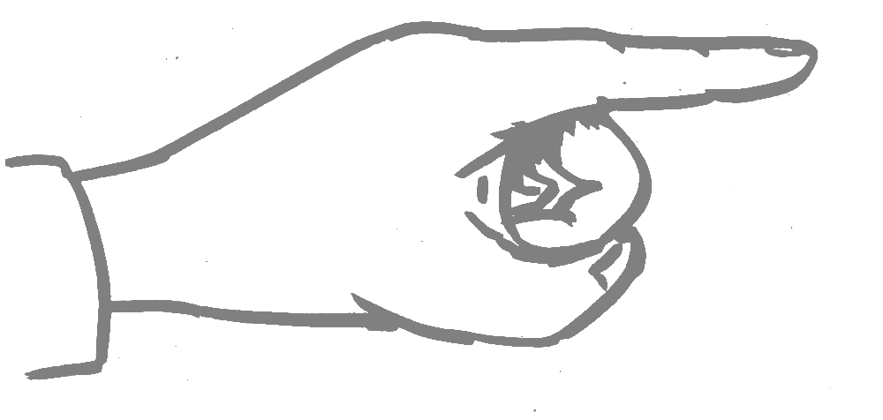
What is this about?
“is this a cat or a dog?”
“what digit is this?”
Classification tasks
Supervised Learning: by examples, with a teacher
cat
dog

Slide 3
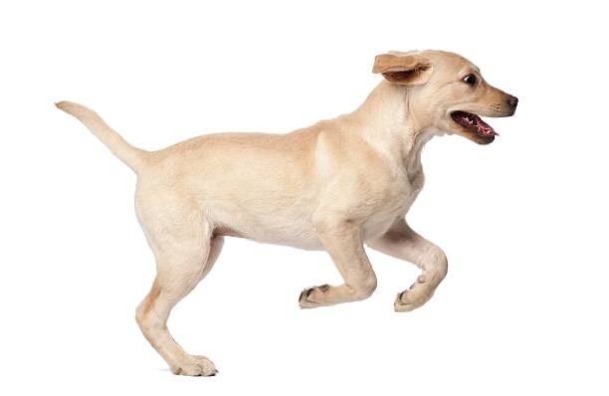
What is this about?
“is this a cat or a dog?”
“what digit is this?”
Classification tasks
Supervised Learning: by examples, with a teacher
cat
dog

Slide 4
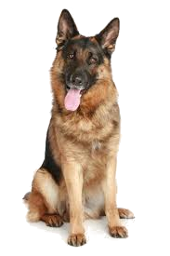
What is this about?
“is this a cat or a dog?”
“what digit is this?”
Classification tasks
Supervised Learning: by examples, with a teacher
cat
??
dog
Generalization to unseen picture

Slide 5
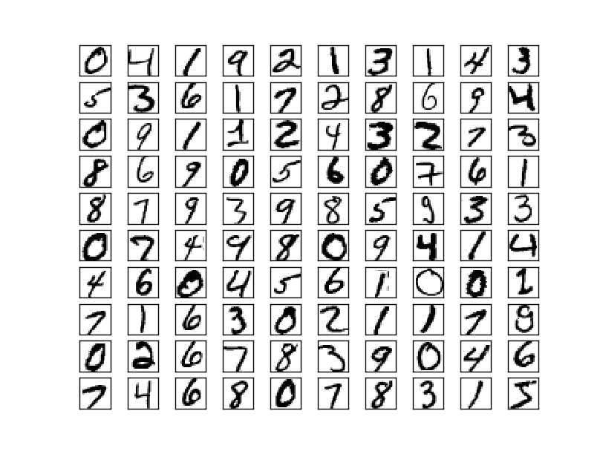
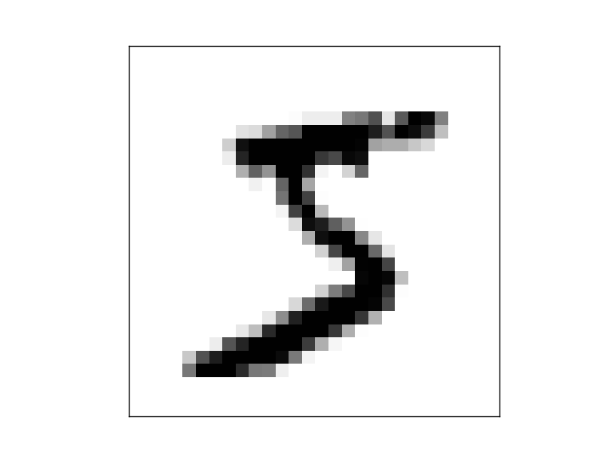
Let us play with digits…
… the MNIST database
Classification of
handwritten
digits
70’000
input/output pairs
How to use them?
Input
Correct output

Slide 6
Let us play with digits…
… the MNIST database
Input
Correct output
A parametrized function…
How to construct it?
Feed-Forward Neural Networks

Slide 7
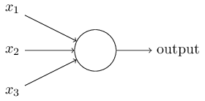
Feed-Forward Neural Networks...
...the ingredients
from the input
or
from other neurons
to output
or
to other neurons

Slide 8
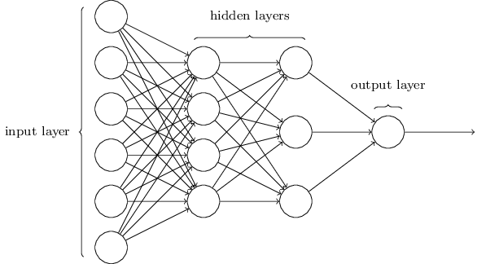

Feed-Forward Neural Networks...
...the architecture
39 weights + 8 biases
= 47 parameters
one weight per arrow
one bias per neuron

Slide 9

Feed-Forward Neural Networks...
...universal function approximators
[Cybenko, G. (1989) Approximations by superpositions of sigmoidal functions]

Slide 10
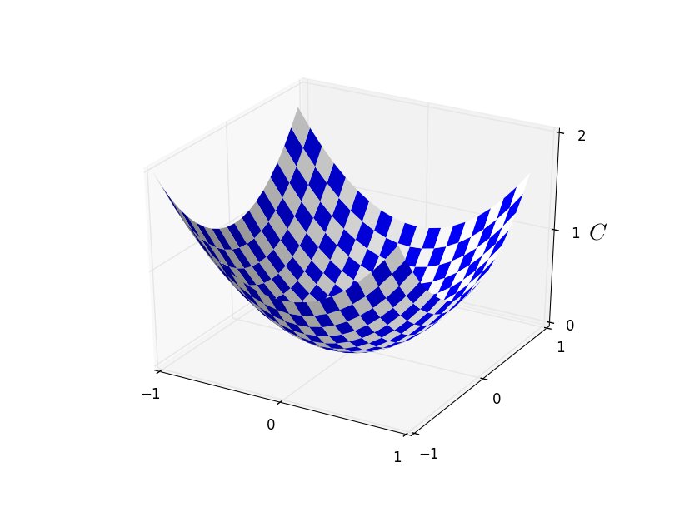






Learning through gradient descent
Minimize a cost function:
neurons
in layer
(output)
training
data
Gradient descent update rules:
learning rate

Slide 11



The backpropagation algorithm
The error:
How much does the cost change as an effect of a change in the input of a given neuron in a given layer?
Small if the parameters are close to optimal.
chain rule

Slide 12




The backpropagation algorithm
Start from the output layer...
… and back-propagate to the previous ones

Slide 13


The mini-batch update
Divide the training dataset into M batches of size S:
{training data} = { {mini-batch 1}, {mini-batch 2}, … {mini-batch M} }
Average within mini-batches first…
mini-batch
mini-batch
… and use the mini-batch estimate of the gradient for gradient descent
(then iterate over all mini-batches)
Stochastic Gradient Descent (SGD)

