Slide 1
GHOTA — DR severity (OCT + fundus)
3-class: none / early–moderate / advanced · Glaucoma stays in GLAUCO

Slide 2
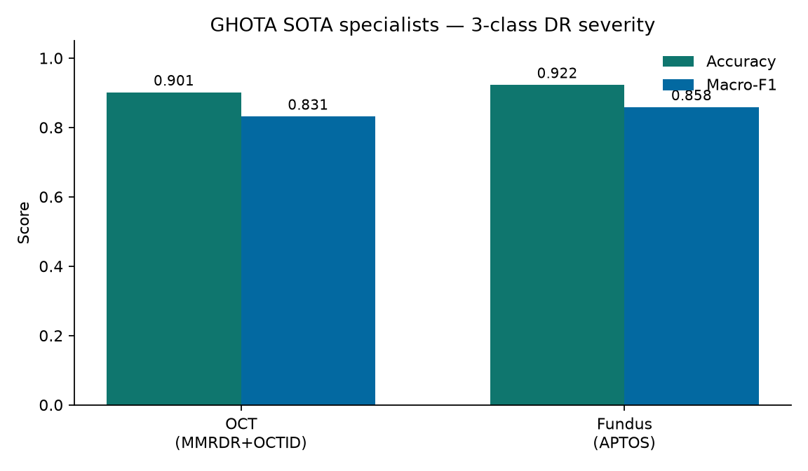
Results — SOTA specialists
OCT (MMRDR+OCTID): Acc 90.1% · Macro-F1 0.831
Fundus APTOS: Acc 92.2% · Macro-F1 0.858
OEFI external DME: AUC 0.994 · Sens 0.952 / Spec 0.969
Recipe: RETFound + Focal + layer-decay 0.65 + cosine + head warmup

Slide 3
Fusion & defense line
Unpaired multi-modal SOTA today: task-conditioned dual specialists
Late fusion / cross-attn code ready — needs real eye-paired fundus+OCT
GLAUCO = glaucoma; GHOTA = DR only — cleaner Acc, cleaner story
Today: dual specialists by modality. Tomorrow: late/cross-attn fusion on real pairs.

