Slide 1
OCT / Fundus AI — Supervisor Update
GLAUCO = glaucoma screening & fusion
GHOTA = diabetic retinopathy 3-class severity (OCT + fundus)
Modality routing + real paired fusion (OEFI) — no disease / modality soup

Slide 2
1. Product split (fixes modality / label conflict)
GLAUCO → Glaucoma only → Fundus AUC 0.983 · RNFLT AUC 0.91 · GLEAM fusion AUC ~0.95
GHOTA → DR / DME only → 3-class: none / early–moderate / advanced
OCT specialist Acc 0.901 · Fundus specialist Acc 0.922
Inference: route by modality; fuse only when same-eye OCT+fundus exist
Glaucoma never mixed into DR head (and vice versa) — cleaner Acc, cleaner clinic story

Slide 3
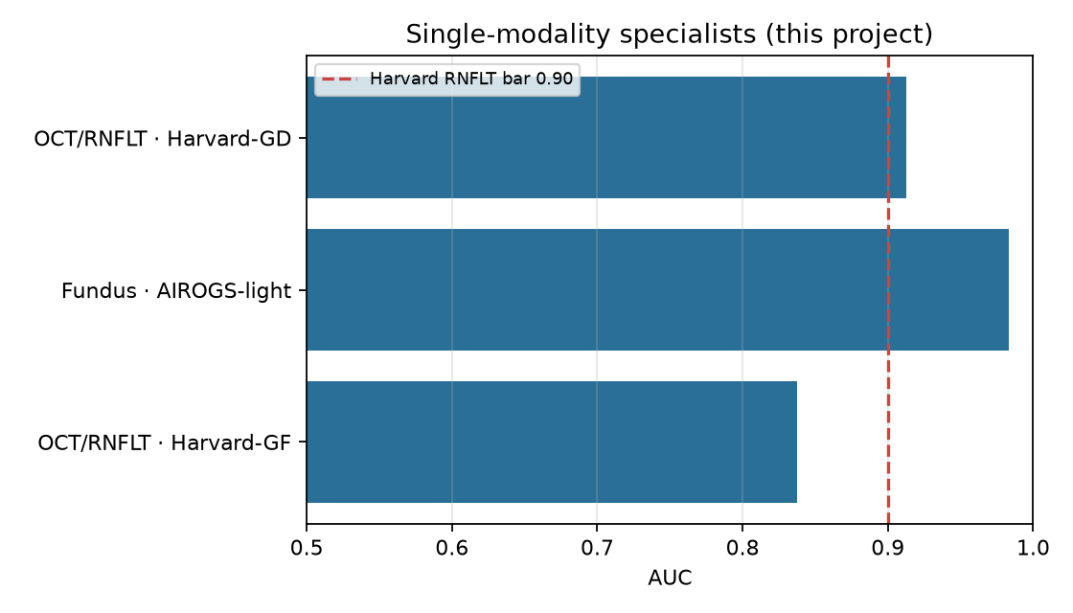
2. GLAUCO — glaucoma results
Fundus RETFound (AIROGS-light): AUC 0.983 · F1 0.936
OCT RNFLT Harvard-GD: AUC 0.913 · F1 0.830
GLEAM trimodal late: Acc 0.762 · F1 0.704 · binary AUC 0.947
GLEAM trimodal binary: Acc 0.867 · AUC 0.955
Compare HAMM lit bar ~ Acc 0.81 / F1 0.76 / AUROC 0.93 — binary AUC on par; multi-class stretch
AR / Lucida-style demo available under docs/glauco_ar_demo/

Slide 4
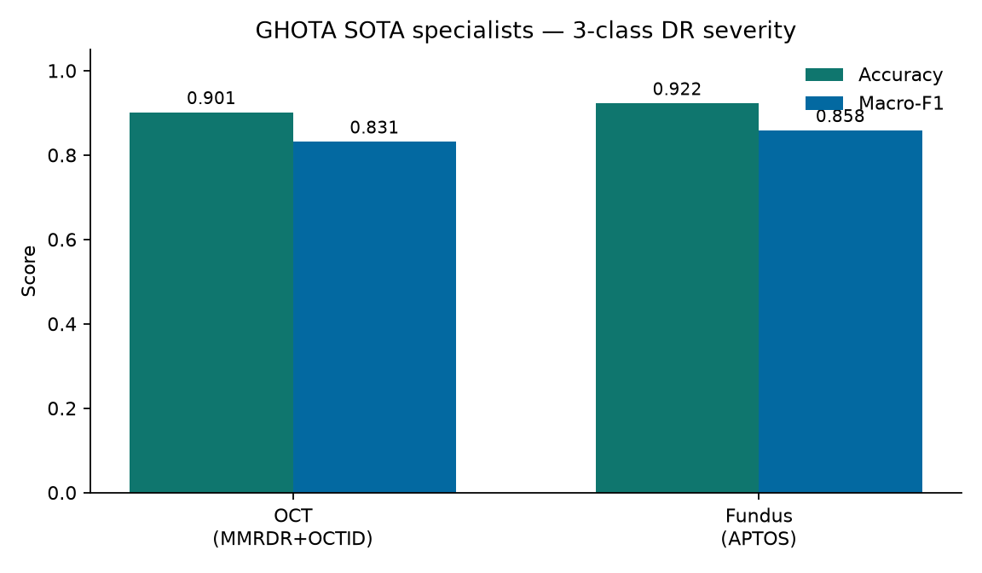
3. GHOTA — 3-class DR (SOTA specialists)
Unified labels: 0 = none · 1 = early–moderate (1+2+3) · 2 = advanced (4+5 / CI-DME)
OCT (MMRDR+OCTID): Acc 0.901 · Macro-F1 0.831
Fundus (APTOS): Acc 0.922 · Macro-F1 0.858
OEFI external DME: AUC 0.994 · Sens 0.952 · Spec 0.969
Recipe: RETFound + Focal + layer-decay 0.65 + cosine + head warmup

Slide 5
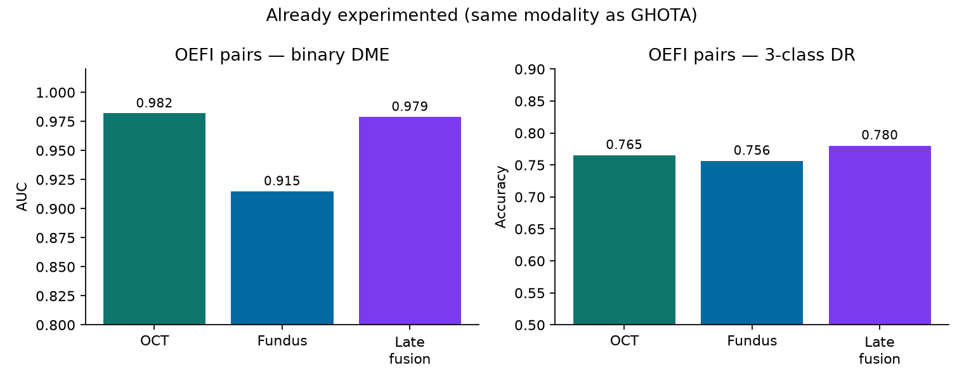
4. Honest paired fusion (OEFI same-eye)
409 real patient/eye pairs from OEFI (not fabricated pairs)
Patient-level holdout test n=101
Avg late fuse Acc 0.733 → Feature MLP 0.762 → Cross-attn Acc 0.802 / F1 0.714
Production CLI: python -m ghota.infer (--modality OR --oct/--fundus)
Key claim: fusion only when pairs are real — resolves mentor modality conflict

Slide 6
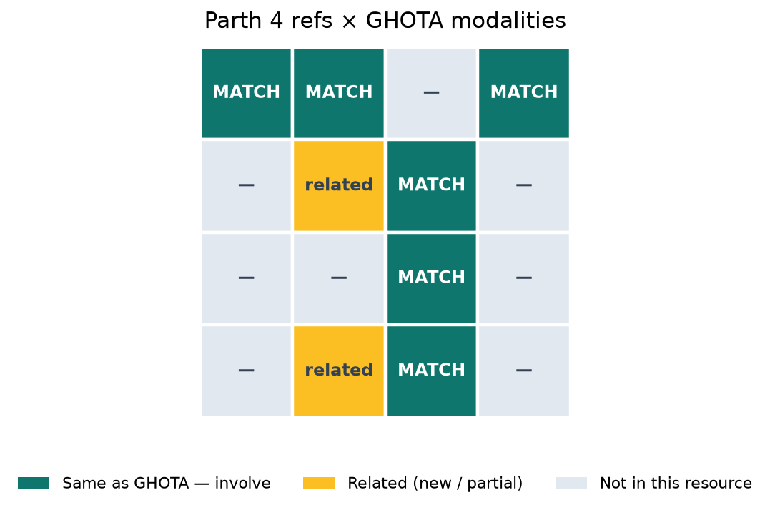
5. Four reference links — modality fit & action
1 OEFI (GitHub) — fundus+OCT paired — MATCH — downloaded, fused, trained
2 OCTA-500 (IEEE) — OCT + OCTA — partial — needs IEEE login + password email
3 ROAD (OCTA DR) — OCTA 3-grade — partial — needs author email; maps to GHOTA 0/1/2
4 DcardNet (arXiv 2006.05480) — private OHSU OCT+OCTA — cite only, no download
Same-modality extras on disk: IDRiD fundus · Kermany OCT (optional scale)
We do NOT force OCTA into CFP/OCT specialists (production discipline)

Slide 7
6. What we want from supervisor
Confirm: keep GLAUCO ⊥ GHOTA split (recommended)
Approve OCTA track (OCTA-500 / ROAD access emails) as Phase-2 modality
Publication angle: task-conditioned dual specialists + honest paired fusion
Ready demos today: specialists Acc · OEFI external · trained xattn fusion · AR glaucoma

