Slide 1


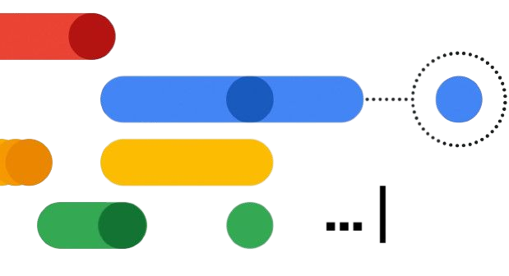
Machine Learning Workshop
Explore, Learn, Thrive
ORGANISED BY
Google DSC Core Team, Silicon Chapter

Slide 2


What is Machine Learning?
Machine learning is the field of study that gives computers the ability to learn without being explicitly programmed.
Instead of writing a program by hand, collect lots of examples that specify the correct output for a given input.
A machine learning algorithm takes these examples and produces a program that does the job.
If done right, the program works for new cases as well as the ones we trained it on.

Slide 3

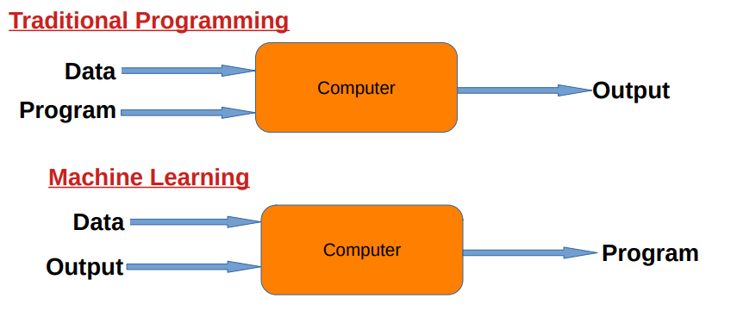
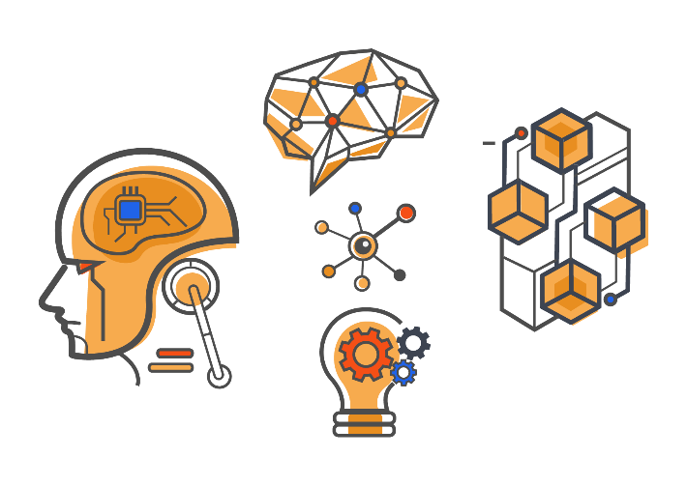
Motivation for ML

Slide 4

Examples in Real Life
● Social Media Features
● Spam Filter
● Product Recommendations
● Image Recognition
● Sentiment Analysis.
● Speech Recognition
● Self Driving Cars

Slide 5
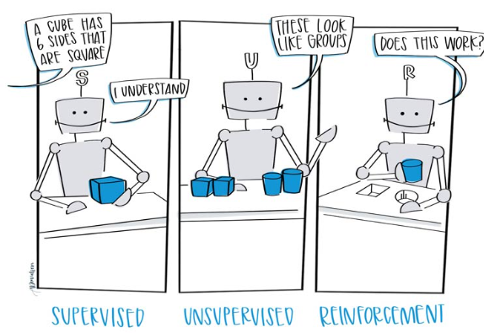
Types of Machine Learning
SUPERVISED LEARNING:
Supervised learning is a type of machine learning that uses labeled data to train machine learning models.
In labeled data, the output is already known.
The model just needs to map the inputs to the respective outputs.
Types:
Classification: A classification problem is when the output variable is a category, such as ‘red’ or ‘blue’, ‘disease’ or ‘no disease’. Ex- Diabetes(Y/N) from age,wt,chl,bp etc..
Regression: A regression problem is when the output variable is a real value, such as ‘dollars’ , ‘weight’.
Ex- Stock Index(number) from goldrate,petrolrate,exchangerate

Slide 6
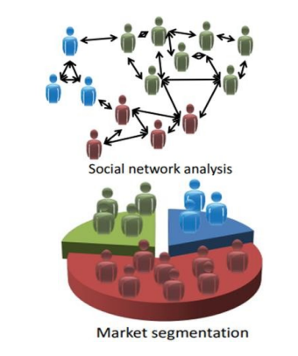
Types of Machine Learning
UNSUPERVISED LEARNING:
Unsupervised learning is a type of machine learning that uses unlabeled data to train machines.
Unlabeled data doesn’t have a fixed output variable.
The model learns from the data, discovers the patterns and features in the data, and returns the output.
Types:
Clustering: A clustering problem is where you want to discover the inherent groupings in the data, such as grouping customers by purchasing behavior.
Association: An association rule learning problem is where you want to discover rules that describe large portions of your data, such as people that buy X also tend to buy Y

Slide 7
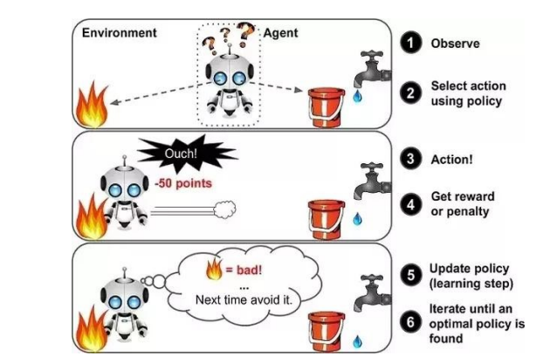
Types of Machine Learning
REINFORCEMENT LEARNING:
A reinforcement learning algorithm, or agent, learns by interacting with its environment.
The agent receives rewards by performing correctly and penalties for performing incorrectly.
The agent learns without intervention from a human by maximizing its reward and minimizing its penalty.

Slide 8
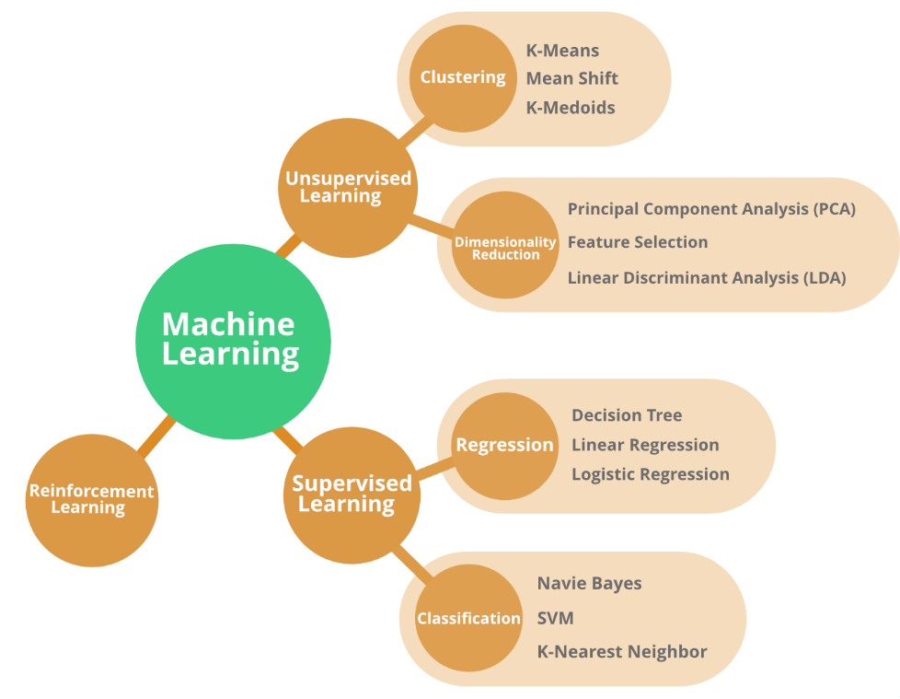
Some Popular Algorithms
Linear Regression: Predicts continuous values based on input features.
Logistic Regression: Estimates probabilities for binary classification.
Decision Trees: Makes decisions by splitting data based on feature values.
Random Forest: Ensemble of decision trees for improved accuracy and robustness.
Support Vector Machines (SVM): Finds hyperplane that best divides data into classes while maximizing the margin.

Slide 9







Essential Tools and Frameworks:
Python
Jupyter Notebook
Scikit Learn

Slide 10

Thank You!

