Slide 1
Supervised Link Prediction

Slide 2
Used algorithms and tools
Matplotlib — AUC plotting
Scikit Learn — Logistic Regression, AUC score
Shortest nodes distance — BFS
DFS — WCC (number, largest, its relative size)
Structure — adjacency list (using maps)
Percentile — map (distance => number of times)
Formulas from the task, etc.

Slide 3
Results (part 1, RA)
Nodes number | 167 | 167
Edges number | 82927 | 82,927
Unique edges number | 3251
Density | 0.23454296226823462
WCCs number | 1
LWCC size | 167 | 167
LWCC relative size | 1
LWCC average clustering coefficient | 0.5918632085486949
Assortativity coefficient | -0.2939402578188977 | −0.295 177
LWCC exact d / r / p | 5 3 3 | 5, -, (2.246 15)
LWCC estimated (random) d / r / p | 4 1 3, 4 0 3, 4 1 3, 4 1 3 4 0 3
LWCC estimated (snowball) d / r / p | 5 3 3, 5 3 3, 5 3 3, 5 3 3 5 3 3

Slide 4
Results (part 1, UC)
Nodes number | 1899 | 1,899
Edges number | 59835 | 59,835
Unique edges number | 13838
Density | 0.007678601848568738
WCCs number | 4
LWCC size | 1893 | 1,893
LWCC relative size | 0.9968404423380727
LWCC average clustering coefficient | 0.10974567163130962
Assortativity coefficient | -0.1877757871466803 | −0.187 776
LWCC exact d / r / p | 8 4 4 | 8, -, (3.657 93)
LWCC estimated (random) d / r / p | 5 1 4, 5 1 4, 5 1 4, 6 1 4, 5 1 4
LWCC estimated (snowball) d / r / p | 6 4 3, 6 4 3, 7 4 3, 6 4 4, 6 4 4

Slide 5
Results (part 1, DG)
Nodes number | 30398 | 30,398
Edges number | 87627 | 87,627
Unique edges number | 86312
Density | 0.00018682089211248675
WCCs number | 373
LWCC size | 29652 | 29,652
LWCC relative size | 0.9754589117705112
LWCC average clustering coefficient | 0.005419329606719914
Assortativity coefficient | 0.0064967849033495265 | 0.004 633 88
LWCC exact d / r / p |  | 12, -, (5.401 91)
LWCC estimated (random) d / r / p | 7 2 6, 8 2 6, 8 2 6, 8 2 6, 8 2 6
LWCC estimated (snowball) d / r / p | 9 7 5, 9 7 5, 9 7 5, 10 7 5, 10 7 5

Slide 6
Results (part 1, MA)
Nodes number | 24818 | 24,818
Edges number | 506550 | 506,550
Unique edges number | 199973
Density | 0.0006493596467263749
WCCs number | 104
LWCC size | 24668 | 24,668
LWCC relative size | 0.9939559996776534
LWCC average clustering coefficient | 0.3139940182622459
Assortativity coefficient | -0.18356859055404015 | −0.215 181
LWCC exact d / r / p |  | 9, -, (3.668 56)
LWCC estimated (random) d / r / p | 6 0 4, 6 2 4, 5 1 4, 5 2 4, 5 2 4
LWCC estimated (snowball) d / r / p | 7 5 3, 7 5 3, 7 5 4, 6 5 3, 7 5 3

Slide 7
Results (part 1, AS)
Nodes number | 159316 | 159,316
Edges number | 964437 | 964,437
Unique edges number | 508003
Density | 0.00004002950418644955
WCCs number | 4250
LWCC size | 152599 | 152,599
LWCC relative size | 0.9578385096286626
LWCC average clustering coefficient | 0.11410799080556859
Assortativity coefficient | -0.13234390518975114 | −0.155 792
LWCC exact d / r / p |  | 13, -, (4.482 80)
LWCC estimated (random) d / r / p | 7 2 5, 7 2 5, 7 2 5, 8 2 5, 7 2 5
LWCC estimated (snowball) d / r / p | 9 7 4, 9 7 4, 10 7 4, 10 7 4, 9 7 4

Slide 8
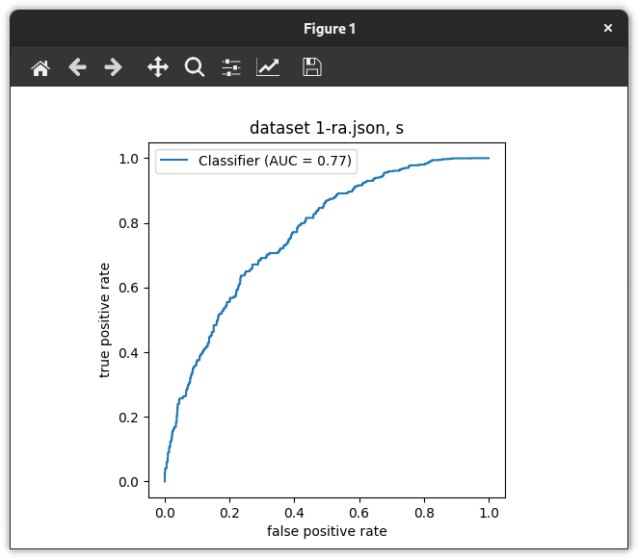
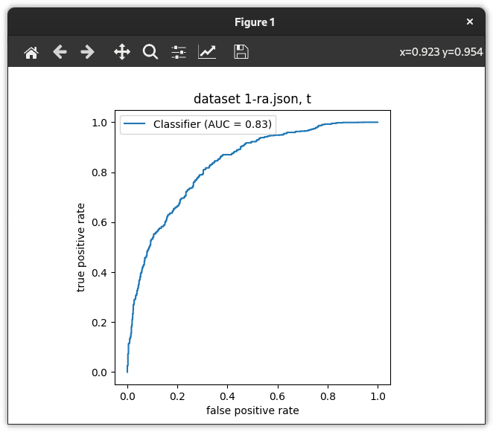
Results (part 2, RA)
 | My results | Paper results
Static AUC | 0.7660381700000001 | 0.864
Temporal AUC | 0.8288871 | 0.852

Slide 9
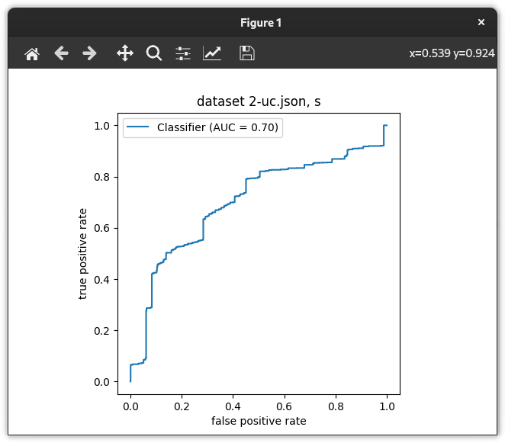
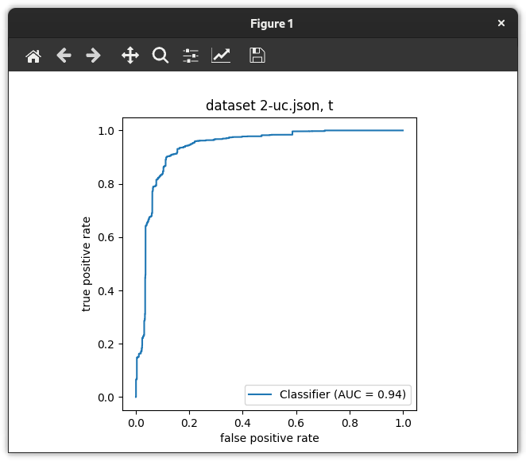
Results (part 2, UC)
 | My results | Paper results
Static AUC | 0.699394115 | 0.731
Temporal AUC | 0.9357742 | 0.744

Slide 10
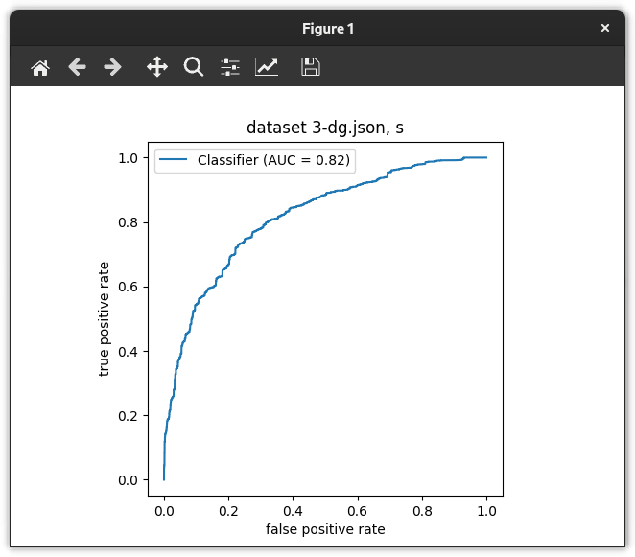
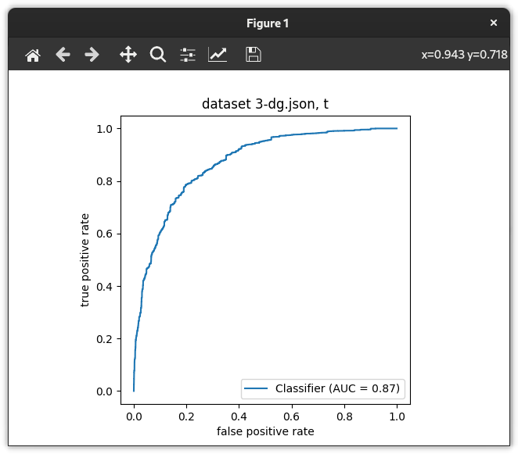
Results (part 2, DG)
 | My results | Paper results
Static AUC | 0.81619254 | 0.837
Temporal AUC | 0.8695438799999999 | 0.866

Slide 11
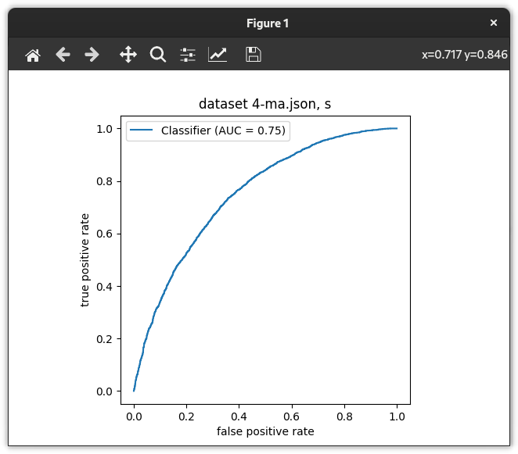
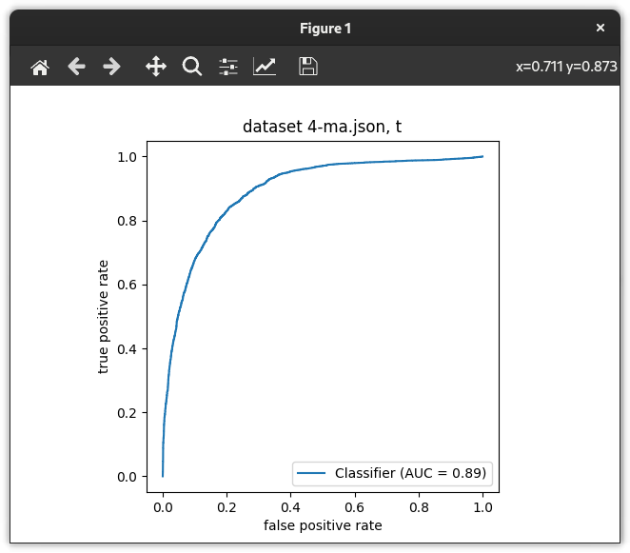
Results (part 2, MA)
 | My results | Paper results
Static AUC | 0.7494679399999999 | 0.859
Temporal AUC | 0.8924620200000001 | 0.909

Slide 12

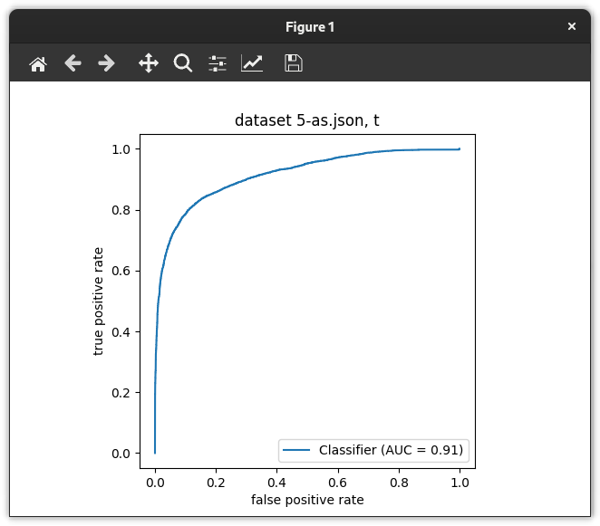
Results (part 2, AS)
 | My results | Paper results
Static AUC | 0.89480297 | 0.937
Temporal AUC | 0.91464895 | 0.959

Slide 13
Conclusions
For me, the temporal topological features worked better than the static ones
The reason of the weird behavior of the UC dataset might be in its small number of nodes and small density
The random nodes method estimates percentiles better, while radius and diameter are estimated better by the snowball method

