Slide 1
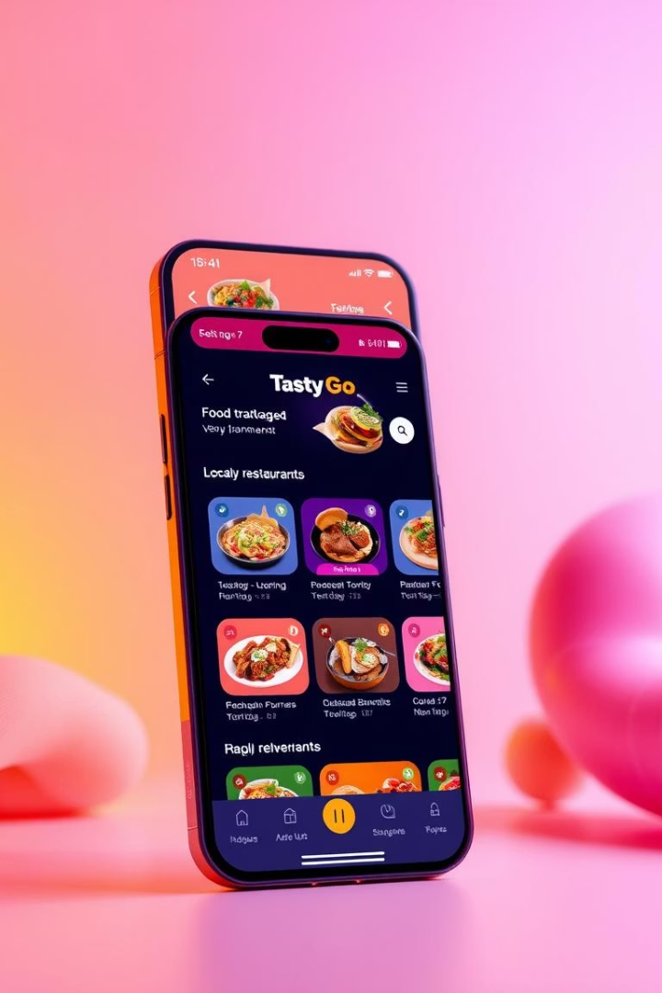
TastyGo: Your Next-Gen Food Delivery Partner
TastyGo is an innovative, efficient food delivery platform. We connect customers with local restaurants. Experience fast, tasty food delivered right to your doorstep. Our system ensures a seamless, satisfying experience.
TG
by IHIRWE NATHENE
IHIMBAZWE JOEL RWAMAMARA
HIMBAZIMANA SAMUEL
AGANZE ANSWER SAND
TUYISENGE EMERANCE

Slide 2




Why Use TastyGo?
Seamless Experience
Efficient Operations
User-friendly for customers and admins.
Streamlined order and restaurant management.
Customer Focused
Features that enhance user satisfaction.
TastyGo offers a comprehensive solution. It benefits both users and operators. Our platform prioritizes ease of use and efficiency.

Slide 3
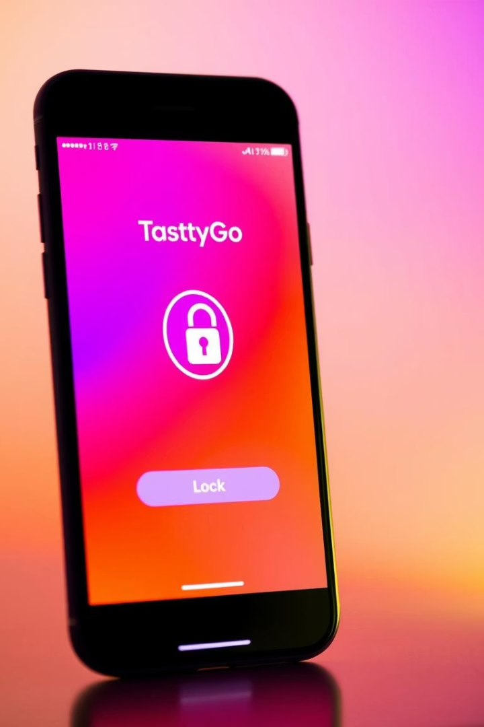




Secure & Personalized Customer Experience
User Authentication
Push Notifications
Rate & Review
Secure login and signup with email and password.
Real-time order status and promotions.
Customers can rate delivery and menu items.
Order History
View past orders and reorder with ease.
Our platform ensures secure access. Customers receive timely updates. They can also personalize their experience. This builds loyalty and engagement.

Slide 4
Effortless Browsing and Ordering
Browse Restaurants
Detailed Menus
Order Customization
View a wide selection of local restaurants. Filter by cuisine type. Explore diverse culinary options.
Access full menus for each restaurant. See dish details and pricing. Make informed choices easily.
Add special requests to any order. Modify dishes to personal preference. Enjoy a tailored dining experience.
TastyGo simplifies finding and ordering food. Our intuitive interface enhances user satisfaction. Customize orders to meet individual needs.

Slide 5
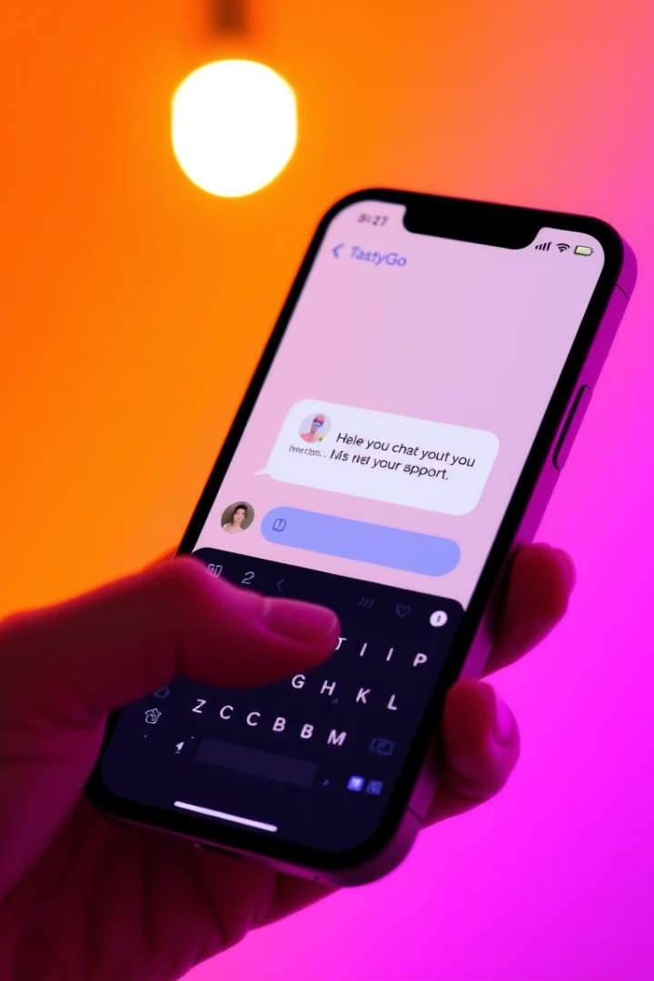



Engaging Customer Interaction
Chatbox for Suggestions
Provide instant feedback. Ask questions directly. Get quick resolutions.
Improve Service
Valuable input enhances our offerings. We continuously refine our platform.
Boost Satisfaction
Responsive support leads to happier customers. This fosters positive relationships.
Our integrated chatbox facilitates direct communication. It ensures customer needs are addressed. We strive for continuous improvement based on feedback.

Slide 6
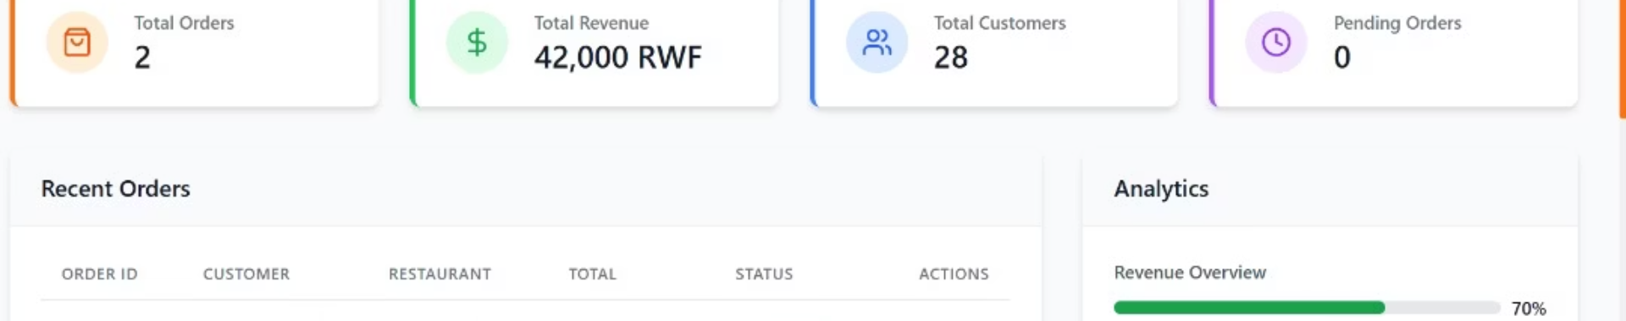
Comprehensive Admin Control
Restaurant Management
Order Management
Customer Support
Add, update, or remove restaurants. Manage all food items. Maintain accurate menu information.
Assign delivery personnel efficiently. Update order statuses in real-time. Ensure smooth delivery operations.
Respond to inquiries quickly. Resolve complaints effectively. Provide excellent service.
Admins have full control over operations. From managing restaurants to handling orders, our tools streamline every task. This leads to greater efficiency.

