Slide 1
Ansys Python Manager
PyCon India 2024

Slide 2
Outline
What is the Ansys Python Manager?
Necessity for a solution
Introduction to Ansys Python Manager
Live Demo & Tips & Tricks
Q&A

Slide 3
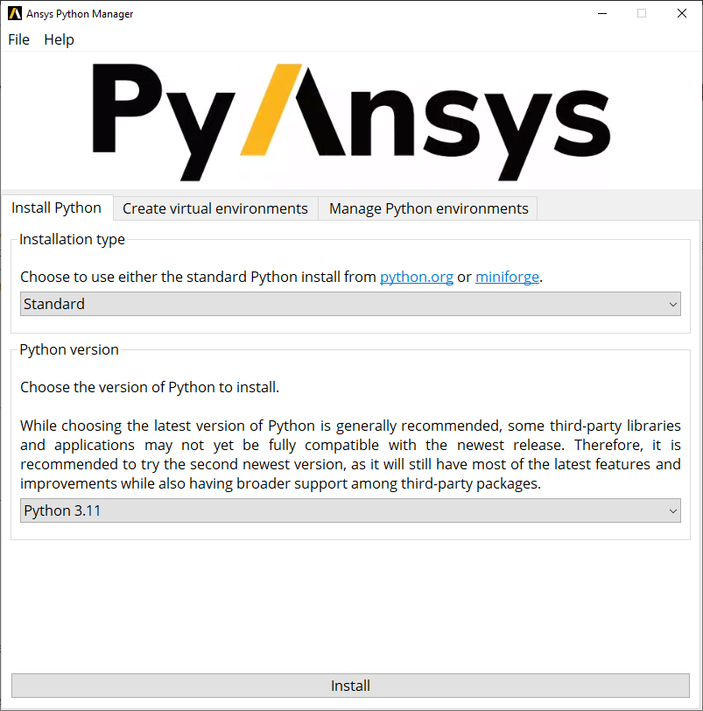

What is Ansys Python Manager?
Collaborative open-source Python QT app
Developed by Ansys for beginner & intermediate Python users
Key Features
Streamlines Python usage
Simplifies virtual environment management
Facilitates PyAnsys (open-source) package administration, easy access to documentation
Support for Windows & Linux
https://github.com/ansys/python-installer-qt-gui.git
Ansys Python Manager Documentation

Slide 4
Necessity for solution
Transition Challenges
Commercialization of famous Python management tools are roadblock for community
Based on the internal scientific/engineering community response
Developed the simplified solution.
Focus on beginner and intermediate Python users
Provide a more accessible, user-friendly experience

Slide 5
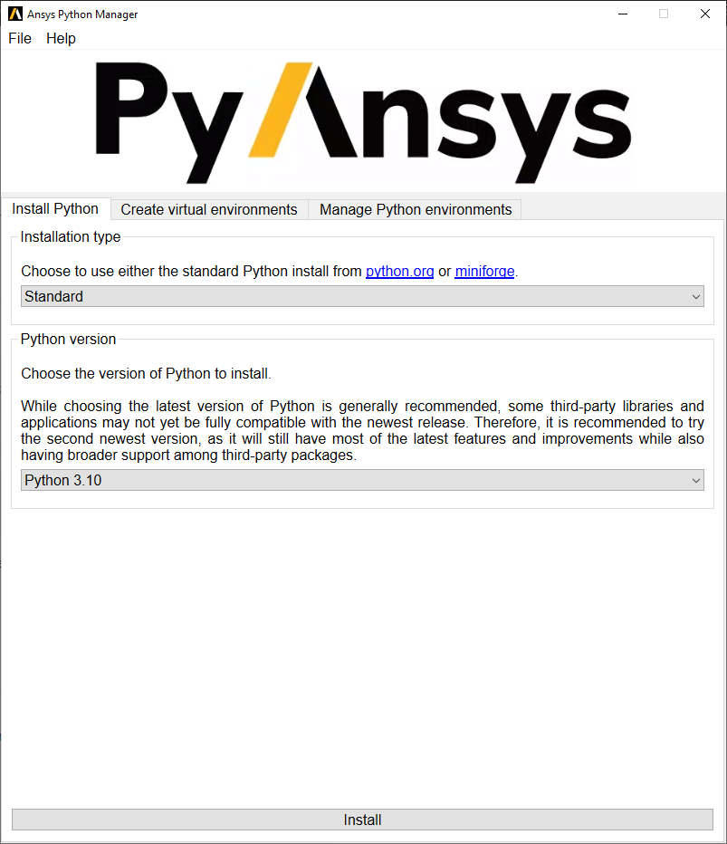
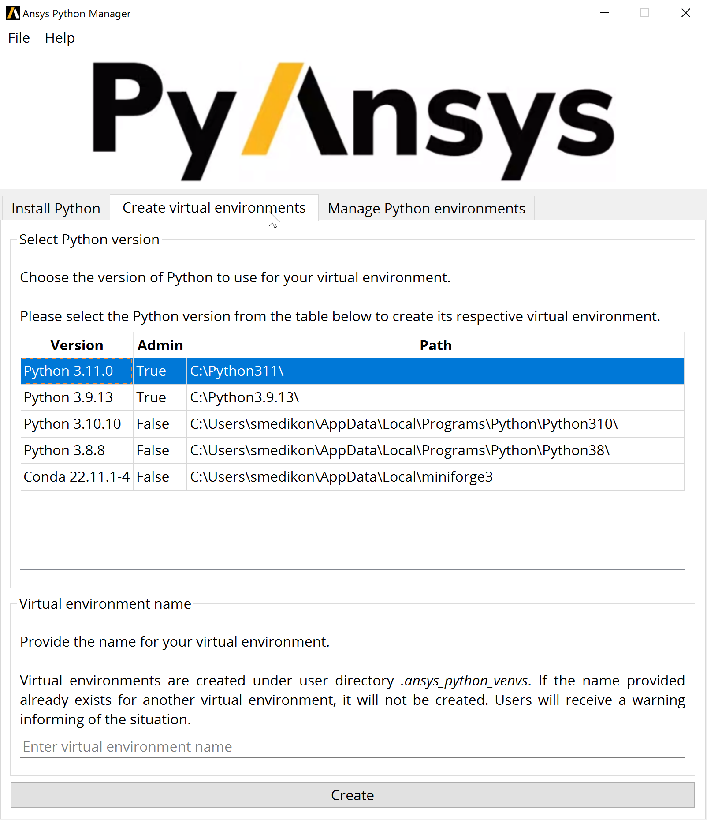
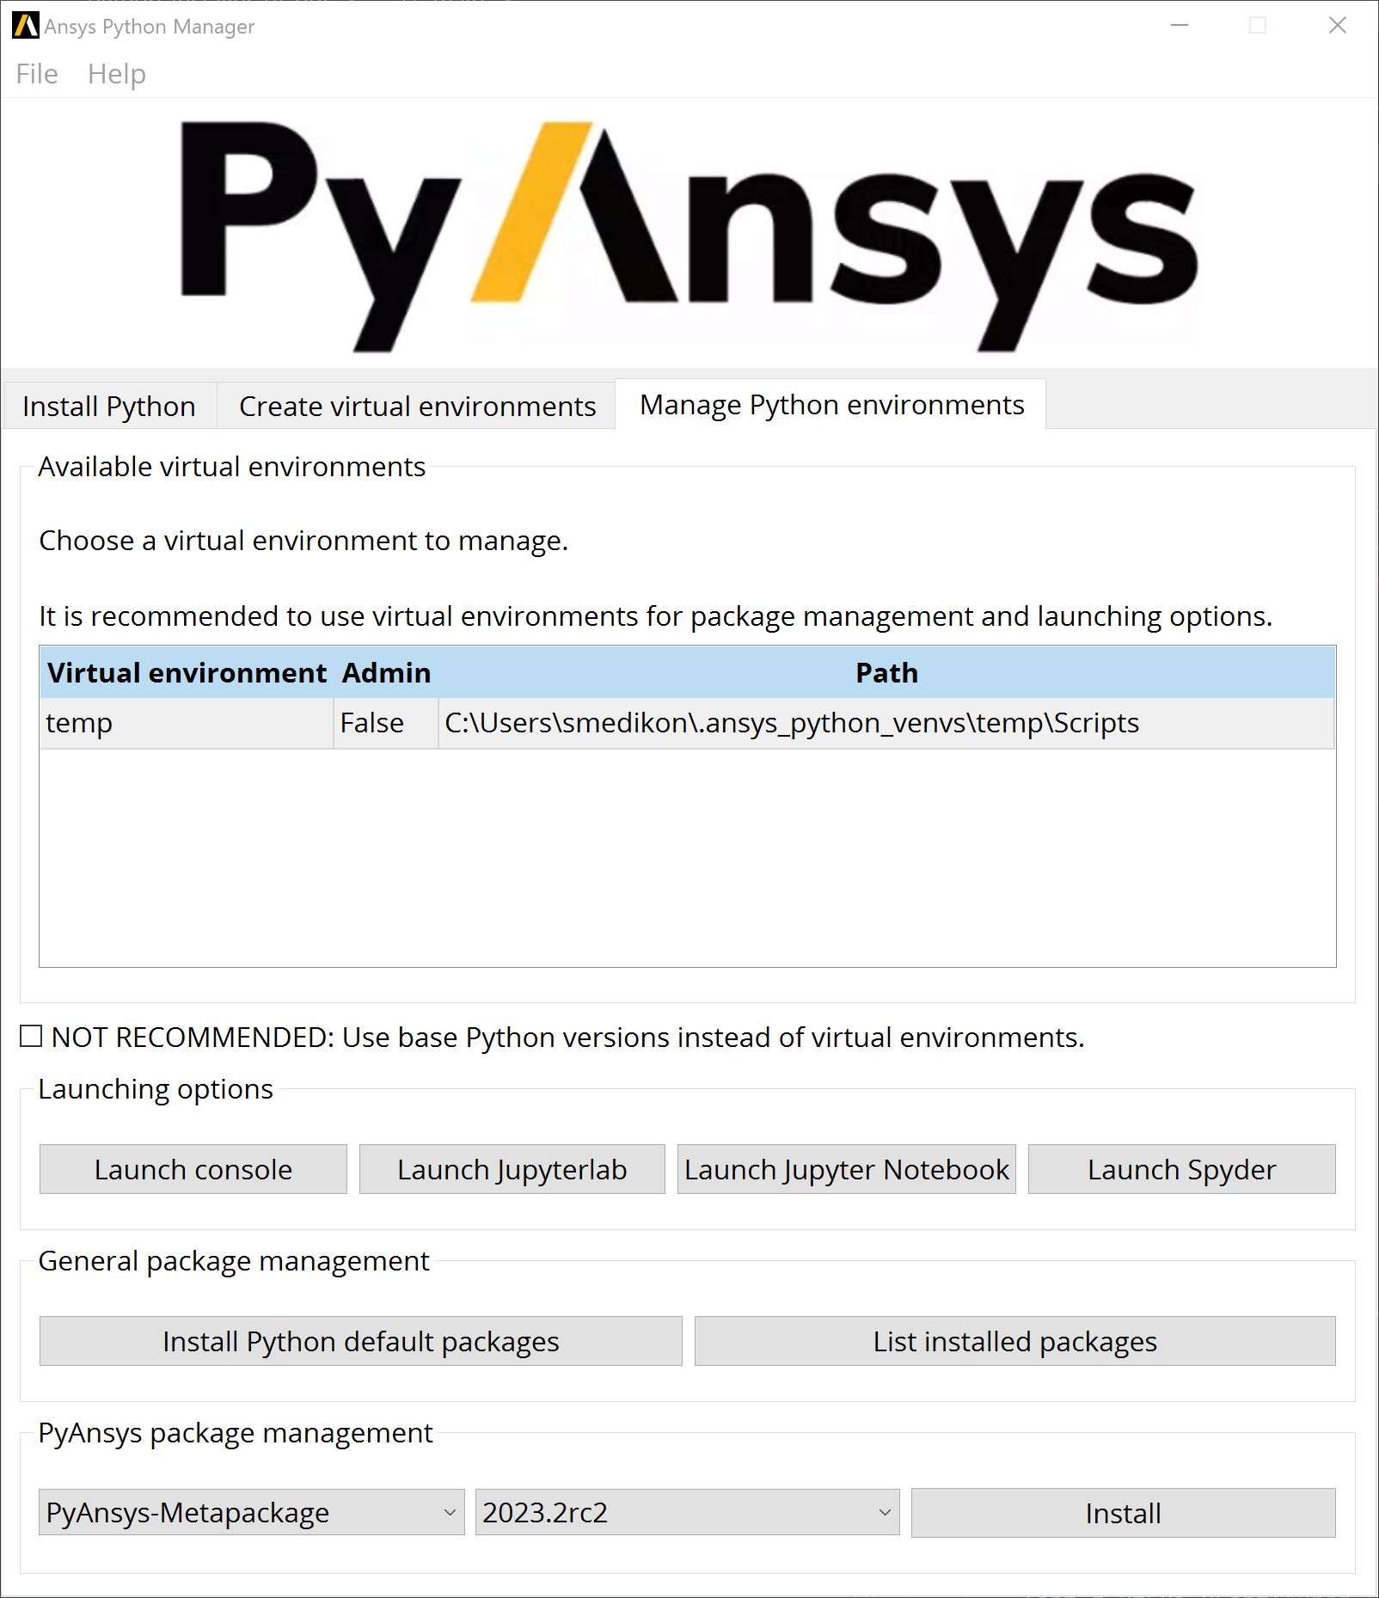
Introduction to Ansys Python Manager
One stop shop for
Getting started with Python
Install Python
Create Virtual Environment
Manage Virtual Environments
Launching IDE & Console options
Console
JupyterLab
Jupyter Notebook
Spyder
1
2
3
1
2
3

Slide 6
Live Demo & Tips & Tricks
License - Ansys Python Manager is licensed under the MIT license. No commercial claim over Ansys whatsoever. For further licensing information refer here.
Distributing - This project is vectored to be an open-source project. For the time being, feel free to distribute it internally, but direct users to visit the Releases page
Security - The versions that are still supported for security updates can be found at the Security guidelines site. Information on how to report vulnerabilities is also found.
This applies to all slides in this presentation.

Slide 7
Q&A

