Slide 1
Ansys Python Manager
PyCon India 2024

Slide 2
Outline
What is the Ansys Python Manager?
Necessity for a solution
Introduction to Ansys Python Manager
Live Demo & Tips & Tricks

Slide 3
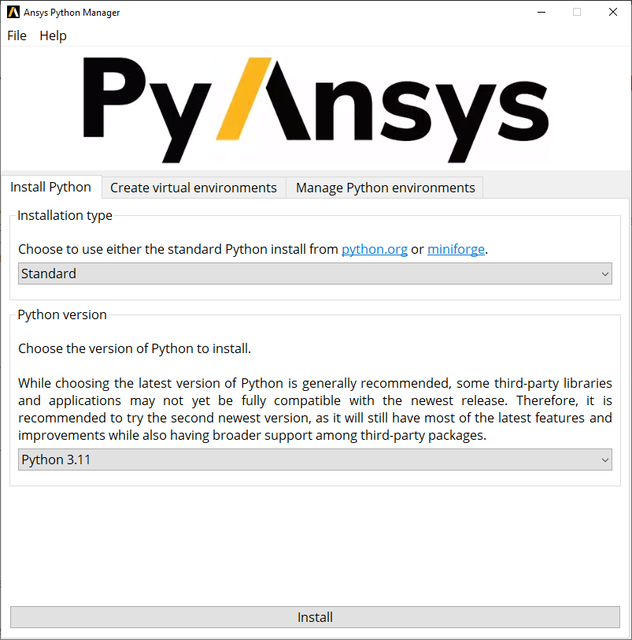

What is Ansys Python Manager?
Collaborative open-source Python QT app
Developed by Ansys for beginner & intermediate Python users
Key Features
Streamlines Python usage
Simplifies virtual environment management
Facilitates PyAnsys (open-source) package administration
Support for Windows & Linux
https://github.com/ansys/python-installer-qt-gui.git
Ansys Python Manager Documentation

Slide 4
Necessity for solution
Transition Challenges
Commercialization of famous Python management tools are roadblock for community
Based on the internal scientific/engineering community response
Developed the simplified solution.
Focus on beginner and intermediate Python users
Provide a more accessible, user-friendly experience

Slide 5
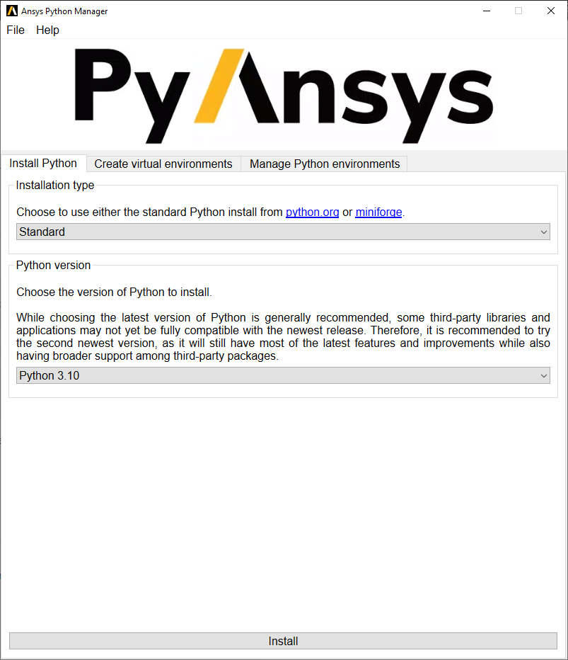
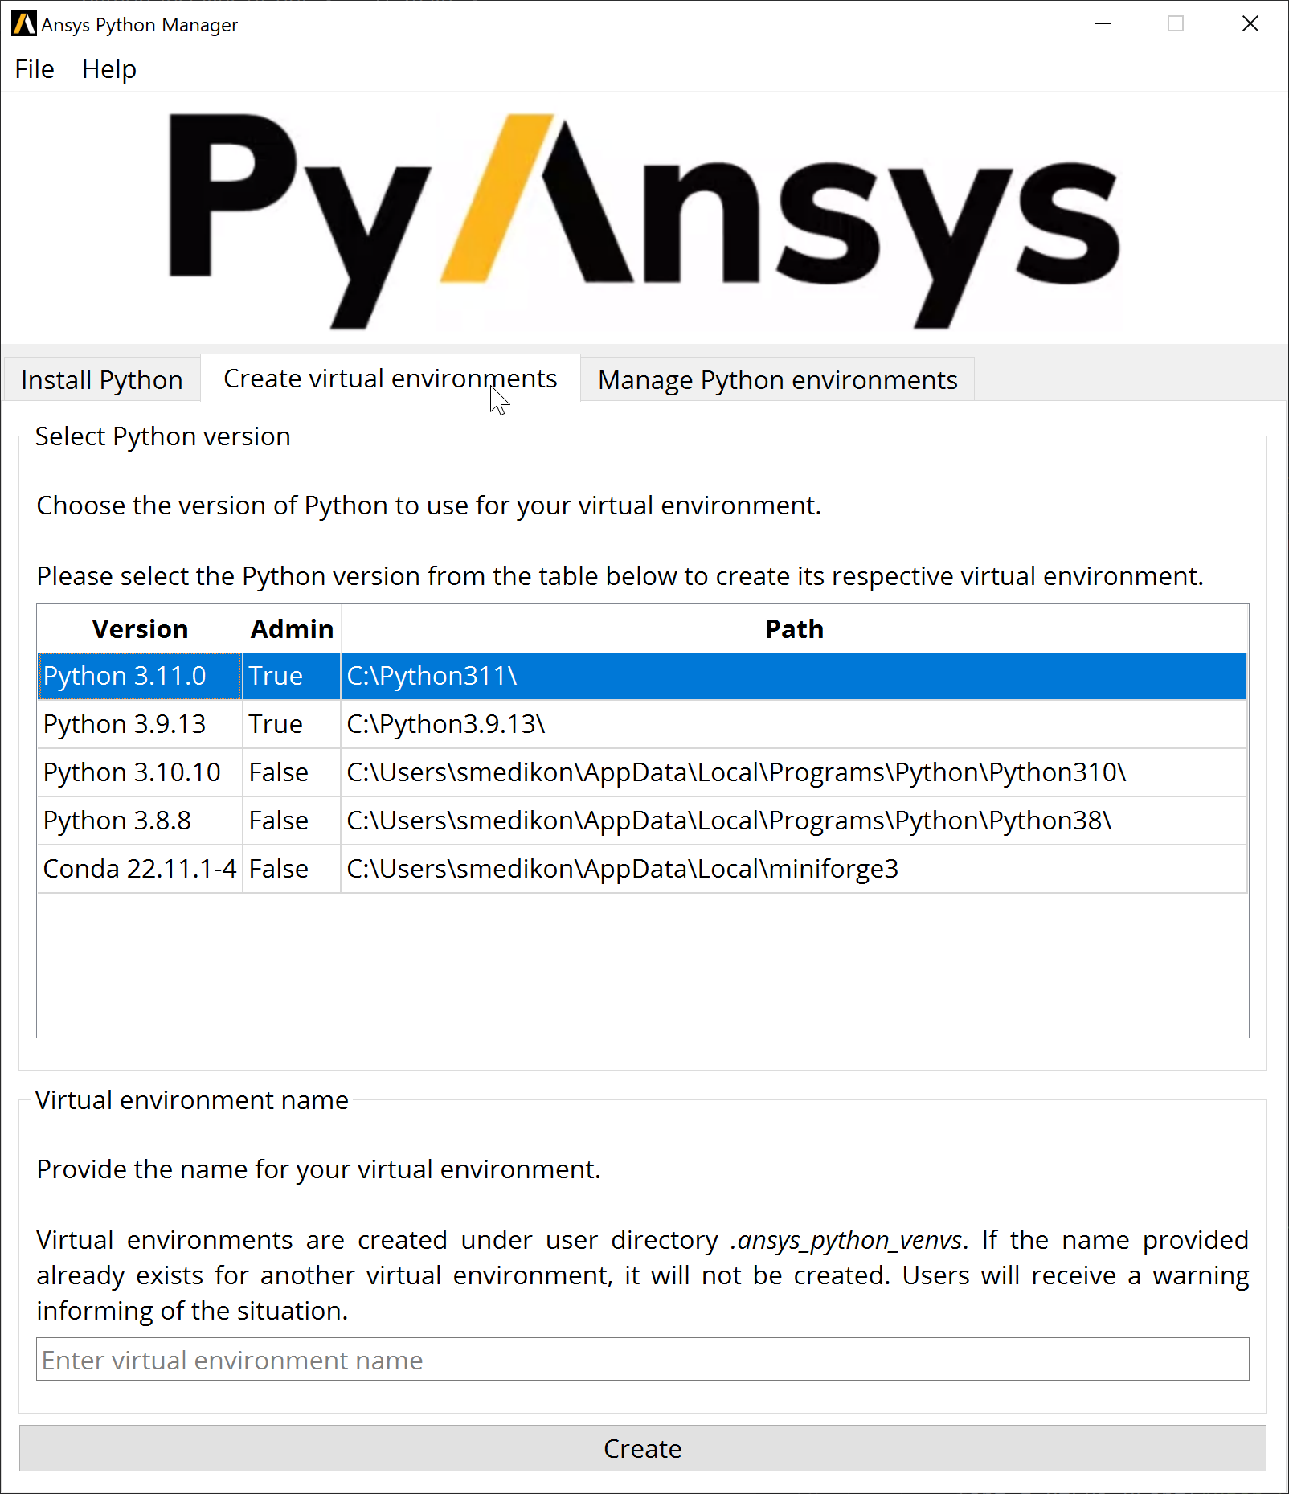
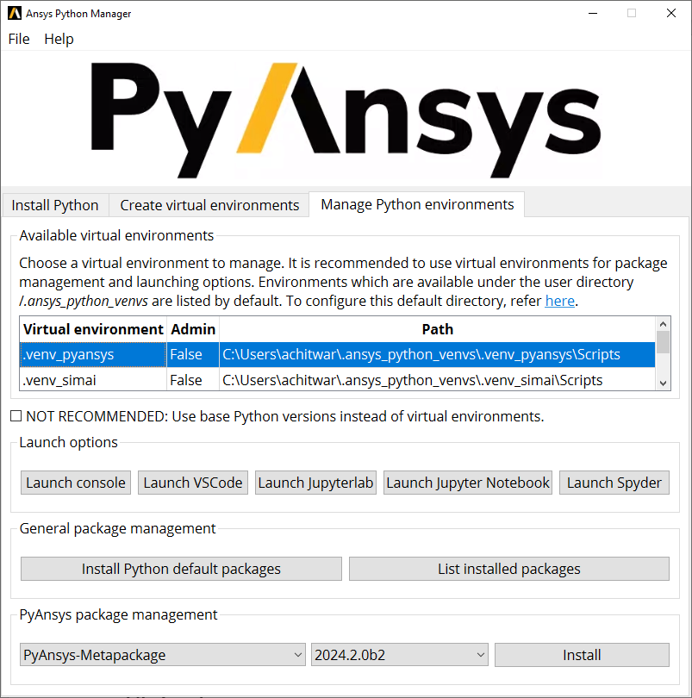
Introduction to Ansys Python Manager
One stop shop for
Getting started with Python
Install Python
Create Virtual Environment
Manage Virtual Environments
Launching options
Console
JupyterLab
Jupyter Notebook
Spyder
VS Code
1
2
3
1
2
3

Slide 6
Live Demo & Tips & Tricks
License - Ansys Python Manager is licensed under the MIT license. No commercial claim over Ansys whatsoever. For further licensing information refer here.
Distributing - This project is vectored to be an open-source project. For the time being, feel free to distribute it internally, but direct users to visit the Releases page
Security - The versions that are still supported for security updates can be found at the Security guidelines site. Information on how to report vulnerabilities is also found.

