Slide 1
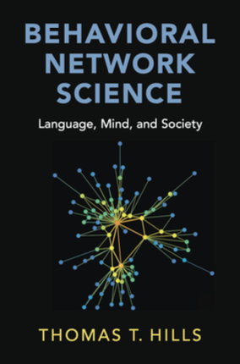
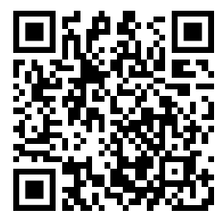
Transforming Text into Networks
Jan Antkiewicz
jan.antkiewicz@warwick.ac.uk

Slide 2
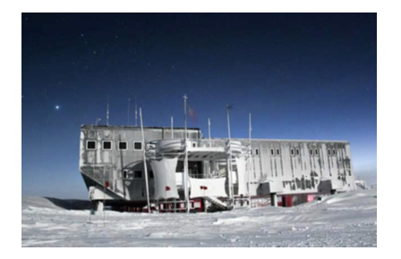
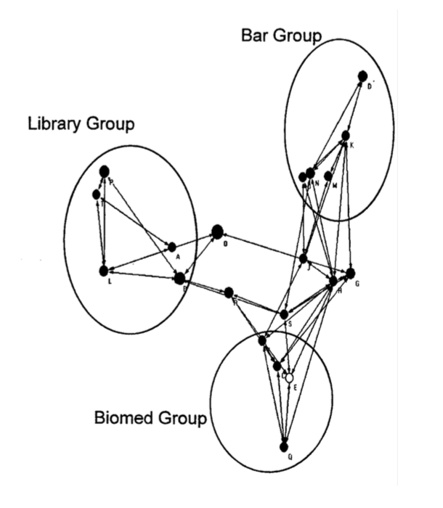
Why think in networks?
Networks allow us to study structure of things
Why care about structure?
can help us predict what's important and why
how to make systems better
Johnson et al. (2003): What holds communities together?
Expressive leaders who coordinated social interactions to help keep the communities connected
Positive deviant (i.e., the clown) that violated social boundaries

Slide 3
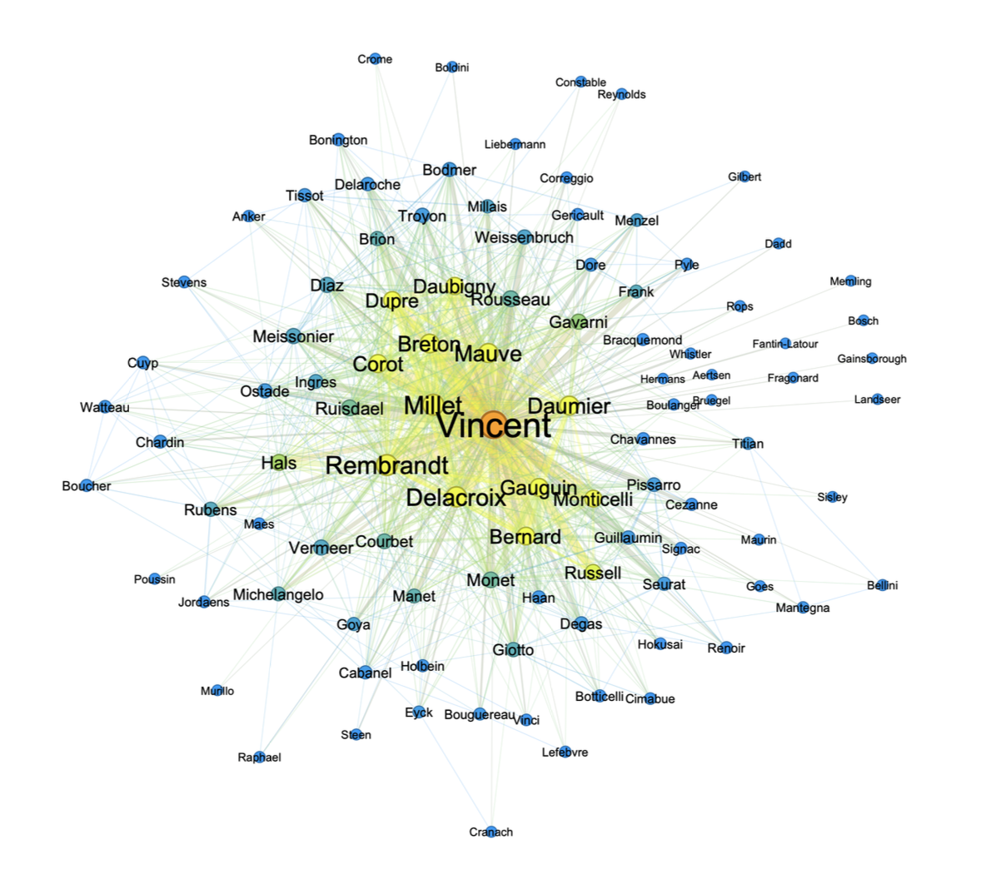
Why text?
Natural data that describes not only things but also relationships between them
(Hills, 2025)
Notes:
Not only social networks where relationships between people are examined. In psychology, researchers have examined how emotions coocur in deth notes.

Slide 4
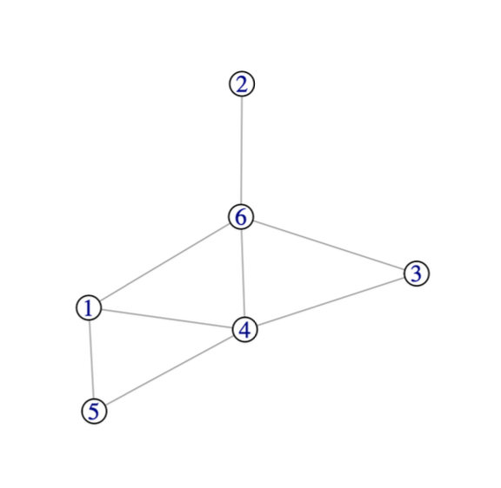
Basic network ingredients
Nodes: People, words, emotions, concepts, …
Edges: friendships, semantic relationships, cooccurrence, causal relationships, …
(Hills, 2025; Siew et al., 2019)
Notes:
These both contain all the
information we need to
construct this network.

Slide 5
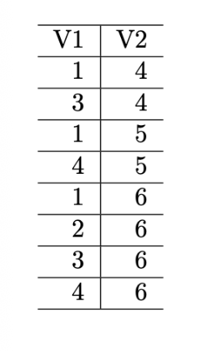
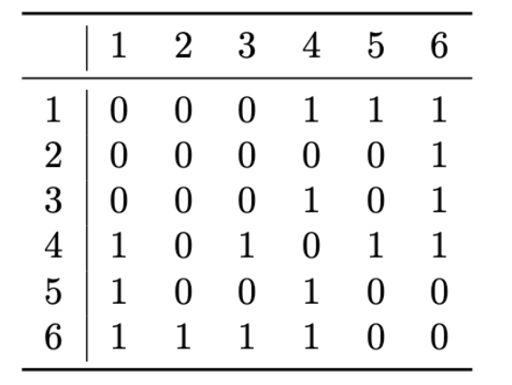
Representing a network
Edge list
Adjacency matrix
(Hills, 2025)
Notes:
These both contain all the
information we need to
construct this network.

Slide 6
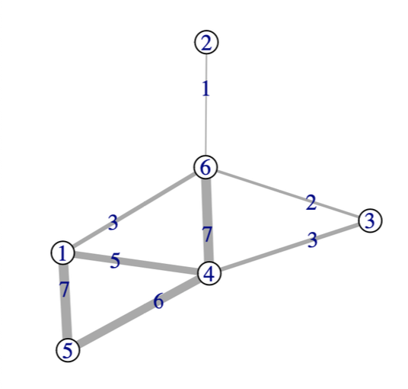
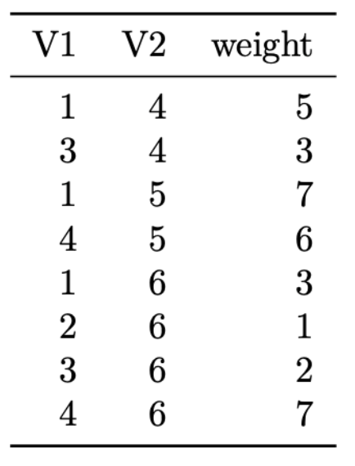
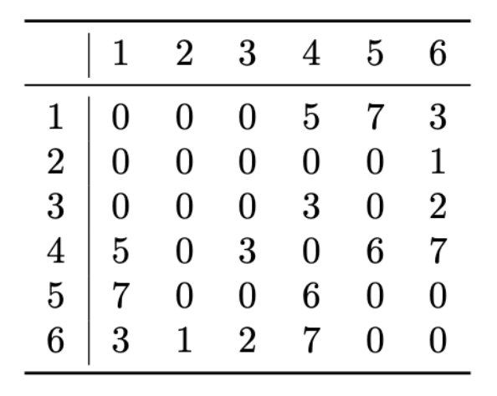
Weighted networks
Edge list
Adjacency matrix
(Hills, 2025)
Notes:
These both contain all the
information we need to
construct this network.

Slide 7
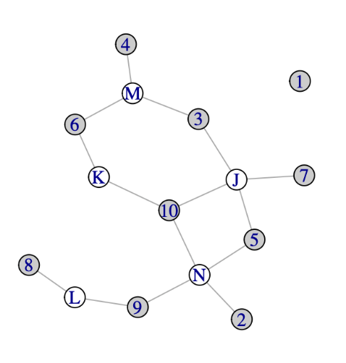
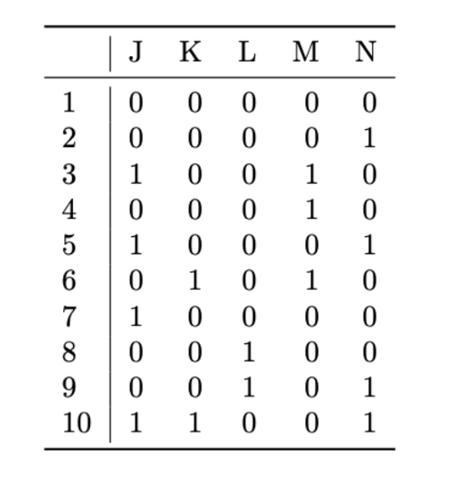
Two-mode networks
have two kinds of nodes and nodes are only connected to nodes of other types.
Adjacency matrix
(Hills, 2025)
Notes:
These both contain all the
information we need to
construct this network.

Slide 8
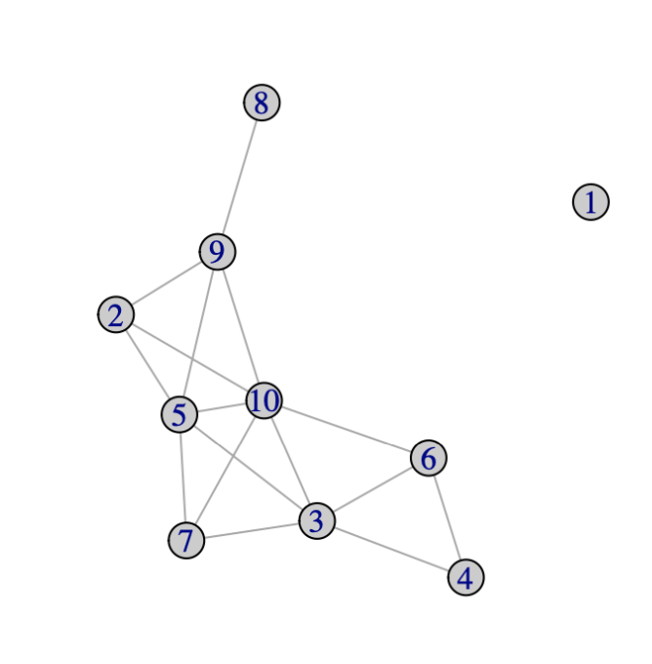
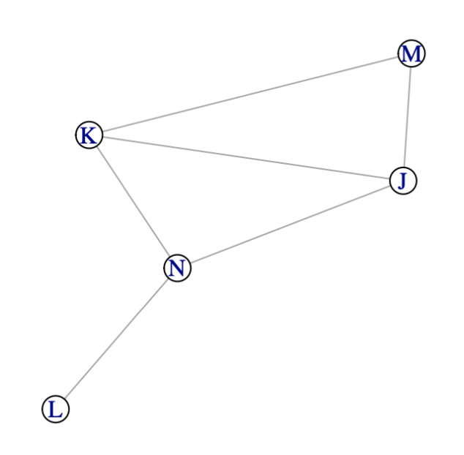
One-mode networks
We can project a two-mode networks into separate one mode-networks
numbers
letters
(Hills, 2025)
Notes:
These both contain all the
information we need to
construct this network.

Slide 9
Analyzing networks

Slide 10
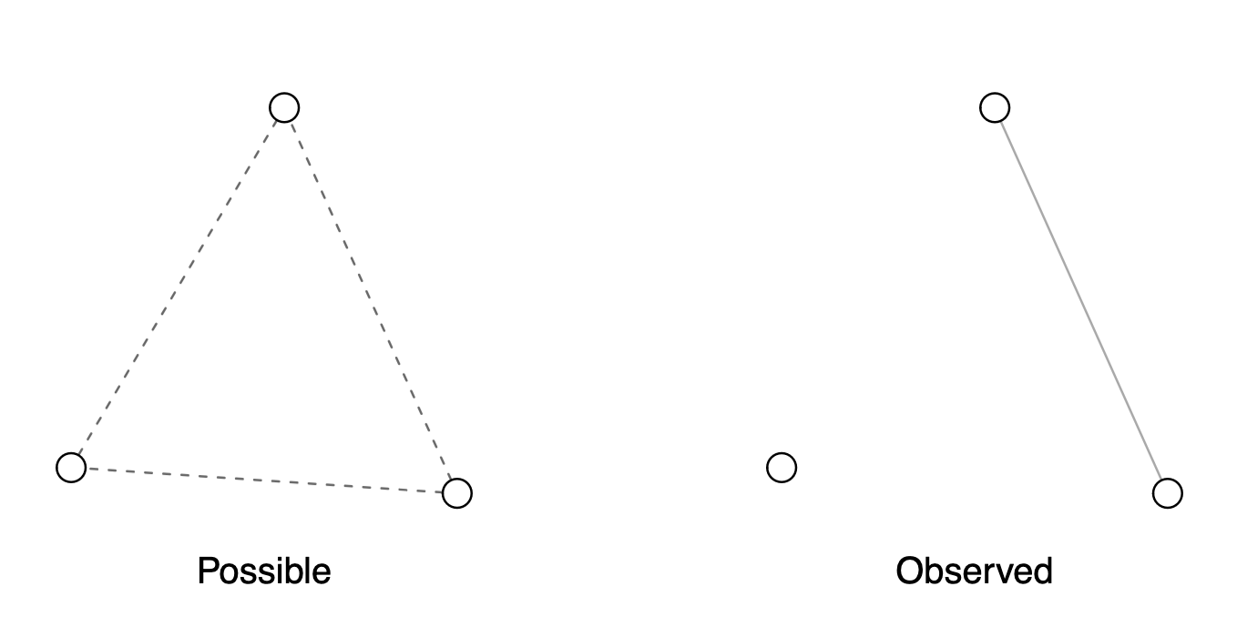
Density = it is the proportion of possible edges that are actually present
(Hills, 2025)

Slide 11
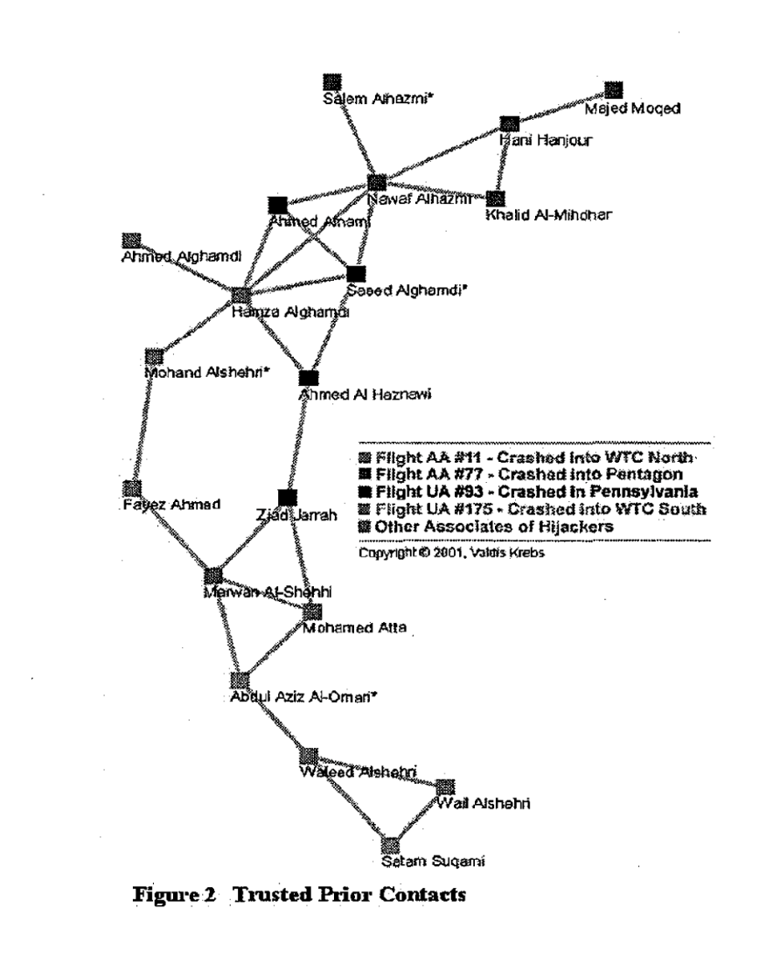
Terrorist cells are characterized by low density
(Krebs, 2002)

Slide 12
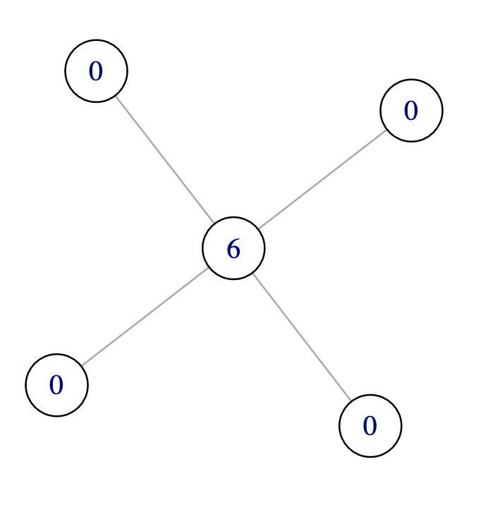
Average Shortest Path Length = average of shortest path between given node and any other node in the network
1.75
1.75
1
1.75
1.75
(Hills, 2025)

Slide 13
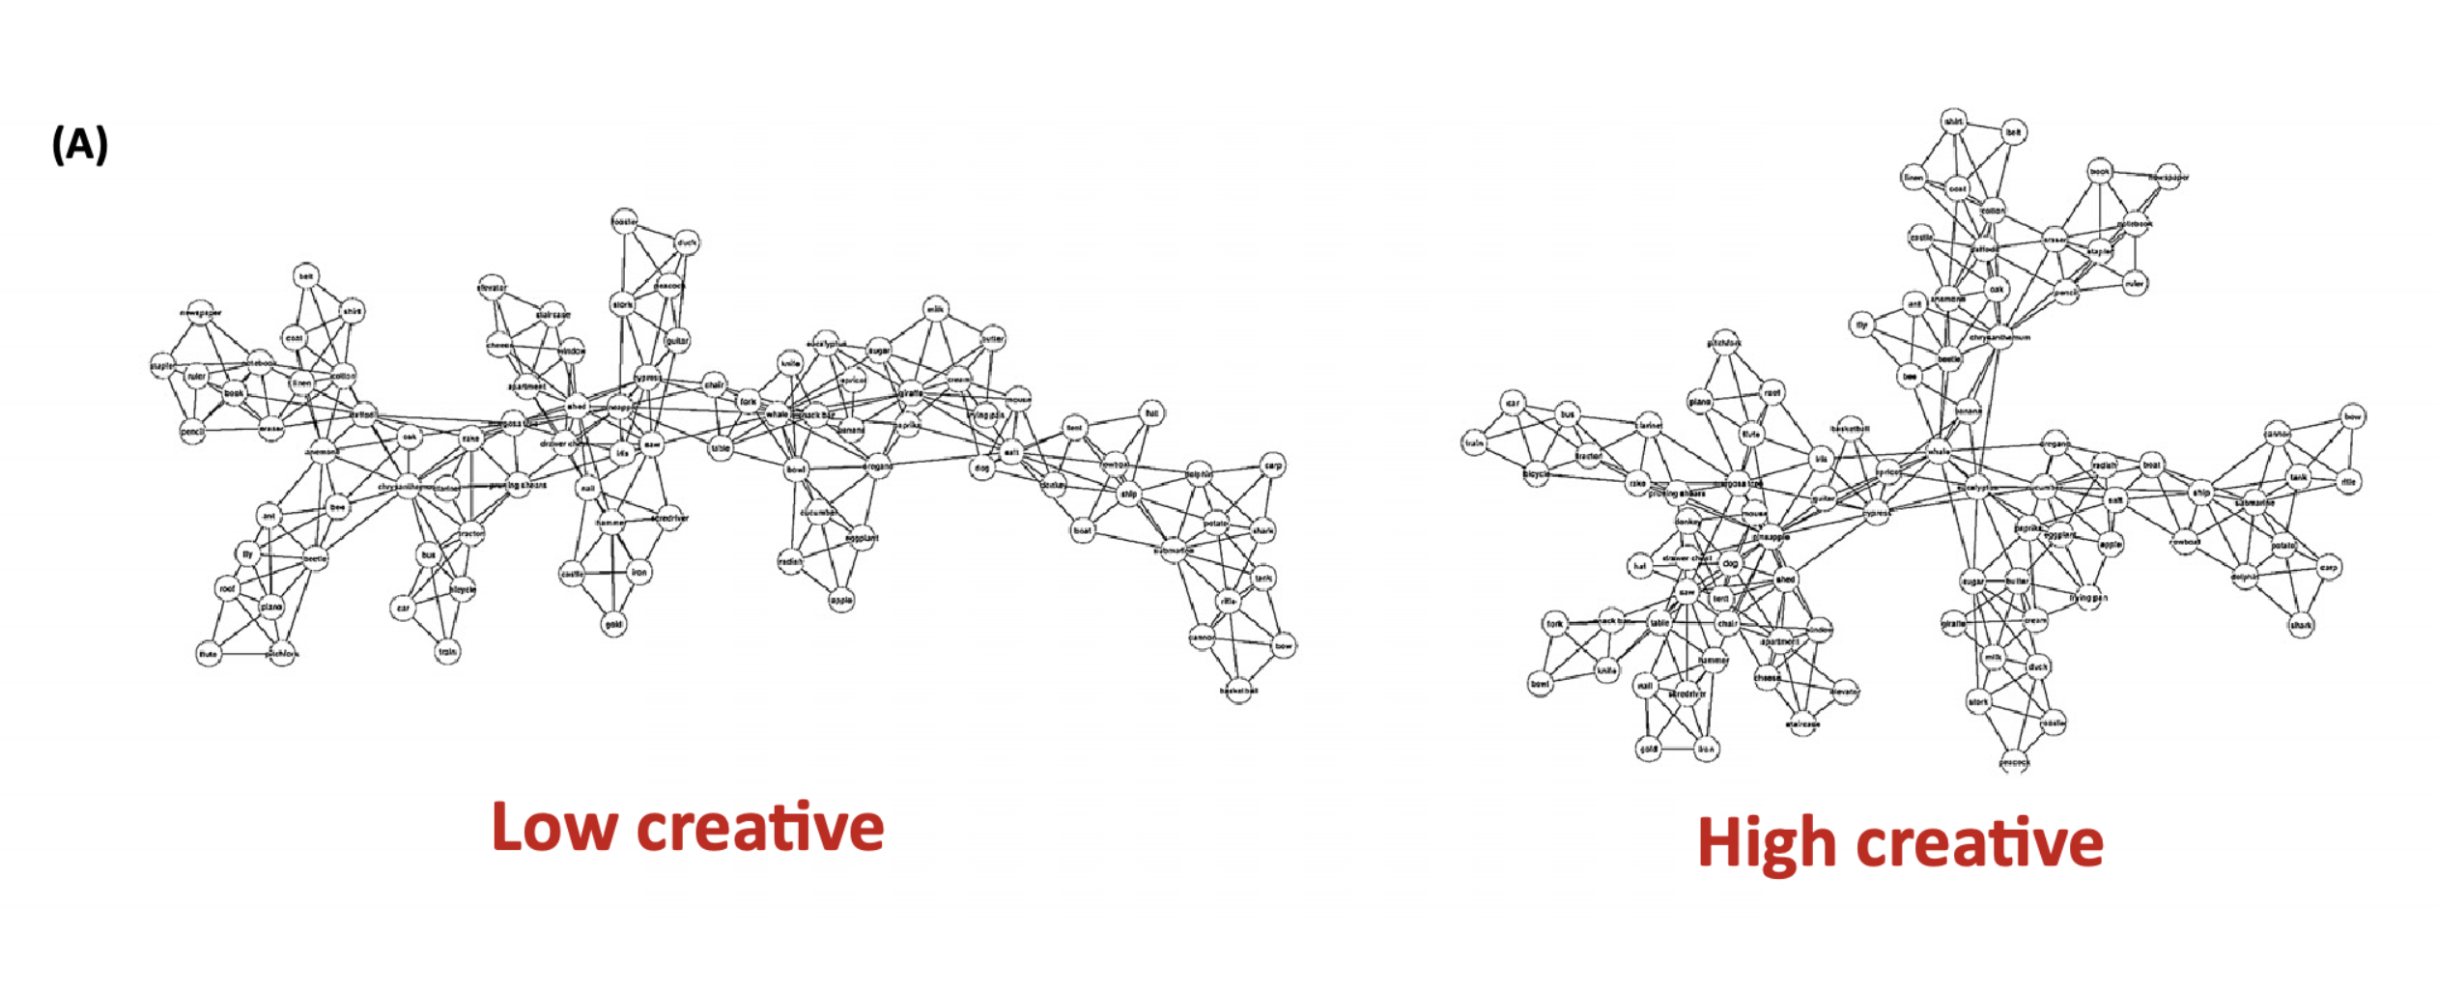
Creative individuals have shorter average shortest path lengths
(Kennet & Faust, 2019)

Slide 14
Betweenness centrality = number of shortest paths between all other pairs of nodes that pass through a given node
(Hills, 2025)

Slide 15
People important for keeping communities together have high betweenness centrality
(Johnson et al.,2003)

Slide 16
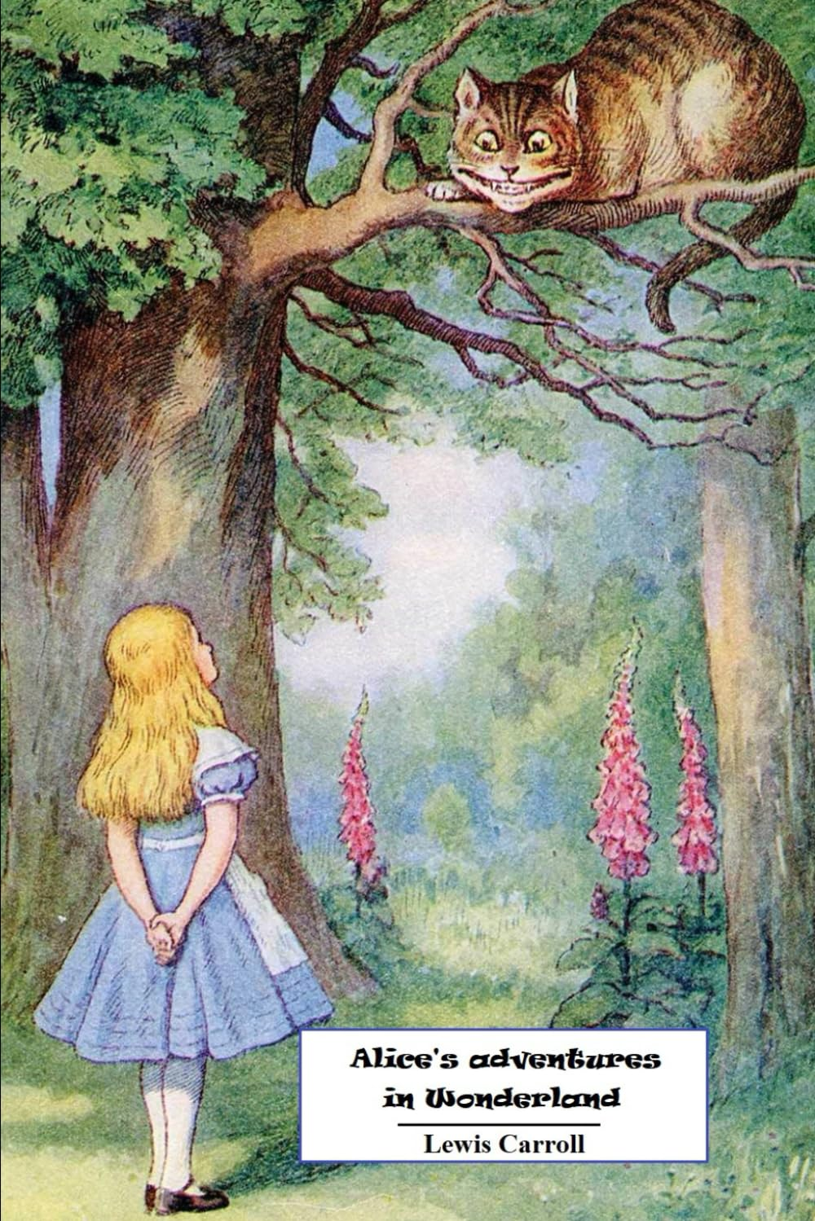
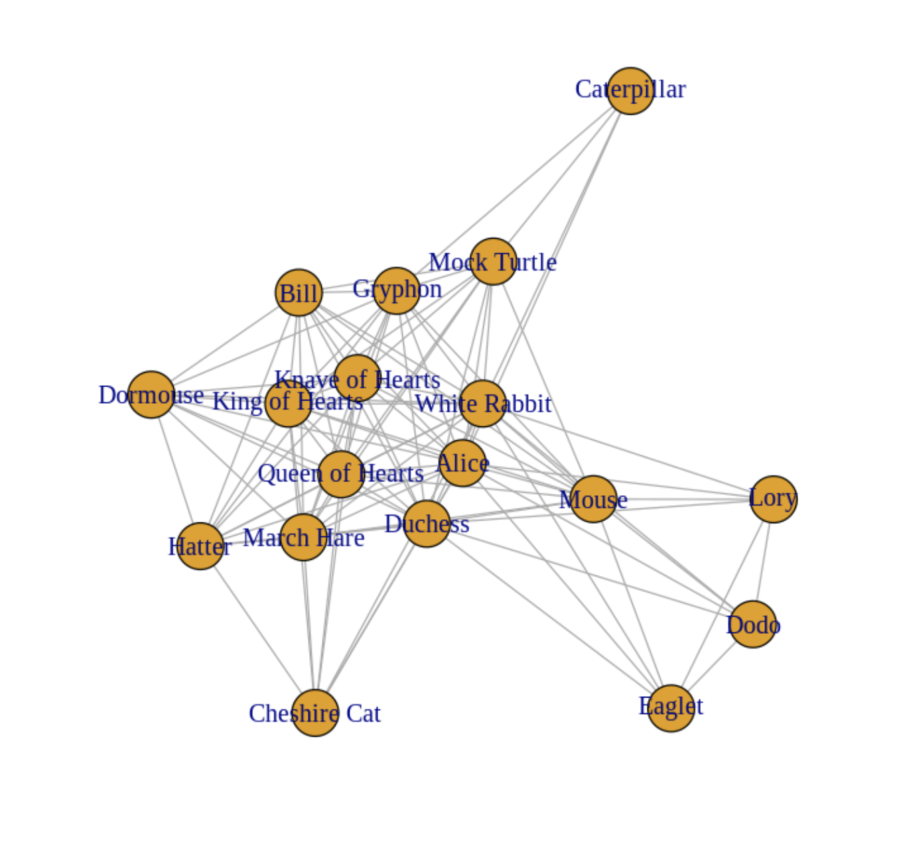
Todays worked example

Slide 17
References
Hills, T. T. (2025). Behavioral network science: Language, mind, and society. (No Title).
Johnson, J. C., Boster, J. S., & Palinkas, L. A. (2003). Social roles and the evolution of networks in extreme and isolated environments. The Journal of Mathematical Sociology, 27(2-3), 89–121.
Stella, M., Swanson, T. J., Li, Y., Hills, T. T., & Teixeira, A. S. (2022). Cognitive networks detect structural patterns and emotional complexity in suicide notes. Frontiers in psychology, 13, 917630.
Siew, C. S., Wulff, D. U., Beckage, N. M., & Kenett, Y. N. (2019). Cognitive network science: A review of research on cognition through the lens of network representations, processes, and dynamics. Complexity, 2019(1), 2108423.
Krebs, V. (2002). Uncloaking terrorist networks. First Monday.
Kenett, Y. N., & Faust, M. (2019). A semantic network cartography of the creative mind. Trends in cognitive sciences, 23(4), 271-274.

