Slide 1
Project Title: < ----------------- >
Guide: < ------ >
Group Members:
1

Slide 2
DEPARTMENT OF COMPUTER SCIENCE & ENGINEERING
Vision of the Department
Creating eminent and ethical leaders in the domain of Computational Sciences through quality professional education with a focus on holistic learning and excellence.
Mission of the Department
To create technically competent and ethically conscious graduates in the field of Computer Science and Engineering by encouraging holistic learning and excellence.
To prepare students for careers in Industry, Academia and the Government.
To instill Entrepreneurial Orientation and research motivation among the students of the
department.
To emerge as a leader in education in the region by encouraging teaching, learning, industry
and societal connect.
2

Slide 3
Programme Educational Objectives (PEOs)
The graduates shall have sound knowledge of Mathematics, Science, Engineering and
Management to be able to offer practical software and hardware solutions for the problems of
industry and society at large.
The graduates shall be able to establish themselves as practicing professionals, researchers or
Entrepreneurs in computer science or allied areas and shall also be able to pursue higher education in reputed institutes.
The graduates shall be able to communicate effectively and work in multidisciplinary teams
with team spirit demonstrating value driven and ethical leadership.
3

Slide 4
Programme Outcomes
Engineering Graduates will be able to:
Engineering knowledge: Apply the knowledge of mathematics, science, engineering fundamentals, and an engineering specialization to the solution of complex engineering problems.
Problem analysis: Identify, formulate, review research literature, and analyze complex engineering problems reaching substantiated conclusions using first principles of mathematics, natural sciences, and engineering sciences.
Design/development of solutions: Design solutions for complex engineering problems and design system components or processes that meet the specified needs with appropriate consideration for the public health and safety, and the cultural, societal, and environmental considerations.
Conduct investigations of complex problems: Use research-based knowledge and research methods including design of experiments, analysis and interpretation of data, and synthesis of the information to provide valid conclusions.
Modern tool usage: Create, select, and apply appropriate techniques, resources, and modern engineering and IT tools including prediction and modeling to complex engineering activities with an understanding of the limitations.
4

Slide 5
The engineer and society: Apply reasoning informed by the contextual knowledge to assess societal, health, safety, legal and cultural issues and the consequent responsibilities relevant to the professional engineering practice.
Environment and sustainability: Understand the impact of the professional engineering solutions in societal and environmental contexts, and demonstrate the knowledge of, and need for sustainable development.
Ethics: Apply ethical principles and commit to professional ethics and responsibilities and norms of the engineering practice.
Individual and team work: Function effectively as an individual, and as a member or leader in diverse teams, and in multidisciplinary settings.
Communication: Communicate effectively on complex engineering activities with the engineering community and with society at large, such as, being able to comprehend and write effective reports and design documentation, make effective presentations, and give and receive clear instructions.
Project management and finance: Demonstrate knowledge and understanding of the engineering and management principles and apply these to one’s own work, as a member and leader in a team, to manage projects and in
multidisciplinary environments.
12. Life-long learning: Recognize the need for, and have the preparation and ability to engage in independent and life-long learning in the broadest context of technological change.
5

Slide 6
Programme Specific Outcomes (PSOs)
On the completion of Computer Science & Engineering program, the students will possess:
An ability to apply knowledge of data structures and algorithms appropriate to computational problems.
An ability to apply knowledge of operating systems, programming languages, data management, or networking principles to computational assignments.
An ability to apply design, development, maintenance or evaluation of software engineering principles in the construction of computer and software systems of varying complexity and quality.
An ability to understand concepts involved in modeling and design of computer science applications in a way that demonstrates comprehension of the fundamentals and trade-offs involved in design choices.

Slide 7
Contents
Introduction ½ slides
Objectives
Literature Review (3 Papers)
Problem statement
Proposed System
Architecture of Proposed System /DFD
Hardware and software requirements
Applications
Conclusion
References [IEEE format]

Slide 8
Introduction
Write brief introduction about this presentation specifically w.r.t. your project objective

Slide 9
Introduction – Sample
Food Ordering: A mobile-based application that allows users to browse restaurants, order food, and track deliveries in real time.
Enhanced User Experience: Provides a seamless interface with secure payment options for a hassle-free ordering process.
Key Features: Includes restaurant listings, menu browsing, order placement, and live tracking to improve service efficiency.
Technology Stack: Developed using Flutter, Firebase, and Node.js, ensuring smooth functionality and scalability.

Slide 10
Objectives
Use the following words to describe the objectives: To develop
To Implement To create etc…

Slide 11
Objectives – sample
To develop a user-friendly platform for browsing restaurants, placing orders, and tracking deliveries in real time.
To implement secure login, smooth navigation, and hassle-free payment integration for a better customer experience.
To enable live order tracking and efficient restaurant management for improved service and customer satisfaction.

Slide 12
literature survey
Sl No | Author, Year, Publisher | Title | Methodology / Dataset / Software / Algorithm etc…. | Inferences
 | Shih-Cheng Huang et al. Npj Digital Medicine 2023, Springers | Self-supervised learning for medical image classification: a systematic review and implementation guidelines | Self supervised learning model DATASET: Clinical data set | Model Developed for Pre-operative scan.

Slide 13
literature survey
Sl No | Author, Year, Publisher | Title | Methodology / Dataset / Software / Algorithm etc…. | Inferences
 | Shih-Cheng Huang et al. Npj Digital Medicine 2023, Springers | Self-supervised learning for medical image classification: a systematic review and implementation guidelines | Self supervised learning model DATASET: Clinical data set | Model Developed for Pre-operative scan.

Slide 14
Problem statement
Write specific problem identified as a single statement w.r.t. literature survey.

Slide 15
Problem statement - Sample
This project aims to develop a user-friendly and efficient food delivery application that simplifies ordering, ensures secure transactions, integrates real-time order tracking, and enhances restaurant management for improved customer satisfaction and operational efficiency.

Slide 16
Proposed System – Discuss modules
Users interact with the Food Delivery App to browse restaurants, place orders, and track deliveries.
Restaurants receive orders and update order status.
Delivery Personnel handle order pickups and deliveries.
Payment Gateway processes online transactions securely.

Slide 17
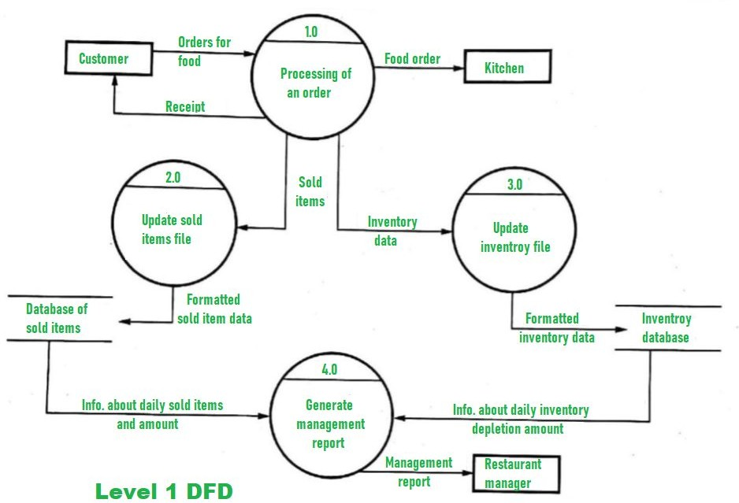
Architecture / DFD of Proposed System
Sample :
https://www.geeksforgeeks.org/dfd-for-food-orderin g-system/

Slide 18
Hardware Software Requirements
Frontend: Flutter / React Native Backend: Firebase / Node.js / Django Database: Firebase / MongoDB / MySQL

Slide 19
Conclusion
Efficient & User-Friendly System
The developed app provides a seamless platform for users to browse restaurants, place orders, and track deliveries in real time.
Improved Order Management
Restaurants can efficiently manage orders, reducing delays and enhancing customer satisfaction through automated processing and live updates.
Secure Transactions & Scalability
Integrated payment gateways ensure secure transactions, and the system is scalable for future enhancements like AI-driven recommendations and analytics.

Slide 20
References
Sample:
Cormen, T. H.; Leiserson, C. E.; Rivest, D. L.; Stein, C. Introduction to algorithms. Second Edition. 2001. ISBN 0-262-03293-7.
J. Smith and R. Brown, “Deep learning for medical image segmentation,” IEEE Transactions on Medical Imaging, vol. 39, no. 5,
pp. 1234–1245, May 2020. DOI: 10.1109/TMI.2020.2991234
[3] GeeksforGeeks. https://www.geeksforgeeks.org
[4] Building web application https://docs.flutter.dev/get-started/web
with
flutter.

