Slide 1
Project Title: Python-Based Network Scanner
Guide:
Mr. Saju Jose Chitilapilly
Group Members:
Jeevan G Neljo J
Jesse J K G Antony
1

Slide 2
DEPARTMENT OF COMPUTER SCIENCE & ENGINEERING
Vision of the Department
Creating eminent and ethical leaders in the domain of Computational Sciences through quality professional education with a focus on holistic learning and excellence.
Mission of the Department
To create technically competent and ethically conscious graduates in the field of Computer Science and Engineering by encouraging holistic learning and excellence.
To prepare students for careers in Industry, Academia and the Government.
To instill Entrepreneurial Orientation and research motivation among the students of the
department.
To emerge as a leader in education in the region by encouraging teaching, learning, industry
and societal connect.
2

Slide 3
Programme Educational Objectives (PEOs)
The graduates shall have sound knowledge of Mathematics, Science, Engineering and
Management to be able to offer practical software and hardware solutions for the problems of
industry and society at large.
The graduates shall be able to establish themselves as practicing professionals, researchers or
Entrepreneurs in computer science or allied areas and shall also be able to pursue higher education in reputed institutes.
The graduates shall be able to communicate effectively and work in multidisciplinary teams
with team spirit demonstrating value driven and ethical leadership.
3

Slide 4
Programme Outcomes
Engineering Graduates will be able to:
Engineering knowledge: Apply the knowledge of mathematics, science, engineering fundamentals, and an engineering specialization to the solution of complex engineering problems.
Problem analysis: Identify, formulate, review research literature, and analyze complex engineering problems reaching substantiated conclusions using first principles of mathematics, natural sciences, and engineering sciences.
Design/development of solutions: Design solutions for complex engineering problems and design system components or processes that meet the specified needs with appropriate consideration for the public health and safety, and the cultural, societal, and environmental considerations.
Conduct investigations of complex problems: Use research-based knowledge and research methods including design of experiments, analysis and interpretation of data, and synthesis of the information to provide valid conclusions.
Modern tool usage: Create, select, and apply appropriate techniques, resources, and modern engineering and IT tools including prediction and modeling to complex engineering activities with an understanding of the limitations.
4

Slide 5
The engineer and society: Apply reasoning informed by the contextual knowledge to assess societal, health, safety, legal and cultural issues and the consequent responsibilities relevant to the professional engineering practice.
Environment and sustainability: Understand the impact of the professional engineering solutions in societal and environmental contexts, and demonstrate the knowledge of, and need for sustainable development.
Ethics: Apply ethical principles and commit to professional ethics and responsibilities and norms of the engineering practice.
Individual and team work: Function effectively as an individual, and as a member or leader in diverse teams, and in multidisciplinary settings.
Communication: Communicate effectively on complex engineering activities with the engineering community and with society at large, such as, being able to comprehend and write effective reports and design documentation, make effective presentations, and give and receive clear instructions.
Project management and finance: Demonstrate knowledge and understanding of the engineering and management principles and apply these to one’s own work, as a member and leader in a team, to manage projects and in
multidisciplinary environments.
12. Life-long learning: Recognize the need for, and have the preparation and ability to engage in independent and life-long learning in the broadest context of technological change.
5

Slide 6
Programme Specific Outcomes (PSOs)
On the completion of Computer Science & Engineering program, the students will possess:
An ability to apply knowledge of data structures and algorithms appropriate to computational problems.
An ability to apply knowledge of operating systems, programming languages, data management, or networking principles to computational assignments.
An ability to apply design, development, maintenance or evaluation of software engineering principles in the construction of computer and software systems of varying complexity and quality.
An ability to understand concepts involved in modeling and design of computer science applications in a way that demonstrates comprehension of the fundamentals and trade-offs involved in design choices.

Slide 7
Contents
Introduction ½ slides
Objectives
Literature Review (3 Papers)
Problem statement
Proposed System
Architecture of Proposed System /DFD
Hardware and software requirements
Applications
Conclusion
References [IEEE format]

Slide 8
Introduction
Network Scanner: A Python-based tool designed to explore networks, identify active devices, detect open ports, and analyze network configurations to enhance security assessment.
Enhanced Network Visibility: Provides a seamless interface for scanning networks, discovering connected devices, and identifying potential vulnerabilities for better network management.
Key Features: Includes device discovery using ARP scanning, multi-threaded port scanning for efficiency, customizable network and port range selection, and result saving for detailed analysis.
Technology Stack: Developed using Python with Scapy for network probing, threading for parallel scanning, and socket programming for port detection, ensuring accurate and efficient network exploration.

Slide 9
Objectives
To develop a Python-based network scanner capable of discovering active devices, identifying open ports, and analyzing network topology for security assessments. To implement efficient scanning techniques using ARP requests and multi-threaded port scanning to enhance speed and accuracy. To create a system that retrieves and displays device manufacturers using MAC address lookup from an OUI database. To enable result logging by saving scan outputs to a file for easier analysis and reporting. To enhance future capabilities by integrating AI/ML for anomaly detection and advanced network threat analysis.

Slide 10
literature survey
Sl No | Author, Year, Publisher | Title | Methodology / Dataset / Software / Algorithm etc…. | Inferences
1 | G. Murali M.Pranavi Y.Navateja K.Bhargavi, 2011, IJCTA | NETWORK SECURITY SCANNER | Constructed using a variety of tools and subsequently deployed. | The functionalities done in Network Security Scanner were well implemented successfully.

Slide 11
literature survey
Sl No | Author, Year, Publisher | Title | Methodology / Dataset / Software / Algorithm etc…. | Inferences
2 | Nikita Jhala, 2014, ResearchGate | Network Scanning & Vulnerability Assessment with Report Generation | Self supervised scanning and result analysis | Scanning Tool Developed and Tested Successfully

Slide 12
Problem statement
This project aims to develop a user-friendly and efficient Python-based network scanner that simplifies network monitoring, ensures accurate device identification, integrates real-time scanning capabilities, and enhances cybersecurity analysis for improved network management and security assessment.

Slide 13
Proposed System – Discuss module
User Interface: Provides a GUI for users to scan and monitor network devices.
Network Scanning: Detects active devices, retrieves IP/MAC addresses, and scans open ports.
Device Identification: Uses an OUI database to recognize device manufacturers.
Logging & Reporting: Stores scan results for network monitoring and security analysis.
Security Analysis: Identifies unknown devices and potential vulnerabilities

Slide 14
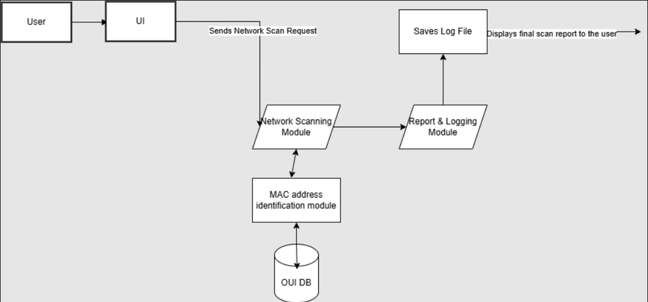
Architecture / DFD of Proposed System

Slide 15
Hardware Software Requirements
Frontend: Python/ CustomTkinter Module Backend: Python / Socket/ Scapy Modules Database: Locally Saved DB from IEEE.org(OUI DB)

Slide 16
Conclusion
Efficient & User-Friendly Network Scanning The developed Python-based network scanner provides a seamless interface for users to scan their network, identify active devices, and analyze security vulnerabilities in real time.
Enhanced Network Monitoring & Security With automated device detection, port scanning, and MAC address identification, users can efficiently monitor their network, ensuring better visibility and proactive security measures.
Scalability & Future Enhancements The system is designed to be scalable, allowing for future integrations such as real-time alerts, AI-driven threat analysis, and advanced vulnerability assessments for improved cybersecurity.

Slide 17
References
M Pranavi et al, Int. J. Comp. Tech. Appl., Vol 2 (6), 1800-1805 IJCTA | NOV-DEC 2011 Available online@www.ijcta.com 1800 ISSN:2229-6093
https://www.researchgate.net/publication/263779662_Network_Scanning_Vulnerability_Assessment_with_Report_Generation
[3] DFD creation: https://www.drawio.com/
[4] Python Scapy Modules : https://scapy.net/

