Slide 1



Who Am I - Antonio Piovesan https://github.com/ant1974/ant-repo-public
2021.03.11 - Spring Boot - Antonio:P - https://github.com/ant1974/ant-repo-public

Slide 2
Introduzione ( .: the boot :. )
Spring Boot rende facile creare applicazioni/web-application di qualità.
Approccio «opinionated» all’uso del framework Spring e altre librerie evitando codice boilerplate
Ridotta necessità di configurazione
Scopi principali di Spring Boot sono:
Fornire un avvio molto rapido nello sviluppo usando Spring
Presumere di fare il meglio per noi, ma lasciandoci la possibilità di scelte personalizzate
Fornire una vasta gamma di features non funzionali che siano ricorrenti nei progetti SW (web server, sicurezza, Internationalization, databases)
Mancanza di java code generation e nessuna config. XML richiesta
2021.03.11 - Spring Boot - Antonio:P - https://github.com/ant1974/ant-repo-public

Slide 3
Introduzione ( .. it follows .. )
Alcuni vantaggi di Spring Boot
Si evitano problemi di conflitti tra versioni e dipendenze: Spring Boot le risolve per noi
Eccellente integrazione con i più usati IDE (Eclipse – Visual Studio Code – IntelliJ Idea).
Rapidità di sviluppo e test anche attraverso l’uso di Web Server integrato (Tomcat /Jetty)
Completa assenza di codice ripetitivo (boilerplate code)
You, Bootiful happy coder
Spring Boot
Spring Framework
2021.03.11 - Spring Boot - Antonio:P - https://github.com/ant1974/ant-repo-public

Slide 4

Spring ( Say what ? )
Defacto Standard per sviluppo Java EE
Light container che offre
IOC / DI container
Supporto nativo allo Aspect Oriented Programming
Ricchezza di «moduli» costruiti con (A) e (B) [ https://spring.io/projects/ ]
Ricchezza di documentazione [ https://spring.io/learn ]
IOC/DI
Hollywood Pattern …. «Don’t call us, we will call you» …
Si rovescia la dipendenza: un oggetto di tipo A che necessiti di un oggetto di tipo B non lo crea ma ne richiede una istanza di classe B (singleton o stereotyp-ed) ad un ‘demiurgo’ esterno (Spring light container)
Spring Bean LifeCycle Servlet LifeCycle in Tomcat container
2021.03.11 - Spring Boot - Antonio:P - https://github.com/ant1974/ant-repo-public

Slide 5
Spring ( .. let's keep it flowin' .. )
Aspect Oriented Programming (AOP)
Codice cross-cutting/ortogonale
Auditing / Loggin’
JDBC/SQL Transaction
Security / Access Control
Advice: cosa fare ( commit o rollback ad esempio) .. Cosa invocare quando …
Pointcut: regola che esprime quando applicare lo Advice
Joinpoint: punti di esecuzione a runtime del codice definiti dal Pointcut (specifica del quando)
Aspect = combinazione di Advice e Pointcut
Before
Around
AfterReturning (exits by normal return)
Afterthrowing (exits by throwing an exception)
After (normal + exception)
2021.03.11 - Spring Boot - Antonio:P - https://github.com/ant1974/ant-repo-public

Slide 6
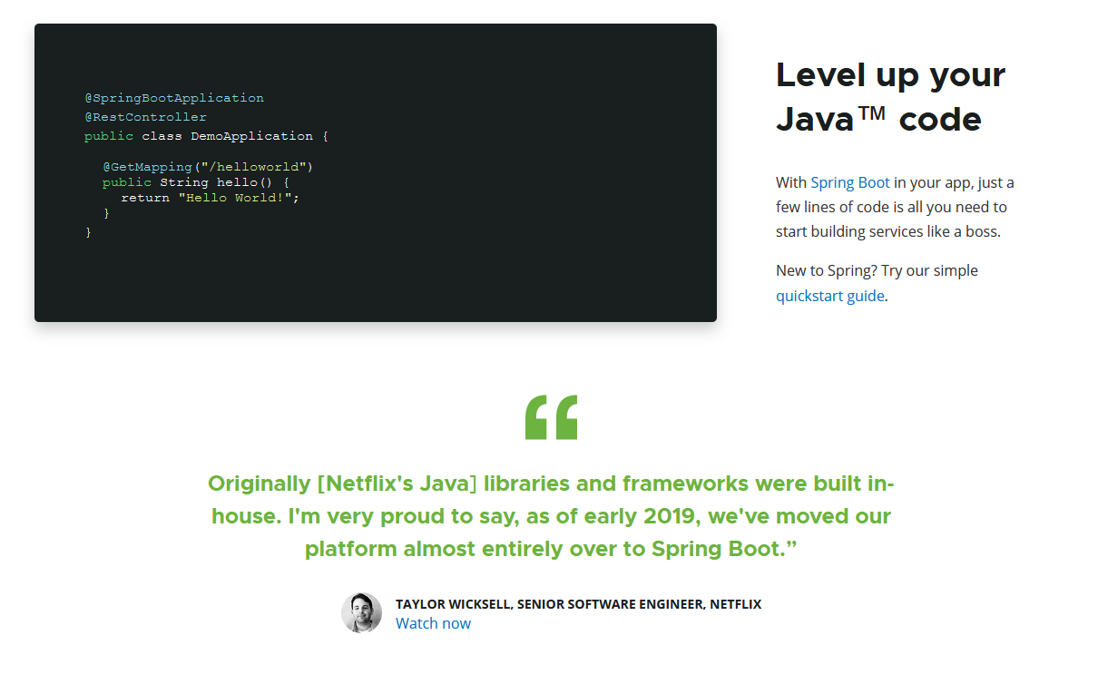
Welcome to the Boot ( .. We’ve got fun and games .. )
2021.03.11 - Spring Boot - Antonio:P - https://github.com/ant1974/ant-repo-public

Slide 7
Starter ( .. chi era costui .. )
<dependency>
<groupId>org.springframework.boot</groupId>
<artifactId>spring-boot-starter-web</artifactId>
</dependency>
<dependencies>
<dependency>
<groupId>org.springframework.boot</groupId>
<artifactId>spring-boot-starter</artifactId>
</dependency>
<dependency>
<groupId>org.springframework.boot</groupId>
<artifactId>spring-boot-starter-json</artifactId>
</dependency>
<dependency>
<groupId>org.springframework.boot</groupId>
<artifactId>spring-boot-starter-tomcat</artifactId>
</dependency>
<dependency>
<groupId>org.hibernate.validator</groupId>
<artifactId>hibernate-validator</artifactId>
</dependency>
<dependency>
<groupId>org.springframework</groupId>
<artifactId>spring-web</artifactId>
</dependency>
<dependency>
<groupId>org.springframework</groupId>
<artifactId>spring-webmvc</artifactId>
</dependency>
</dependencies>
Spring Boot starter: è un template (realizzato come dipendenza MAVEN) che raccoglie le dipendenze delle librerie necessarie per le funzionalità che si dichiara (in pom.xml) di voler usare.
2021.03.11 - Spring Boot - Antonio:P - https://github.com/ant1974/ant-repo-public

Slide 8
Autoconfiguration ( .. it’s a kind of magic .. )
La “autoconfiguration” è abilitata attraverso l’uso della java annotation @EnableAutoConfiguration
La auto configuration scansiona il java classpath, scova le librerie che sono presenti, imposta la migliore configurazione possibile per queste, instanzia i componenti/beans registrandone le inter - dipendenze (DI – Dependency Injection).
@SpringBootApplication | @EnableAutoConfiguration: enable Spring Boot's auto-configuration mechanism @ComponentScan: enable @Component scan on the package where the application is located (see the best practices) @Configuration: allow to register extra beans in the context or import additional configuration classes
2021.03.11 - Spring Boot - Antonio:P - https://github.com/ant1974/ant-repo-public

Slide 9
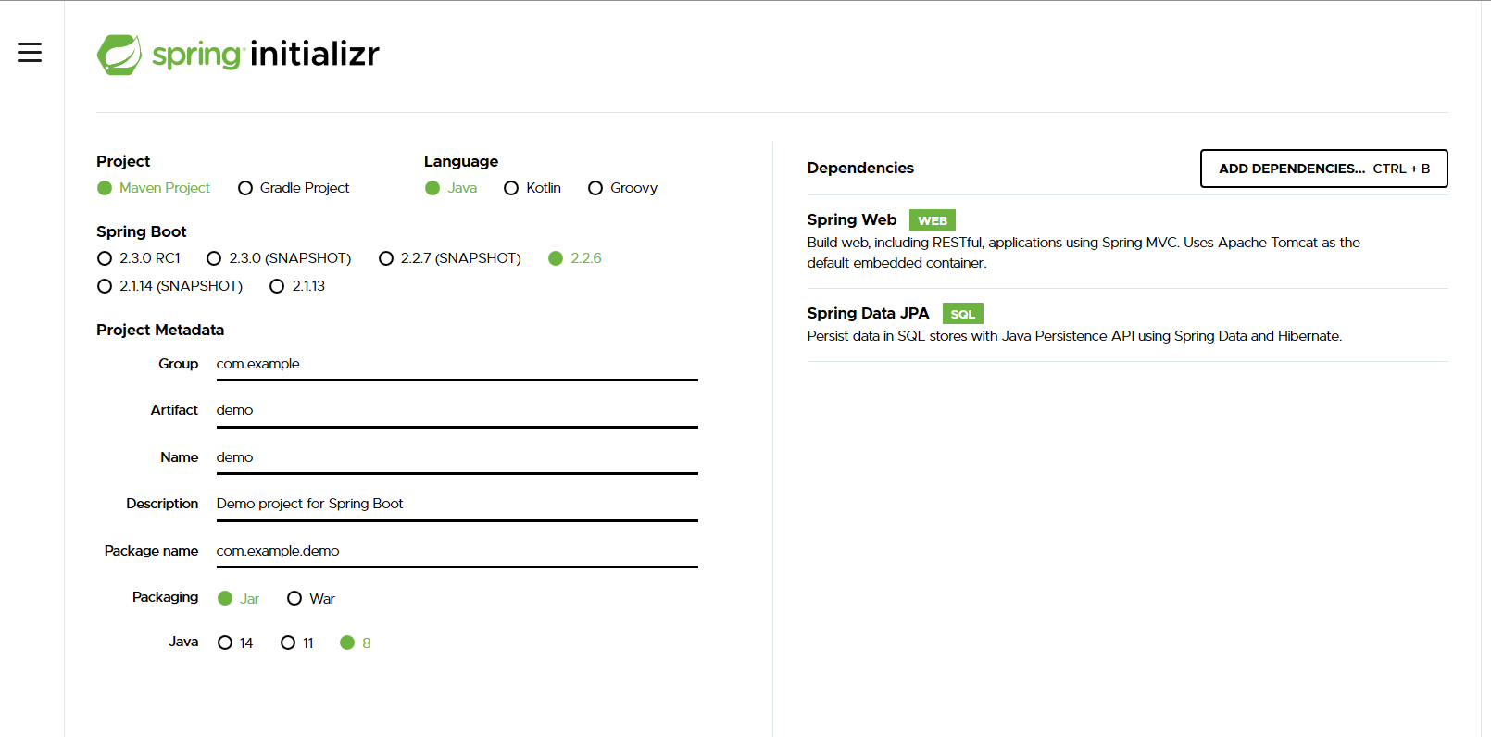
Let’s start coding ( .. Rock & Roll, baby .. )
https://start.spring.io/
2021.03.11 - Spring Boot - Antonio:P - https://github.com/ant1974/ant-repo-public

Slide 10
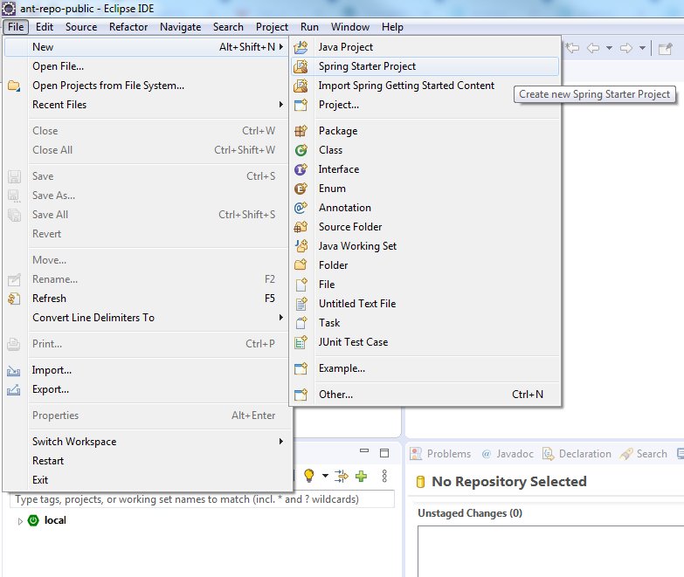
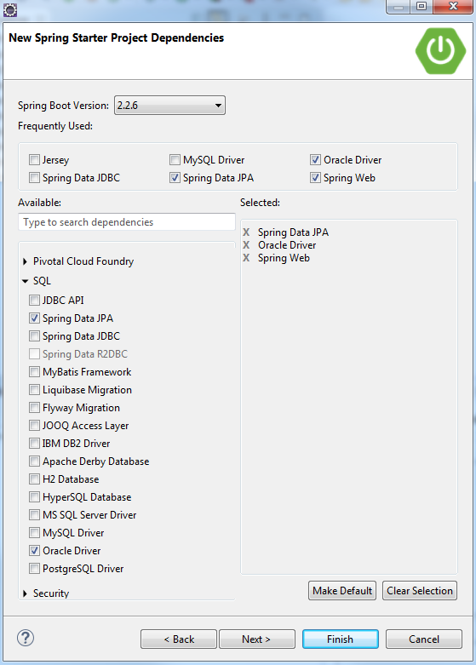
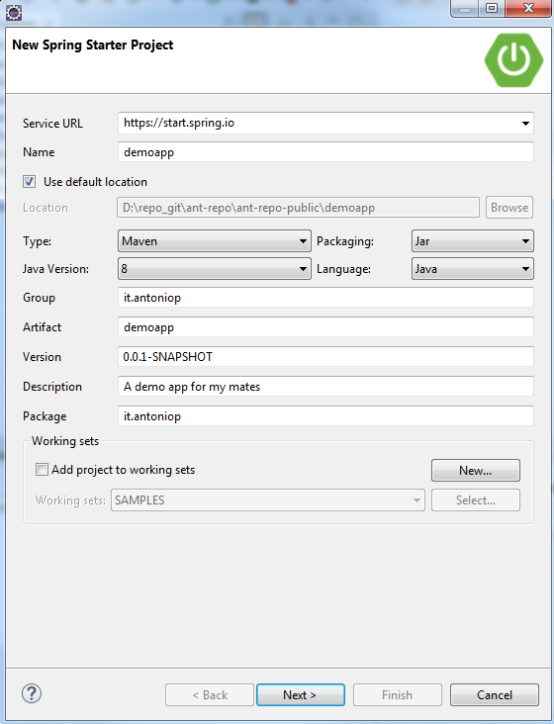
Let’s start coding ( .. Keep on rockin’ in Eclipse world .. )
2021.03.11 - Spring Boot - Antonio:P - https://github.com/ant1974/ant-repo-public

Slide 11
Spring Boot ( .. recap .. )
Approccio «opinionated» all’uso di Spring et altro (Logging, ORM, REST, JSON, ..) evitando codice ripetitivo
Auto Configuration
Maven Starters
spring-boot-starter-web
spring-boot-starter-data-jpa
spring-boot-starter-actuator
Annotazioni java
@SpringBootApplication
@Component | @Bean | @Repository | @Service
@Autowired | @Controller
@RestController
@RequestMapping
@RequestBody
@GetMapping | @PostMapping | @DeleteMapping
2021.03.11 - Spring Boot - Antonio:P - https://github.com/ant1974/ant-repo-public

Slide 12
Continueed ( .. How many .. )
Maven Starters
spring-boot-starter-thymeleaf
spring-boot-starter-mustache
spring-boot-starter-test
spring-boot-configuration-processor { auto complete su configuration files }
spring-boot-starter-aop
spring-boot-starter-security
thymeleaf-extras-springsecurity5
spring-boot-starter-actuator
spring-boot-starter-logging
{ logging con LogBACK usando Simple Logging Facade for Java (SLF4J) }
spring-boot-starter-tomcat { Servlet Server Tomcat }
spring-boot-starter-log4j2 { logging con Log4j }
spring-boot-starter-jetty { Servlet Server Jetty }
2021.03.11 - Spring Boot - Antonio:P - https://github.com/ant1974/ant-repo-public

Slide 13
Continueed ( .. Whole lotta annotation .. )
Annotazioni java
@Bean | @Value
@Repository | @Service
@Controller | @RestController
@Configuration | @ConfigurationProperties
@Profile
@Aspect
@Before: Advice that executes before a join point, but which does not have the ability to prevent execution flow proceeding to the join point (unless it throws an exception).
@AfterReturning: Advice to be executed after a join point completes normally.
@AfterThrowing: Advice to be executed if a method exits by throwing an exception.
@After: Advice to be executed regardless of the means by which a join point exits (normal or exceptional return).
@Around: Advice that surrounds a join point such as a method invocation.
2021.03.11 - Spring Boot - Antonio:P - https://github.com/ant1974/ant-repo-public

Slide 14
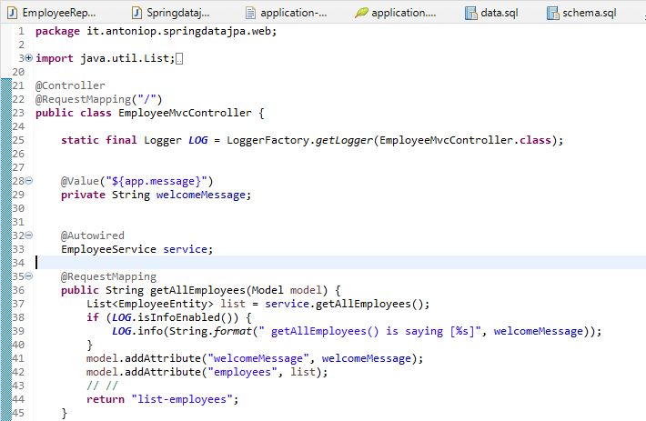
MVC / DI ( .. are there any patterns ?? .. )
I’m an MVC controller
Please Spring, gimme the service
Let’s feed Model… the view is hungry
View! Show me the list
2021.03.11 - Spring Boot - Antonio:P - https://github.com/ant1974/ant-repo-public

Slide 15
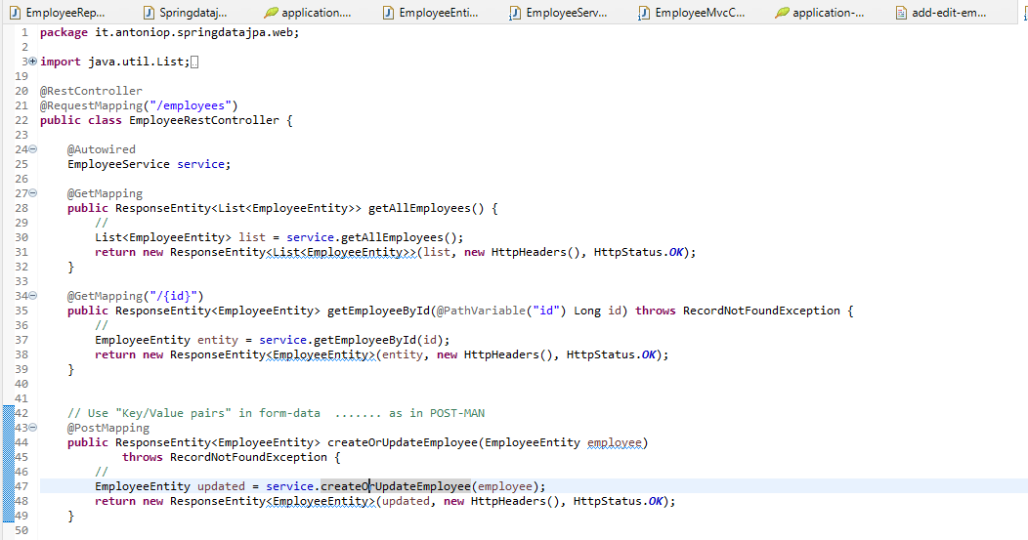

REST / DI ( .. lotta stuff 1 .. )
I’m a REST controller
Please Spring, gimme the service
2021.03.11 - Spring Boot - Antonio:P - https://github.com/ant1974/ant-repo-public

Slide 16
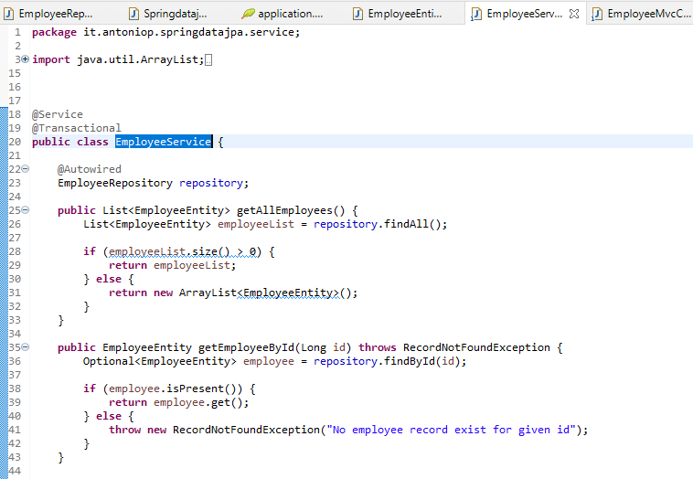

Service Vs Repo ( .. lotta stuff 2 .. )
I’m a Service component .. I’m Commit/Rollback ready
Please Spring, gimme a JPA ready component
2021.03.11 - Spring Boot - Antonio:P - https://github.com/ant1974/ant-repo-public

Slide 17
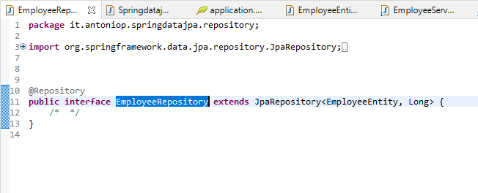

Thanks Spring for the Repo ( .. lotta stuff 3 .. )
I’m a JPA ready component …
No code … It’s all free …
Free as a beer
Spring DOES the magic
2021.03.11 - Spring Boot - Antonio:P - https://github.com/ant1974/ant-repo-public

Slide 18
Profiles ( .. Test it like PROd .. )
I Profiles sono una funzionalità chiave che ci permette di associare la creazione di componenti a diversi profili/contesti – ad esempio dev, test, prod. … Possiamo quindi usare profili diversi per situazioni diverse.
Usando la annotazione java @Profile associamo un bean ad un particolare profile; l’annotazione si aspetta semplicemente iI nome di uno o più profili.
Quando annotiamo un bean/component con un profile “dev” un’istanza del componente DevDatasourceConfig sarà creata/attiva solo se allo start-up si chiede di usare il profilo dev
@Component
@Profile("dev")
public class DevDatasourceConfig
Spring Boot permette di avere/definire profile-specific application.properties files con il formato
applications-{profile}.properties.
Spring Boot caricherà automaticamente le properties nel file application.properties comune a tutti i profiles e quelle definite nei “profile-specific .properties files” riferiti allo start-up come attivi.
I nomi profilo possono essere passati come JVM system parameters; il nome profile usato come segue sarà attivato allo start-up dell’applicativo:
java -jar -Dspring.profiles.active=dev ...
oppure
java -jar app-file-name.jar --spring.profiles.active=dev
2021.03.11 - Spring Boot - Antonio:P - https://github.com/ant1974/ant-repo-public

Slide 19
Security ( .. stay safe .. wear masks ..)
Wikipedia – Basic Access AUTH
https://it.wikipedia.org/wiki/Basic_access_authentication
Creare un file in formato
- jks (Java Keystore File) oppure
- p12 [ PKCS12 (§) ]
https://www.baeldung.com/spring-boot-https-self-signed-certificate
https://mkyong.com/spring-boot/spring-boot-ssl-https-examples/
https://tomcat.apache.org/tomcat-9.0-doc/ssl-howto.html#Prepare_the_Certificate_Keystore
(§) PKCS12: Public Key Cryptographic Standards
https://en.wikipedia.org/wiki/PKCS_12
2021.03.11 - Spring Boot - Antonio:P - https://github.com/ant1974/ant-repo-public

Slide 20
Actuators ( .. small step for the human kind but … )
“An actuator is a manufacturing term that refers to a mechanical device for moving or controlling something. Actuators can generate a large amount of motion from a small change.”
Spring Boot include delle features aggiuntive per aiutarci a monitorare e a gestire la nostra applicazione quando essa viene usata in produzione.
Possiamo scegliere di gestire/monitare la nostra applicazione attraverso endpoints HTTP oppure con le API Java JMX.
Esempi:
httptrace, health,
metrics, mappings, env,
beans, loggers, logfile,
threaddump, heapdump.
Starter: spring-boot-starter-actuator
Default URL per HTTP endpoints : /actuator /actuator/<actuator-name>
https://docs.spring.io/spring-boot/docs/2.2.6.RELEASE/reference/htmlsingle/#production-ready
2021.03.11 - Spring Boot - Antonio:P - https://github.com/ant1974/ant-repo-public

Slide 21
Deploying Spring Boot Applications
Linux
https://docs.spring.io/spring-boot/docs/current/reference/htmlsingle/#deployment-service
Windows service
https://docs.spring.io/spring-boot/docs/current/reference/htmlsingle/#deployment-windows
https://github.com/kohsuke/winsw
https://github.com/snicoll-scratches/spring-boot-daemon
Deploying in Docker Container
https://medium.com/swlh/deploying-spring-boot-applications-15e14db25ff0
Deploying in Microsoft Azure
https://spring.io/guides/gs/spring-boot-for-azure/
https://docs.microsoft.com/it-it/azure/developer/java/spring-framework/deploy-spring-boot-java-app-with-maven-plugin
2021.03.11 - Spring Boot - Antonio:P - https://github.com/ant1974/ant-repo-public

Slide 22
Links
Spring «Getting Started» Docs
https://spring.io/quickstart
https://spring.io/guide
https://start.spring.io/
Spring Boot/Spring Docs
https://docs.spring.io/spring-boot/docs/current/reference/htmlsingle/
https://docs.spring.io/spring-framework/docs/current/spring-framework-reference/index.html
Baeldung
https://www.baeldung.com/start-here
https://www.baeldung.com/spring-boot
mkyong.com
https://mkyong.com/tutorials/spring-boot-tutorials/
2021.03.11 - Spring Boot - Antonio:P - https://github.com/ant1974/ant-repo-public

Slide 23
THANK YOU ALL! Antonio
2021.03.11 - Spring Boot - Antonio:P - https://github.com/ant1974/ant-repo-public

