Slide 1
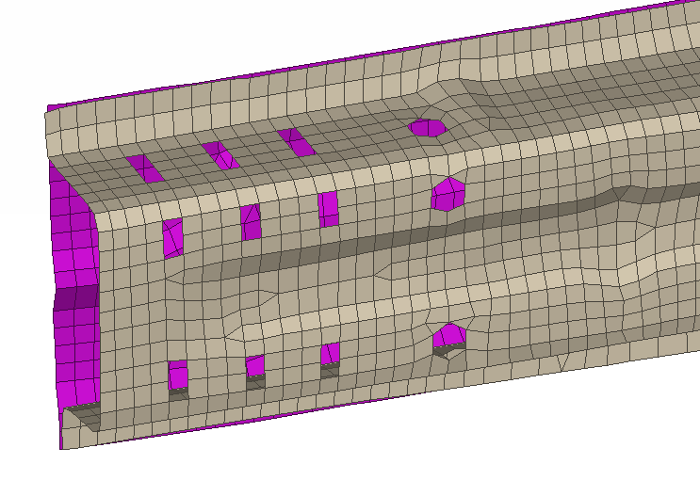
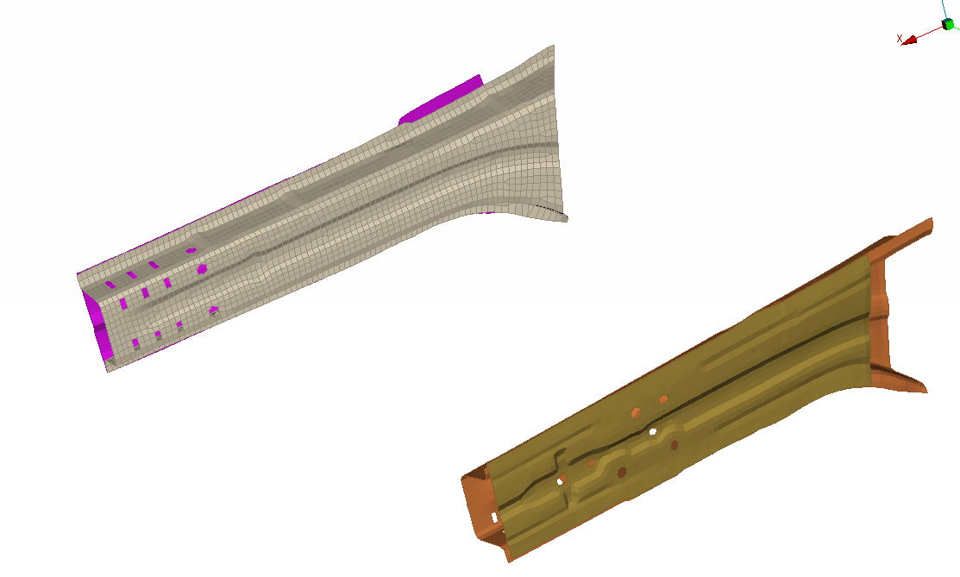
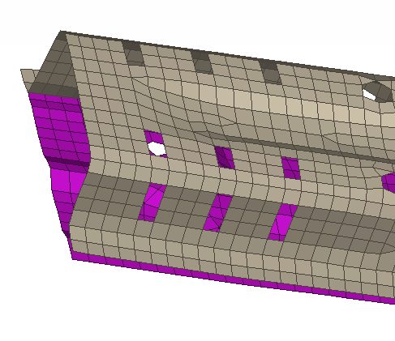
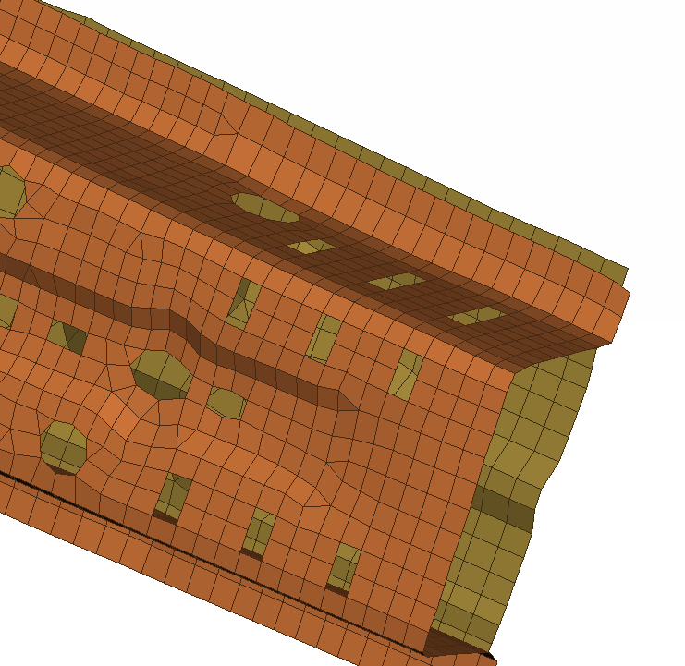
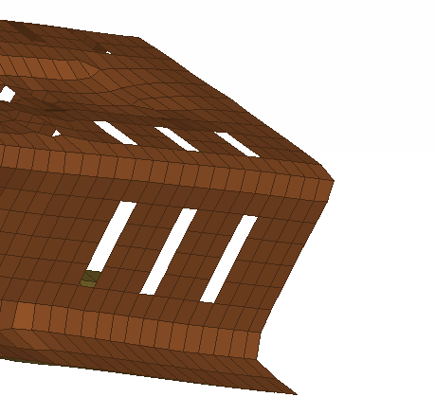
NISSAN_ff_0002

Slide 2
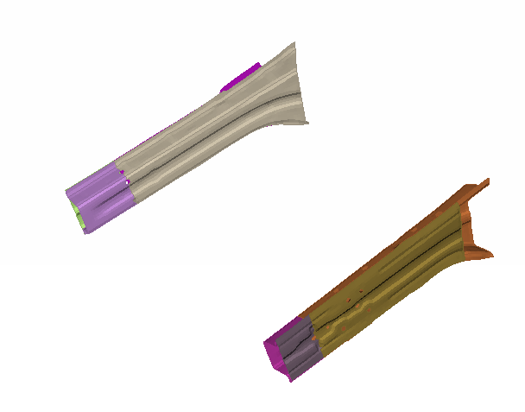
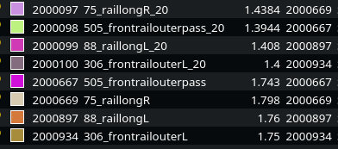
NISSAN_ff_0003
Thickness to 80%

Slide 3
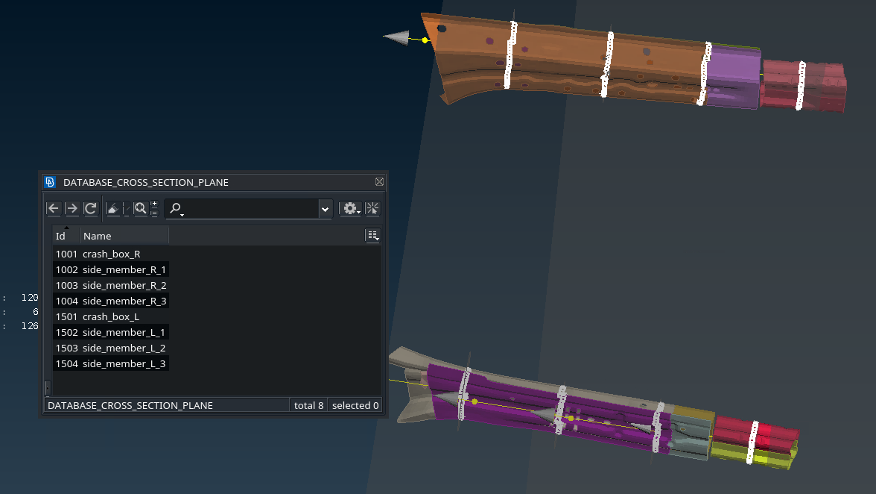
NISSAN_ff_0004

Slide 4
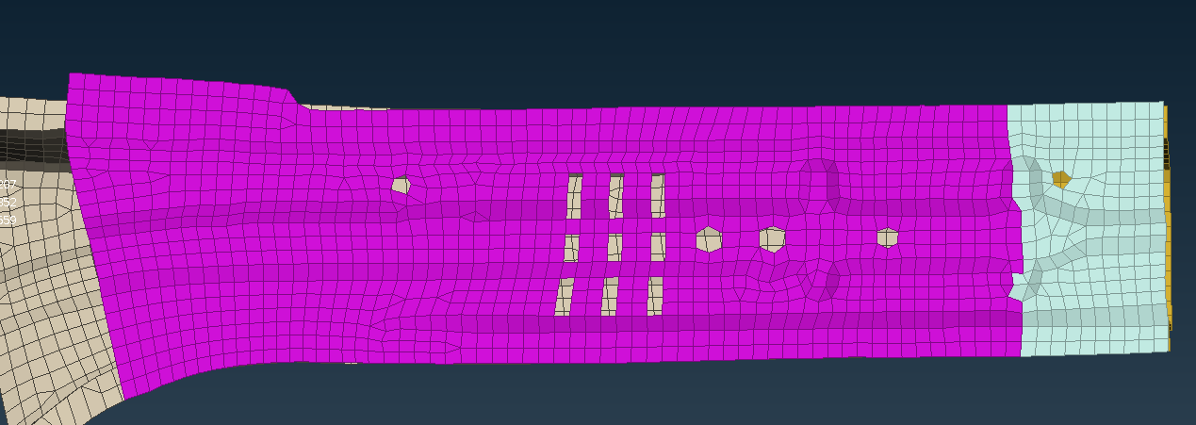
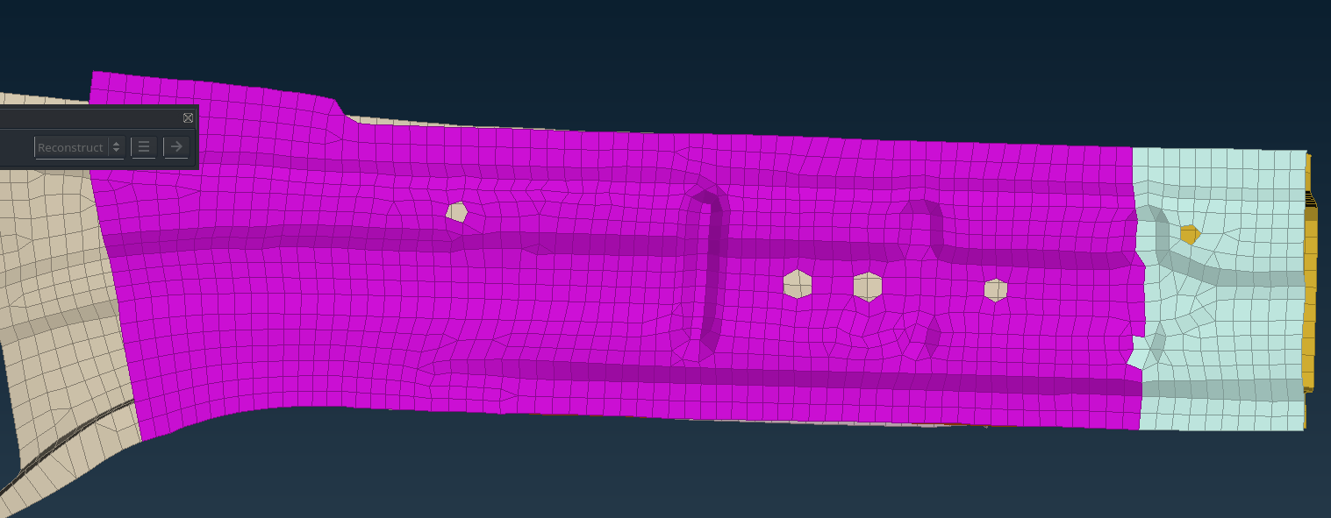
NISSAN_ff_0005
NISSAN_ff_0006

Slide 5
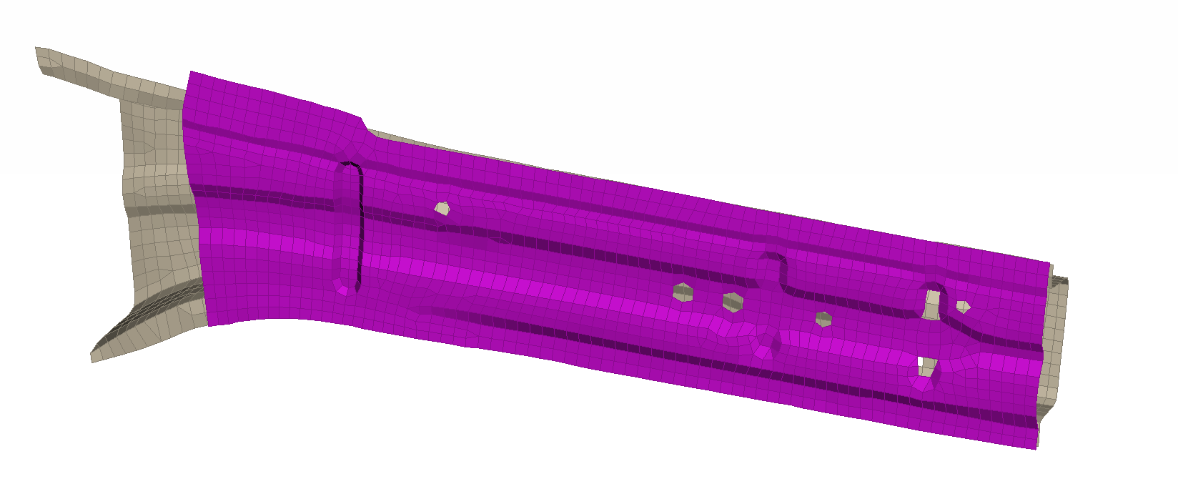
NISSAN_ff_0002
NISSAN_ff_0007

Slide 6
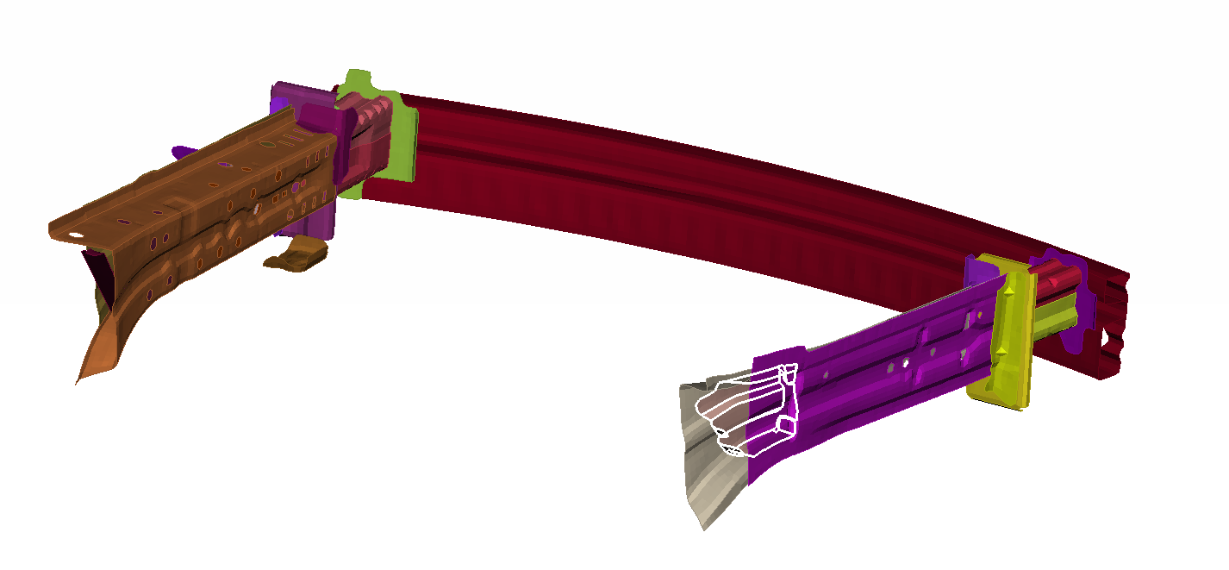
NISSAN_ff_0008
Thickness from 1.219 -> 1.1 mm

Slide 7
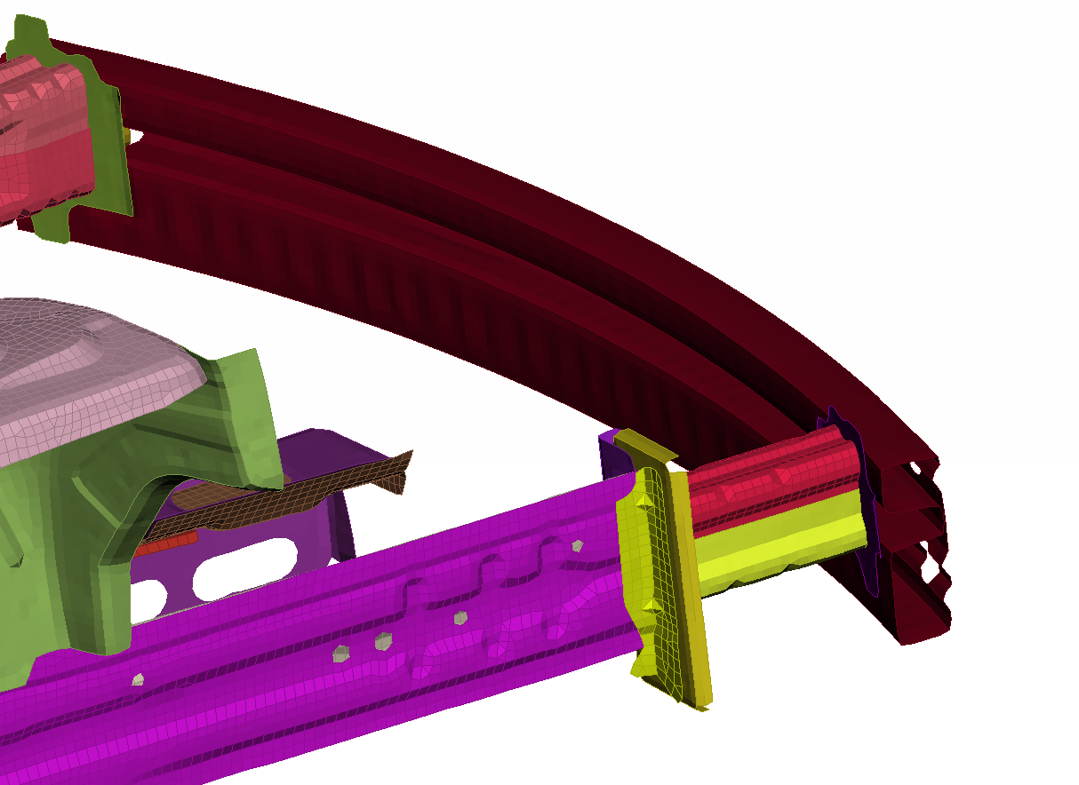
NISSAN_ff_0009

Slide 8
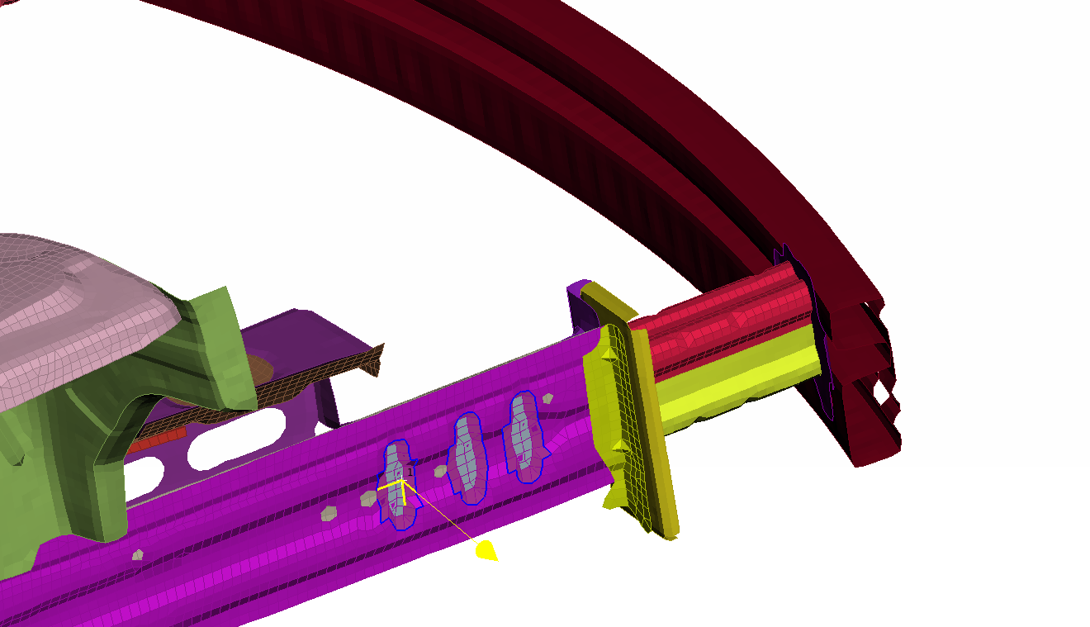
NISSAN_ff_0010
Morph with translate -4mm in z

Slide 9
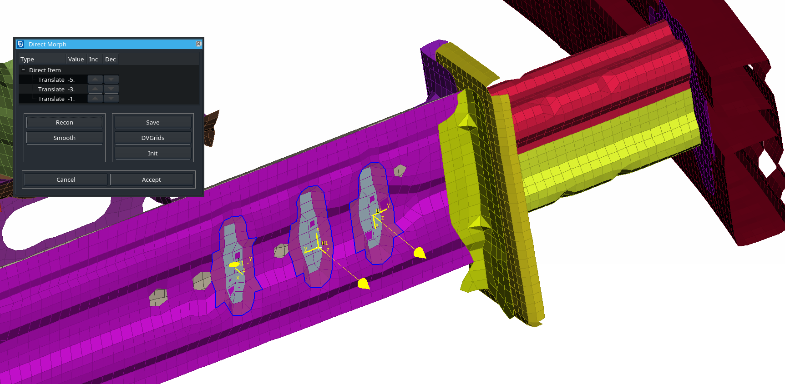
NISSAN_ff_0011

Slide 10
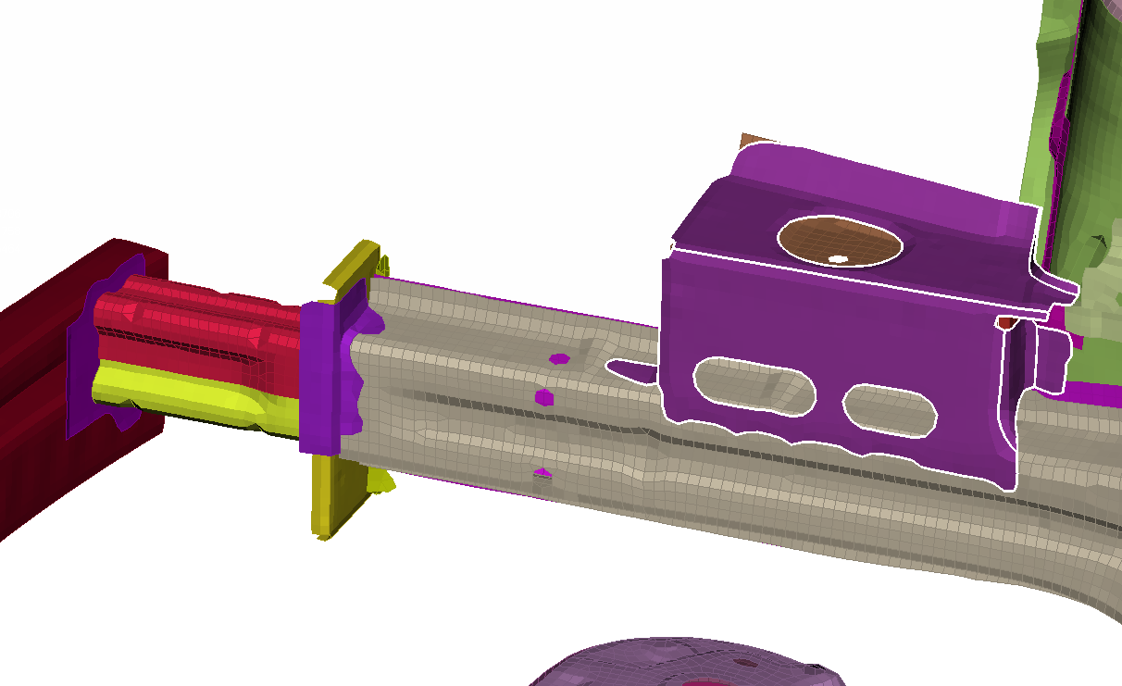
NISSAN_ff_0012
Thickness from 2.04 -> 3 mm

Slide 11
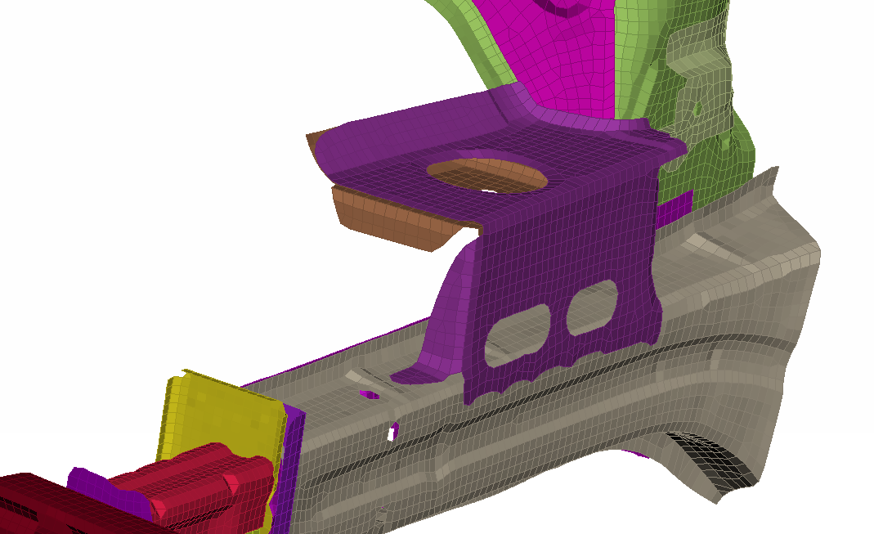
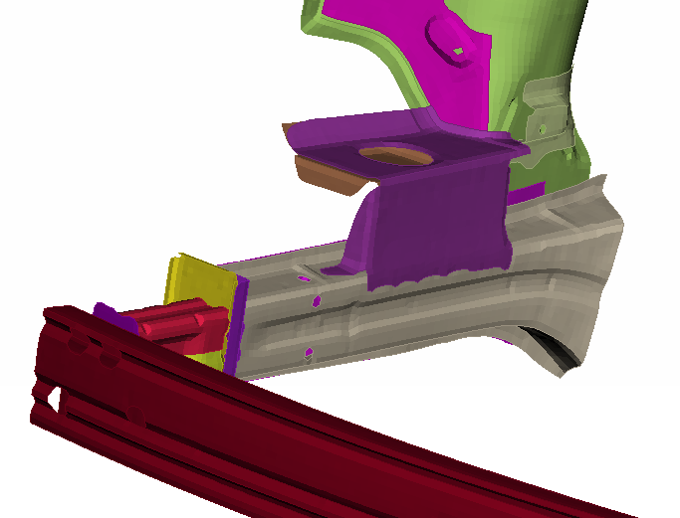
NISSAN_ff_0013

Slide 12
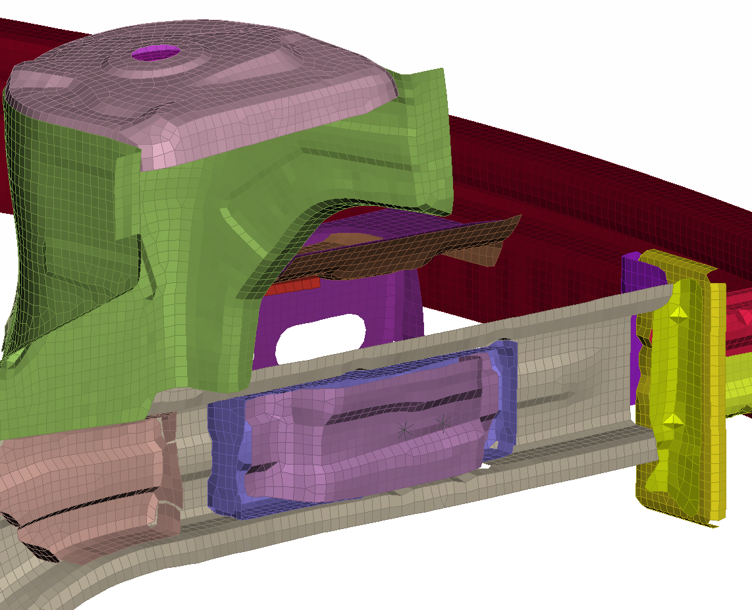
NISSAN_ff_0014
NISSAN_ff_0011

Slide 13
NISSAN_ff_0014
NISSAN_ff_0015
NISSAN_ff_0012
NISSAN_ff_0011
Thickness from 2.04 -> 3 mm

Slide 14
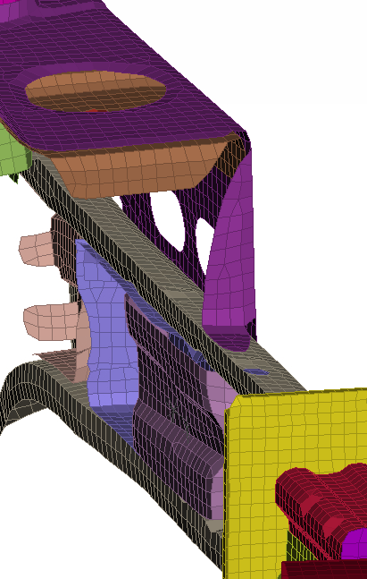
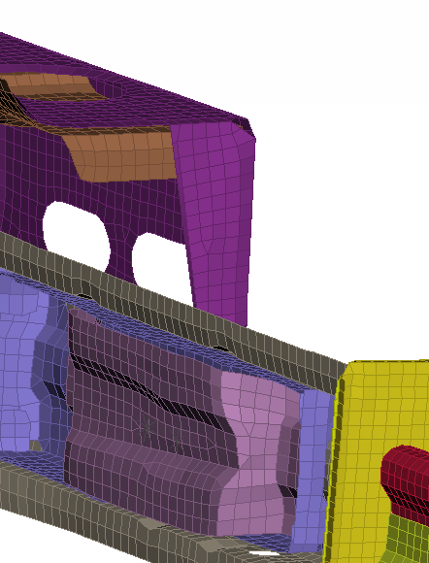
NISSAN_ff_0016

Slide 15
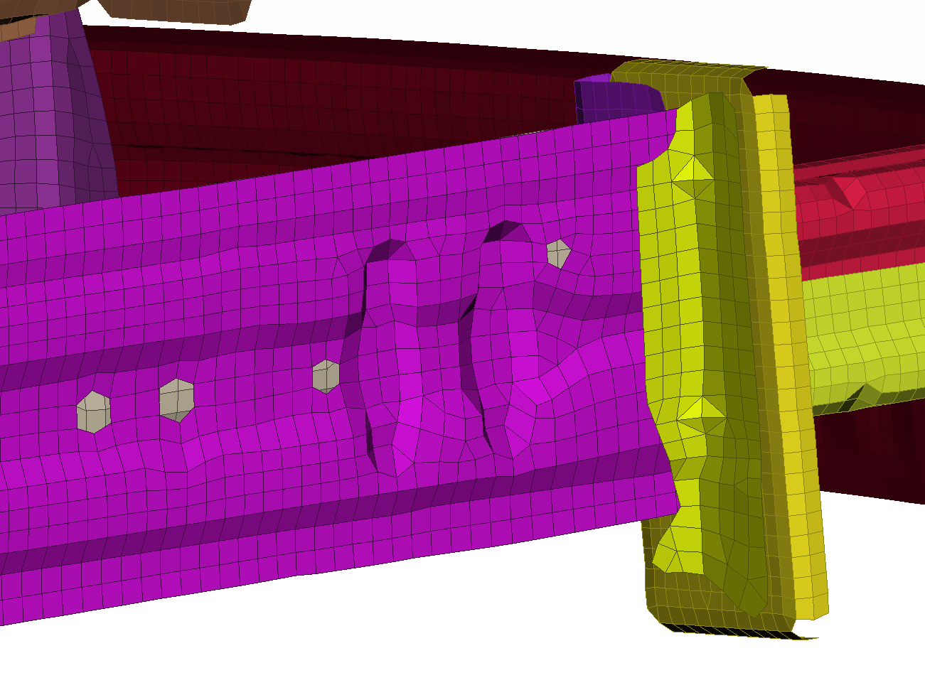
NISSAN_ff_0017
NISSAN_ff_0011

