Slide 1
Case Study Data Scientist Production Planning
Anahita Pakiman

Slide 2

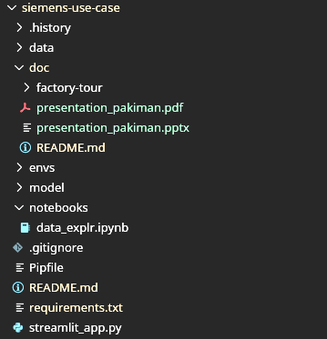



Work Flow
Repo link
Packages:
pandas
numpy
scikit-learn
matplotlib
ipykernel
seaborn
streamlit
sklearn
jupyter

Slide 3


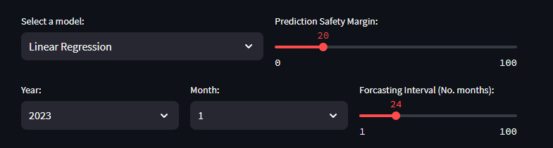
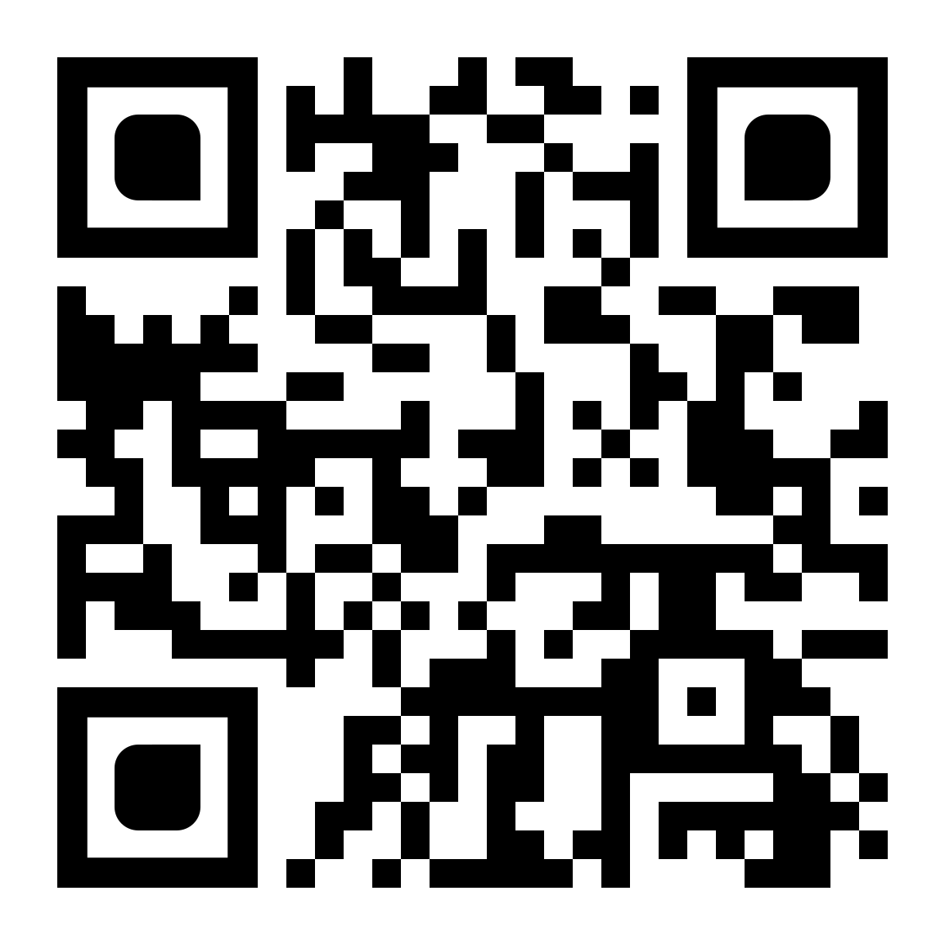

Consumption forecast
Predict Consumption APP
Models:
Linear Regression - annual
Random Forest - monthly
Decision Tree – monthly
Autoregressive Integrated Moving Average – Time series
$$Consumption=pred+SM ∗RMSE$$

Slide 4
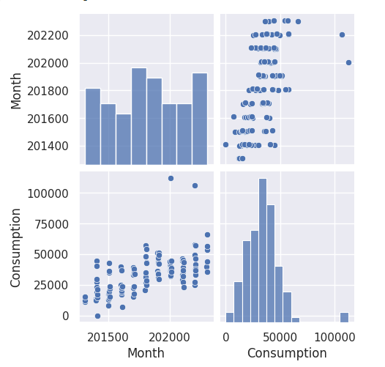
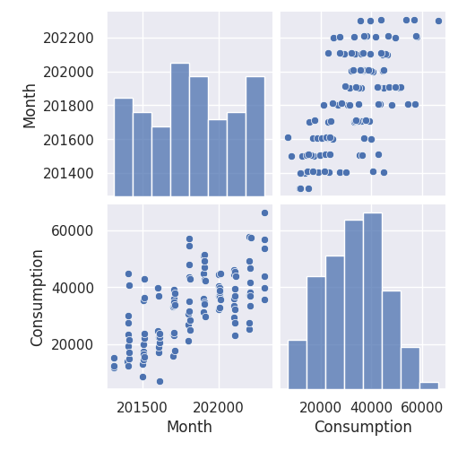
Data Cleaning

Slide 5

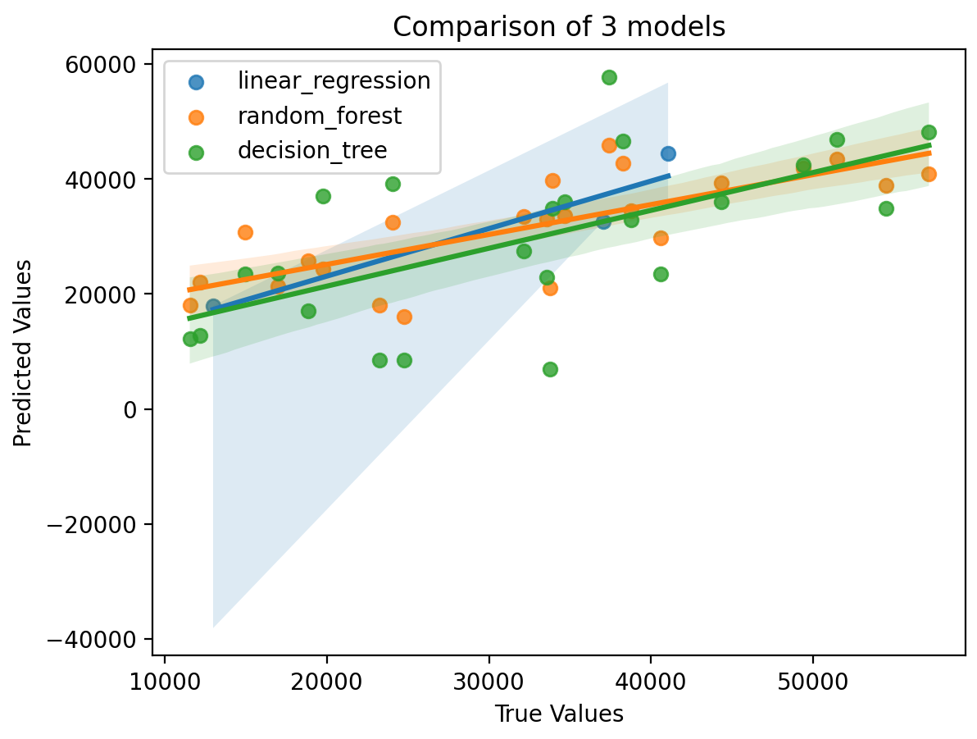
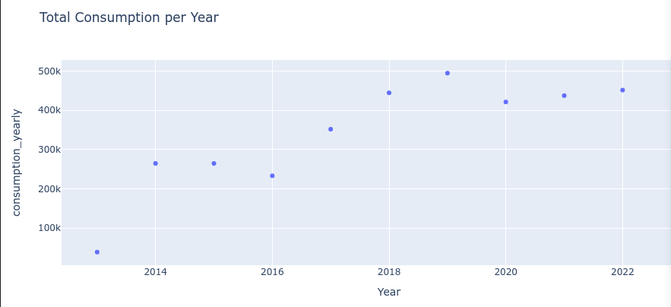
Models
------------------------------------------------------------------
Linear Regression:
RMSE on the test data: 4295
The future cost prediction: 99622
with 20% safety margin = 100481
------------------------------------------------------------------
Random Forest:
RMSE on the test data: 8486
The future cost prediction: 1186575
with 20% safety margin = 1188272
------------------------------------------------------------------
Decision Tree: - RMSE on the test data: 11642
The future cost prediction: 1274226
with 20% safety margin = 1276554
------------------------------------------------------------------
ARIMA: 1277340
Predict Consumption APP
Methods | RMSE
Mean | 10262
Linear Regression | 4295
Random Forest | 8486
Decision Tree | 11642

Slide 6
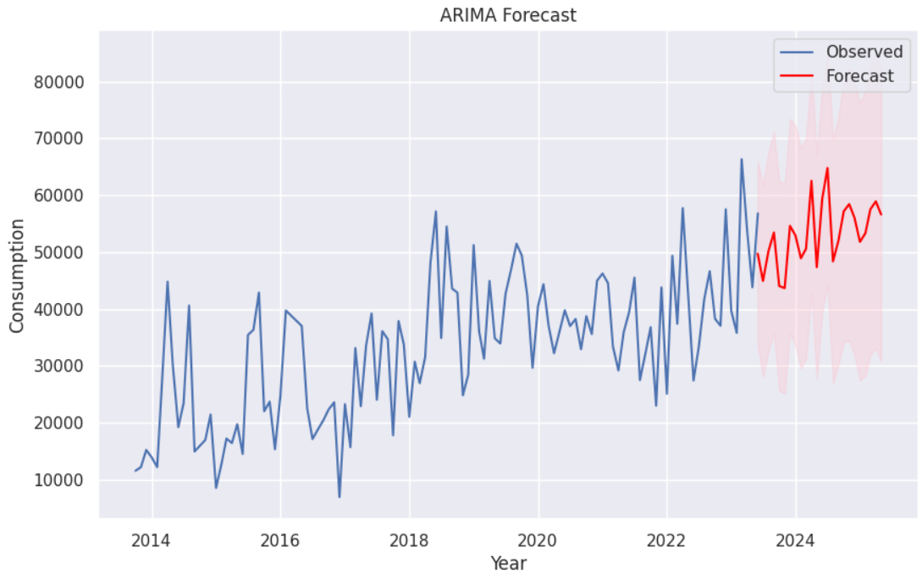
Autoregressive Integrated Moving Average - ARIMA
Issues:
No data split, no RSME to compare
Dta point is not continues
Parameter:
order=(30, 2, 5)

Slide 7
Improvement
Data split:
Change data split for annual forecast, first split and later average annual or seasonal consumption.
Hyperparameter tuning
All models are set to their default hyperparameters (python pkgs, mlflow, hyperopt). Of the models examined, the decision tree clearly overfits the data and the model complexity needs to be reduced (max_depth).
Modify prediction target, Time Series
Current models are trained to predict for a specific year/month. However, the result could be improved if we use a time series prediction and consider the time history (e.g. average consumption) in the input data and train it on its future prediction performance.
Re-evaluate data cleaning
Check the validity of the cleaned data points and reconsider including them in the dataset.
Try other models
For example: Support Vector Regression (SVR), Autoregressive Integrated Moving Average (ARIMA)

Slide 8
Commercial Plant Manager
Present the APP and the parameters study available in the APP.
Highlight the current best prediction and the reasoning behind it.
Ask him/her to use the app and give feedback on the visualisations he/she needs to improve the use case and understanding of the models.
Suggest further selection of data for better prediction (e.g. material type).
Predict Consumption APP
Focus on Communication and feedback:
Exploration accasibility > colbaorative development
Simplifying the DS concept > extend brain strorming of problem solving

Slide 9
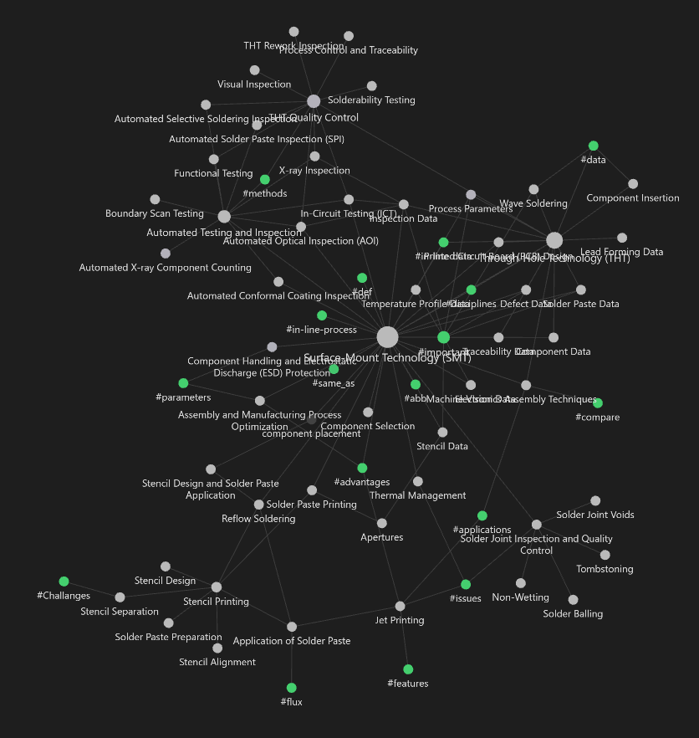
Elctronic Mounting KG
Data Sceience idea:
Reporting
Interdependency analyses
Correlation of parameters
Hypothesis
Specification limits
In-circuit analysis > Graph embedding
Human based inspections

