Slide 1

Analysis for
By Bálint Antal, JDS March 2025

Slide 2
General insights
Dilan’s Guide has shown impressive growth over the past three months, attracting 581,877 total reads from 210,023 unique readers.
A strong 63.9% of users returned*, indicating high content engagement.
Despite a relatively small fiscal investment, the blog generated $194,480 in revenue.
There are 7,618 total newsletter subscribers.
While the reader-to-subscriber conversion rate has room for improvement, the subscriber-to-buyer conversion rate is exceptional at 87.3%, highlighting the effectiveness of post-subscription monetization.
*Returning Readers is a cumulative metric, it shows the proportion of all users who have returned at least once during the 3-month period. Good at representing loyalty over the long haul.

Slide 3
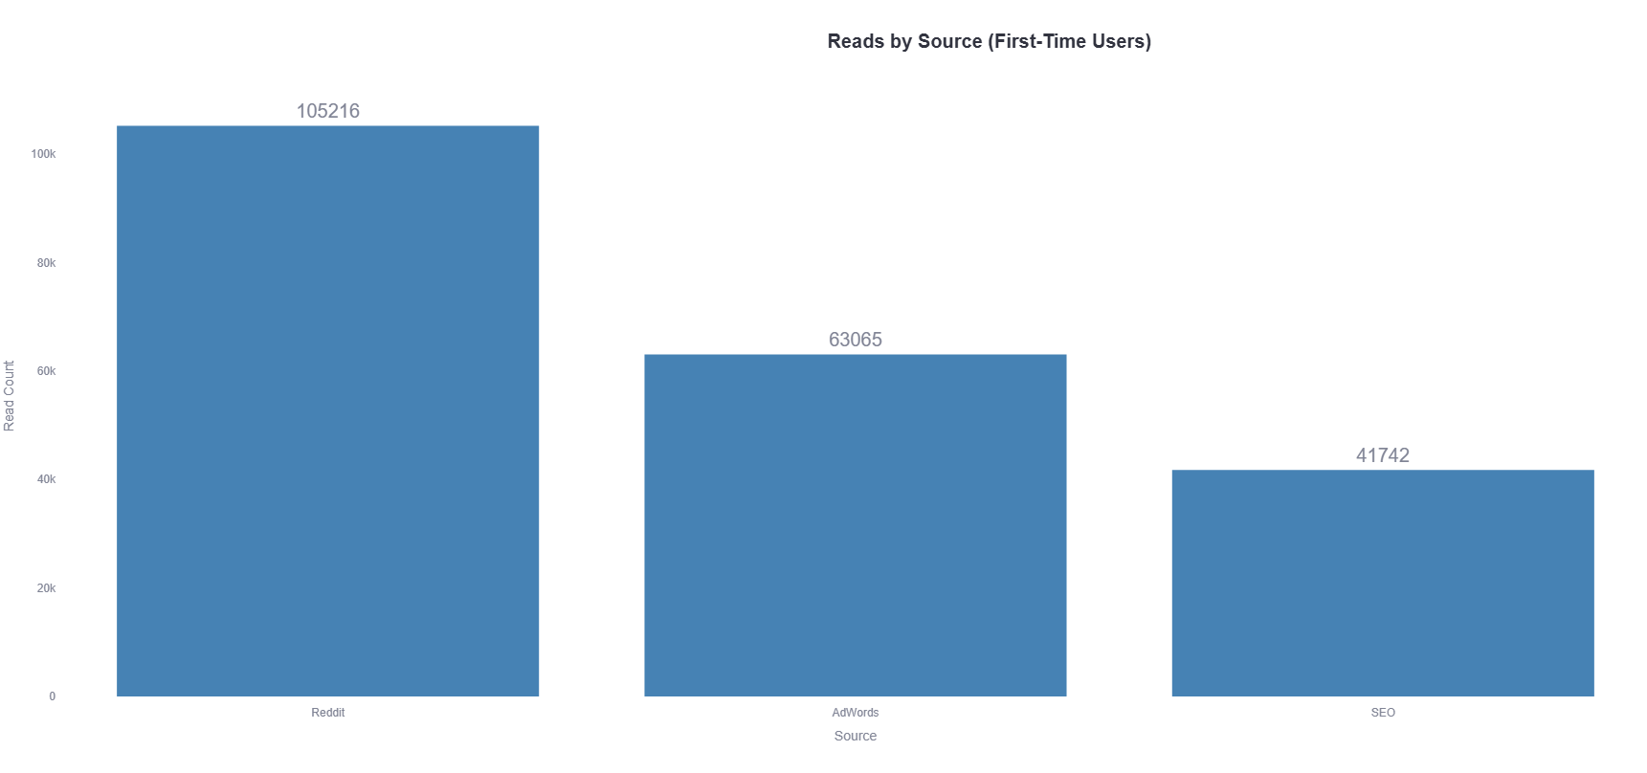
Reddit generated 105,216 - the highest volume of- first-time readers. It is a strong acquisition channel worth reinforcing with more budget and tailored content.

Slide 4
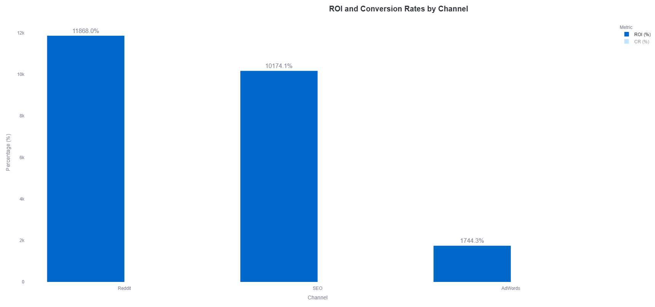
Reddit also delivered the highest ROI*, although all channels exceeded expectations in terms of return on investment.
*ROI is calculated as (Revenue - Cost) / Cost. For example, Dilan spent $250 per month for Reddit, in total $750 and generated $89,760 in revenue through that channel.

Slide 5
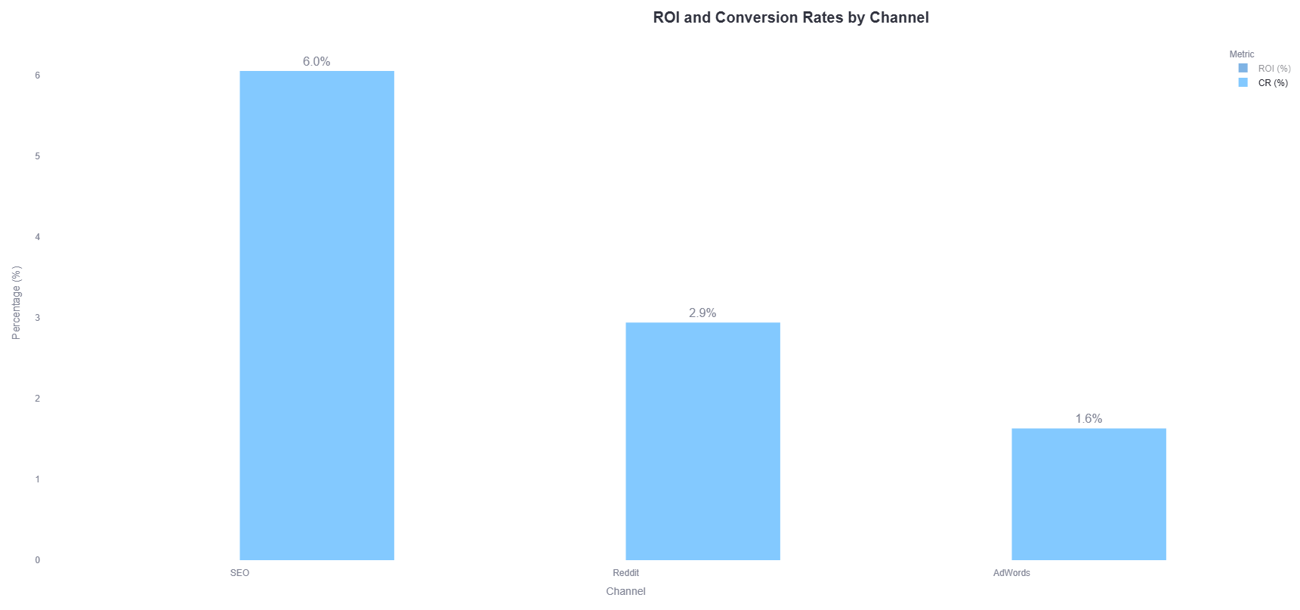
However, if we consider conversion rates*, strong SEO could serve as the backbone of the organic acquisition strategy within the marketing mix.
*CR metric represents the reader-to-buyer conversion rate. It is calculated by dividing the number of buyers by the number of first-time readers from a given source, highlighting how effectively each channel converts audience interest into purchases

Slide 6
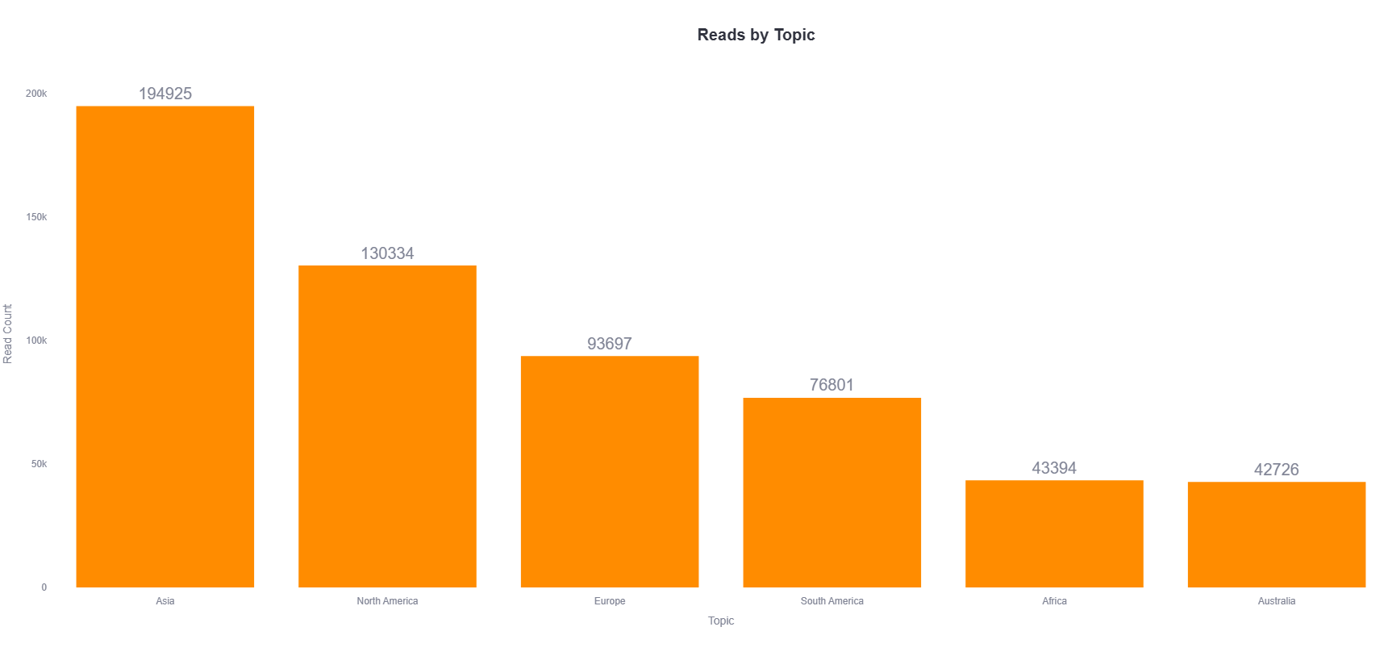
The topic Asia received the most interest with 194,925 reads. Expanding content on this topic could boost traffic and engagement.

Slide 7
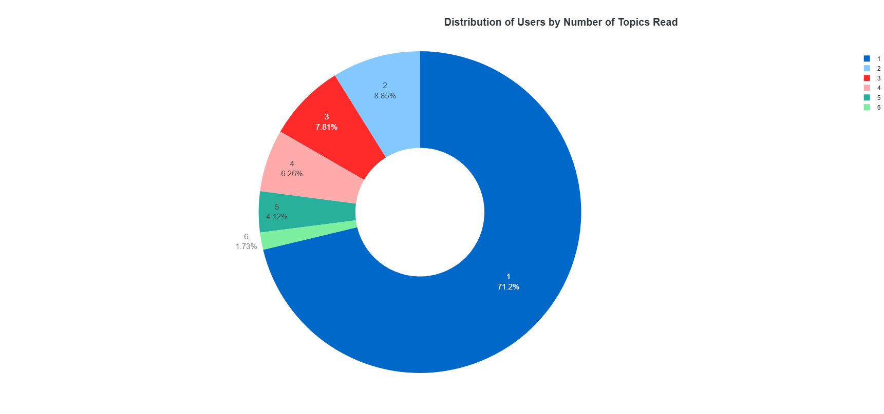
A significant portion of users engage with only one topic, 71,2% — almost two-thirds of them. Introducing cross-topic links or recommendations could help retain user engagement and encourage broader content exploration.

Slide 8
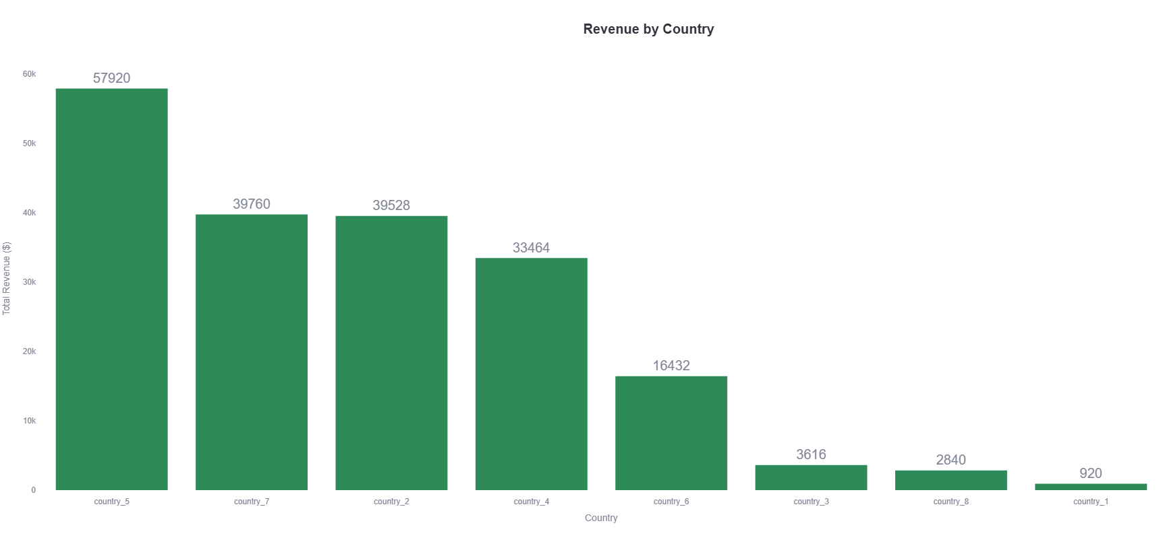
Users from country_5 generated the highest revenue ($57,920). It may be strategic to localize offers or create region-specific campaigns.

Slide 9
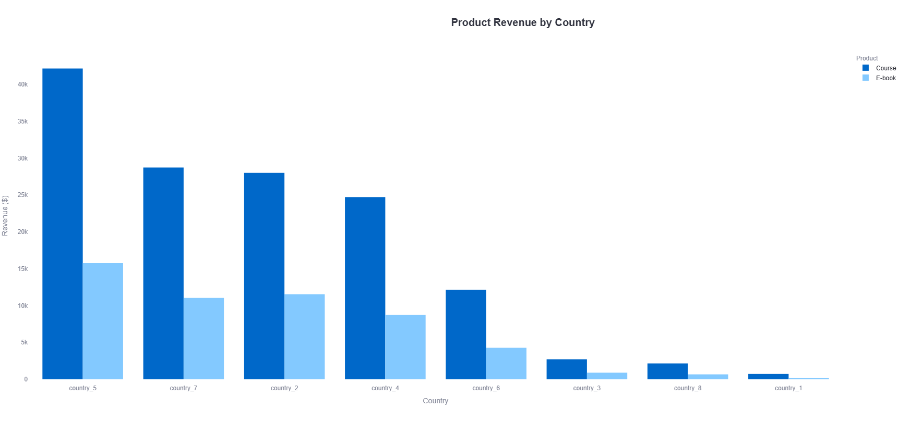
Since country_5 leads in both Course and E-book purchases—and the Course is the primary revenue driver—targeted regional campaigns focused on promoting the Course could yield strong results.

Slide 10
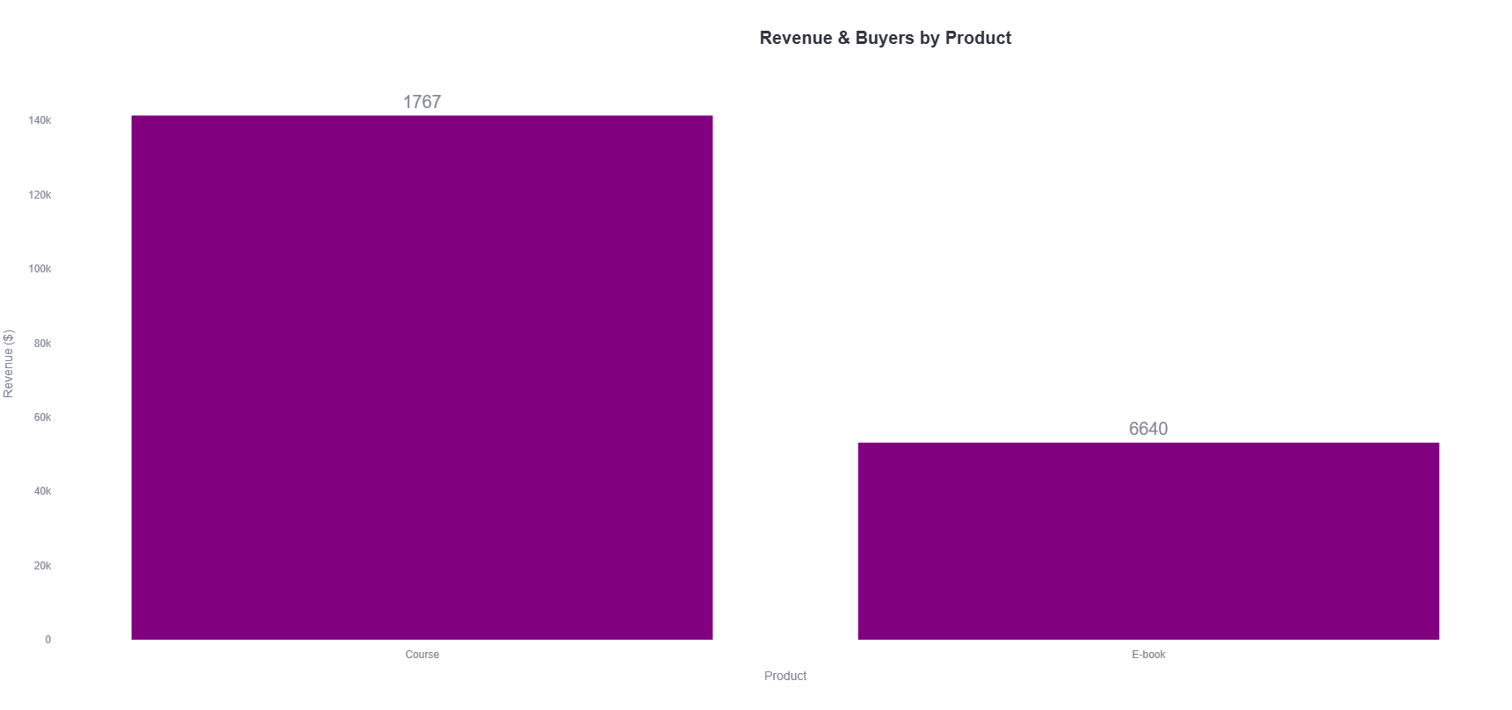
Out of all buyers, 1,767 purchased the Course while 6,640 opted for the E-book. This suggests a strategic opportunity: offering a follow-up discount on the Course to E-book buyers could increase high-value conversions and boost total revenue.

Slide 11
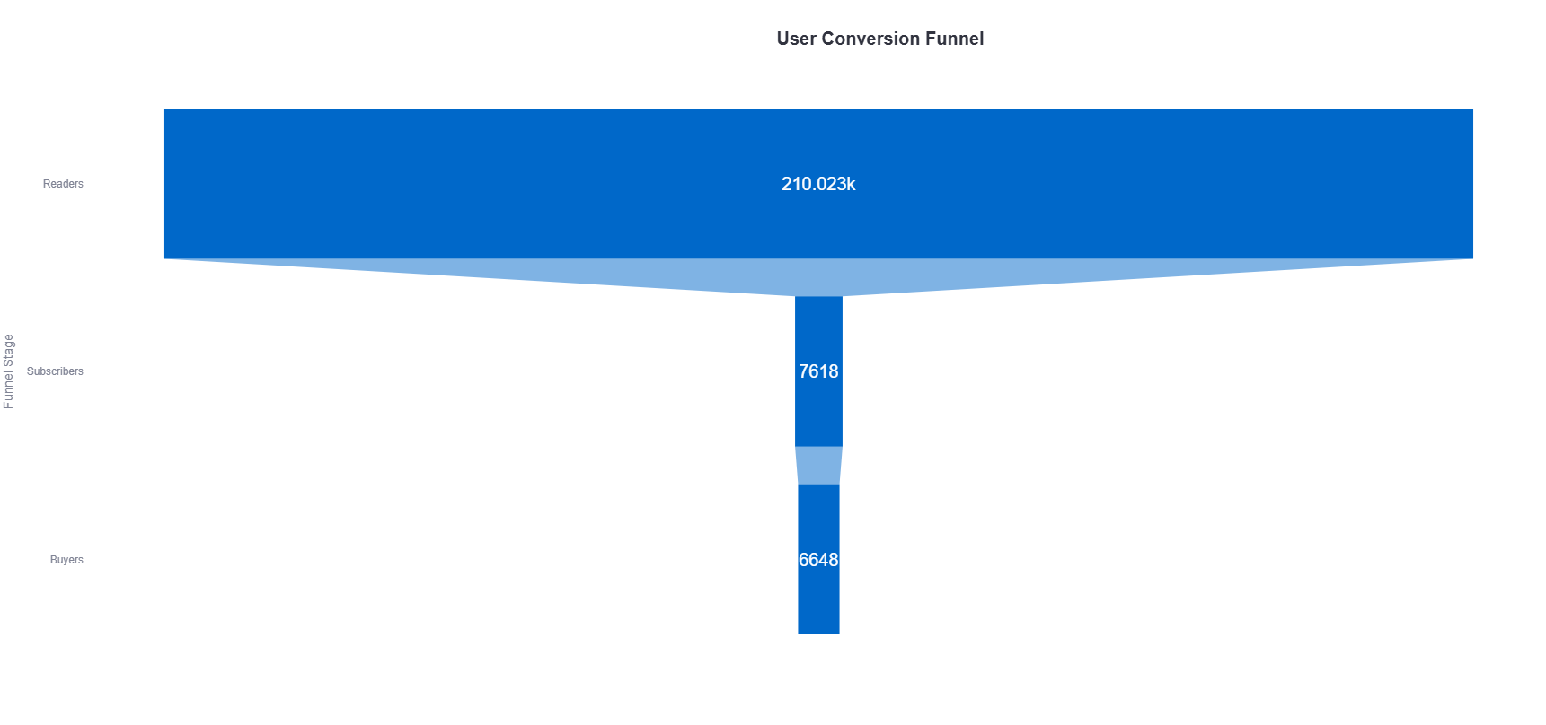
The largest drop in the funnel is from readers to subscribers. Improving sign-up CTAs or value propositions could help increase the subscription rate.

Slide 12
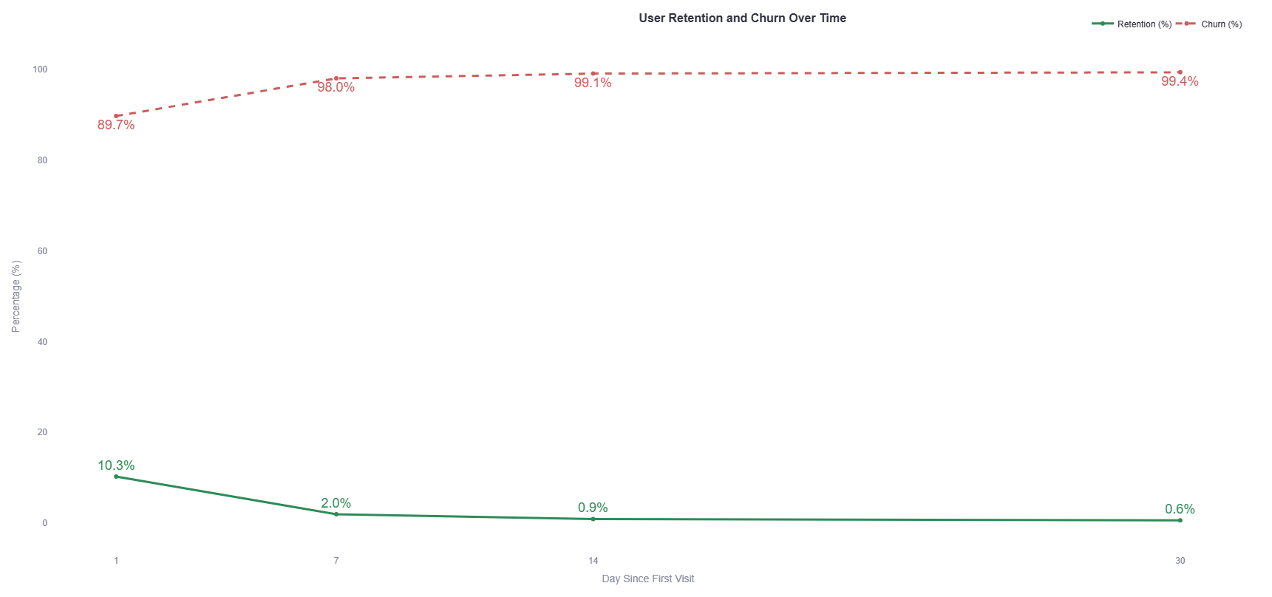
Retention* falls sharply after day 1. A drip email campaign or retargeting ads could help re-engage users during these drop-off points*.
*Retention Rate: The percentage of users who returned to the blog on a specific day after their first visit. For example, a Day 1 retention rate of 10% means that 10% of users came back the next day.
* Churn rate represents the percentage of users who did not return by a given day. For example, a Day 30 churn rate of 99.35% means that nearly all users stopped engaging by the 30th day after their first visit.
Retention/and churn is a good metric for understanding short-term engagement loss and where you need drip campaigns.

Slide 13
Key takeways
Dilan’s Travel Guide attracted over 210,000 unique readers with strong engagement—63.9% returned within the 3-month period.
Revenue reached $194,480, primarily driven by Course sales, with Reddit emerging as the top-performing channel by ROI and reach.
While the subscriber-to-buyer conversion is excellent at 87.3%, the reader-to-subscriber conversion remains low and needs improvement.
Retention drops sharply after day 1, highlighting the need for re-engagement strategies like email follow-ups.
country_5 shows high buying intent, making it a prime candidate for targeted Course promotions.

