Slide 1

XGBOOST ALGORITHM
Notes:
XGBoost is an optimized distributed gradient boosting library designed to be highly efficient, flexible and portable. It implements machine learning algorithms under the gradient boosting framework. XGBoost provides a parallel tree boosting (also known as GBDT, GBM) that solve many data science problems in a fast and accurate way. The same code runs on major distributed environment (Hadoop, SGE, MPI) and can solve problems beyond billions of examples.

Slide 2

XGBoost is an optimized distributed gradient boosting library designed to be highly efficient, flexible and portable.
It implements machine learning algorithms under the gradient boosting framework.
XGBoost provides a parallel tree boosting (also known as GBDT, GBM) that solve many data science problems in a fast and accurate way.
The same code runs on major distributed environment (Hadoop, SGE, MPI) and can solve problems beyond billions of examples.

Slide 3
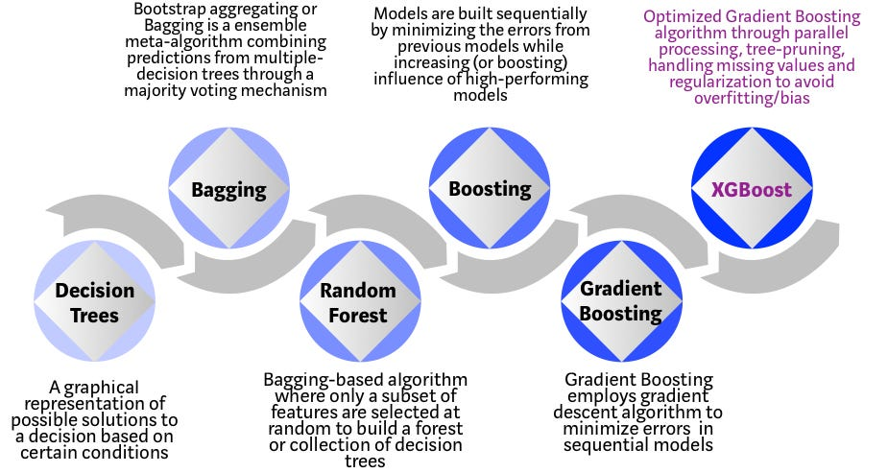
Evolution of XGBoost algorithm from Decision trees

Slide 4
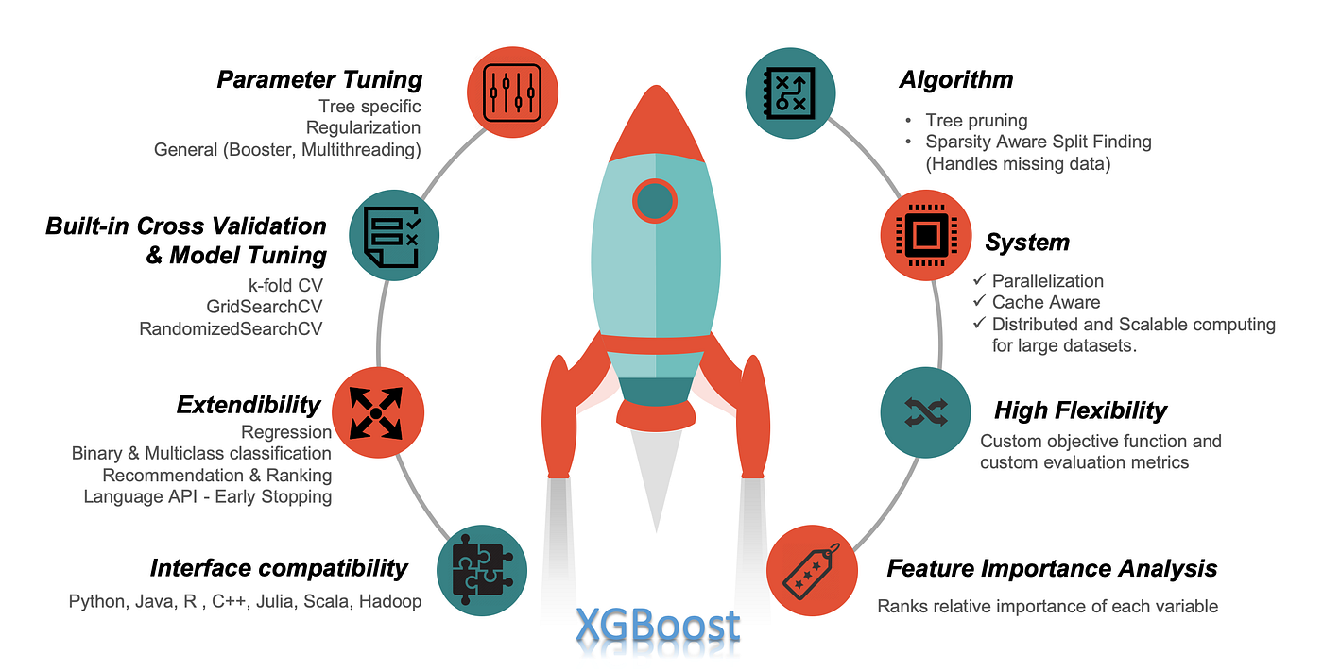
XGBOOST FEATURES

Slide 5
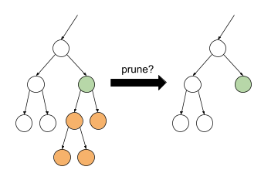
TREE PRUNING
Cost complexity or weakest link pruning (MSE, k-fold cross validation and learning rate)
Max_depth is specified
Starts pruning from backward until the loss is below a treshold

Slide 6
MISSING DATA AND PARALLELIZATION
To be aware of the sparsity patterns in the data, a default direction is assigned to each tree. XGBoost handles missing data by assigning them to default direction and finding the best imputation value so that it minimizes the training loss. Optimization here is to visit only missing values which make the algorithm run 50x faster than the naïve method.
Tree learning needs data in a sorted manner. To cut down the sorting costs, data is divided into compressed blocks (each column with corresponding feature value). XGBoost sorts each block parallelly using all available cores/threads of CPU. This optimization is valuable since a large number of nodes gets created frequently in a tree. In summary, XGBoost parallelizes the sequential process of generating trees.

Slide 7
FLEXIBILITY IN XGBOOST
Customized Objective Function: an objective function intends to maximize or minimize something. In ML, we try to minimize the objective function which is a combination of the loss function and regularization term.
Customized Evaluation Metric: this is a metric used to monitor the model’s accuracy on validation data (Rmse, mae, …)

Slide 8
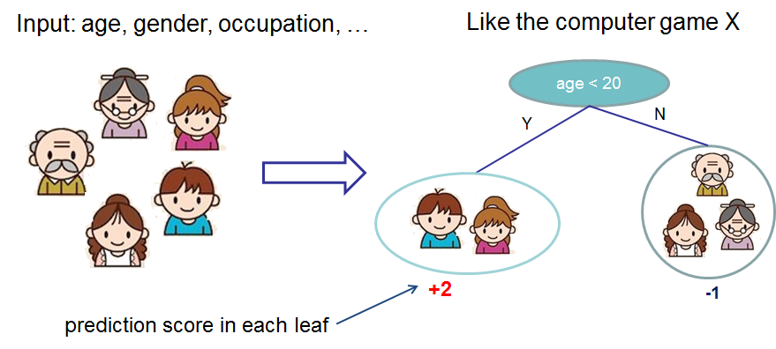
Model choice of XGBoost: decision tree ensembles
Notes:
CART

Slide 9
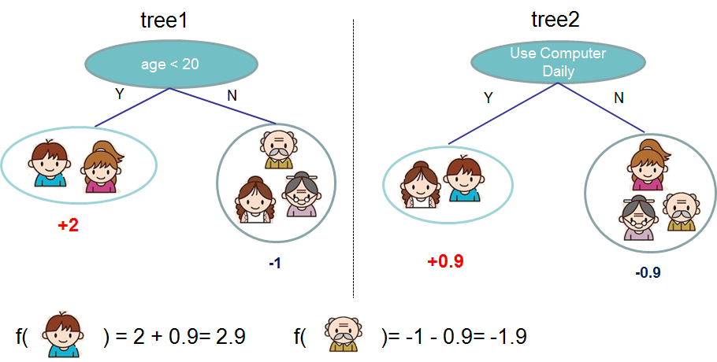
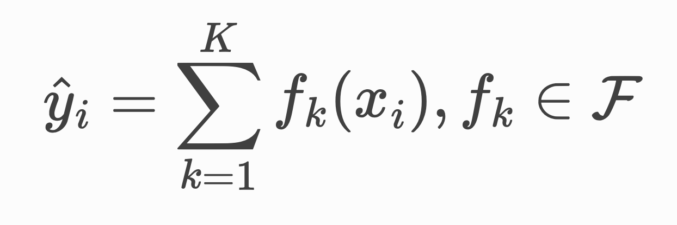
Model choice of XGBoost: decision tree ensembles

Slide 10
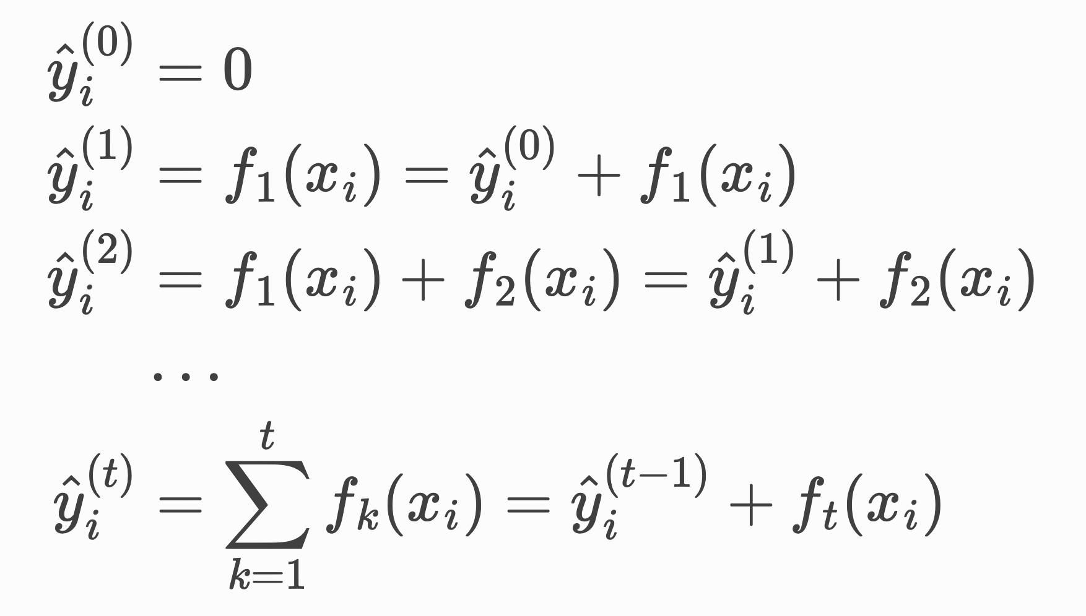
Additive training
Notes:
Non possiamo imparare tutti gli alberi in una volta, strategia additiva. Ad ogni step aggiungiamo l’albero che ci fa minimizzare la funzione di loss

Slide 11
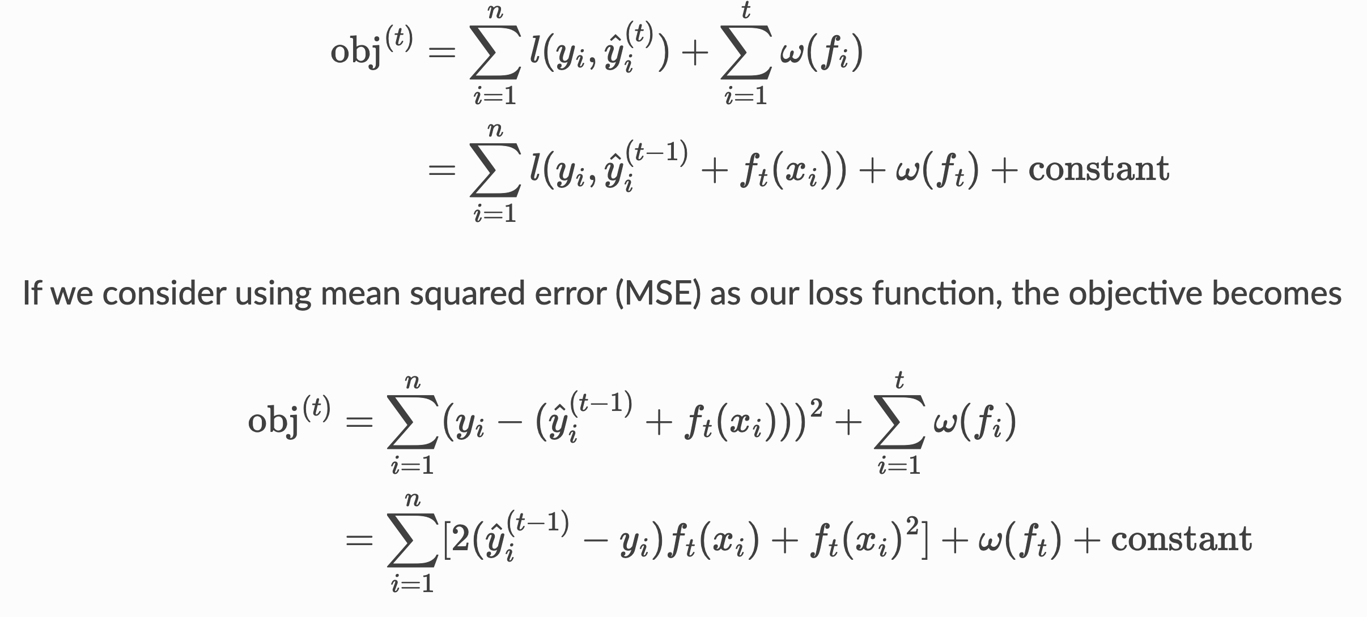
Objective function
Notes:
Con MSE abbiamo un termine del primo ordine (solitamente chiamato residuo) e un termine quadratico

Slide 12
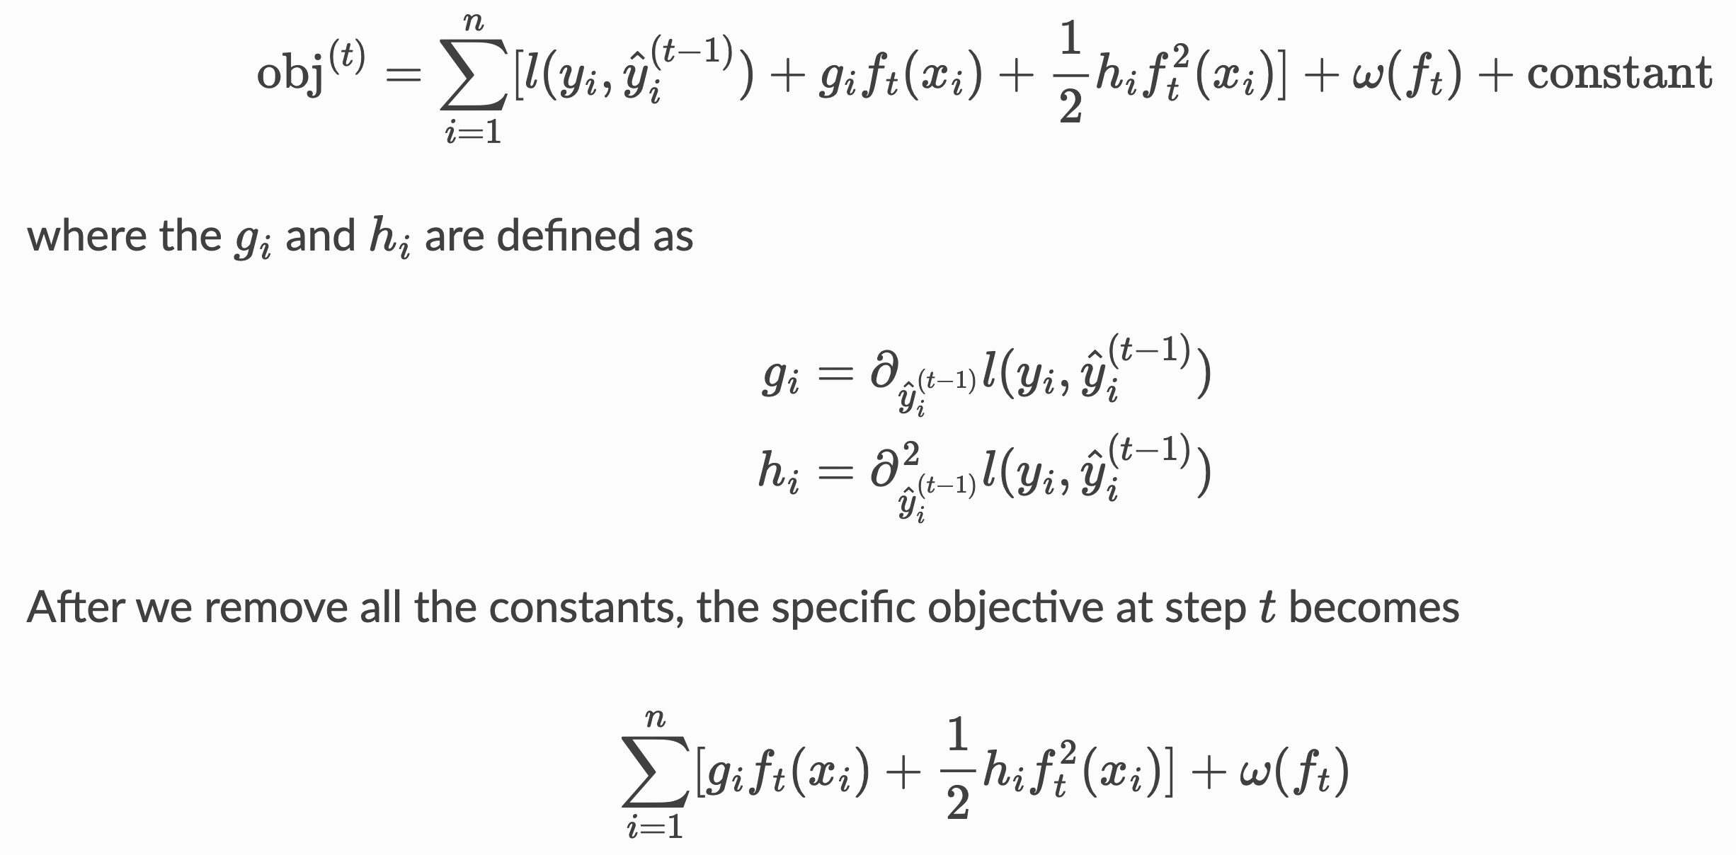
Objective function
Notes:
Nel caso generale prendiamo l’espansione di taylor del secondo ordine, rimangono le due derivate. La loss può essere qualsiasi, prendo in input solo g e h

Slide 13
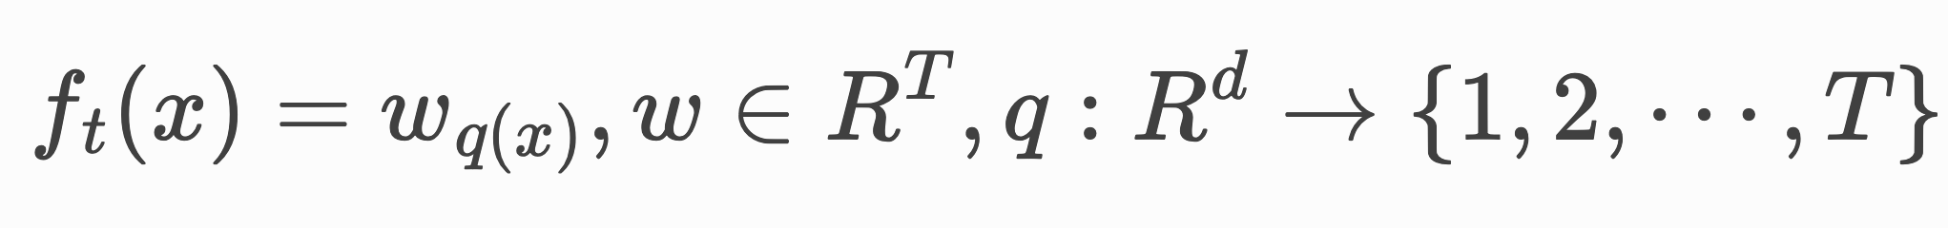
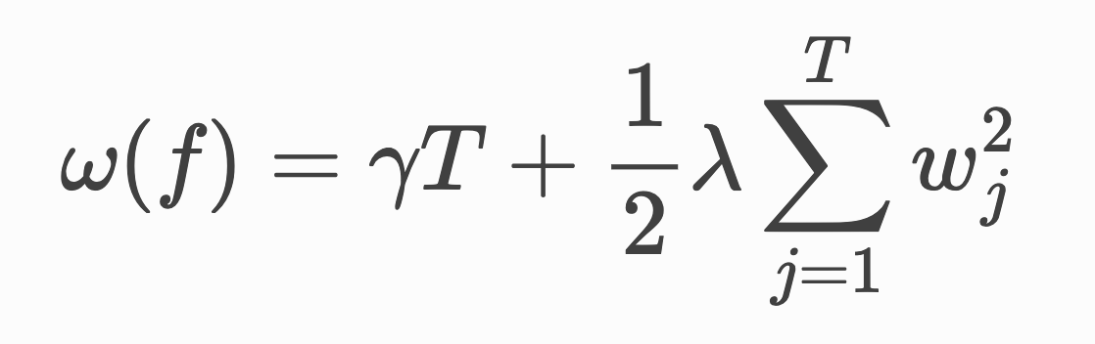
Model complexity
Refine the definition of a tree:
In XGBoost, we define the complexity as:
Notes:
w is vector of scores on leaves, q assegna ogni punto alla foglia corrispondente

Slide 14
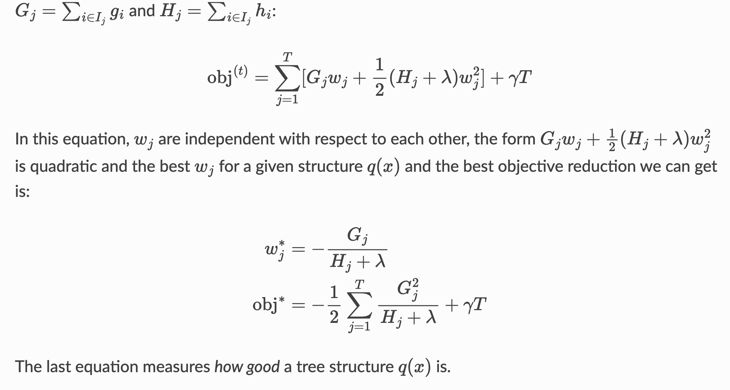
The structure score

Slide 15
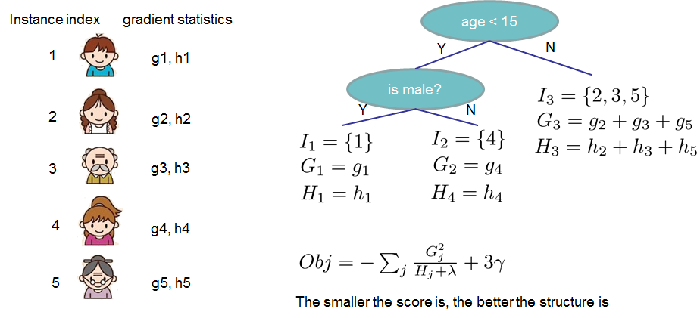
The structure score

Slide 16
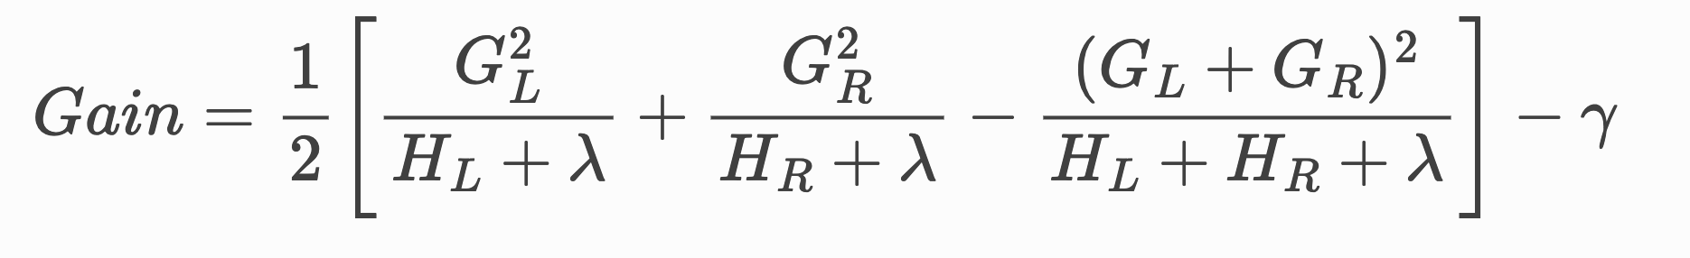
Learn the tree structure
We can see an important fact here: if the gain is smaller than γ, we would do better not to add that branch. This is exactly the pruning techniques in tree based models!

Slide 17
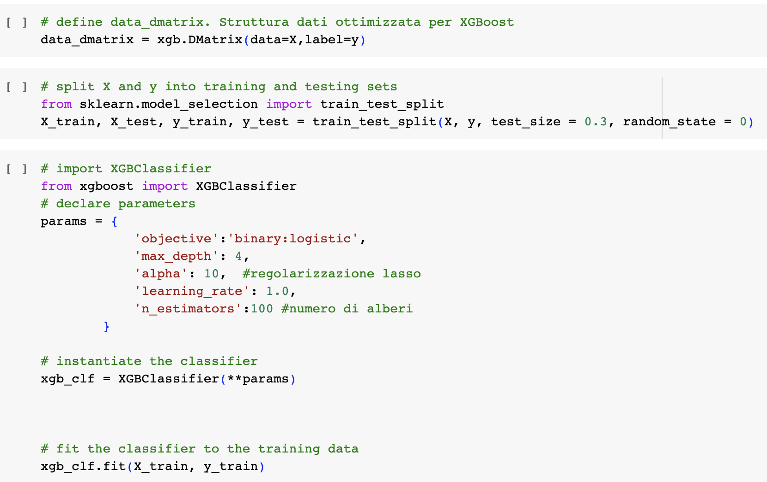
Implementation

Slide 18
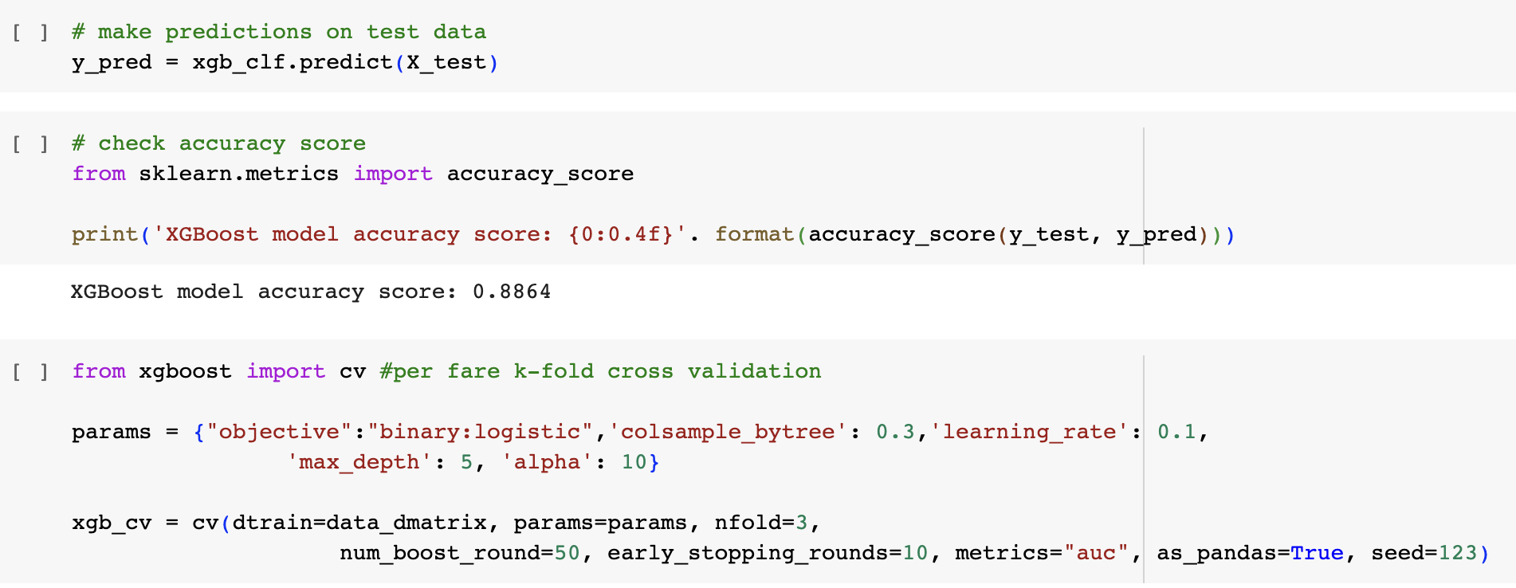
Implementation

Slide 19
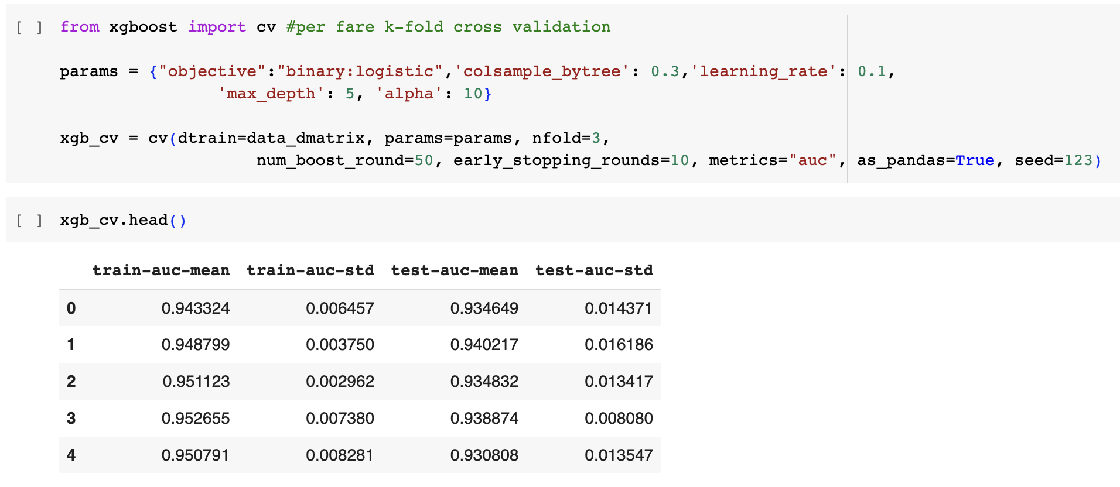
Implementation

Slide 20
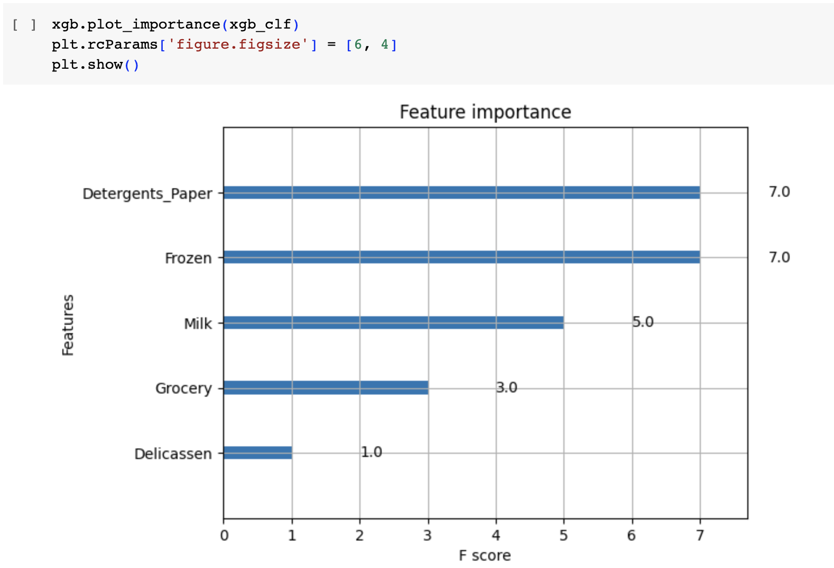
Implementation

