Slide 1
Community day
22 September 2022

Slide 2
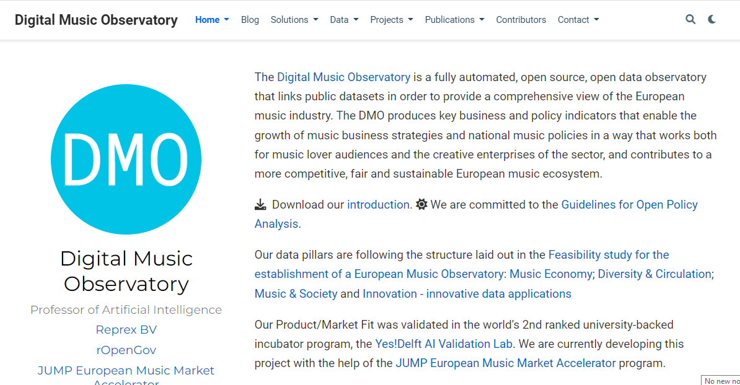
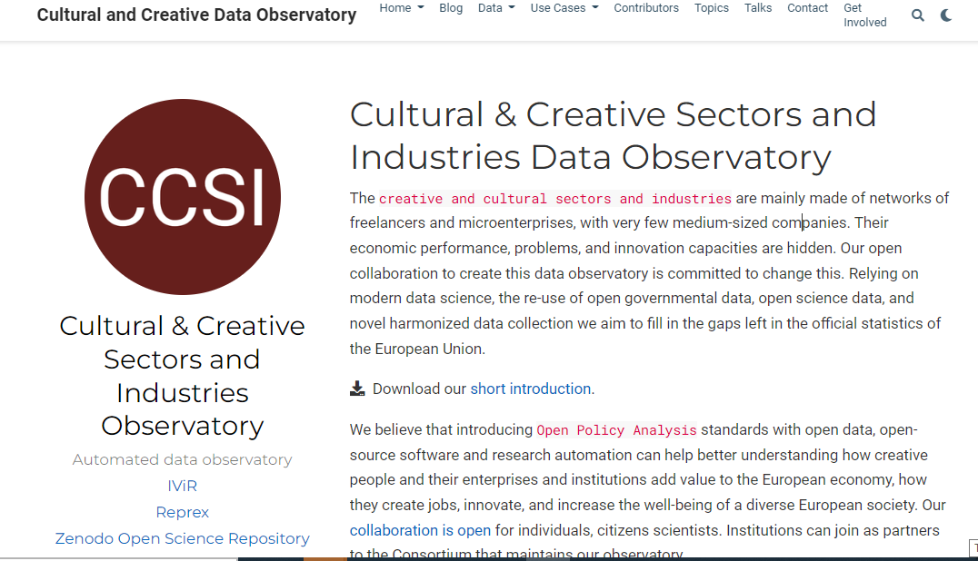
REPREX: BIG DATA FOR ALL
Only the largest corporations, best-endowed universities, and rich governments can afford data collection and processing capacities that are large enough to harness the advantages of AI.
There are about 60 functional and 20 abandoned social sciences and humanities observatories in the world, for example, the European Audiovisual Observatory, or the European Music Observatory for which we build a prototype.
Our product is a future-proof “data observatory 3.0” that connects small datasets, databases, heritage of small countries, companies, into something big enough that can be exploited for trustworthy AI.

Slide 3
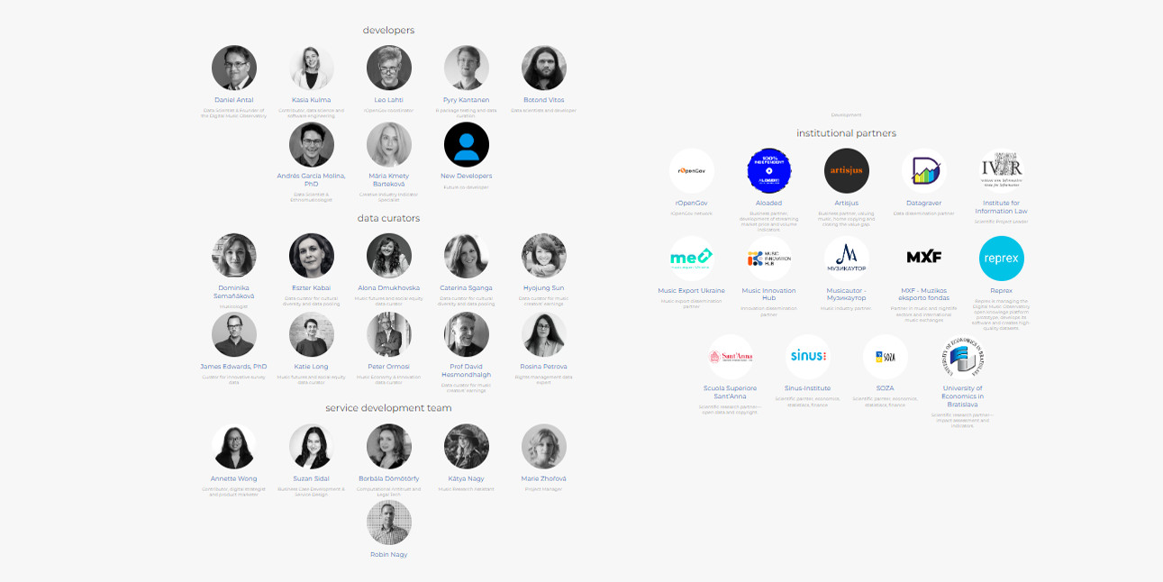
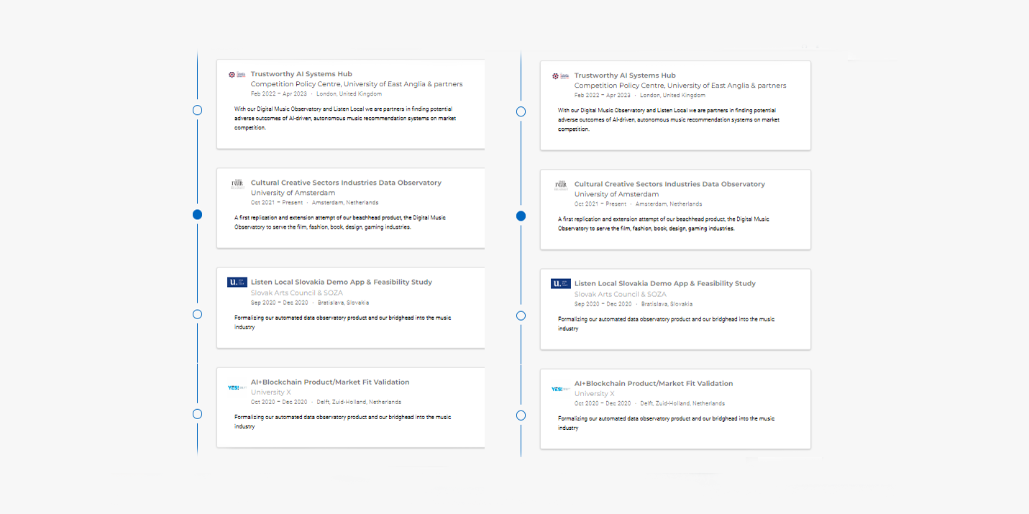
REPREX: BIG DATA FOR ALL
WE ARE OPEN Open collaboration to create open source software and an open scholarly infrastructure to exploit Linked Open Data, the Data Governance Act, and the Open Data Directive. We create open source tools, open datasets and open knowledge.
Listen Local - decolonize local music ecosystems, make sure that music from Utrecht and music relevant from Utrecht is not crowded out. Ethical recommender systems.
Digital Music Observatory - a prototype to connect Europe’s music resources
Cultural Creative Sectors Industries Observatory - roll out our experience in music to new fields.
Computational Antitrust, ESG reporting in music and culture
Survey harmonization, survey recycling, questionbanks.
https://music.dataobservatory.eu/#contributors
https://reprex.nl/#accomplishments

Slide 4

WE ARE OPEN FOR COLLABORATION!
NLAIC Culture & Media, Utrecht 2022.09.22.
Reprex is looking for new collaborations within the

