Slide 1
Big data creates inequalities
Only the largest corporations, best-endowed universities, and rich governments can afford data collection and processing capacities that are large enough to harness the advantages of AI.

Slide 2
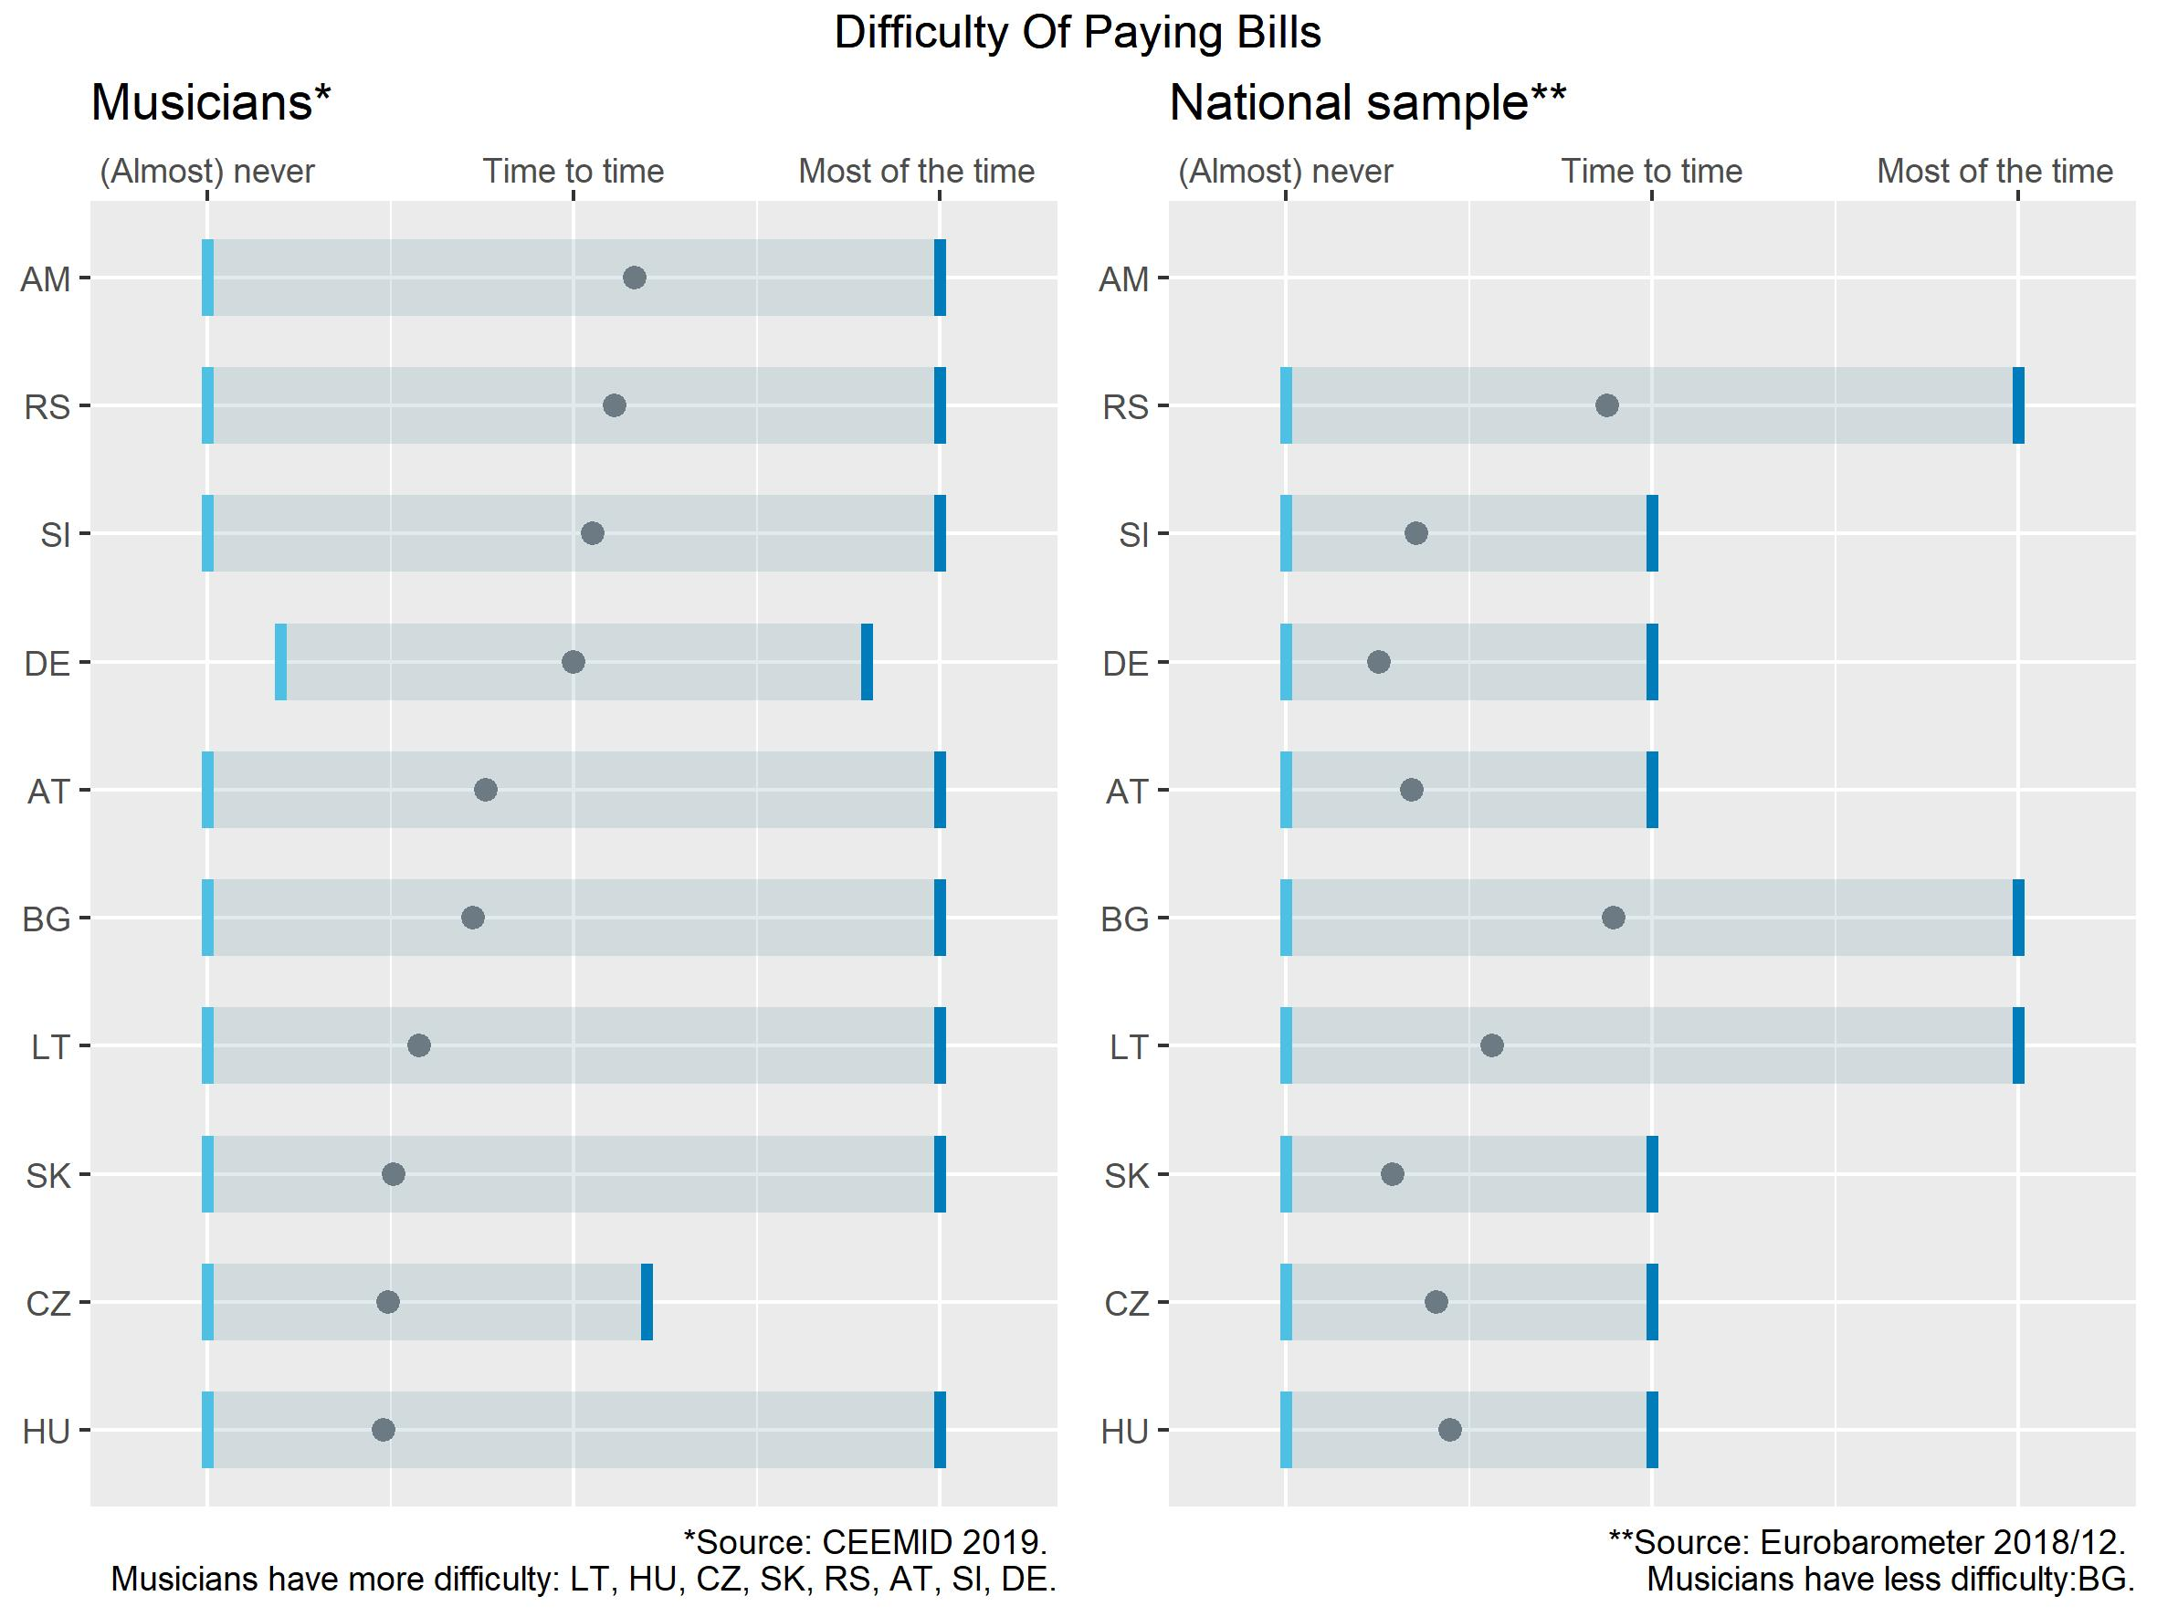
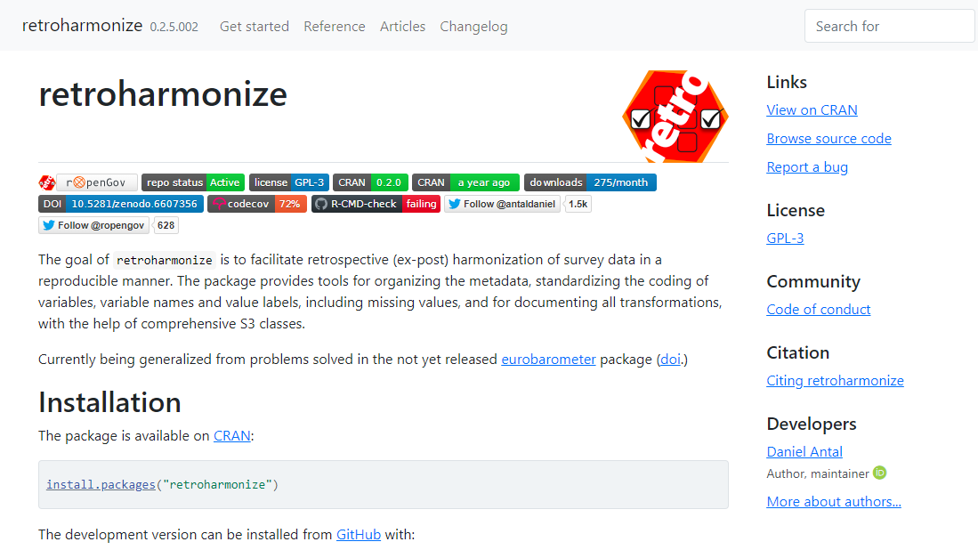
retroharmonize: survey harmonization

Slide 3
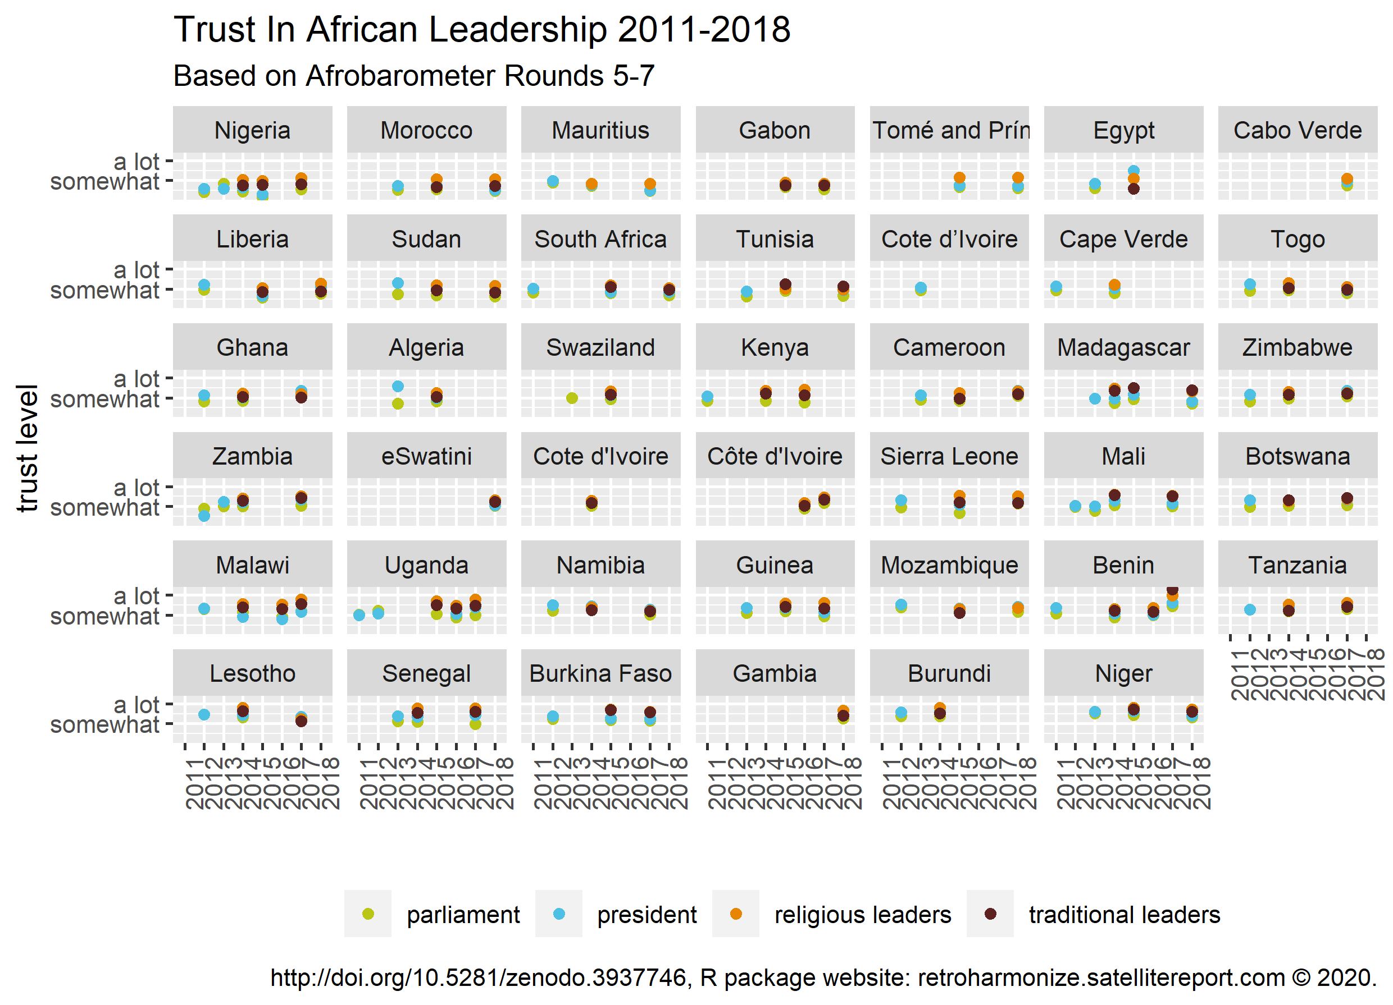
41x3 surveys in one chart

Slide 4
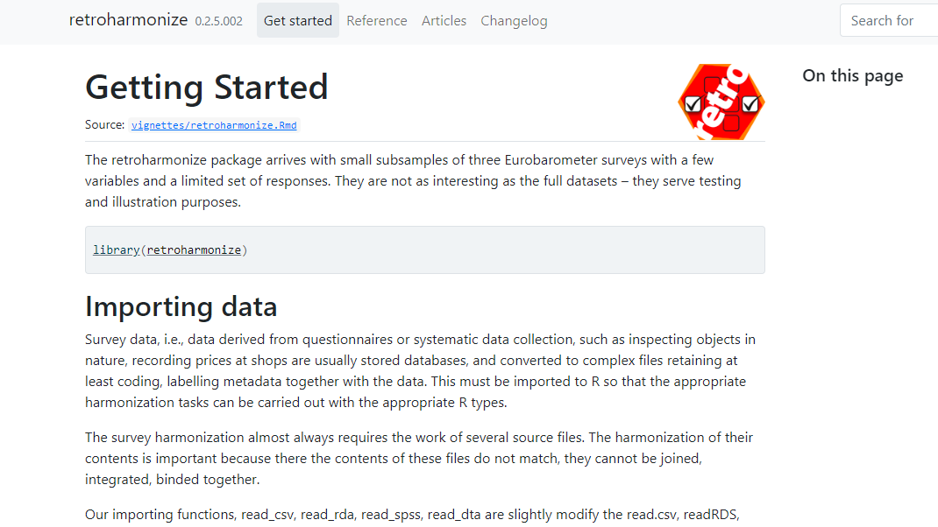
Load pre-written code and run it

Slide 5
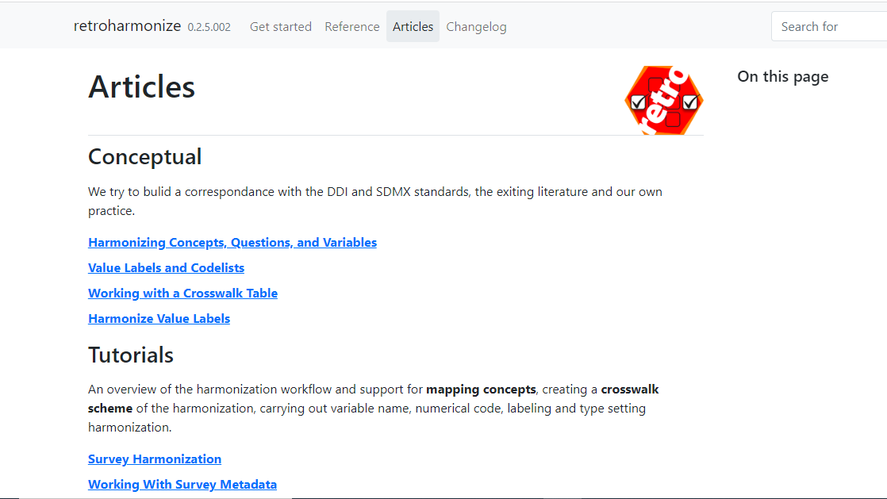
Run from tutorials

Slide 6
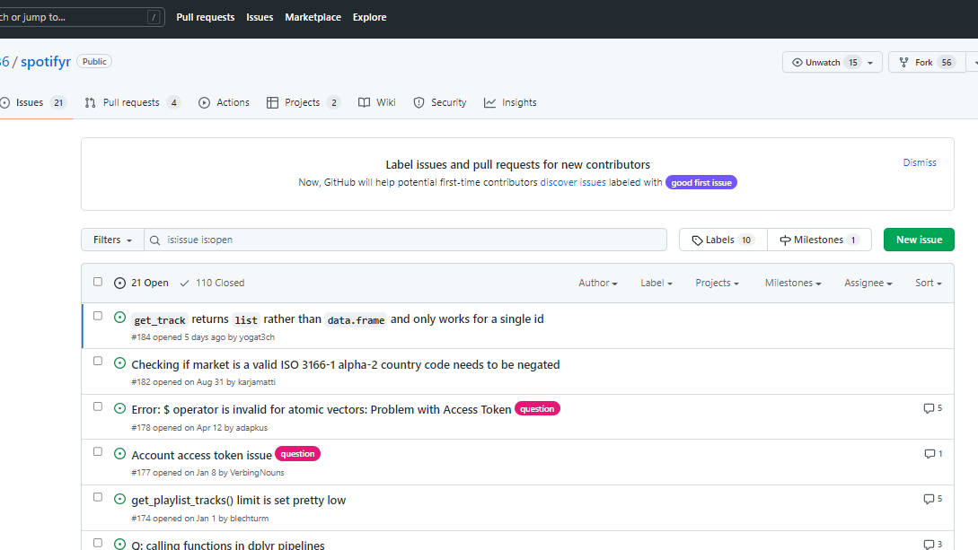
Find help, ask for help: reprex

Slide 7
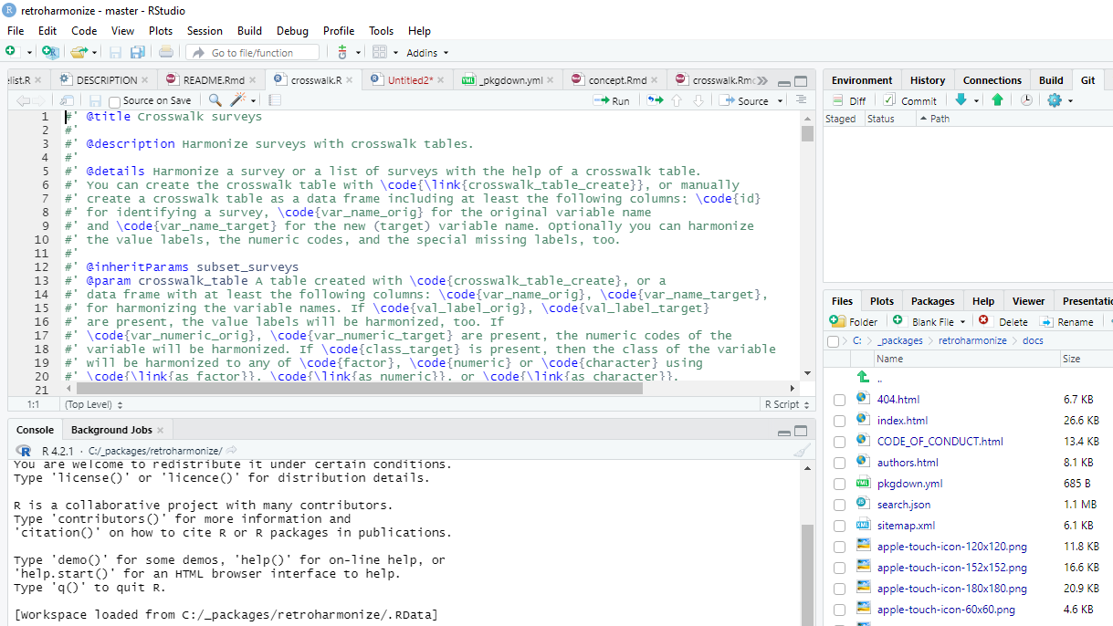
Documentation for better tutorials

Slide 8
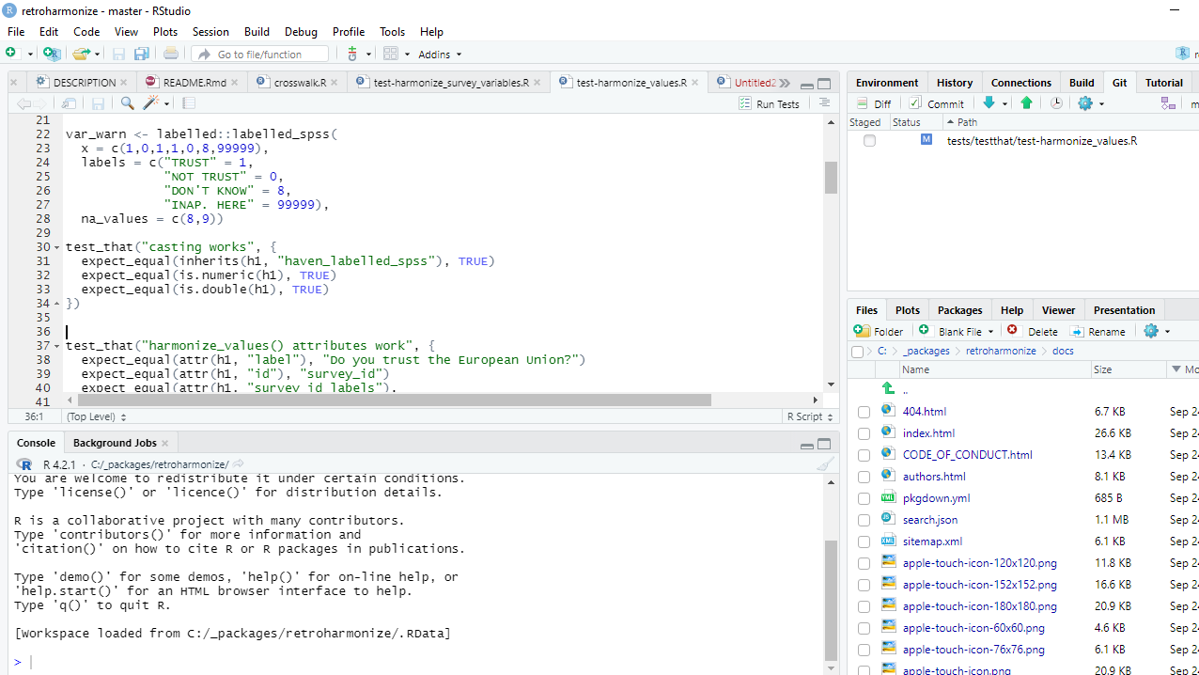
Debugging and testing code

Slide 9
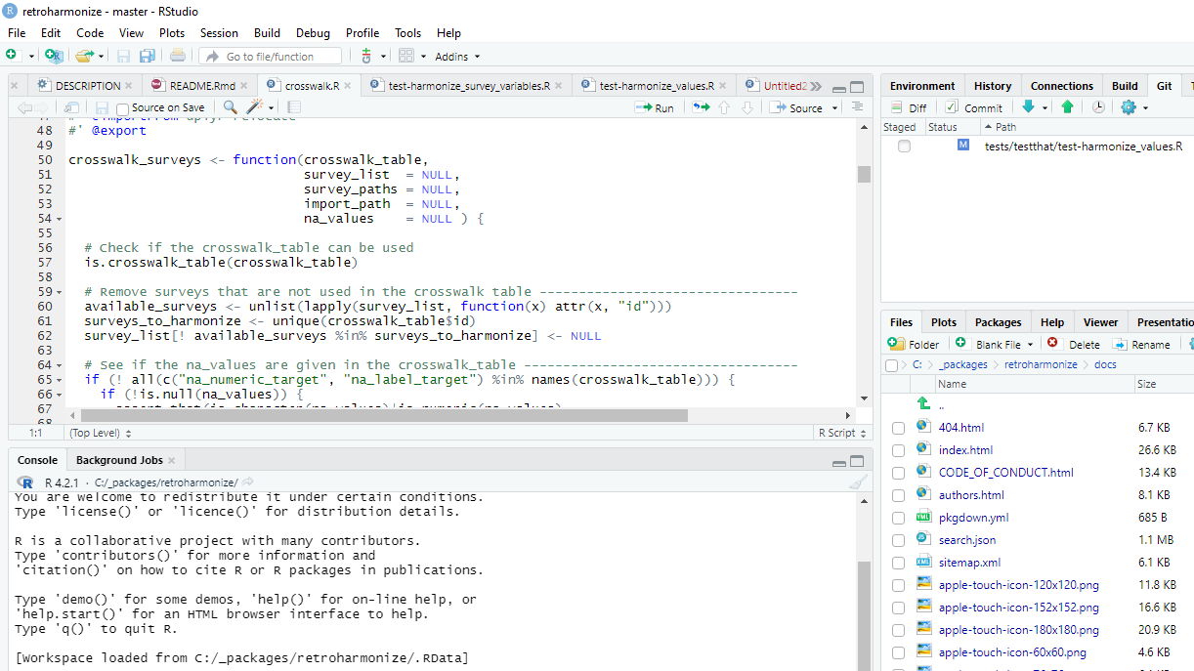
R is a functional language

Slide 10
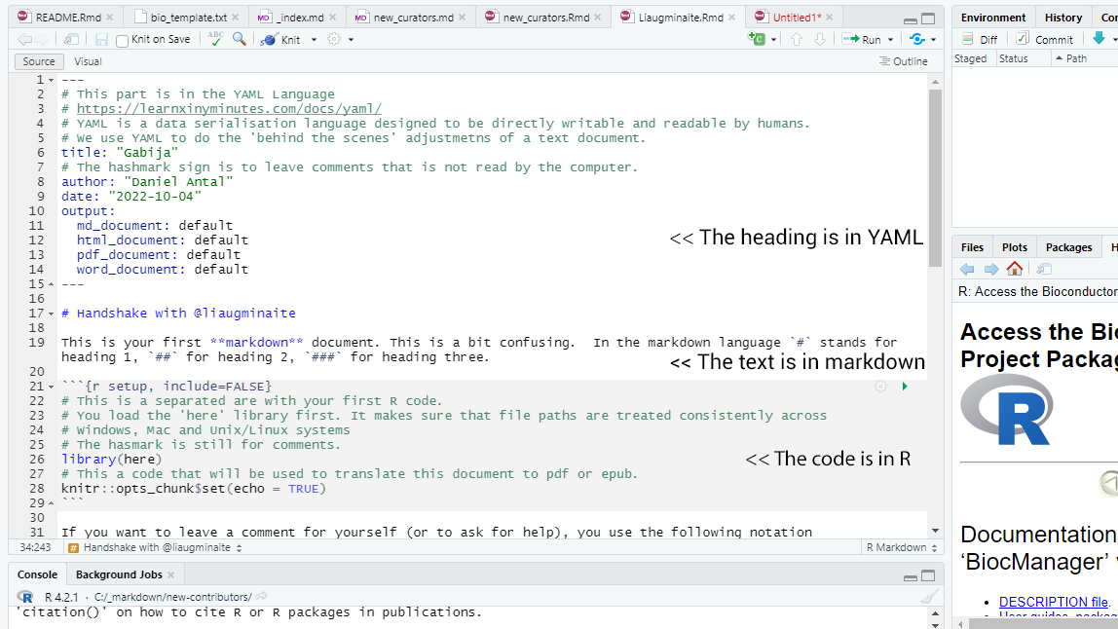
R + YAML + markdown = web ready

Slide 11
Package and release: a team effort

